Slide 1
Another Perspective on Diffusion

Slide 2
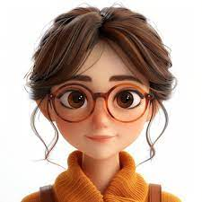
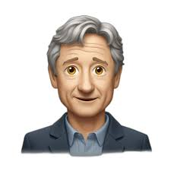
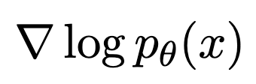

I have images x … can you generate more samples of real images?
Do you have ?
No
Do you have ?
No
Ok, can you give me your images with a
slight bit of noise, i.e., y = x + n
Yes, here they are y(1:N)
Wait … doing Langevin
And here you go, samples from
But I wanted samples from
It’s the same, since you added negligible
noise, so y samples almost same as x :-)
Yeah !!! They should give you the Nobel prize

Slide 3

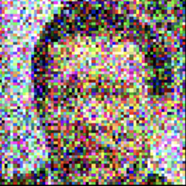
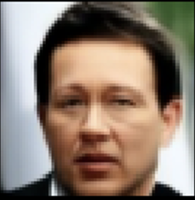
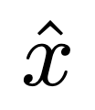
Classical inverse problem:
How can we estimate from ?

Slide 4
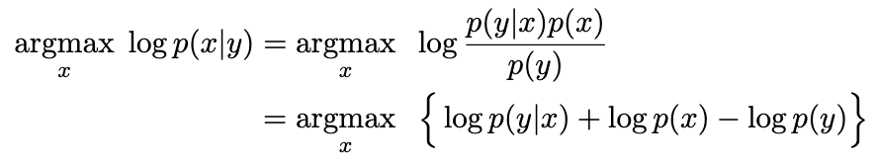
Classical inverse problem:
How can we estimate from ?
One idea: Estimate

Slide 5
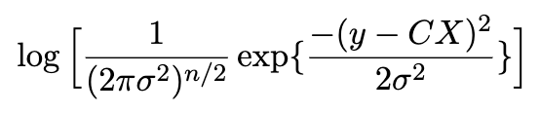
Classical inverse problem:
How can we estimate from ?
One idea: Estimate
Gaussian

Slide 6

Classical inverse problem:
How can we estimate from ?
One idea: Estimate

Slide 7
Simpler inverse problem:
How can we estimate from ?

Slide 8
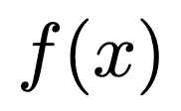
Simpler inverse problem:
How can we estimate from ?
Idea sketch: 1. Langevin showed us a way to sample from if we can estimate
2. Say we can somehow estimate , which is the gradient of
3. Then we can use Langevin to sample modes of the distribution.
4. Can we call those samples “generative data” if we make noise negligible?

Slide 9
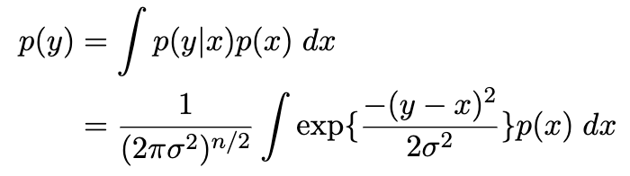
Idea sketch: 1. Langevin showed us a way to sample from if we can estimate
2. Say we can somehow estimate , which is the gradient of
3. Then we can use Langevin to sample modes of the distribution.
4. Can we call those samples “generative data” if we make noise negligible?

Slide 10
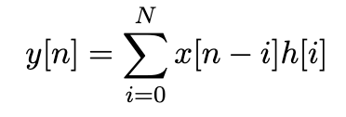
Idea sketch: 1. Langevin showed us a way to sample from if we can estimate
2. Say we can somehow estimate , which is the gradient of
3. Then we can use Langevin to sample modes of the distribution.
4. Can we call those samples “generative data” if we make noise negligible?
Same?
Remember this?

Slide 11

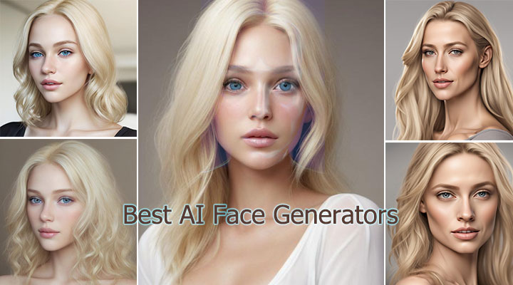
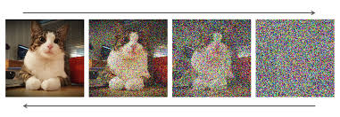
Idea sketch: 1. Langevin showed us a way to sample from if we can estimate
2. Say we can somehow estimate , which is the gradient of
3. Then we can use Langevin to sample modes of the distribution.
4. Can we call those samples “generative data” if we make noise negligible?
Same?
Remember this?

Slide 12
Idea sketch: 1. Langevin showed us a way to sample from if we can estimate
2. Say we can somehow estimate , which is the gradient of
3. Then we can use Langevin to sample modes of the distribution.
4. Can we call those samples “generative data” if we make noise negligible?
Same?
Remember this?

Slide 13
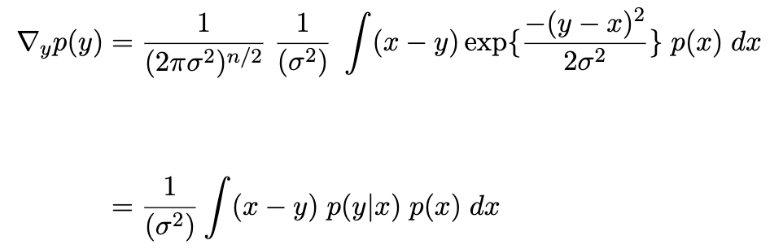
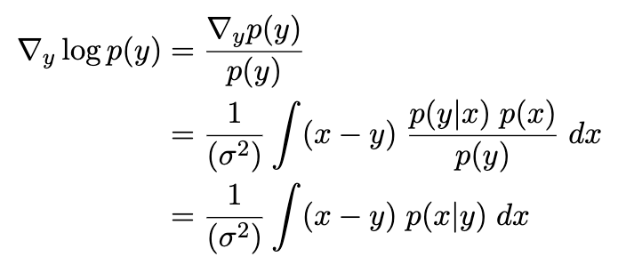
Idea sketch: 1. Langevin showed us a way to sample from if we can estimate
2. Say we can somehow estimate , which is the gradient of
3. Then we can use Langevin to sample modes of the distribution.
4. Can we call those samples “generative data” if we make noise negligible?
Same?
Remember this?

Slide 14
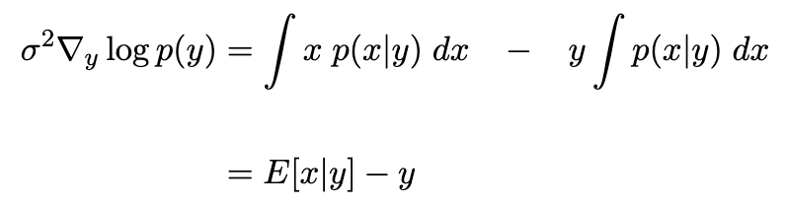
Idea sketch: 1. Langevin showed us a way to sample from if we can estimate
2. Say we can somehow estimate , which is the gradient of
3. Then we can use Langevin to sample modes of the distribution.
4. Can we call those samples “generative data” if we make noise negligible?
Gaussian blurring

Slide 15
Idea sketch: 1. Langevin showed us a way to sample from if we can estimate
2. Say we can somehow estimate , which is the gradient of
3. Then we can use Langevin to sample modes of the distribution.
4. Can we call those samples “generative data” if we make noise negligible?

Slide 16

Idea sketch: 1. Langevin showed us a way to sample from if we can estimate
2. Say we can somehow estimate , which is the gradient of
3. Then we can use Langevin to sample modes of the distribution.
4. Can we call those samples “generative data” if we make noise negligible?
What is this?

Slide 17
Idea sketch: 1. Langevin showed us a way to sample from if we can estimate
2. Say we can somehow estimate , which is the gradient of
3. Then we can use Langevin to sample modes of the distribution.
4. Can we call those samples “generative data” if we make noise negligible?
What is this? It’s a denoiser

Slide 18

Idea sketch: 1. Langevin showed us a way to sample from if we can estimate
2. Say we can somehow estimate , which is the gradient of
3. Then we can use Langevin to sample modes of the distribution.
4. Can we call those samples “generative data” if we make noise negligible?
What is this? It’s a denoiser
Langevin, Ito, Euler said:
We can give you samples from distribution
if you can give us

Slide 19
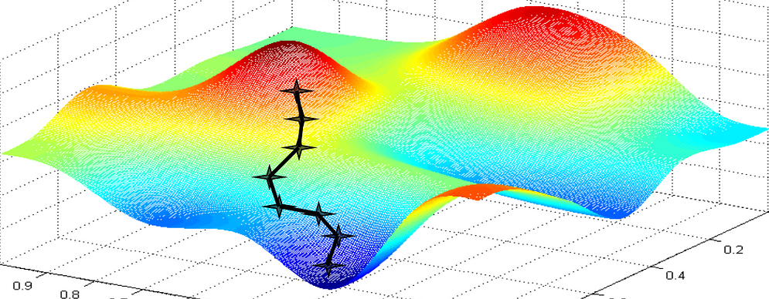
Idea sketch: 1. Langevin showed us a way to sample from if we can estimate
2. Say we can somehow estimate , which is the gradient of
3. Then we can use Langevin to sample modes of the distribution.
4. Can we call those samples “generative data” if we make noise negligible?
What is this? It’s a denoiser
Langevin, Ito, Euler said:
We can give you samples from distribution
if you can give us

Slide 20

Idea sketch: 1. Langevin showed us a way to sample from if we can estimate
2. Say we can somehow estimate , which is the gradient of
3. Then we can use Langevin to sample modes of the distribution.
4. Can we call those samples “generative data” if we make noise negligible?
What is this? It’s a denoiser
Langevin, Ito, Euler said:
We can give you samples from distribution
if you can give us

Slide 21
Idea sketch: 1. Langevin showed us a way to sample from if we can estimate
2. Say we can somehow estimate , which is the gradient of
3. Then we can use Langevin to sample modes of the distribution.
4. Can we call those samples “generative data” if we make noise negligible?
Langevin, Ito, Euler said:
We can give you samples from distribution
if you can give us
So start from a random point and do Langevin ascent → you have samples from modes of

Slide 22
Idea sketch: 1. Langevin showed us a way to sample from if we can estimate
2. Say we can somehow estimate , which is the gradient of
3. Then we can use Langevin to sample modes of the distribution.
4. Can we call those samples “generative data” if we make noise negligible?
Langevin, Ito, Euler said:
We can give you samples from distribution
if you can give us
So start from a random point and do Langevin ascent → you have samples from modes of

Slide 23

Idea sketch: 1. Langevin showed us a way to sample from if we can estimate
2. Say we can somehow estimate , which is the gradient of
3. Then we can use Langevin to sample modes of the distribution.
4. Can we call those samples “generative data” if we make noise negligible?
Langevin, Ito, Euler said:
We can give you samples from distribution
if you can give us
So start from a random point and do Langevin ascent → you have samples from modes of
But recall, was a blurring with a Gaussian kernel
To start from far away initial points (far from images) we should blur with , then do Langevin.

Slide 24

Langevin, Ito, Euler said:
We can give you samples from distribution
if you can give us
So start from a random point and do Langevin ascent → you have samples from modes of
But recall, was a blurring with a Gaussian kernel
To start from far away initial points (far from images) we should blur with , then do Langevin.
Ideas from simulated annealing:
Instead of 1000 Langevin steps on very highly blurred images
Blur with k decreasing noise levels:
And perform 1000/k Langevin steps for each noise level.

Slide 25
Ideas from simulated annealing:
Instead of 1000 Langevin steps on very highly blurred images
Blur with k decreasing noise levels:
And perform 1000/k Langevin steps for each noise level.
…
Annealed Langevin Dynamics

Slide 26
Ideas from simulated annealing:
Instead of 1000 Langevin steps on very highly blurred images
Blur with k decreasing noise levels:
And perform 1000/k Langevin steps for each noise level.
…
Annealed Langevin Dynamics
But adding infinite noise and choosing is impractical

Slide 27



But adding infinite noise and choosing is impractical
Define as a convex combination of given image and isotropic Gaussian
=
=

Slide 28
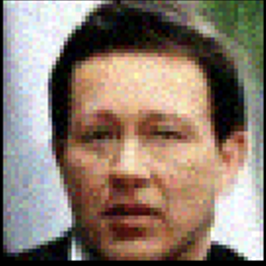

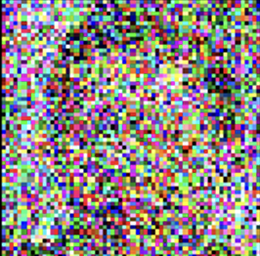
But adding infinite noise and choosing is impractical
Define as a convex combination of given image and isotropic Gaussian
=
=
Denoising Diffusion Probabilistic Model (DDPM)

Slide 29
Questions

