Slide 1


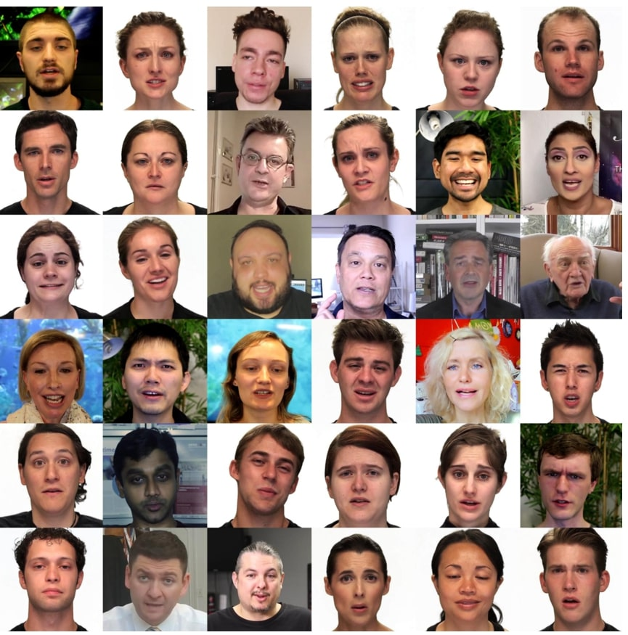
Generative Adversarial Network (GAN)
Motivation:
may blur the generated images
gives good rules, but we care about the image
VAE
Encoder
Decoder

Slide 2
Generative Adversarial Network (GAN)
Motivation:
may blur the generated images
gives good rules, but we care about the image
VAE
Encoder
Decoder
Can we focus on “generating realistic pictures”?
Train the decoder using the metric “realistic or not”

Slide 3
Generative Adversarial Network (GAN)
Motivation:
may blur the generated images
gives good rules, but we care about the image
VAE
Encoder
Decoder
Can we focus on “generating realistic pictures”?
Train the decoder using the metric “realistic or not”
76% Real
Generator
Critic network
15% Real

Slide 4
Generative Adversarial Network (GAN)
76% Real
Generator
Critic network
15% Real
But how do we get this critic?

Slide 5


Generative Adversarial Network (GAN)
76% Real
Generator
Critic network
15% Real
But how do we get this critic?
Train another network (discriminator) as the classifier!
R or G?
Real (training) images

Slide 6
Generative Adversarial Network (GAN)
R or G?
To train the network, optimizes the cross-entropy loss
Real (training) images

Slide 7

Generative Adversarial Network (GAN)
R or G?
To train the network, optimizes the cross-entropy loss
Real (training) images
Generated
Real data
A
B
C
D

Slide 8
Generative Adversarial Network (GAN)
R or G?
To train the network, optimizes the cross-entropy loss
Real (training) images
Generated
Real data
A
B
C
D
And wants to do the opposite. The objective function becomes

Slide 9
Generative Adversarial Network (GAN)
R or G?
To train the network, optimizes the cross-entropy loss
Real (training) images
Generated
Real data
A
B
C
D
And wants to do the opposite. The objective function becomes

Slide 10
Generative Adversarial Network (GAN)
R or G?
To train the network, optimizes the cross-entropy loss
Real (training) images
Generated
Real data
A
B
C
D
And wants to do the opposite. The objective function becomes

Slide 11
Generative Adversarial Network (GAN)
R or G?
To train the network, optimizes the cross-entropy loss
Real (training) images
Generated
Real data
A
B
C
D
And wants to do the opposite. The objective function becomes
GAN is a min-max gaming between the generator and discriminator!
But where is the balance – Nash Equilibrium (NE)

Slide 12
Nash Equilibrium (NE)
But where is the balance – Nash Equilibrium (NE)
Discriminator side

Slide 13
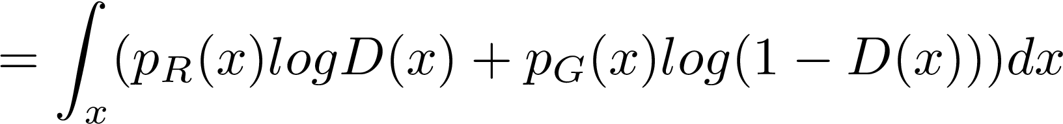
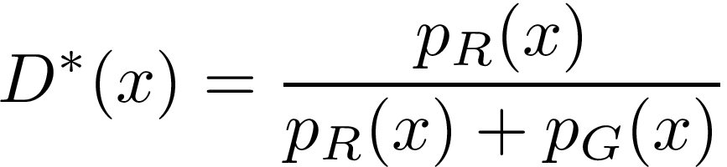
Nash Equilibrium (NE)
But where is the balance – Nash Equilibrium (NE)
Discriminator side
Distribution ratio

Slide 14
Nash Equilibrium (NE)
But where is the balance – Nash Equilibrium (NE)
Discriminator side
Distribution ratio
Generator side

Slide 15
Nash Equilibrium (NE)
But where is the balance – Nash Equilibrium (NE)
Discriminator side
Distribution ratio
Generator side
optimizes for Jensen-Shannon Diversity

Slide 16
Problems of GAN
Mode collapse
Gradient vanishing

Slide 17
Problems of GAN
Mode collapse
generates only few easy modes
Generated images are of a kind

Slide 18
Problems of GAN
Mode collapse
generates only few easy modes
Generated images are of a kind
cat
Generated
dog
Real data
:I am excellent at drawing cat! Let’s only draw cat
How should react to these realistic generated cats?

Slide 19
Problems of GAN
Mode collapse
generates only few easy modes
Generated images are of a kind
cat
Generated
dog
Real data
:I am excellent at drawing cat! Let’s only draw cat
How should react to these realistic generated cats?
Every time sees a cat, less likely to say it’s true
Better solutions? Can generator get some “constraints”?

Slide 20
Conditional GAN - CGAN
cat
Generated
dog
:I am excellent at drawing cat! Let’s only draw cat
Real data

Slide 21
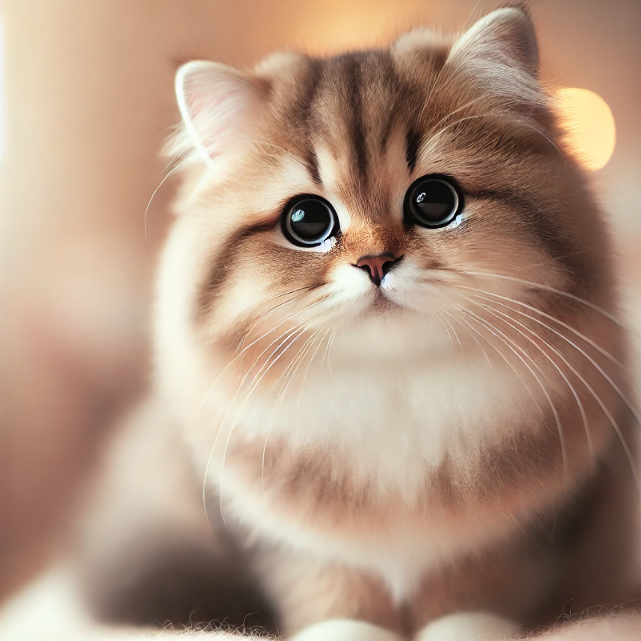
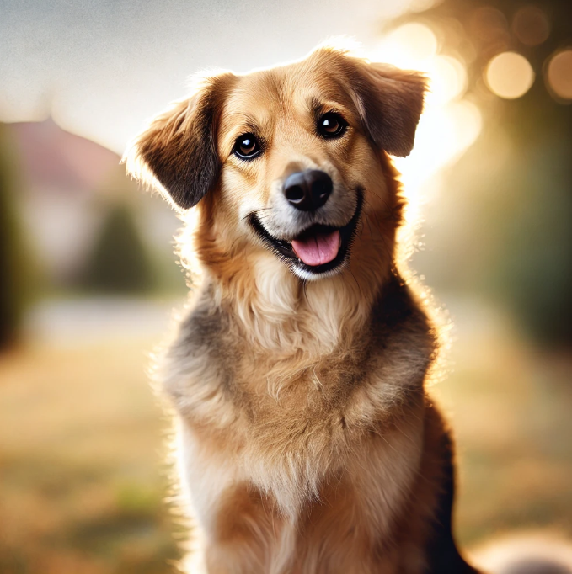
Conditional GAN - CGAN
cat
Generated
dog
:I am excellent at drawing cat! Let’s only draw cat
Real data
Assume we have labels {cat/ dog} on the training images
Let’s tell both and the class information!
R or G?
Real (training) images

Slide 22
Conditional GAN - CGAN
cat
Generated
dog
:I am excellent at drawing cat! Let’s only draw cat
Real data
Assume we have labels {cat/ dog} on the training images
Let’s tell both and the class information!
R or G?
y=dog
y=dog
Real (training) images

Slide 23

Conditional GAN - CGAN
cat
Generated
dog
:I am excellent at drawing cat! Let’s only draw cat
Real data
Assume we have labels {cat/ dog} on the training images
Let’s tell both and the class information!
R or G?
y=dog
y=dog
Real (training) images

Slide 24
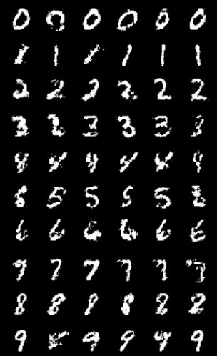
Conditional GAN - CGAN
R or G?
y=dog
y=dog
Real (training) images
Solve part of mode collapse, but not within the classes! Many research going on...

Slide 25
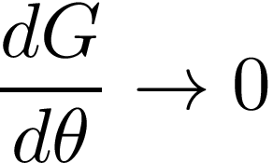

Problems of GAN
Mode collapse
Gradient vanishing
generates only few easy modes
When is too strong, will not learn
Generated images are of a kind
cat
Generated
Generated
dog
Real data
Real data

Slide 26
Problems of GAN
Gradient vanishing
Generated
When is too strong, will not learn
Real data

Slide 27
Problems of GAN
Gradient vanishing
Generated
When is too strong, will not learn
Real data
Recall
optimizes for Jensen-Shannon Diversity – calculate similarity rather than distance

Slide 28
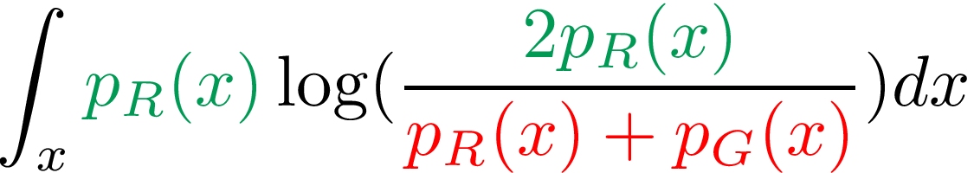
Problems of GAN
Gradient vanishing
Generated
When is too strong, will not learn
Real data
Recall
optimizes for Jensen-Shannon Diversity – calculate similarity rather than distance

Slide 29
Problems of GAN
Gradient vanishing
Generated
When is too strong, will not learn
Real data
Recall
optimizes for Jensen-Shannon Diversity – calculate similarity rather than distance
Only the “overlap” between two distributions matters

Slide 30

Problems of GAN
Gradient vanishing
Generated
When is too strong, will not learn
Real data
Recall
optimizes for Jensen-Shannon Diversity – calculate similarity rather than distance
Only the “overlap” between two distributions matters
increases

Slide 31



Problems of GAN
Gradient vanishing
Generated
When is too strong, will not learn
Real data
Recall
optimizes for Jensen-Shannon Diversity – calculate similarity rather than distance
Only the “overlap” between two distributions matters
increases
If and are far away, will have tiny gradient
will not learn

Slide 32
Problems of GAN
Gradient vanishing
Generated
When is too strong, will not learn
Real data
If and are far away, will have tiny gradient
will not learn
Solution? Let optimizes on other divergence
Change loss
Wasserstein GAN estimates the distances between and . Many research going on...

Slide 33
Questions

