Slide 1
Normalizing Flows

Slide 2
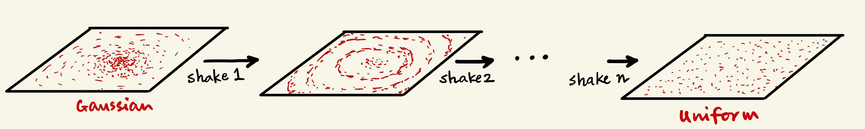
Normalizing Flows

Slide 3
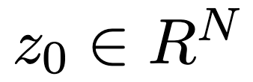
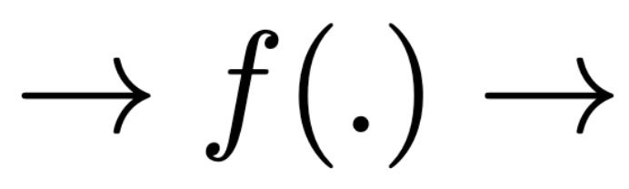
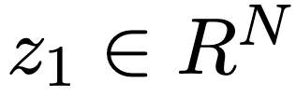
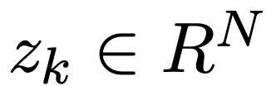
Normalizing Flows
…

Slide 4
Normalizing Flows
…
Is a scalar valued or a vector valued function?

Slide 5
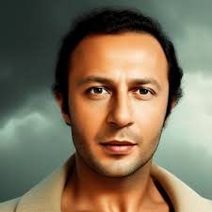

Normalizing Flows
…
Is a scalar valued or a vector valued function?
Also, how is this any different from GAN? Isn’t GAN just a one shot version of this?
GANs

Slide 6
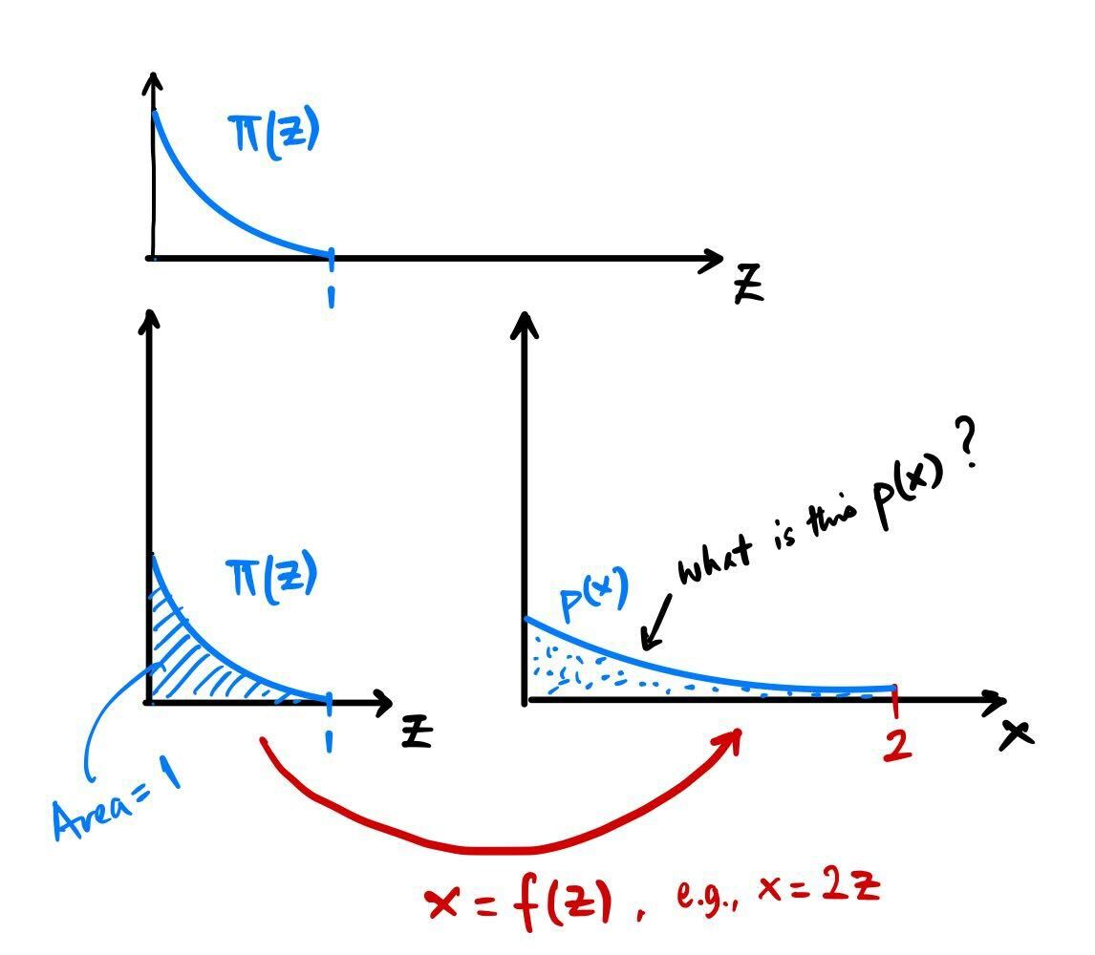
Normalizing Flows
…
Do we know how to transform distributions?

Slide 7
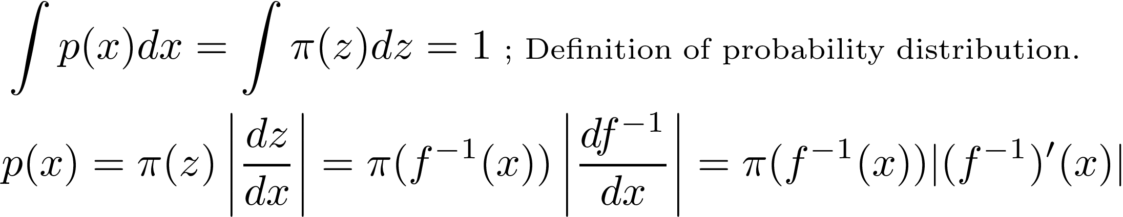
Normalizing Flows
…
Do we know how to transform distributions?

Slide 8

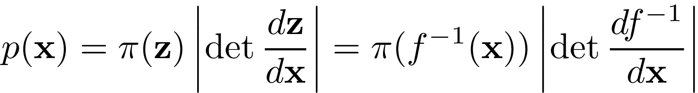

Normalizing Flows
…
Do we know how to transform distributions?
Jacobian
Generalizing to

Slide 9
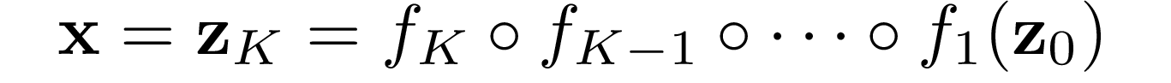
Normalizing Flows
…
Let’s repeat this K times …
Chain of transformations

Slide 10
Normalizing Flows
…
Wait, stop …
why the h***
are we doing
all this?
Let’s repeat this K times …
Chain of transformations

Slide 11
Normalizing Flows
…
Wait, stop …
why the h***
are we doing
all this?
Let’s repeat this K times …
Because, we
want the f(.)
to transform
noise to image
Chain of transformations

Slide 12
Normalizing Flows
…
Wait, stop …
why the h***
are we doing
all this?
Let’s repeat this K times …
Because, we
want the f(.)
to transform
noise to image
Chain of transformations
Once Flow is trained:
Start with Gaussian noise → prob. known → Chain of transformations → get image → prob. known

Slide 13
Normalizing Flows
…
Let’s repeat this K times …
Once Flow is trained:
Chain of transformations
Start with Gaussian noise → prob. known → Chain of transformations → get image → prob. known
How do you train?

Slide 14
Normalizing Flows
…
Let’s repeat this K times …
Once Flow is trained:
Chain of transformations
Start with Gaussian noise → prob. known → Chain of transformations → get image → prob. known
How do you train?
Start with → Chain of inverse transforms → get → calculate Gaussian prob
→ chain of transforms → get back to image → compute image probability

Slide 15
Normalizing Flows
…
Let’s repeat this K times …
Once Flow is trained:
Chain of transformations
Start with Gaussian noise → prob. known → Chain of transformations → get image → prob. known
How do you train?
Start with → Chain of inverse transforms → get → calculate Gaussian prob
→ chain of transforms → get back to image → compute image probability

Slide 16

Normalizing Flows
Chain of transformations
Let’s sketch out the math … for single transformation:

Slide 17
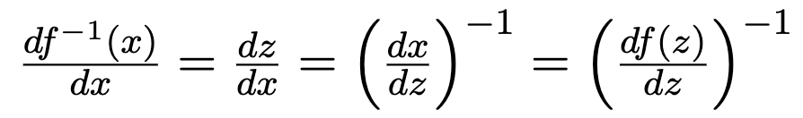

Normalizing Flows
Chain of transformations
Let’s sketch out the math … for single transformation:

Slide 18
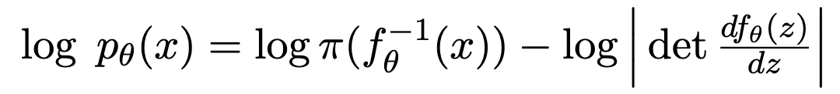
Normalizing Flows
Chain of transformations
Let’s sketch out the math … for single transformation:

Slide 19
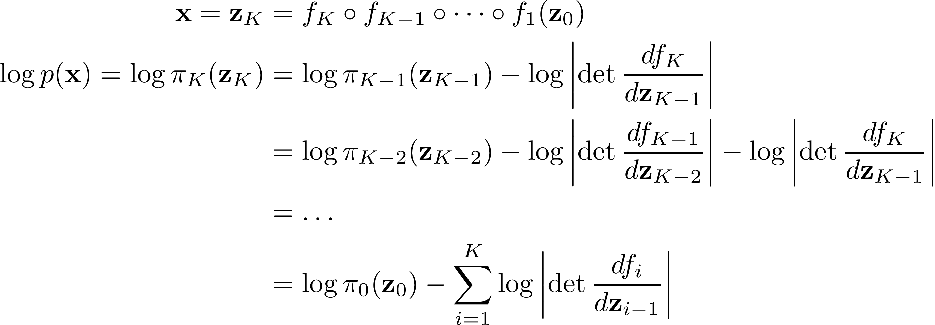

Normalizing Flows
Chain of transformations
Let’s sketch out the math … for single transformation:
With a chain of transformations:

Slide 20

Normalizing Flows
Chain of transformations
Let’s sketch out the math … for single transformation:
With a chain of transformations:
We know:
We design to be invertible.
Hence we have:

Slide 21
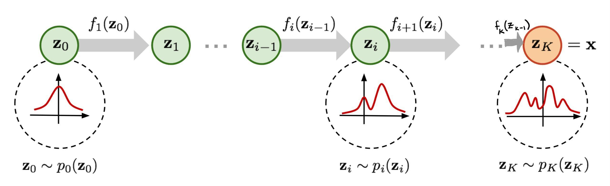
Normalizing Flows

Slide 22
Normalizing Flows
During inference: Sample from Gaussian → run the sample through the flow → generate a new image.
Plug the Gaussian sample probability and the determinant values in the equation → get image probability

Slide 23
Questions

