Slide 1
Learning Energy-Based Models of
High-Dimensional Data
Geoffrey Hinton
Max Welling
Yee-Whye Teh
Simon Osindero
www.cs.toronto.edu/~hinton/EnergyBasedModelsweb.htm

Slide 2
Discovering causal structure as a goal for unsupervised learning
It is better to associate responses with the hidden causes than with the raw data.
The hidden causes are useful for understanding the data.
It would be interesting if real neurons really did represent independent hidden causes.

Slide 3
A different kind of hidden structure
Instead of trying to find a set of independent hidden causes, try to find factors of a different kind.
Capture structure by finding constraints that are Frequently Approximately Satisfied.
Violations of FAS constraints reduce the probability of a data vector. If a constraint already has a big violation, violating it more does not make the data vector much worse (i.e. assume the distribution of violations is heavy-tailed.)

Slide 4
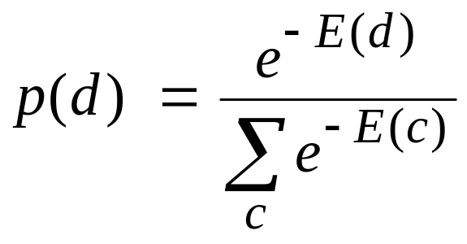

Two types of density model
Stochastic generative model using directed acyclic graph (e.g. Bayes Net)
  Synthesis is easy
  Analysis can be hard
  Learning is easy after analysis
Energy-based models that associate an energy with each data vector
  Synthesis is hard
  Analysis is easy
  Is learning hard?

Slide 5
Bayes Nets
It is easy to generate an unbiased example at the leaf nodes.
It is typically hard to compute the posterior distribution over all possible configurations of hidden causes.
Given samples from the posterior, it is easy to learn the local interactions
Hidden cause
Visible
effect

Slide 6
Approximate inference
What if we use an approximation to the posterior distribution over hidden configurations?
  e.g. assume the posterior factorizes into a product of distributions for each separate hidden cause.
If we use the approximation for learning, there is no guarantee that learning will increase the probability that the model would generate the observed data.
But maybe we can find a different and sensible objective function that is guaranteed to improve at each update.

Slide 7
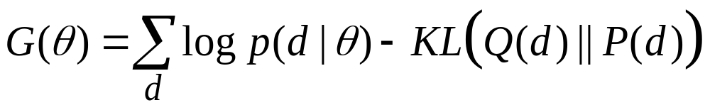
A trade-off between how well the model fits the data and the tractability of inference
approximating posterior distribution
true posterior distribution
parameters
data
This makes it feasible to fit very complicated models, but the approximations that are tractable may be very poor.
new objective function
How well the model fits the data
The inaccuracy of inference

Slide 8
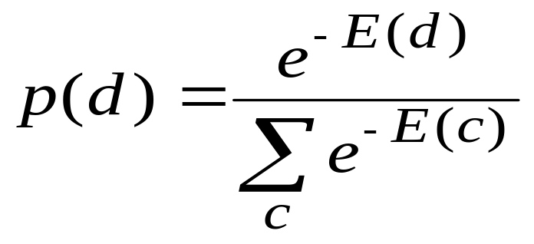
Energy-Based Models with deterministic hidden units
Use multiple layers of deterministic hidden units with non-linear activation functions.
Hidden activities contribute additively to the global energy, E.
Ek
k
Ej
j
data

Slide 9
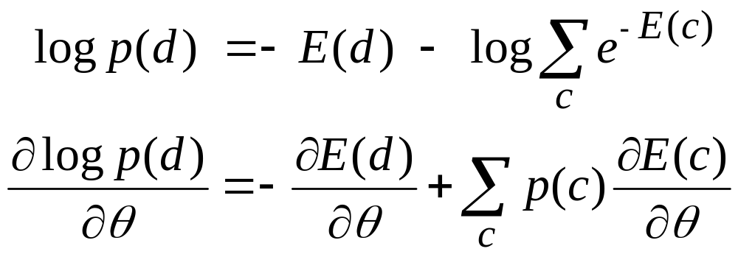
Maximum likelihood learning is hard
To get high log probability for d we need low energy for d and high energy for its main rivals, c
To sample from the model use Markov Chain Monte Carlo

Slide 10
Hybrid Monte Carlo
The obvious Markov chain makes a random perturbation to the data and accepts it with a probability that depends on the energy change.
  Diffuses very slowly over flat regions
  Cannot cross energy barriers easily
In high-dimensional spaces, it is much better to use the gradient to choose good directions and to use momentum.
  Beats diffusion. Scales well.
  Can cross energy barriers.

Slide 11
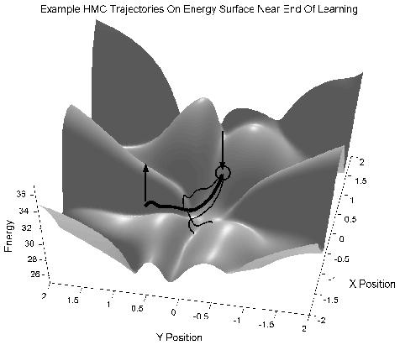
Trajectories with different initial momenta

Slide 12
Backpropagation can compute the gradient that Hybrid Monte Carlo needs
Do a forward pass computing hidden activities.
Do a backward pass all the way to the data to compute the derivative of the global energy w.r.t each component of the data vector.
  works with any smooth
  non-linearity
Ek
k
Ej
j
data

Slide 13
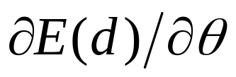

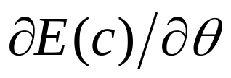
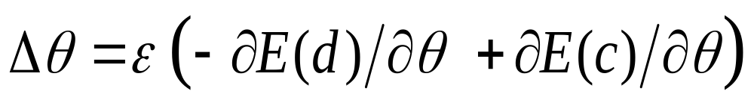
The online HMC learning procedure
Start at a datavector, d, and use backprop to compute for every parameter.
Run HMC for many steps with frequent renewal of the momentum to get equilbrium sample, c.
Use backprop to compute
Update the parameters by :

Slide 14
A surprising shortcut
Instead of taking the negative samples from the equilibrium distribution, use slight corruptions of the datavectors. Only add random momentum once, and only follow the dynamics for a few steps.
  Much less variance because a datavector and its confabulation form a matched pair.
  Seems to be very biased, but maybe it is optimizing a different objective function.
If the model is perfect and there is an infinite amount of data, the confabulations will be equilibrium samples. So the shortcut will not cause learning to mess up a perfect model.

Slide 15
Intuitive motivation
It is silly to run the Markov chain all the way to equilibrium if we can get the information required for learning in just a few steps.
  The way in which the model systematically distorts the data distribution in the first few steps tells us a lot about how the model is wrong.
  But the model could have strong modes far from any data. These modes will not be sampled by confabulations. Is this a problem in practice?

Slide 16
Contrastive divergence
Aim is to minimize the amount by which a step toward equilibrium improves the data distribution.
distribution after one step of Markov chain
data distribution
model’s distribution
Minimize divergence between data distribution and model’s distribution
Maximize the divergence between confabulations and model’s distribution
Minimize Contrastive Divergence

Slide 17
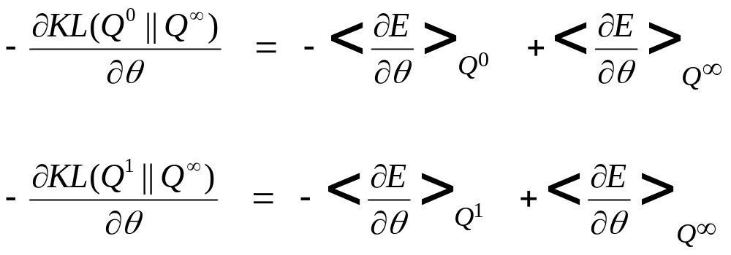
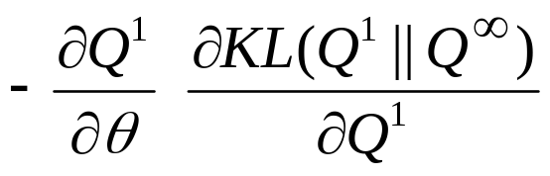
Contrastive divergence
.
Contrastive divergence makes the awkward terms cancel
changing the parameters changes the distribution of confabulations

Slide 18
Frequently Approximately Satisfied constraints
The intensities in a typical image satisfy many different linear constraints very accurately, and violate a few constraints by a lot.
The constraint violations fit a heavy-tailed distribution.
The negative log probabilities of constraint violations can be used as energies.
On a smooth intensity patch the sides balance the middle
-
+
-
Gauss
energy
Cauchy
0
Violation

Slide 19
Learning constraints from natural images
(Yee-Whye Teh)
We used 16x16 image patches and a single layer of 768 hidden units (3 x overcomplete).
Confabulations are produced from data by adding random momentum once and simulating dynamics for 30 steps.
Weights are updated every 100 examples.
A small amount of weight decay helps.

Slide 20
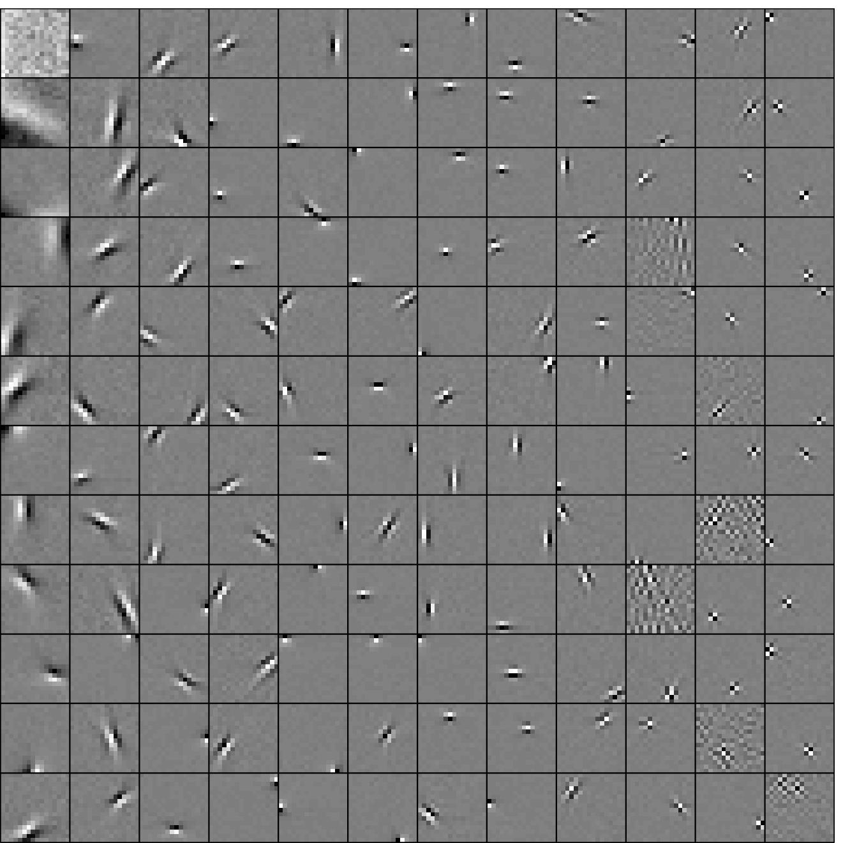
A random subset of 768 basis functions

Slide 21
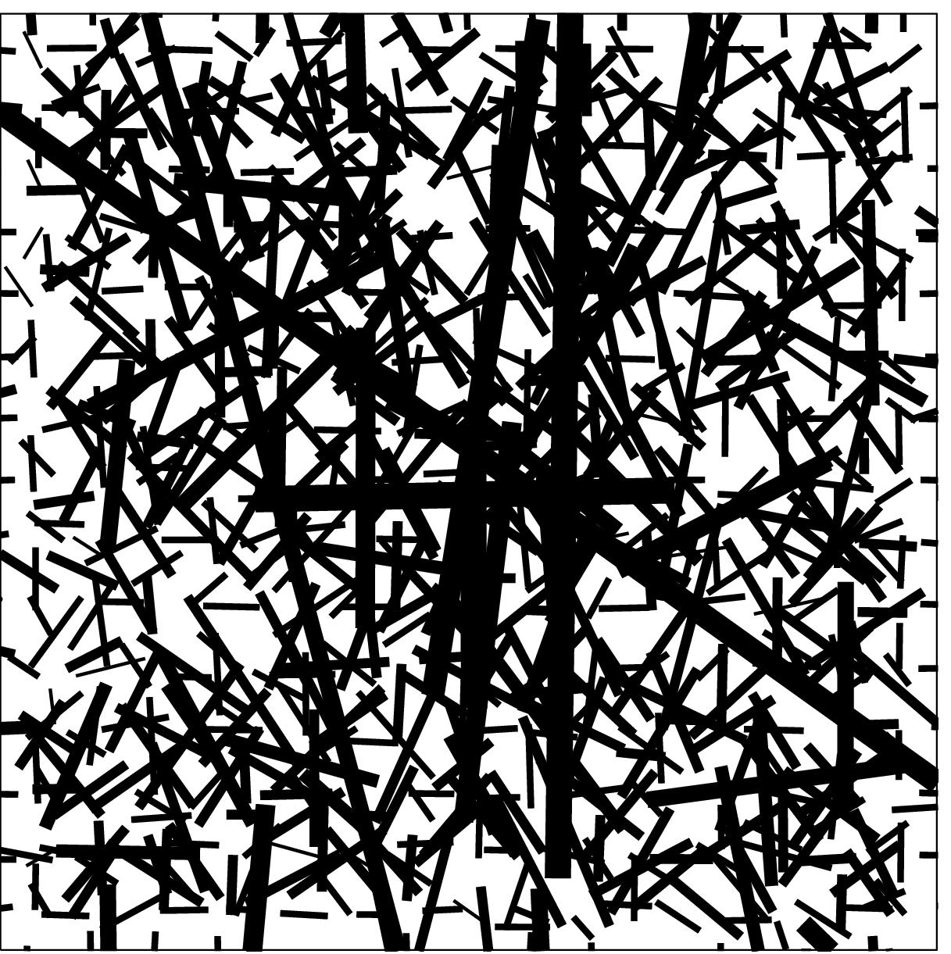
The distribution of all 768 learned basis functions

Slide 22
How to learn a topographic map
The outputs of the linear filters are squared and locally pooled. This makes it cheaper to put filters that are violated at the same time next to each other.
Pooled squared filters
Local connectivity
Cost of second violation
Linear filters
Global connectivity
Cost of first violation
image

Slide 23
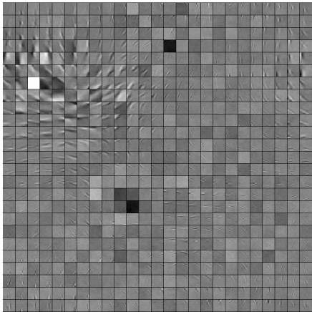

Slide 24
Faster mixing chains
Hybrid Monte Carlo can only take small steps because the energy surface is curved.
With a single layer of hidden units, it is possible to use alternating parallel Gibbs sampling.
  Much less computation
  Much faster mixing
  Can be extended to use pooled second layer (Max Welling)
  Can only be used in deep networks by learning one hidden layer at a time.

Slide 25
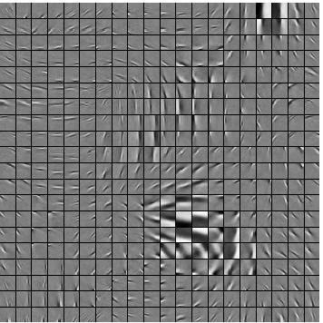

Slide 26
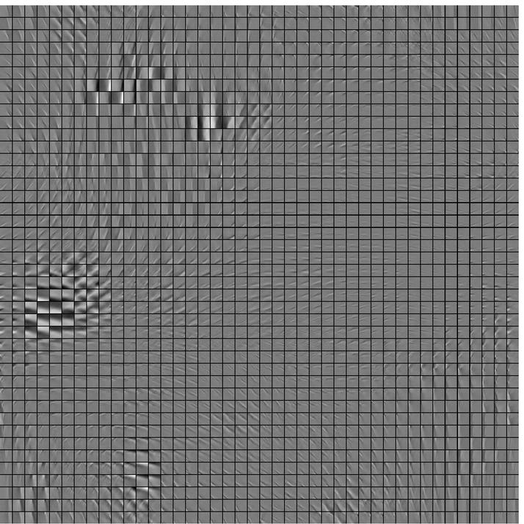

Slide 27
Two views of Independent Components Analysis
Stochastic Causal
Generative models
The posterior distribution is intractable.
Deterministic
Energy-Based Models
Partition function I is intractable
Z becomes
determinant
Posterior collapses
ICA
When the number of linear hidden units equals the dimensionality of the data, the model has both marginal and conditional independence.

Slide 28
Density models
Causal models
Energy-Based Models
Tractable posterior
mixture models, sparse bayes nets factor analysis
Compute exact posterior
Intractable posterior
Densely connected DAG’s
Markov Chain Monte Carlo
or
Minimize variational free energy
Stochastic hidden units
Full Boltzmann Machine
Full MCMC
Restricted Boltzmann Machine
Minimize contrastive divergence
Deterministic hidden units
Markov Chain Monte Carlo
Fix the features (“maxent”)
Minimize contrastive divergence
or

Slide 29
Where to find out more
www.cs.toronto.edu/~hinton has papers on:
  Energy-Based ICA
  Products of Experts
This talk is at www.cs.toronto.edu/~hinton

