Slide 1

Langevin Dynamics
for sampling and
global optimization
Kirill Neklyudov

Slide 2
Goals of this talk
Introduction to the Langevin dynamics
Derive basics (1st half)
Outline some important results (2nd half)
Recommend some literature

Slide 3
Langevin Equation
Ito Stochastic Differential Equation (SDE):
Force
Random fluctuations
Discrete approximation:

Slide 4
1-d simulation
Langevin equation
Fokker-Planck equation

Slide 5
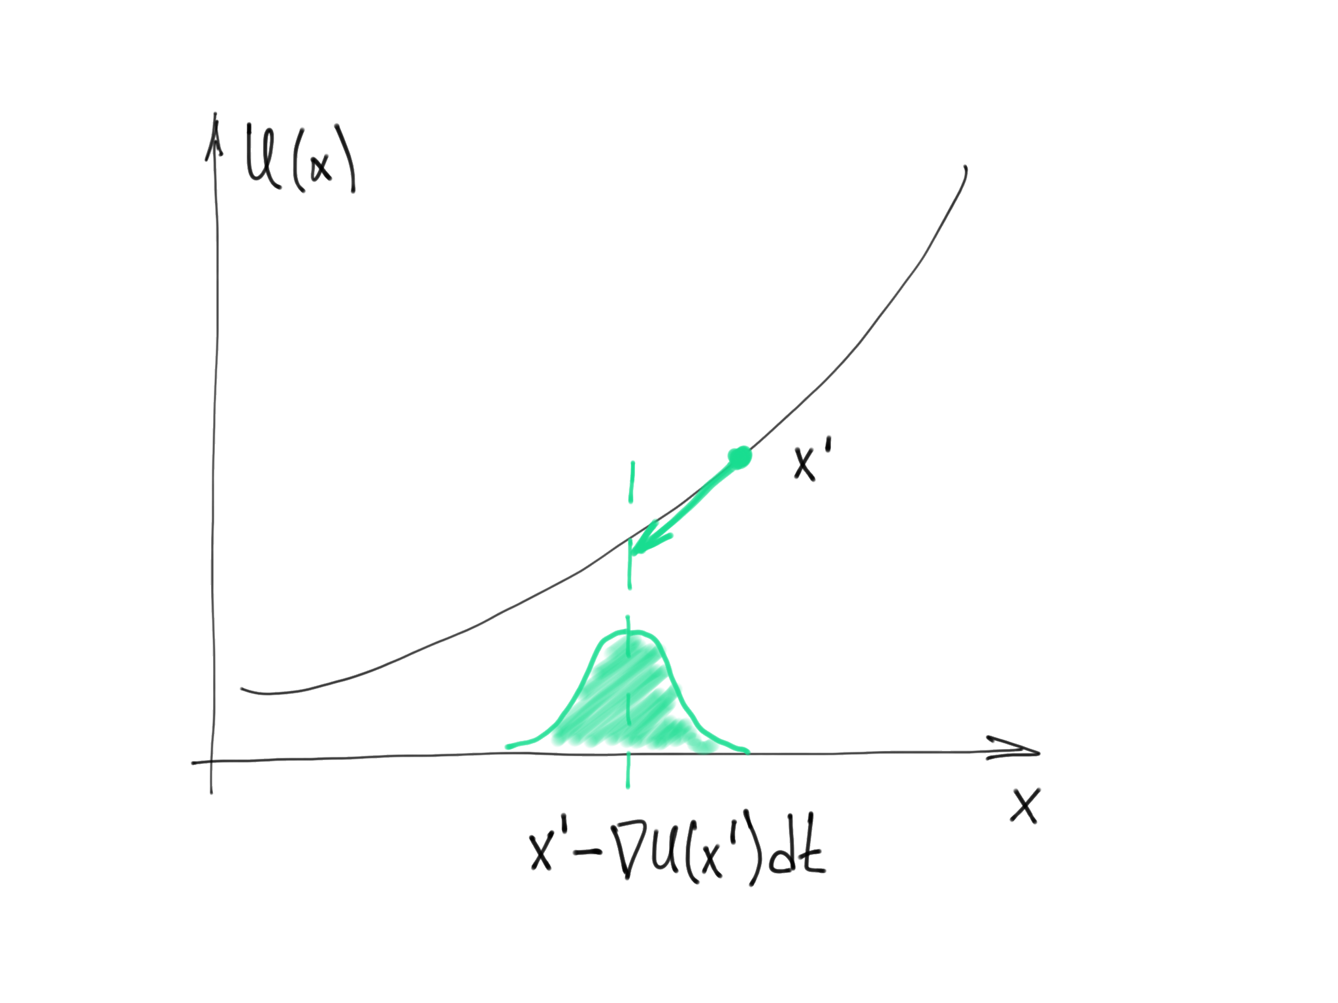


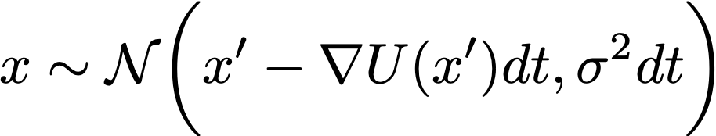
Derivation of the Fokker-Planck equation
Langevin equation:
Increments of the Brownian motion:
Consider a small increment of :

Slide 6
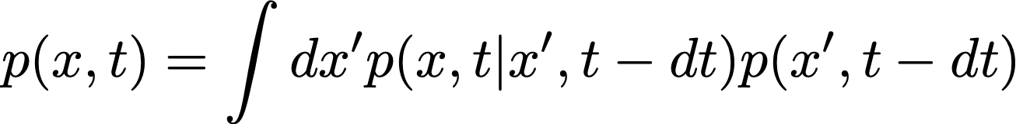

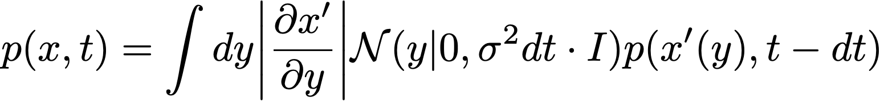
Derivation of the Fokker-Planck equation
Unknown density!
Density of particle distribution:
Using the change of variables formula, we obtain:

Slide 7
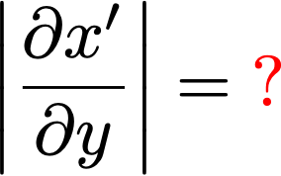


Changing variables
The change of variables:
We can’t invert this

Slide 8
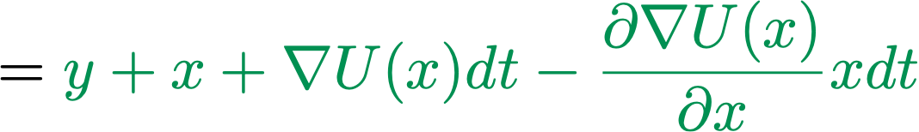
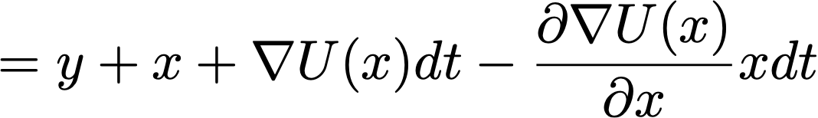
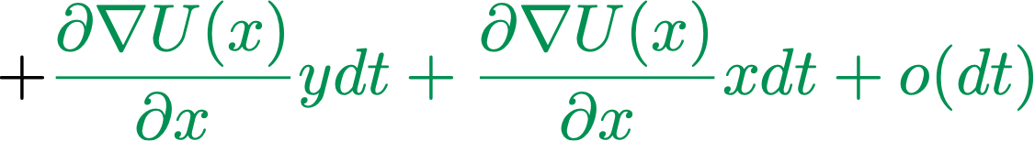
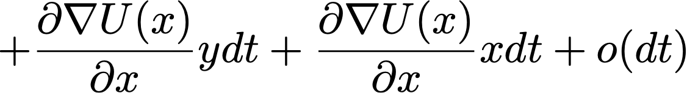
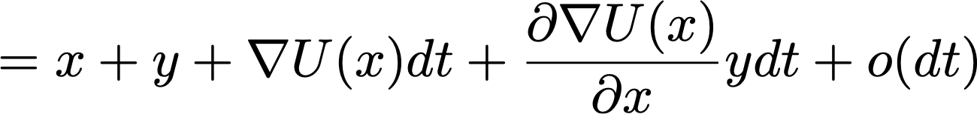
Changing variables

Slide 9
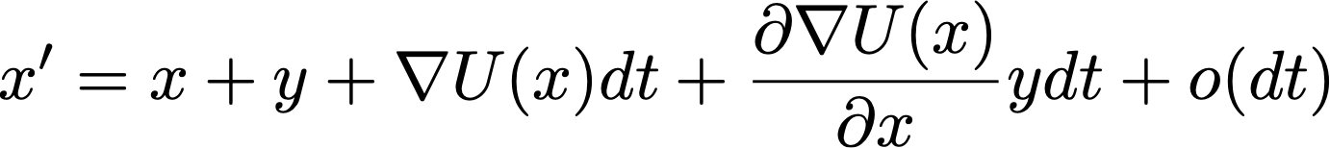

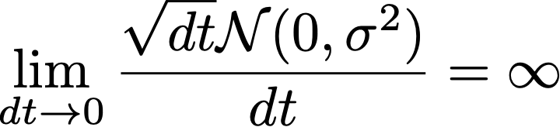

Changing variables
From the previous slide:
Equation for the increment
(Langevin equation)
Note that
since

Slide 10
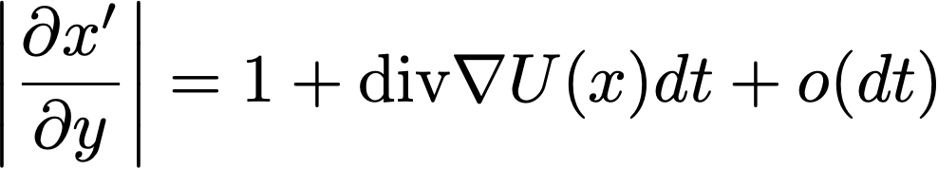
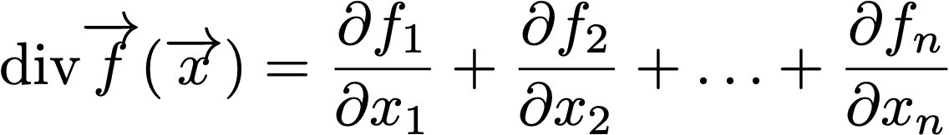
Changing variables
Finally!
With a little more efforts (homework):
Reminder:

Slide 11

Derivation of the Fokker-Planck equation
Increment of the density
Change of variables
???

Slide 12
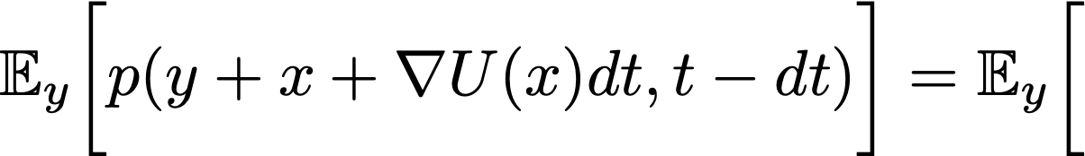

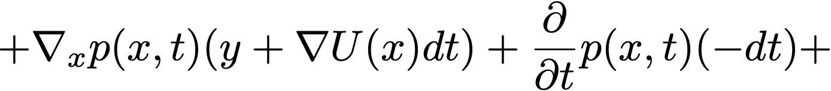
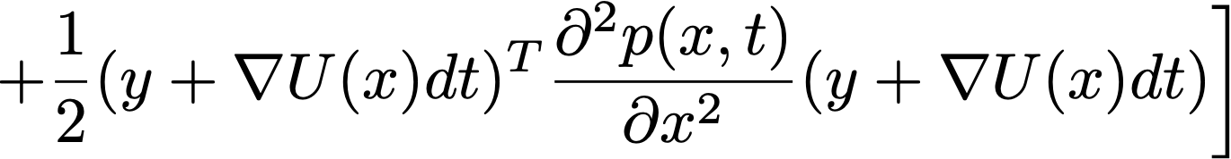
Derivation of the Fokker-Planck equation
0th order:
1st order:
2nd order:

Slide 13
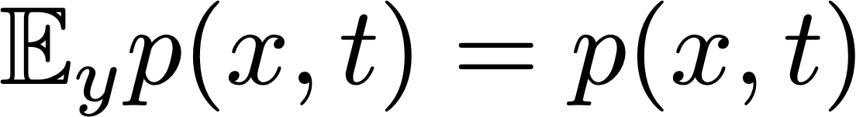
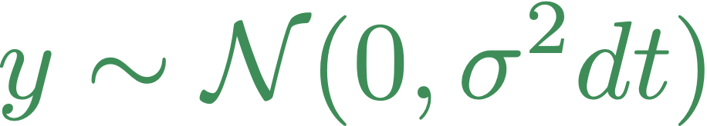
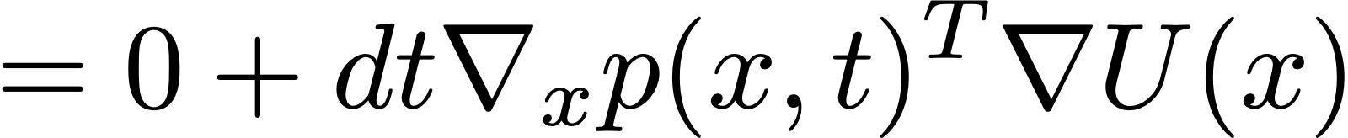
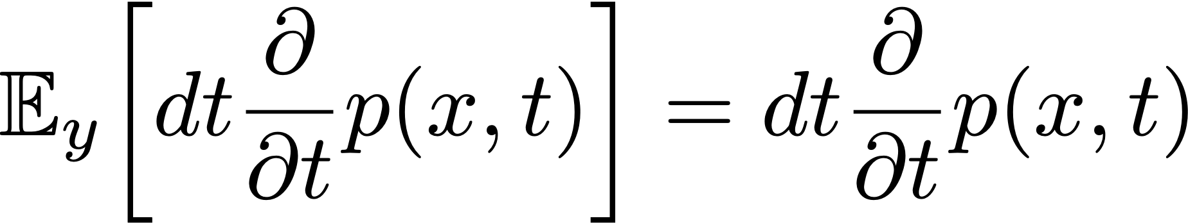
Taking the expectation
0th order:
1st order:

Slide 14
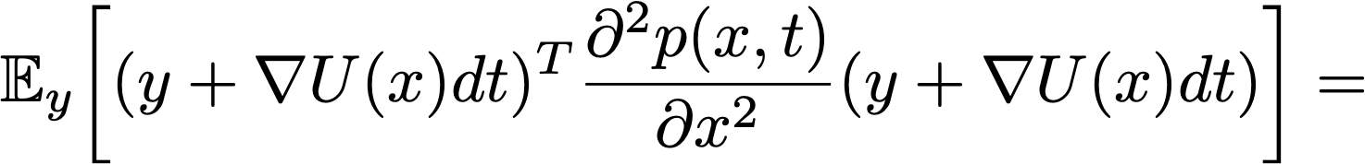

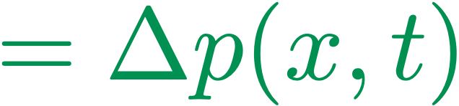
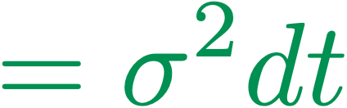
Taking the expectation (2nd order)

Slide 15
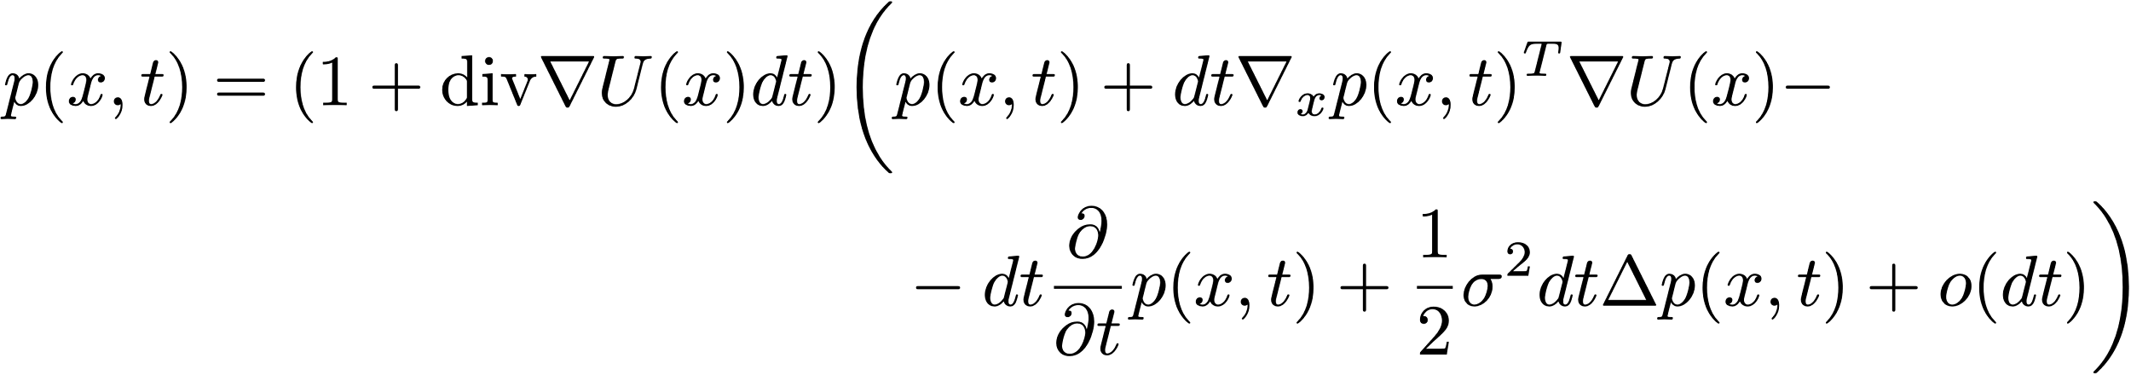
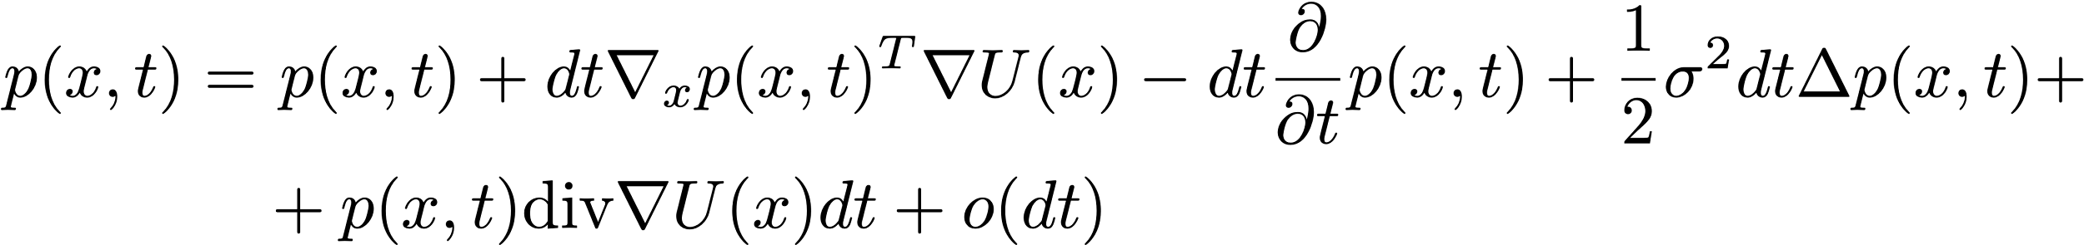
Derivation of the Fokker-Planck equation
Increment of the density
Taylor series
0

Slide 16
5 min break

Slide 17
Fokker-Planck equation

Slide 18
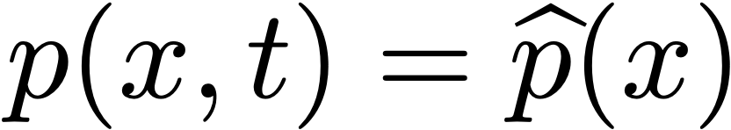
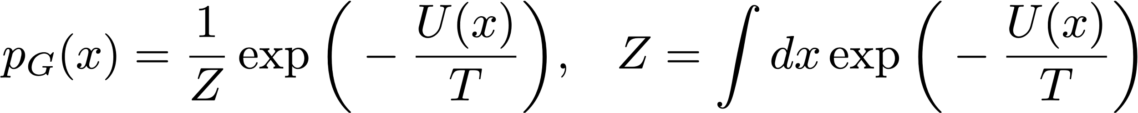
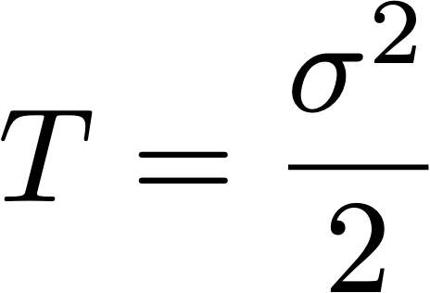
Stationary distribution of the Langevin dynamics
(density does not change anymore)
Let
Gibbs distribution
With a little efforts (homework), we obtain:
when

Slide 19
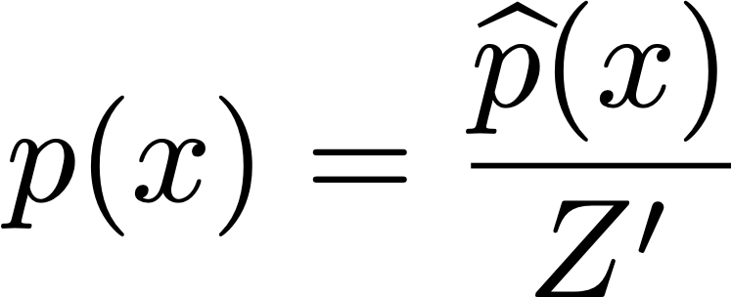
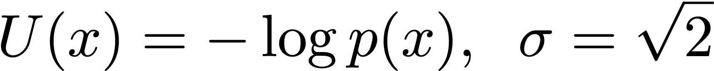
Sampling via the Langevin dynamics
Langevin equation
Particles have the stationary distribution:
Gibbs distribution
We want to sample from
Note!

Slide 20
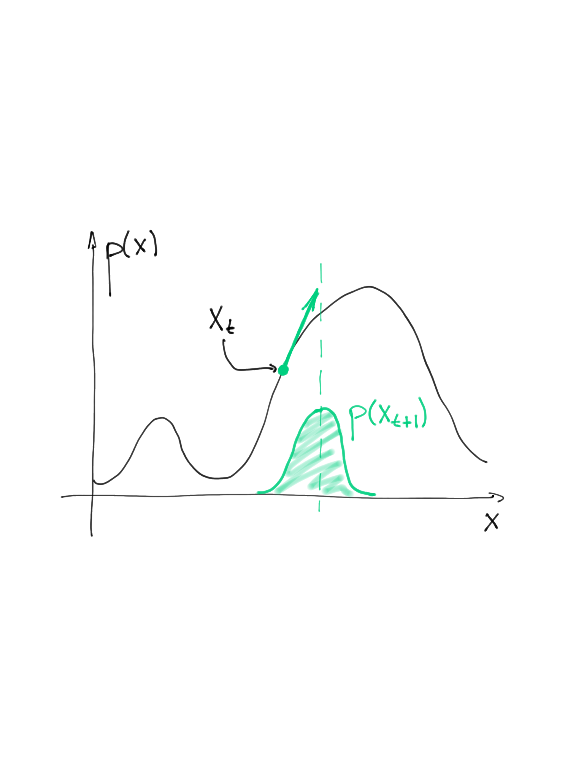
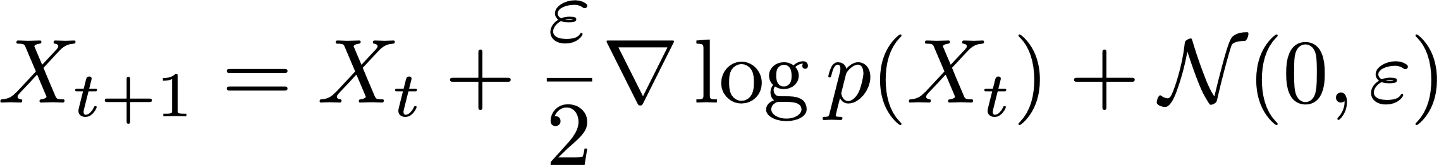
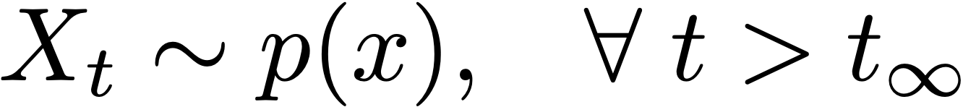
Sampling via the Langevin dynamics
Stochastic Differential Equation for sampling:
Discrete approximation:
More popular way:

Slide 21
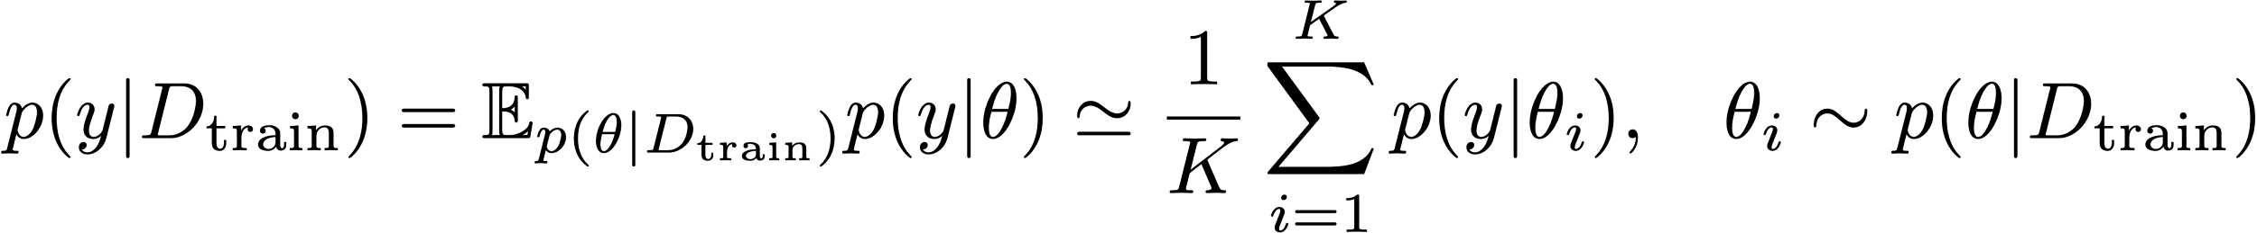
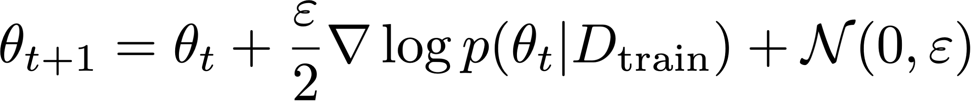
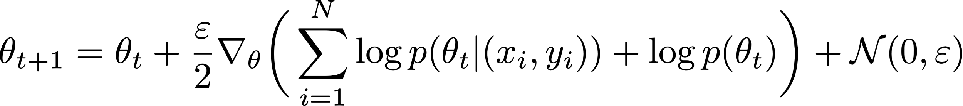
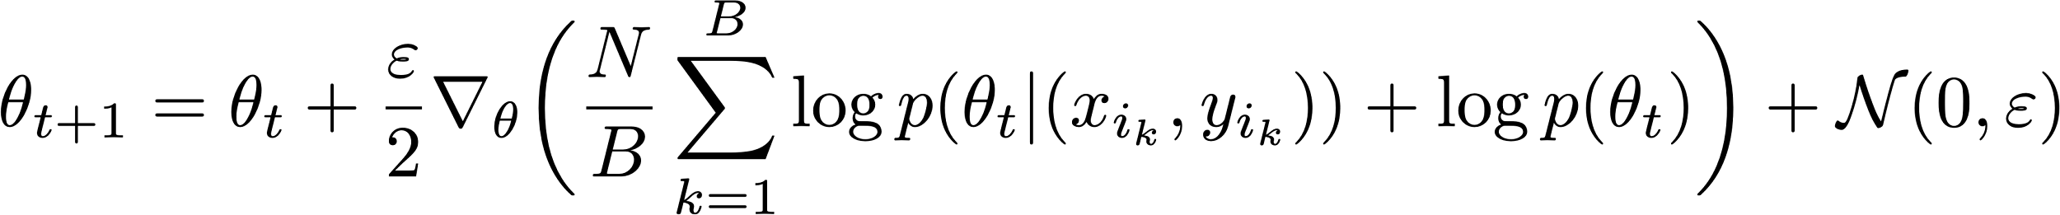
Langevin dynamics for the Bayesian inference
Predictive distribution
We need samples
Langevin equation
???
Discrete approximation
???

Slide 22
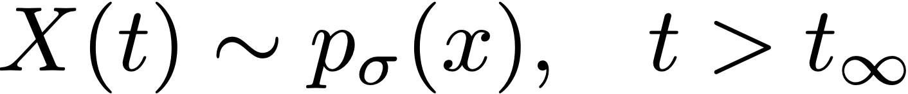
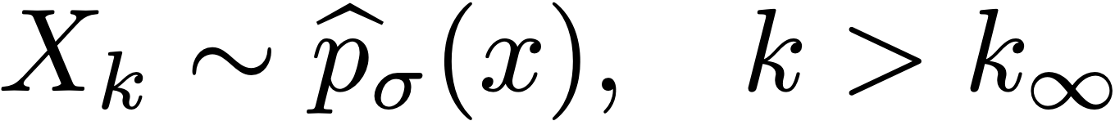
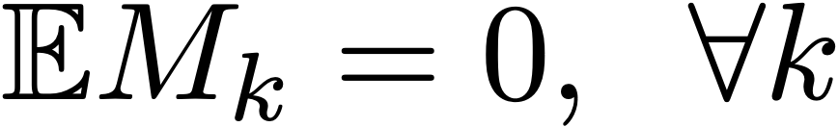
Borkar, Mitter, 1999
Consider a SDE:
Stationary distribution
Discrete approximation:
Stationary distribution
Theorem

Slide 23
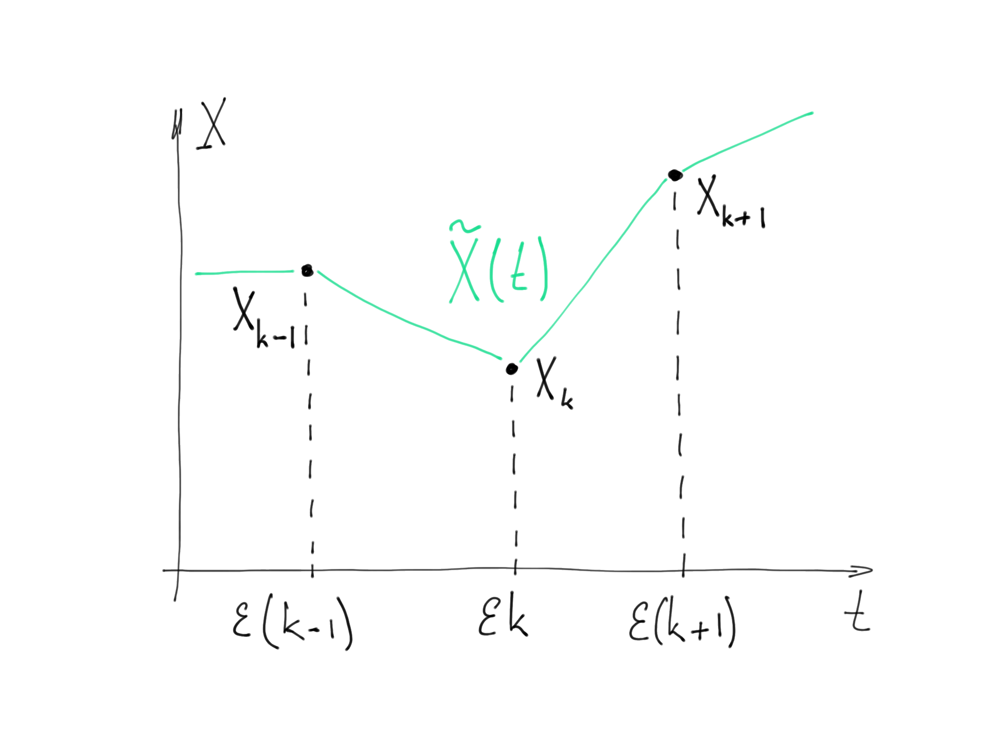
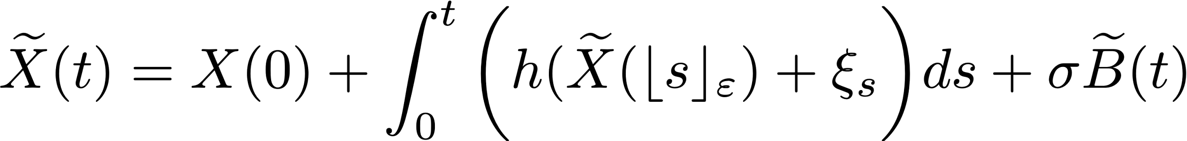
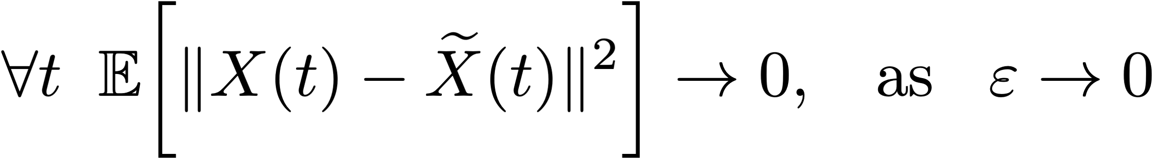
Sketch of the proof
Lemma

Slide 24
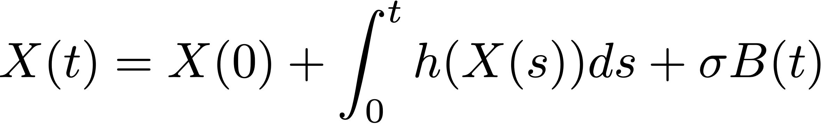
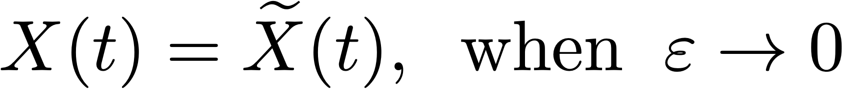
What happened to the noise?
Original dynamics
The same but integrated
Our approximation
Free speed-up?
Lemma says

Slide 25
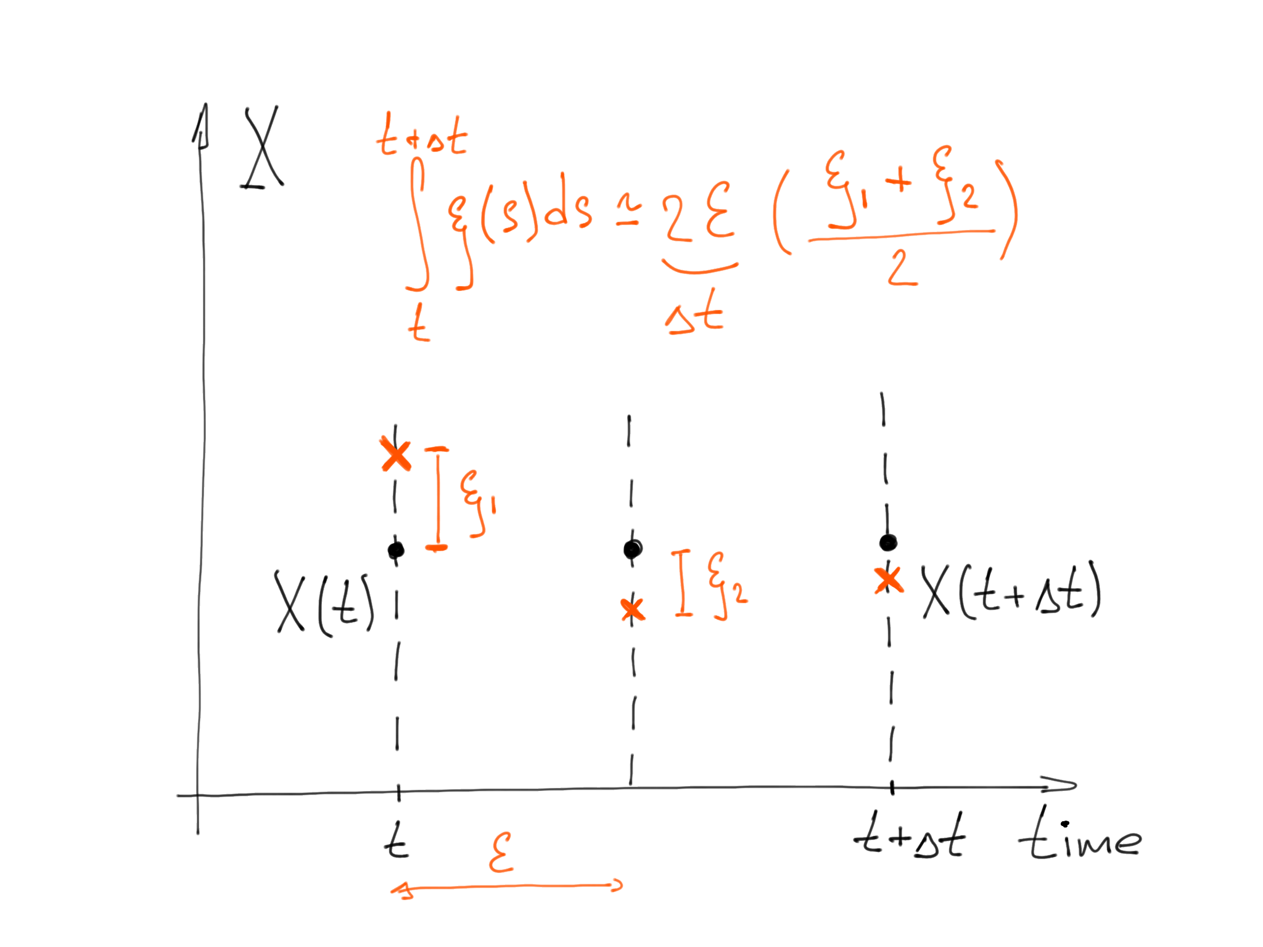
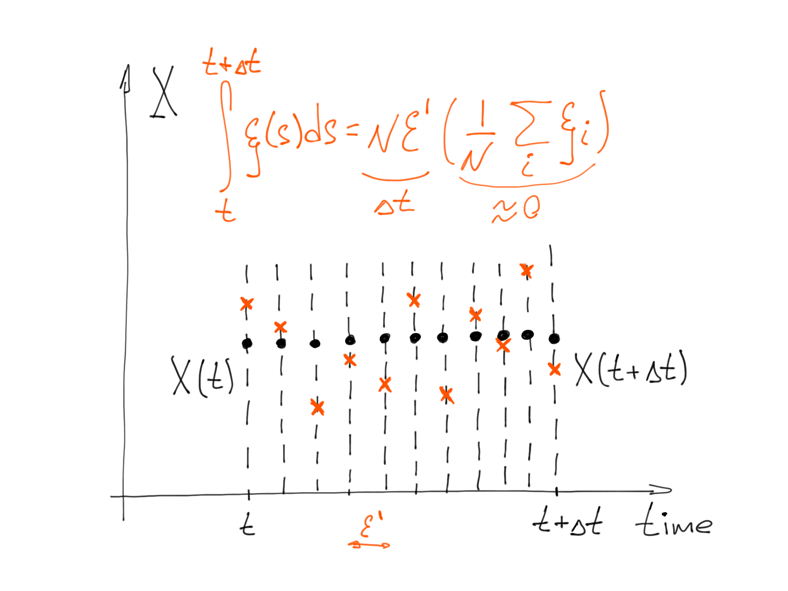
What happened to the noise?
Computational efforts are hidden here

Slide 26
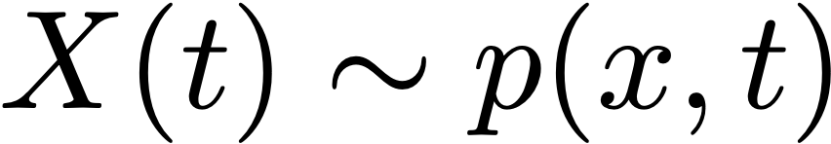
Sketch of the proof
Stationary distribution
Stationary distribution
Lemma 1
Lemma 2
Theorem

Slide 27
Global optimization

Slide 28
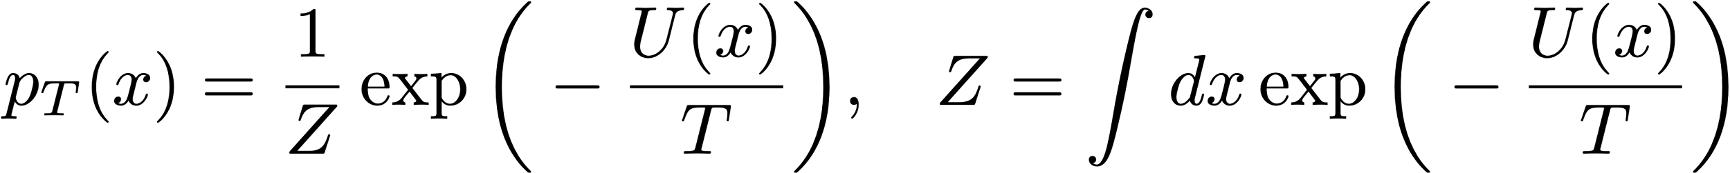

Temperature annealing
Langevin equation
Particles have the stationary distribution:
Gibbs distribution
Concentrates on the global minima

Slide 29

Annealing example

Slide 30



???
Langevin equation
Distribution of particles
Theorem:
Annealing schedule

Slide 31





Distribution of particles
Theorem:
Annealing schedule

Slide 32


Stationary distribution
Continuous process
Discrete approximation
Discretization error
Convergence speed

Slide 33


Further reading

Slide 34
The end

