Slide 1
ShardingSQLCasesRegistry
SQLCasesLoader
sql_case_id
sql_case_value
sql case
sql_case_id
sql_case_value
sql case
sql_case_id
sql_case_value
sql case
sql_case_id
sql_case_value
sql case
Load
dal
dml
dcl
XML
ddl
dql
tcl

Slide 2
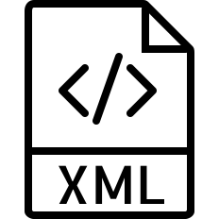
IntegrateTestParameters
*-integrate-test-cases.xml
*-integrate-test-cases.xml
Integrate test cases
env.properties
/sql/*.xml
test env
sql cases
object[0] = sql_case_id
object[1] = expected_file
object[2] = sharding_type
object[3] = environment
object[4] = sql_type
Create DB
Create Table
BaseIT
SingleIT
BatchIT
dataSetEnvironmentManager
dmlIT
ddllIT
dqlIT
…

