Slide 1

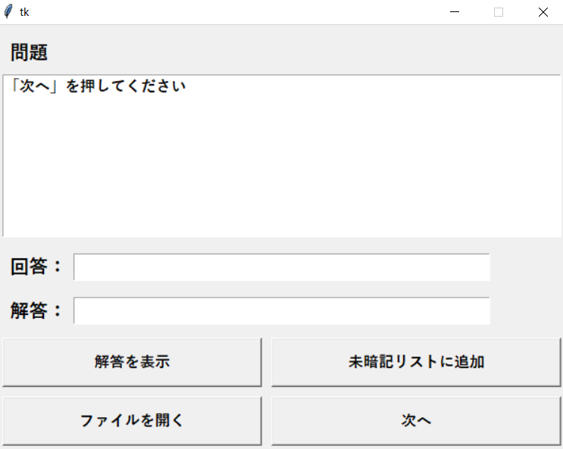
question_list
answer_list

