Slide 2

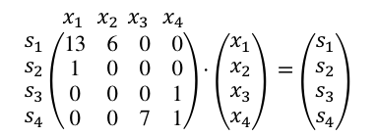
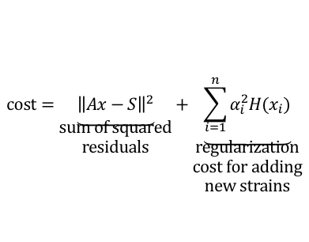
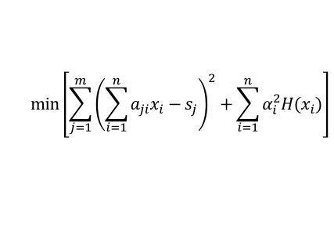

Quality control
Paired-end read merging
PCR primer trimming
Quality filtering / length trimming
AGGTACTAATCGGA
AGGTACTAAGCGGATTACT
CTAAGCGGATTACT
AGGTACTAAGCGTGATTACT
$$\min\left[\sum_{j=1}^{m}{{\left(\sum_{i=1}^{n}{a_{ji}x_{i}−s_{j}}\right)}^{2}}+\sum_{i=1}^{n}{α_{i}^{2}H(x_{i})}\right]$$
AGGTACTAAGCGGATTACT
A | G | G | T | A | C | T | A | A | T
23 | 45
sequences
strains
$$\begin{matrix}s_{1} \\ s_{2} \\ s_{3} \\ s_{4}\end{matrix}$$
$$\begin{matrix}x_{1} \\ x_{2} \\ x_{3} \\ x_{4}\end{matrix}$$
C. beijerinckii
$$\begin{matrix} \\ \begin{matrix}s_{1} \\ s_{2} \\ s_{3} \\ s_{4}\end{matrix}\end{matrix}\begin{matrix} \\ \\ \begin{matrix} \\ \end{matrix}\end{matrix}\begin{matrix}x_{1}{ x}_{2}{ x}_{3}{ x}_{4} \\ \left(\begin{matrix}13 & 6 & 0 & 0 \\ 1 & 0 & 0 & 0 \\ 0 & 0 & 0 & 1 \\ 0 & 0 & 7 & 1\end{matrix}\right)\end{matrix}⋅\begin{matrix} \\ \left(\begin{matrix}x_{1} \\ x_{2} \\ x_{3} \\ x_{4}\end{matrix}\right)\end{matrix}\begin{matrix} \\ \end{matrix}=\begin{matrix} \\ \left(\begin{matrix}s_{1} \\ s_{2} \\ s_{3} \\ s_{4}\end{matrix}\right)\end{matrix}\begin{matrix} \\ \end{matrix}$$
C. beijerinckii
S. agalactiae
T | A | C | T | A | A | T | T | C | A
23 | 45
L. monocytogenes
C. beijerinckii
Denoising based on posterior quality scores
DADA2 partitioning
Extending sequences
Retrieve consensus full-length sequence before trimming
Align seq to check for offset shifts
$$\text{cost}=\underset{\begin{aligned}\text{sum} \text{of} \text{squared} \\ \text{residuals}\end{aligned}}{\underbrace{{\left\|Ax−S\right\|}^{2}}}+\underset{\begin{aligned}\text{regularization} \\ \text{cost} \text{for} \text{adding} \\ \text{new} \text{strains}\end{aligned}}{\underbrace{\sum_{i=1}^{n}{α_{i}^{2}H(x_{i})}}}$$
13
(plot seq vs abundance?, show multiple hits for each sequence)
1
Least-square linear model with regularization
Alignment vs custom 16S database
Abundance estimation

Slide 3
Figure 1. Pipeline.
Merge paired-end reads
Remove PCR primers
Filter low quality sequences,
trim to fixed length
A | G | G | T | A | C | T | A | A | G | G | G | G | A | T | T
 | G | G | T | C | C | T | A | A | G | C | G | G | A | T | T | C
A | G | G | T | A | C | T | A | A | G | C | G | G | A | T | T | C
A | G | G | T | A | C | T | A | A | G | C | G | G | A | T | T | C
A | G | G | G | A | C | T | A | A | G | C | G | T | C | G | T | T | C
A | G | G | C | A | G | A | A | A | T | C | C | C | C | T | T | C
T | A | C | T | A | A | G | C | G | G | A
G | A | C | T | A | A | G | C | G | T | C | G
C | A | G | A | A | A | T | C | C | C | C
C | A | G | A | N | A | T | C | C | C | C
high quality
low quality
filtered out
forward
reverse
Denoising: DADA2
Partition sequences using quality scores
Denoised
sequences
Reference database with exact strains and 16S copy numbers
Estimates of
species
abundance
 | C | A | G | A | A | A | T | C | C | C | C
 | C | A | G | A | G | A | T | C | C | C | C
 | T | A | C | T | A | A | G | C | G | G | C
 | T | A | C | T | A | A | G | C | G | T | C
 | G | A | C | T | A | A | G | C | G | T | C

