Slide 1
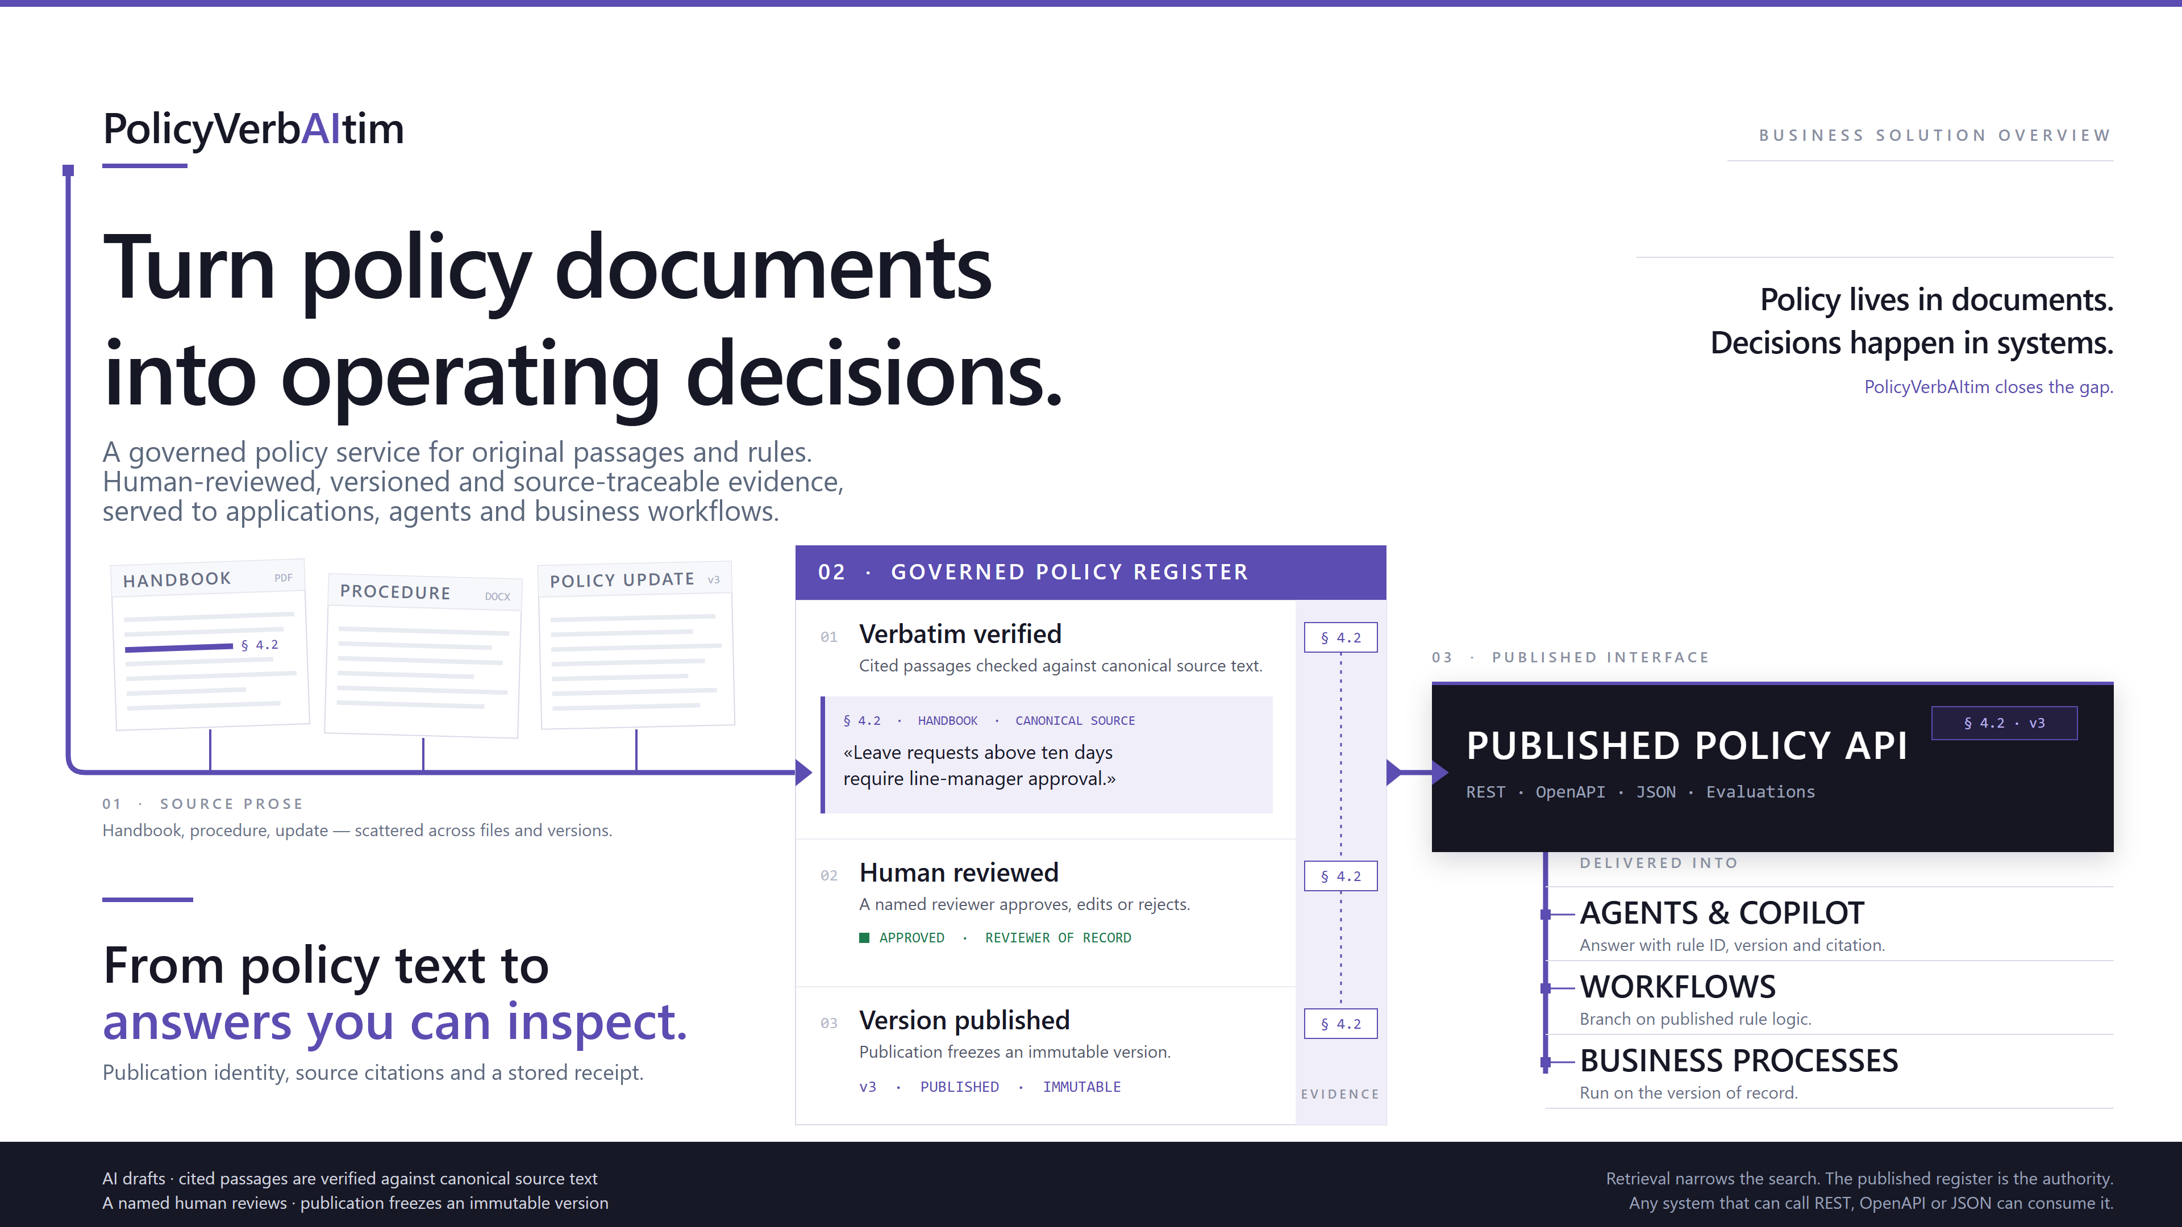
Notes:
CONDENSED FROM ORIGINAL SLIDE 1
Original slide artwork, theme, fonts, colors and layout retained. Only necessary wording and architecture labels were updated.
Use the original cover to introduce the business proposition: a shared governed policy foundation, rather than a separate document pipeline in each application. The cover's illustrated rule and quotation are illustrative, not a live result. The service now supports original-passage publications as well as approved rules. Traceability and a sealed receipt do not guarantee interpretation correctness. Applications retain responsibility for business approval and action.
ARCHITECTURE BASIS
Current main at 4dfce681, published 22 September 2026. This is a source-defined architecture snapshot, not a live deployment audit.
https://github.com/taomar/PolicyVerbAItim/blob/4dfce681/README.md
https://github.com/taomar/PolicyVerbAItim/blob/4dfce681/docs/reference/architecture.md

Slide 2
THE BUSINESS PROBLEM
EXECUTIVE · 02
One policy. Different answers.
The problem is not finding a document. It is applying the right version, consistently, across people and systems.
01 / SCATTERED SOURCES
02 / REPEATED TRANSLATION
03 / INCONSISTENT DELIVERY
Policy / current release
Interpret again.
Rebuild the rules.
People reinterpret
Exception / local email
Context and exceptions depend on who answers.
Update / changed wording
Applications drift
Application / hard-coded rule
Across people and applications
Policy changes need separate code updates.
ILLUSTRATIVE REQUEST / SAME FACTS
Am I eligible under this policy?
PORTAL
SERVICE DESK
EMAIL RESPONSE
Eligible
Not eligible
Need more facts
Different channels. Conflicting guidance.
WHAT THIS COSTS THE BUSINESS AND THE CUSTOMER
Conflicting guidance
Repeated effort
Wrong-version risk
Harder to defend
Repeat contacts; lower trust.
Re-reading, re-coding, rework.
New cases use old policy logic.
Time spent rebuilding the why.
Notes:
CONDENSED FROM ORIGINAL SLIDE 2
Original slide artwork, theme, fonts, colors and layout retained. Only necessary wording and architecture labels were updated.
The original business-problem slide is retained to answer why the service is needed. These are risks of fragmented policy handling, not measured claims about a particular customer. Explain the operational and customer-facing consequences: inconsistent answers, repeated interpretation, unclear release identity and difficult audit reconstruction. VerbAItim centralizes the evidence foundation; it does not guarantee identical or correct model interpretations on every call.
ARCHITECTURE BASIS
Current main at 4dfce681, published 22 September 2026. This is a source-defined architecture snapshot, not a live deployment audit.
https://github.com/taomar/PolicyVerbAItim/blob/4dfce681/README.md
https://github.com/taomar/PolicyVerbAItim/blob/4dfce681/docs/reference/architecture.md
VISUAL AND CONTENT REFINEMENT
Follow the three-step visual: scattered releases and exceptions -> repeated human/system interpretation -> inconsistent delivery. The four consequence cards translate the operating problem into customer guidance, repeated work, version risk and explanation difficulty. These are illustrative failure modes, not measured customer outcomes. The same policy foundation can reduce fragmentation without promising identical or always-correct model answers.
CONCRETE PROBLEM EXAMPLE
The eligibility request and its three channel responses are explicitly illustrative. They are not an actual customer case, measured incident, or model-evaluation result, and no response is asserted to be correct. The example makes the operational risk of repeated translation concrete. These risks motivate reviewed source evidence, version control and traceable case handling; the service does not guarantee identical or correct model interpretations. The existing flow and consequence cards are retained.

Slide 3
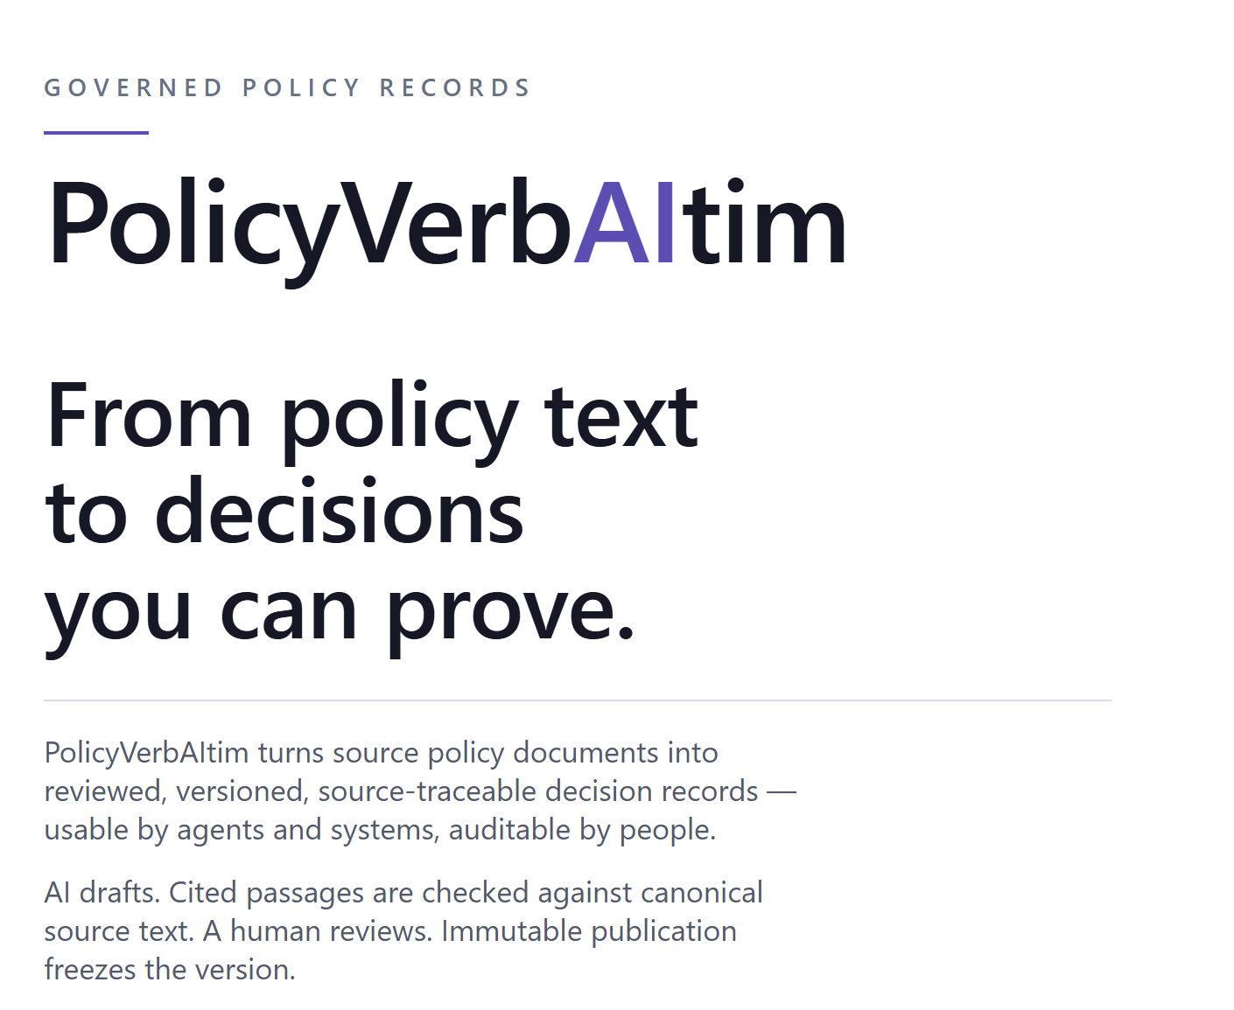
THE SOLUTION
EXECUTIVE · 03
PolicyVerbAItim is the governed policy layer
A shared policy service: prepare and govern the source, answer questions and cases, and return evidence that people can inspect.
Turn documents into governed evidence
Preserve source text, prepare candidates and review before publication.
Answer questions and assess cases
Return policy information, case findings and what is still missing.
Publish once, govern every change
Publication freezes a version; a correction is a new version, not an edit in place.
Serve people and business systems
Employee Desk, applications and agents consume cited answers over an API.
Two paths coexist: original passages (opt-in) and approved policy rules (the default UI).
Notes:
CONDENSED FROM ORIGINAL SLIDE 4
Original slide artwork, theme, fonts, colors and layout retained. Only necessary wording and architecture labels were updated.
Retain the supplied solution slide and its illustration. The two paths share projects, ingestion, authentication and infrastructure, but have distinct candidate, publication, index-build and receipt identities. Choosing passage v2 does not convert approved rules. Employee Desk is the separate passage Light client with Scenarios, Information and Chat; it has a same-origin server gateway and server-held reader credential, no client-side policy judgment and no canned answers. It is not automatically hosted by the main Azure deployment.
ARCHITECTURE BASIS
Current main at 4dfce681, published 22 September 2026. This is a source-defined architecture snapshot, not a live deployment audit.
https://github.com/taomar/PolicyVerbAItim/blob/4dfce681/README.md
https://github.com/taomar/PolicyVerbAItim/blob/4dfce681/docs/reference/architecture.md
https://github.com/taomar/PolicyVerbAItim/blob/4dfce681/apps/ais-self-service/README.md

Slide 4
MARKET COMPARISON
POSITIONING · 04
Why a policy service—not search alone
Search, enterprise AI and decision engines solve different jobs. VerbAItim brings publication governance and case evidence into one service.
MARKET OPTIONS · CORE STRENGTHS
VERBAITIM · GOVERNED POLICY ANSWERS
Retrieve, assist or execute
Better fit for governed policy cases
• Azure AI Search: hybrid and agentic retrieval
• Human-reviewed, immutable policy publications
• Glean: permission-aware enterprise answers
• Index IDs resolve to authoritative, reviewed records
• Camunda: DMN models and FEEL execution
• Supported FEEL rules + source-grounded AI cases
• Modern search can also synthesize and cite answers
• Release-bound answers, citations and stored receipts
Strong for enterprise discovery and rule automation.
Governance + rule evaluation + case evidence.
Search locates. PostgreSQL supplies reviewed evidence. AI interprets; supported FEEL evaluates eligible rules.
Notes:
ADAPTED FROM ORIGINAL SLIDE 3 — WHERE SEARCH FITS
Original two-panel layout, shapes, typography and theme retained.
POSITIONING, NOT A UNIVERSAL SUPERIORITY CLAIM
The comparison names representative market options and their documented strengths, not an exhaustive procurement assessment or a matrix of unsupported missing-feature claims. VerbAItim is a better fit than a search-engine-only implementation when the requirement is a human-reviewed policy release, exact publication/index binding, case findings with unresolved points and canonical citations, and a durable request/result receipt in a reusable service. These are application-level policy lifecycle and case contracts; retrieval alone does not constitute human approval of the policy or establish which reviewed release governs a case. Equivalent application controls could be implemented on top of other retrieval services. VerbAItim itself uses Azure AI Search rather than replacing it.
COMPETITOR CAPABILITIES RECOGNIZED
Azure AI Search supports classic and agentic retrieval; current official documentation describes query planning, hybrid search, answer synthesis, references, permissions and activity logs. Do not describe modern search as only returning document links. Glean mirrors source permissions across search, AI answers/citations, agents and MCP, and documents operational audit logs and human confirmations for write actions. Do not imply that citations, MCP or auditability are unique to VerbAItim. Camunda models and executes DMN tables and expressions; it is a strong fit for explicitly modeled decision automation. This deck does not claim that VerbAItim has broader enterprise connectors, stronger security, lower cost, greater scale or better answer accuracy than those products. No head-to-head evaluation was performed. Choose by workload, and validate against source.
OFFICIAL SOURCES CHECKED 22 SEPTEMBER 2026
https://learn.microsoft.com/en-us/azure/search/search-what-is-azure-search
https://docs.glean.com/security/security-principles
https://docs.camunda.io/docs/components/modeler/dmn/
https://github.com/taomar/PolicyVerbAItim/blob/4dfce681/README.md
https://github.com/taomar/PolicyVerbAItim/blob/4dfce681/docs/reference/architecture.md
https://github.com/taomar/PolicyVerbAItim/blob/4dfce681/docs/evaluation/latest-full-run.md
RETRIEVAL AND FEEL CLARIFICATION
Compared with answering directly from search-index content, the external secondary-index pattern resolves candidate IDs back to authoritative reviewed records. PolicyVerbAItim additionally checks publication/index bindings, validates citations and records receipts. These are application controls, not automatic guarantees supplied by the pattern. The benefit is evidence integrity and traceability; the trade-off is additional database access and consistency checks. This does not guarantee complete retrieval, accurate model interpretation, lower cost or lower latency, and no head-to-head advantage is asserted.
Camunda is a product; DMN is the decision-modeling standard and FEEL is its expression language. PolicyVerbAItim already supports bounded expression compilation and its own typed FEEL artifacts/evaluator for eligible approved-rule routes. It does not claim a complete FEEL engine or normative DMN interchange. Passage Consume does not execute retained child-rule Boolean artifacts. Shared FEEL concepts are therefore not the differentiator; the focus is the integrated reviewed-publication, source-grounded case and receipt lifecycle.
https://github.com/taomar/PolicyVerbAItim/blob/4dfce681/docs/reference/standards.md
https://learn.microsoft.com/en-us/azure/architecture/patterns/index-table
https://learn.microsoft.com/en-us/azure/architecture/patterns/cqrs
https://docs.camunda.io/docs/components/modeler/dmn/

Slide 5
HOW IT WORKS
HOW IT WORKS · 05
From source document to an inspectable answer
Two phases, six steps. Human review approves the content; a verified index makes the published release usable.
PREPARE & REVIEW / THE SOURCE BECOMES A REVIEWED CANDIDATE
01
02
03
HUMAN GATE
Preserve the source
›
AI prepares candidates
›
A person reviews
Original file + source version
Canonical text + available locators
Source-linked passages or rules
Coverage gaps remain visible
Check meaning against the source
Approve, reject or resolve issues
PUBLISH & SERVE / THE REVIEWED RELEASE BECOMES CONSUMABLE
04
05
READINESS GATE
06
Publish a fixed release
›
Verify Search readiness
›
Answer with evidence
Reviewed content becomes immutable
A correction creates a new version
Build the version-bound Search index
Bind the effective, authorized release
Findings + gaps + source citations
Store the request and result receipt
AI prepares. A person approves. The index is verified. The caller still owns the business action.
Notes:
CONDENSED FROM ORIGINAL SLIDE 5
Original slide artwork, theme, fonts, colors and layout retained. Only necessary wording and architecture labels were updated.
The original six-stage visual is preserved; the stages now represent the maintained lifecycle. Approved-rule review is exposed in Projects > Review. Passage review currently uses an API binding the decision to candidate/review hashes with explicit issue dispositions. Passage publication creates an immutable manifest, followed by an isolated Search build with exact source/manifest readback. Case serving requires an effective reviewed publication, authorized project access, runtime opt-ins and exact publication/hash/index-build binding. Publication and readiness are not synonyms. Load work has durable records but API-owned in-process execution; restart reconciliation is not task resumption.
ARCHITECTURE BASIS
Current main at 4dfce681, published 22 September 2026. This is a source-defined architecture snapshot, not a live deployment audit.
https://github.com/taomar/PolicyVerbAItim/blob/4dfce681/docs/reference/architecture.md
https://github.com/taomar/PolicyVerbAItim/blob/4dfce681/docs/api/passage-v1.md
VISUAL AND CONTENT REFINEMENT
The first row is preparation and human review; the second row is publication and delivery. The purple human gate and lilac readiness gate are distinct: a completed AI Load does not approve content, and publication does not prove the Search projection is ready. The dark endpoint groups the consumer outputs: findings, unresolved points, canonical citations and the persisted receipt. Original passages and approved rules retain their distinct publication contracts. Existing locator availability and project/effective-publication/index validation limits still apply. Stage six depicts an audited case request, not retrieval-only output or a promise that every request yields a reached verdict.

Slide 6







HOW IT IS BUILT
ARCHITECTURE · 06
Two entrances. One governed API.
Product authoring enters directly. External REST and MCP traffic passes through APIM before reaching the same API.
CLIENTS
PRIVATE DEPENDENCIES
AZURE CONTAINER APPS
Direct authoring route
PostgreSQL + Files
Product browser
Web / Nginx
Records + originals
Authoring + human review
Public ingress
Azure AI Search
REST / MCP clients
APIM
Retrieval projection
Apps, agents and workflows
Consume only
Internal FastAPI
Access, bindings, receipts
Microsoft Foundry
MCP is operator-managed and calls Consume REST.
Managed identity
Optional Blob source via upload. Original passages and approved rules retain separate serving paths.
Search is a projection. PostgreSQL and retained source documents remain authoritative.
Notes:
CONDENSED FROM ORIGINAL SLIDE 31
Original theme, palette, Segoe UI typography and header treatment retained; the body uses editable diagram shapes.
The request-path diagram replaces the stacked inventory, preserving the original theme and header treatment. Azure external clients enter through APIM, then public Web/Nginx, then the internal FastAPI Container App. Product browser authoring bypasses APIM. Employee Desk has a separate gateway and hosting arrangement; local clients may call their configured local API. Source APIM defines twelve restricted operations, not a wildcard authoring gateway. Actual deployments can expose a different subset.
MCP (Model Context Protocol) is an agent-facing integration adapter over the existing Consume REST contracts, not a separate policy engine. The operator-managed adapter exposes readiness, answer and receipt tools for the passage-v2 profile, with an approved-rule legacy profile also documented. It uses the configured API endpoint and preserves authentication, publication/index bindings and receipt semantics. The protected adapter installation is not bundled with this repository; Employee Desk's optional local MCP route is distinct from its hosted direct-HTTP route. The adapter does not cache answers or silently switch contracts.
PostgreSQL and canonical records are authoritative; Azure Files preserves source and raw Load evidence. Azure AI Search is a version-bound projection. Foundry inference uses the API system-assigned managed identity. The application uses OpenAI-compatible REST, not a Foundry Agent Service, Semantic Kernel or Agent Framework runtime. Sol/max prepares source; Terra/high plans automatic cases; Terra/medium answers admitted evidence. APIM Developer has no production SLA and the Azure profile retains one API replica/worker. Private networking, Key Vault, ACR and logging support these components. No live Azure readiness claim is made.
ARCHITECTURE BASIS
Current main at 4dfce681, published 22 September 2026. This is a source-defined architecture snapshot, not a live deployment audit.
https://github.com/taomar/PolicyVerbAItim/blob/4dfce681/docs/reference/architecture.md
https://github.com/taomar/PolicyVerbAItim/blob/4dfce681/docs/deployment/azure-deployment.md
https://github.com/taomar/PolicyVerbAItim/blob/4dfce681/infra/modules/apim.bicep
https://github.com/taomar/PolicyVerbAItim/blob/4dfce681/infra/modules/container-apps.bicep
https://github.com/taomar/PolicyVerbAItim/blob/4dfce681/docs/api/mcp-passage-operations.md
DOCUMENT SOURCE ADDITION
Azure Blob Storage is shown at the user's request as an optional upstream document repository, supplying documents through the upload/ingestion boundary. It is not a claim that the current deployment provisions Blob Storage, automatically synchronizes blobs, or replaces the authoritative Azure Files mount. Source access/import integration is required. PostgreSQL remains authoritative for records and receipts, and Azure Files retains uploaded originals and raw Load artifacts in the documented deployment.
DIAGRAM READING
The Container Apps outline contains Web/Nginx and internal FastAPI, not APIM or the managed data/model services. Arrows show request ingress and API dependencies; they do not enumerate every network hop, response or background operation. Product browser authoring bypasses APIM; external Azure Consume uses APIM -> Web/Nginx -> FastAPI. Read-only receipt operations and readiness checks retain their own semantics. The three dependency branches are not a claim that every request calls every service. Azure icons retain their original appearance and aspect ratio.

Slide 7
APPLICATION COMPONENTS & AZURE
COMPONENTS · 07
How the main components connect
One flow prepares governed evidence. A second uses that evidence to answer a case and store a receipt.
PREPARE POLICY / SOURCE → HUMAN REVIEW → PUBLISHED EVIDENCE
Source documents
Ingest + AI Load
Review + approve
Publish + index
Original text + locators
Source-linked candidates
Check meaning and issues
Fixed release; verified index
Files + optional Blob
Microsoft Foundry
Human gate
PostgreSQL + AI Search
ANSWER A CASE / AUTHORIZE → RETRIEVE → INTERPRET → RECORD
Published index projection
Apps / agents
Consume API
Retrieve + hydrate
(CQRS)
Answer + receipt
REST or MCP adapter
Authorize + bind release
Find IDs; load reviewed source
Findings + gaps + citations
Client integration
APIM → Web → FastAPI
AI Search + PostgreSQL
Foundry + PostgreSQL
PATTERN External secondary index / Index Table | CQRS-style read projection | RAG for case answers
Container Apps hosts the API. Search is a projection; PostgreSQL and source files are authoritative.
Notes:
MAIN COMPONENT FLOW DIAGRAM
The two connected rows replace the earlier component inventory. The original dark theme, Segoe UI typography and header/footer styling are retained. Boxes are application responsibilities, not a claim that each is an independently deployed microservice.
PREPARATION FLOW
PDF/DOCX upload preserves original files in Azure Files and canonical source identity in PostgreSQL. Application ingestion uses pdfplumber/python-docx, with optional Docling. AI Load in Microsoft Foundry proposes source-linked passages or rule candidates. Human review is explicit. Publication freezes reviewed content; the version-bound Search index must then be built and verified. The arrow to retrieval denotes a published Search projection, not a new model call or publication during each case.
CASE FLOW
Authorized REST clients or the operator-installed MCP adapter invoke Consume. In Azure the route is APIM -> public Web/Nginx -> internal FastAPI, hosted in Container Apps. The API validates caller/project access and exact effective publication/index bindings. Azure AI Search performs hybrid retrieval; application services use candidate IDs to hydrate authoritative reviewed passage/source records from PostgreSQL, then enforce the evidence budget. This is search-then-hydrate retrieval, used within a RAG flow. The established matching data-access pattern is an external secondary index, corresponding to the Index Table pattern's index-to-key-to-authoritative-record lookup. The materialized search projection is CQRS-related, but separate data stores alone are not proof of a full CQRS architecture. RAG describes using the retrieved evidence to ground a generated answer. Hybrid search means lexical plus vector search, not the combination of database and Search. Each requested judge receives the same admitted source union and original request. Microsoft Foundry supplies model interpretation, and the application validates citations and persists the request/result receipt in PostgreSQL. Explicit passage Light Information/Verdict uses no planner; auto/full retain planning. The diagram depicts audited case answering, not retrieval-only responses.
BOUNDARIES AND AZURE SUPPORT
PostgreSQL and canonical source files remain authoritative; Search is a projection. The MCP adapter is externally operator-managed, not another policy engine or an Azure service automatically deployed here. Product browser authoring bypasses APIM. Eligible approved-rule deterministic evaluation is separate and omitted from this main-flow diagram; passage child-rule expressions are not executed. Foundry inference uses managed identity. Key Vault, ACR, private networking/DNS and Log Analytics support the illustrated services but are intentionally omitted to keep the main flow clear. Neither a receipt nor this diagram proves interpretation correctness or live readiness.
SOURCE BASIS — MAIN 4dfce681, 22 SEPTEMBER 2026
https://github.com/taomar/PolicyVerbAItim/blob/4dfce681/docs/reference/architecture.md
https://github.com/taomar/PolicyVerbAItim/blob/4dfce681/docs/deployment/azure-deployment.md
https://github.com/taomar/PolicyVerbAItim/blob/4dfce681/docs/api/mcp-passage-operations.md
https://github.com/taomar/PolicyVerbAItim/blob/4dfce681/src/policy_platform/application/passage_compact_consume.py
PATTERN REFERENCES
https://learn.microsoft.com/en-us/azure/architecture/patterns/index-table
https://learn.microsoft.com/en-us/azure/architecture/patterns/cqrs
OFFICIAL SERVICE ICONS
Microsoft Azure Architecture Center public service icons V24, used under the architecture diagram permission. Icons retain their original colors, shape and aspect ratio and are placed next to the relevant service name; they are not product branding for VerbAItim. Raster derivatives are generated only for PowerPoint compatibility.
https://learn.microsoft.com/en-us/azure/architecture/icons
https://arch-center.azureedge.net/icons/Azure_Public_Service_Icons_V24.zip
DOCUMENT SOURCE ADDITION
Azure Blob Storage is shown at the user's request as an optional upstream document repository, supplying documents through the upload/ingestion boundary. It is not a claim that the current deployment provisions Blob Storage, automatically synchronizes blobs, or replaces the authoritative Azure Files mount. Source access/import integration is required. PostgreSQL remains authoritative for records and receipts, and Azure Files retains uploaded originals and raw Load artifacts in the documented deployment.
CQRS LABEL
CQRS expands to Command Query Responsibility Segregation. The parenthetical label highlights the read-projection aspect discussed with the user; it does not assert full CQRS adoption merely because a search index and relational database both exist. The exact index-ID-to-authoritative-record lookup is the Index Table/external secondary-index pattern. This distinction is retained in the pattern references above.
The Blob icon is Microsoft's unmodified V24 Blob Block icon, with its original colors and aspect ratio preserved.

Slide 8
INTEGRATION & EXPERIENCE
EXPERIENCE · 08
One policy service. Connected to every channel.
Reuse reviewed evidence through Employee Desk, your application APIs and the operator-managed MCP adapter.
SUPPLIED / SEPARATELY HOSTED
Reviewed release + source evidence
OPERATOR-MANAGED MCP
Employee Desk
AI agents + copilots
AI
Scenarios, Information and Chat
Readiness, answer and receipt tools
VerbAItim
Governed policy API
Citations + receipts
REST / OPENAPI INTEGRATION
REST / OPENAPI INTEGRATION
Service applications
Request in.
Evidence-backed result out.
Workflows + approvals
Customer portals and staff applications
Findings inform the next approval step
Other channels require integration. MCP is operator-managed; the host controls business actions.
Notes:
CONNECTED EXPERIENCE MAP
An editable hub-and-spoke diagram replaces the unconnected channel cards while retaining the original theme. Two-way links represent requests and evidence-bearing responses, not automatic actions or a claim that all channels are already deployed. The top publication node represents the governed evidence binding, not a cached answer. Channel-specific hosting, adapter and integration requirements remain visible.
Employee Desk is an implemented, separately hosted passage client, not a claim of a live or automatically deployed service. It supplies Scenarios, Information and stateless Chat. A user must submit a selected scenario; examples are not guaranteed policy outcomes. Earlier Chat messages are not silently carried forward as case facts.
AI agents and copilots can use an operator-installed MCP adapter exposing readiness, answer and receipt tools over Consume REST. It is not a separate policy engine or an automatically deployed Azure component. The hosted Desk's direct-key configuration does not use MCP.
Service applications includes customer portals and staff-facing applications. Workflows can attach findings and receipts to cases; the host retains responsibility for approvals and business actions. These are integration patterns, not packaged product connectors.
The shared output line summarizes evidence available through case-answering integrations. It does not claim identical response schemas across all routes or that a readiness lookup produces findings or a case receipt. Missing facts, negative answers, refusals, partial responses and transport failures must remain distinguishable.
Approved rules: POST /api/policy-decisions/{project_key}/case and /case/light execute the same decision and store the full receipt; Light is representation, not a cheaper adjudicator. POST .../policies retrieves approved records without adjudication.
Passages: POST .../case/passages-v2 retains planned Full behavior. The separate POST .../case/passages-v2/light accepts request_kind=information or verdict. A completed explicit request uses one embedding batch and one Terra/medium whole-request answerer, with no model planner. This describes model-service calls, not all HTTP calls. Its stored audit is passage_case_direct_v1, planning_source=caller_selected, planning_call=null. Omitted/auto Light retains Terra/high planning; unsuffixed Full rejects request_kind and can retain mixed-track planned behavior. Planned audits retain passage_case_v2; both can project to passage_case_light_v1. Every judge receives the same admitted source union and unchanged original request. Exact-ID validation, rank merging and budgets are application responsibilities; semantic meaning is interpreted by Search and models. No passage child FEEL execution or answer caching occurs. GET receipt readback does not reroute or reevaluate. Passage requests are stateless, with no implicit follow-up facts or idempotent replay. Do not claim automatic and explicit modes have proven equal accuracy.
ARCHITECTURE BASIS
Current main at 4dfce681, published 22 September 2026. This is a source-defined architecture snapshot, not a live deployment audit.
https://github.com/taomar/PolicyVerbAItim/blob/4dfce681/docs/api/README.md
https://github.com/taomar/PolicyVerbAItim/blob/4dfce681/docs/api/passage-v1.md
https://github.com/taomar/PolicyVerbAItim/blob/4dfce681/docs/reference/architecture.md
https://github.com/taomar/PolicyVerbAItim/blob/4dfce681/src/policy_platform/application/passage_direct_routing.py
https://github.com/taomar/PolicyVerbAItim/blob/4dfce681/apps/ais-self-service/README.md
https://github.com/taomar/PolicyVerbAItim/blob/4dfce681/docs/api/mcp-passage-operations.md

Slide 9
OUTCOMES
OUTCOMES · 09
One reviewed foundation. Three kinds of value.
Reuse the same governed evidence for teams, customers and reviewers, then measure the effect in your pilot.
ONE GOVERNED FOUNDATION
VALUE ENABLED
MEASURE VS. BASELINE
Teams: less repeated work
Handling time
Wrong-version incidents
PUBLISHED EVIDENCE
Reuse reviewed releases; control policy updates.
Reviewed
policy release
Customers: clearer answers
Repeat contacts
Clarification rounds
Cite the source; make missing facts visible.
Sources + versions
+ approved evidence
Reviewers: traceable cases
Review time
per case
One shared evidence foundation
Inspect the source, release and stored receipt.
Track these measures in a pilot. Benefits are intended, not measured ROI or accuracy guarantees.
Notes:
CONDENSED FROM ORIGINAL SLIDE 6
Original theme, palette, typography and header treatment retained; editable evidence-to-value diagram added.
The branching diagram connects a shared reviewed publication to intended team, customer and review benefits. A shared governed service can reduce repeated pipeline implementation and improve release traceability; cited explanations and explicit missing information can support a clearer customer journey. These are intended benefits, not measured ROI, deflection-rate, satisfaction or accuracy claims. Validate in the user's own workflow.
Model-mediated case interpretation is separate from eligible deterministic approved-rule evaluation. Source categories are not execution or approval permissions. Supported findings can coexist with missing case_fact or source_definition findings. Negative outcomes, missing facts, source gaps, partial results and transport failure should remain distinguishable. A receipt hash establishes identity/content integrity, not model correctness or reproducibility. Available page/span/table coordinates depend on source. Downstream action is the caller's job.
ARCHITECTURE BASIS
Current main at 4dfce681, published 22 September 2026. This is a source-defined architecture snapshot, not a live deployment audit.
https://github.com/taomar/PolicyVerbAItim/blob/4dfce681/README.md
https://github.com/taomar/PolicyVerbAItim/blob/4dfce681/docs/reference/architecture.md
https://github.com/taomar/PolicyVerbAItim/blob/4dfce681/docs/api/passage-v1.md
PILOT MEASUREMENT PLAN
The five measures are proposed evaluation criteria, not observed improvements or numerical commitments. Agree definitions, baseline, sample and thresholds with the business owner before the pilot. Compare representative case mixes and include negative answers, missing facts, refusals, partial results and transport failures rather than reporting only successful answers. Suggested definitions: time spent handling policy questions; incidents involving a wrong policy release; repeat contacts for the same question; clarification exchanges; and effort needed to inspect a case's evidence. Efficiency must not be accepted at the expense of source-grounded correctness. Human review of findings remains a separate acceptance criterion. The five proposed measures are grouped beside the three intended beneficiary outcomes.
DIAGRAM SEMANTICS
The stacked pages represent reusable, versioned publication evidence. The branches show intended value relationships, not runtime execution steps or proof that any improvement has been achieved. Governance and source linkage support inspection; they do not guarantee correct interpretation, identical answers or business approval.

Slide 10
NEXT STEP
NEXT STEP · 10
Prove one policy. Then scale with evidence.
Start with one domain, one accountable reviewer and one consuming channel. Expand only after the pilot clears agreed gates.
01
PILOT SCOPE
02
SOURCE QUALITY
03
HUMAN + INDEX GATE
04
PILOT EVIDENCE
Frame the pilot
Load and inspect
Approve + publish
Integrate + evaluate
Pick a high-value policy and real cases. Agree the baseline and acceptance criteria.
›
Ingest the source. Check locators, coverage and unresolved issues.
›
Approve the evidence, publish a fixed release and verify the Search index.
›
Connect Desk, REST or MCP. Grade findings against the source; track effort and failures.
Scope + success criteria
Source-quality review
Approved release + index
Graded pilot results
EXPAND ONLY
WHEN...
Source-grounded findings
pass agreed criteria
Missing facts and refusals
stay visible
Version and access
boundaries are verified
Start with one policy owner, one source set and one consuming channel.
Notes:
CONDENSED FROM ORIGINAL SLIDE 33
Original slide artwork, theme, fonts, colors and layout retained. Only necessary wording and architecture labels were updated.
Retain the original four-step adoption slide, its success questions and summary bar. Pilot one source domain and one consumer; review and version the evidence and explicitly verify the runtime/index binding before judging service behavior.
Current published evaluation (updated 22 September 2026; no new inference for publication): latest complete sixty-case evaluation had 40 passes, 16 failures and 4 uncertain results, 66.7% strict. A matched forty-case development comparison had 33 passes, 6 failures and 1 uncertain in each automatic/caller-selected arm, 82.5%, with different per-case failures. These overlapping development sets are not a before/after uplift and are not an unseen holdout. The 95% goal is not established. Later Employee Desk checks were bounded curated acceptance, not a full rerun or an accuracy benchmark. The slide intentionally makes no unsupported ROI, quality-equivalence, unattended-action or production-SLA claim.
ARCHITECTURE BASIS
Current main at 4dfce681, published 22 September 2026. This is a source-defined architecture snapshot, not a live deployment audit.
https://github.com/taomar/PolicyVerbAItim/blob/4dfce681/docs/evaluation/latest-full-run.md
https://github.com/taomar/PolicyVerbAItim/blob/4dfce681/README.md
https://github.com/taomar/PolicyVerbAItim/blob/4dfce681/docs/deployment/azure-deployment.md
GATED ADOPTION REFINEMENT
The existing four stages are retained, with explicit outputs and a go/no-go gate. A useful pilot does not require a disputed policy: select a valuable, bounded domain and representative cases, including boundary and failure cases. Name the policy owner and reviewer, select the publication path and consumer, and agree acceptance criteria before evaluation. A completed Load is not human approval; a publication is not proof of Search readiness. Verify the index and exact serving bindings before exercising the consumer. Employee Desk is separately hosted and MCP requires an operator-installed adapter. Grade findings against source evidence and preserve missing facts, refusals and failures. Expansion is a human decision after agreed quality, evidence, operational and access-control gates pass; it is not automatic deployment or business-action approval. No fixed timeline, ROI, accuracy level or measured uplift is promised. A valid receipt still does not prove a correct interpretation.

