Slide 1
A feature-level sentiment analysis about gamification effect using social media data
Muqiao Tao

Slide 2

Why duolingo
General vs specific features

Slide 3
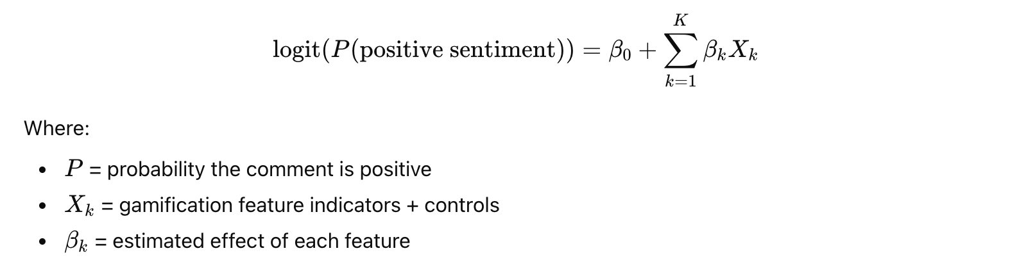
Overall Plan
Features: Streaks motivate daily engagement by rewarding consistency.
Hearts were the old system that limited mistakes—similar to ‘lives’ in a game.
Energy is the newer replacement for hearts, and it also regulates how much users can practice at once.
XP, or experience points, give users a measurable sense of progress.
Leaderboards create competition by ranking learners each week.
Quests provide daily or weekly challenges that guide people’s learning.
Rewards include gems, chests, and bonuses that reinforce progress.
Chess mode, one of Duolingo’s newest features, adds a playful, puzzle-like experience that isn’t strictly tied to language learning.

Slide 4
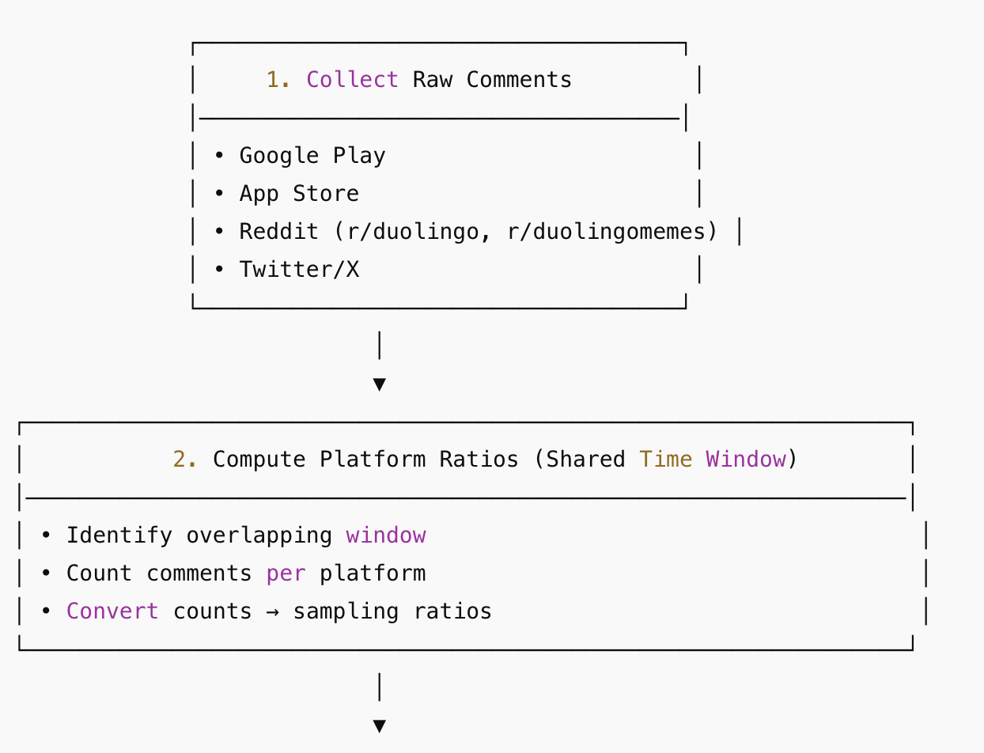
Data Collection
Google play: 0.58
App store: 0.12
Reddit: 0.26
Twitter: 0.04

Slide 5
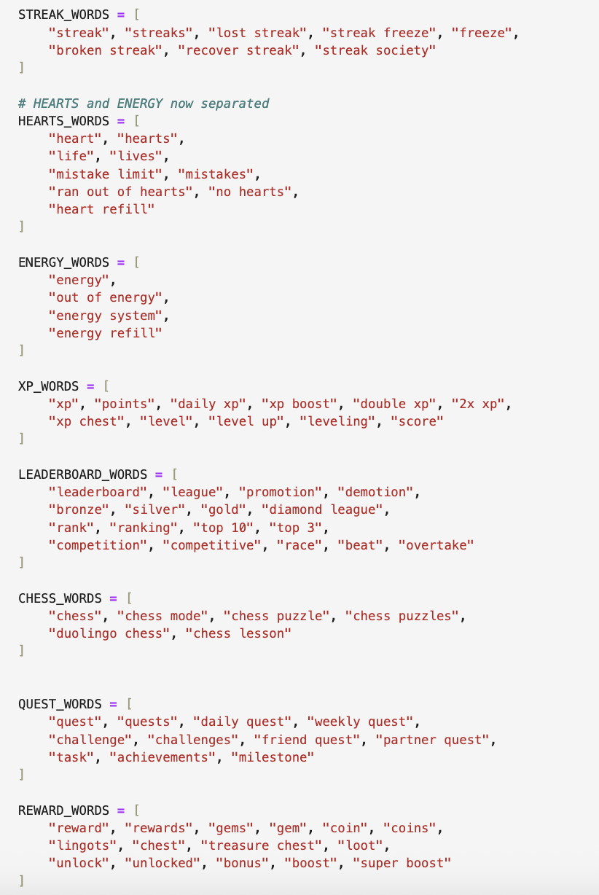
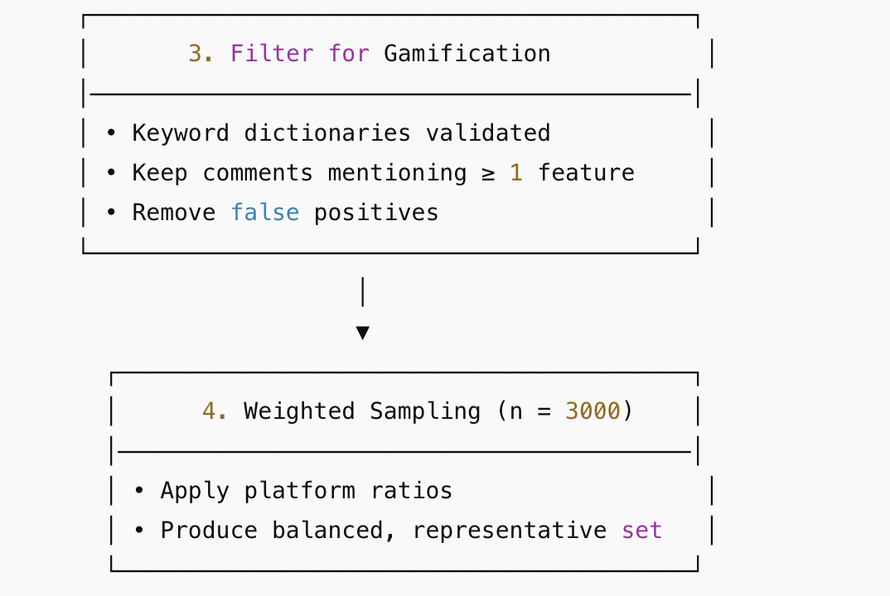
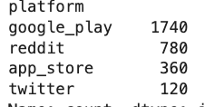
Data Collection

Slide 6

Data Processing
One-hot encoding for feature variables:
E.g You can't learn any language if you haven't purchased premium this app ask again and again in the form of energy. this is very bad thing of this application. otherwise this is best
Double check
E.g quest in request
Control Variables:
Feat_energy_vs_heart : “Bring back the hearts” “Energy is worse than heart”
Platform control
Time control monthly
Comment length control

Slide 7
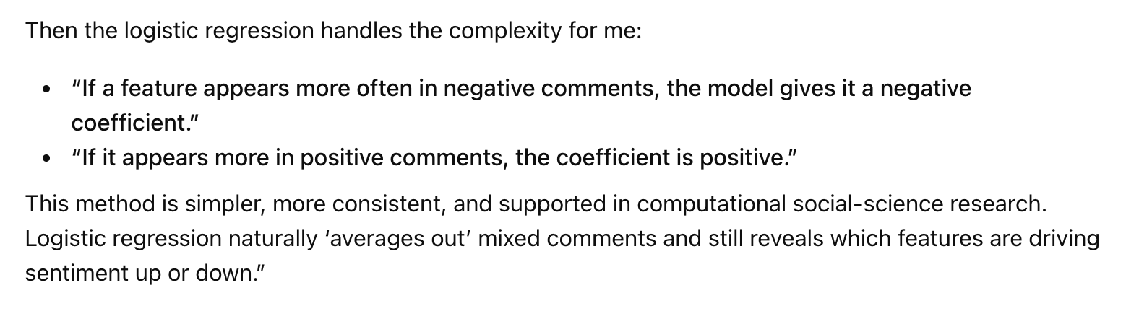
Labeling
- Manual labeling + human logic like AI
- logic for labeling: according to overall sentiment

Slide 8
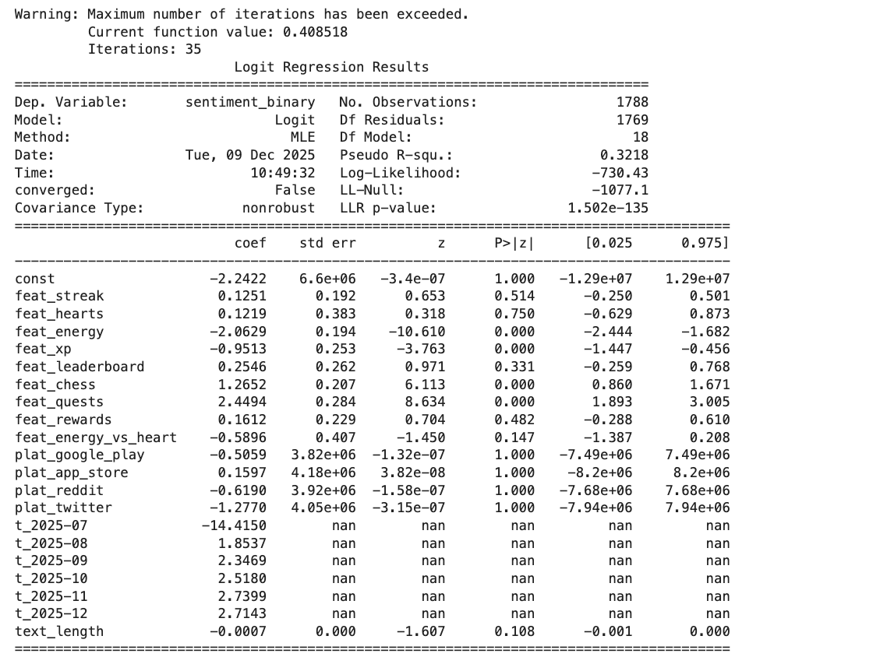
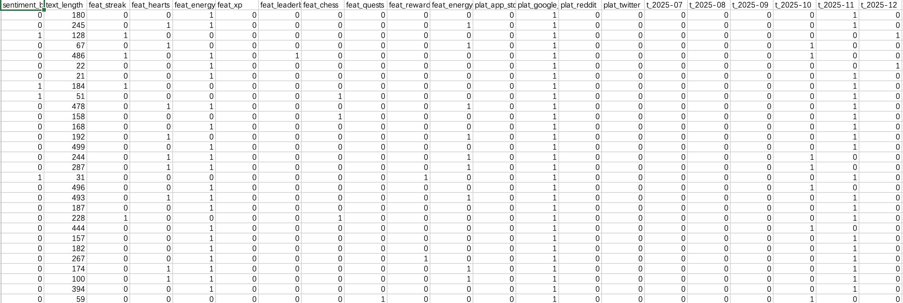
Analysis

Slide 9
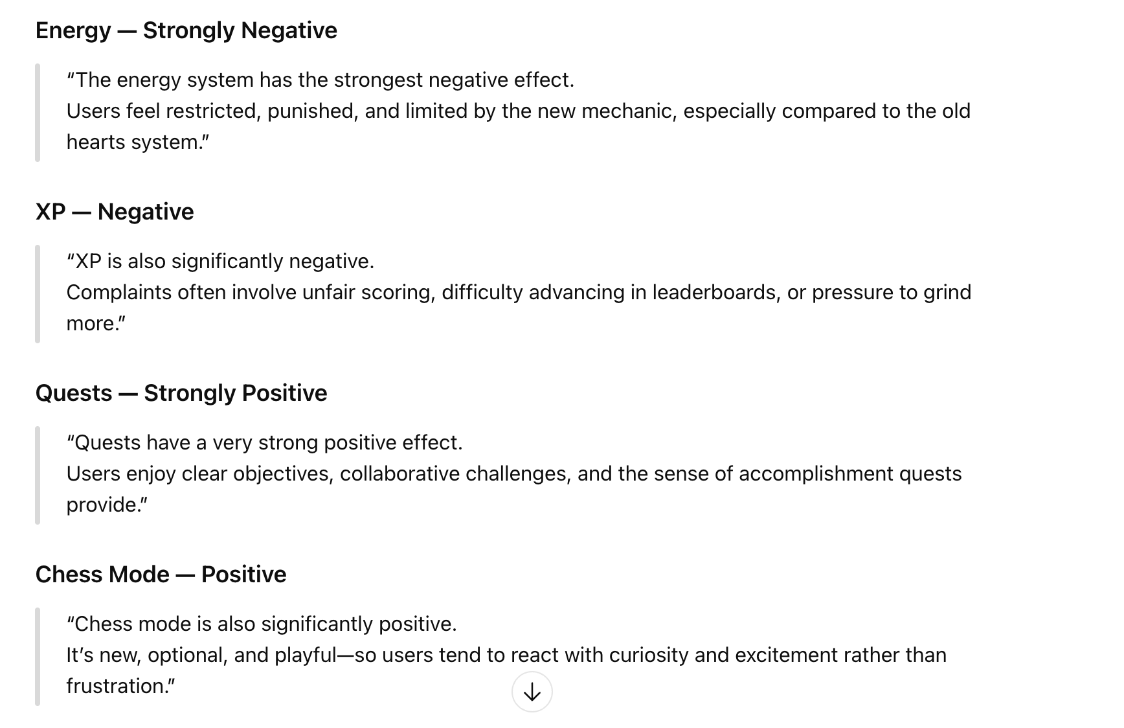
Analysis

