Slide 1


CS-SIMS: BSCS Student Information Management System.
Presented By:
Carl Xavier Valdez, Carlo John Aspiras,
Jedidiah Andrei Dela Cruz, Kathleen May Calderon,
Ara Gutierrez, Ian Cedric Ramirez
Version 2……

Slide 2
Methodology
Prototype Methodology
Client are included for customer evaluation and review.
Aside from actual Tester, Client also will act as Tester.
It ensure greater level of client satisfaction and comfort.
Using this methodology reduce the risk of failure and potential risk at an early stage and moderation can be taken quickly

Slide 3
PROJECT HIGHLIGHTS
Manage Profiles
Subjects Enrolled for the Student and Professor Involved
Manage Student’s Research Repository
(Title and Abstract only)
Manage Student’s Subjects*
Manage Student’s Activities
Award
Webinars/Conferences
Competition/Contest

Slide 4
OBJECTIVES OF THE PROJECT
The project aims to design and develop Web Based Bachelor of Science in Computer Science Student Archieve System specifically the proponent aims to:
Test the following System’s Functionality
Profile of Students of Bachelor of Science in Computer Science Course.
Report using a tabular and graphical presentation of data.
Manage Students Profiles and Activities
Manage Student Subjects
Manage Students Researches

Slide 5
Testing
Test the compatibility of the system using the following Web Browsers:
Google Chrome
Firefox
Microsoft Edge
Safari
Opera
Continuation……

Slide 6
Testing
Test the compatibility of the system using the Operating System:
Smartphone/tablet
Android 8 (Oreo)
Android 11 (Red Velvet Cake/R)
Android 10 – Tablet
Android 6
Computer/ Laptop
Windows 7,10,11
Linux
MacOS
Continuation……

Slide 7
Testing
Evaluate the system using Software Product Quality (ISO 25010) as
perceived by users’ acceptability with respect to:
Functionality
Usability
Reliability

Slide 8
SCOPE AND LIMITATION OF THE PROJECT
The system will have two types of user, the first user is the administrator which is the Program Chair followed by the class president. The system is capable to Manage Students’ Records such as the following, the first is the student manage profile in which the system is capable to collect the basic information of the student’s including the name, address, contacts and scholarship grant. It also includes the subjects enrolled for every students and professors involved. Next the system is capable to Manage Student Activities wherein the system is capable to track the different contested activities, who are the following students are willing to join and update the award that given to the students. It also include the update of the different webinars that related to the course.
Continuation……

Slide 9
SCOPE AND LIMITATION OF THE PROJECT
And under the Manage Student Research Repository, the system is capable to store and retrieve student researches base by the titles and the abstracts. Another set of users of the system is the (Representative) account where in the user is capable to manage student information of their section. Wherein the class president/vice-president can update student’s information, update student’s activities.
Continuation……

Slide 10
SCOPE AND LIMITATION OF THE PROJECT
The System will be designed using Adobe XD as the interface prototyping of the user to the system. The System will be developed using HTML,PHP,JavaScript and CSS. The database of the system is MySQL server as the repository of data. It is a web-based system that will used two layer of architecture application layer and data layer. The System is a web-based system. It means that is accessible using a Web browser and is therefore accessible from anywhere in the world via the Web using any device.

Slide 11
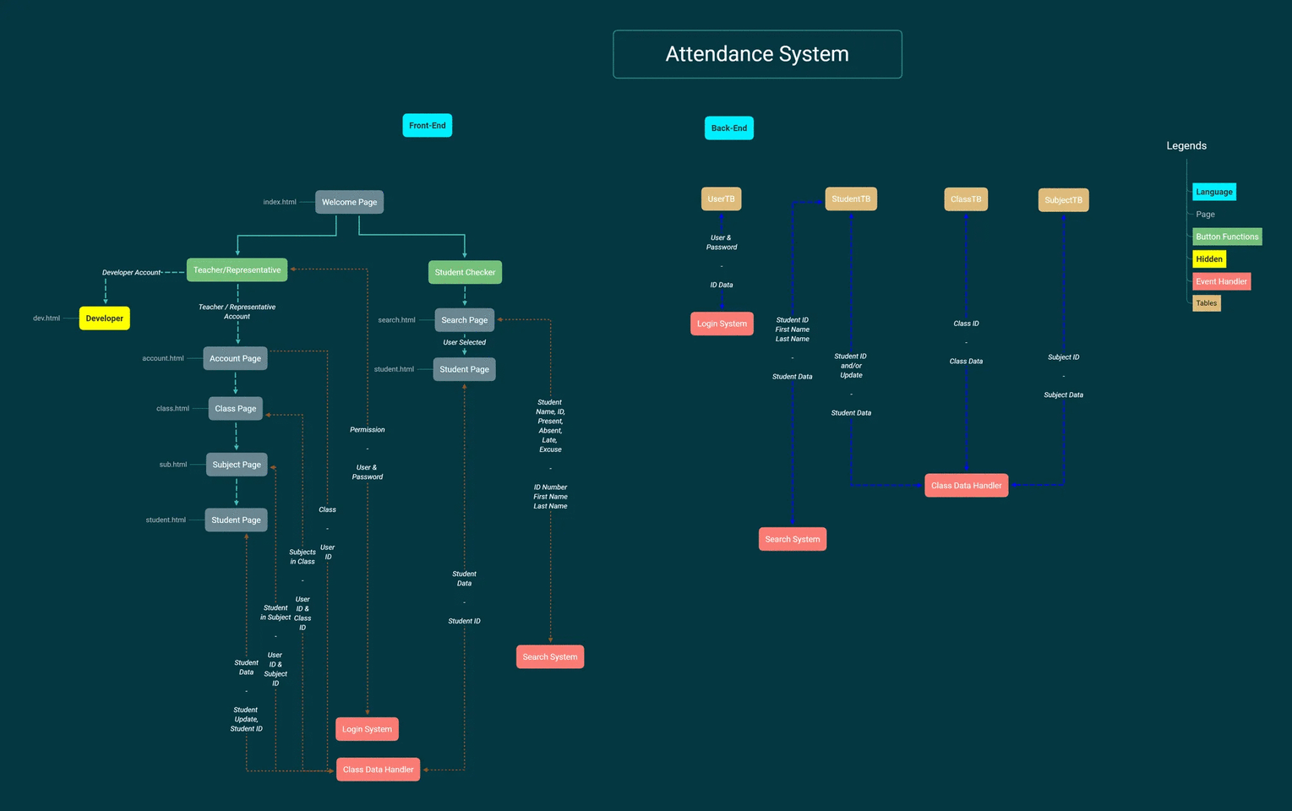

Slide 12
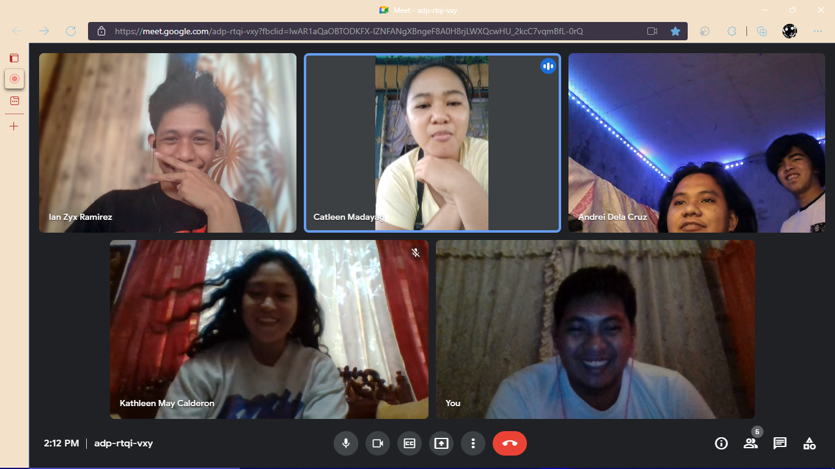
Meeting with the client (Virtual – Gmeet)

Slide 13
Recommendations by the Client
Title: Revision, to be aligned for the project.
Project Features: Revision, As archive system most of the core feature are altered.
From: Profiling and Updating Feature to Archive System of data student earn during his/her time to the Dept.

