Slide 1
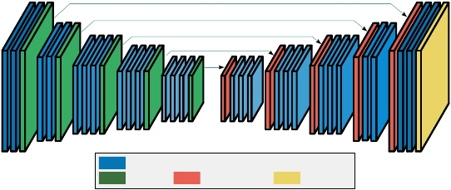


Input
Convolutional Encoder-Decoder
Skip connections
Conv + Batch Normalisation + ReLU
Pooling Upsampling Sigmoid
Output
Noisy &clean
Denoised

