Slide 1

House price prediction
House price prediction machine learning model

Slide 2
Goals
Analyze data of more than 1300 houses in Ames, Iowa
Clean the data and use feature engineering to make sense of the features
Find what features affect the sale prices of the houses
Create a linear regression model to predict the price of a house
Implement a web user interface where users can test the model
Notes:
Analyze the data
Clean the data
Use feature engineering
Identify which features affect the sale price
Create linear regression machine learning model
Create a WebUI

Slide 3
The data…
This is a complex dataset with more than 79 features (columns) per house, and 1300 observations (rows) were used to train the model
The dataset required a lot of feature engineering to encode the features in a meaningful way.
Notes:
This dataset have more than 1300 entries or rows
and 79 features or columns.

Slide 4
Findings…
The following features tend to influence a higher sale price
Paved street
Houses in low density residential zone
Irregular shape
House with relative lower age
More above ground living space

Slide 5
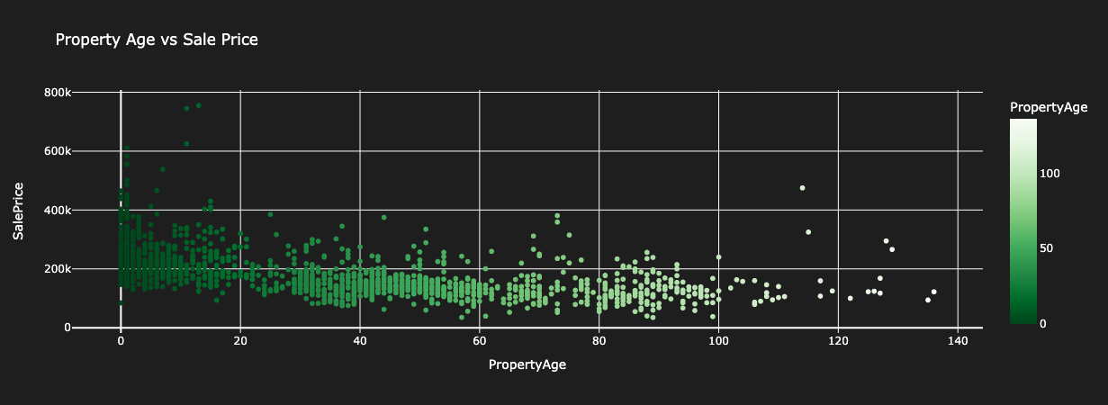
Notes:
The property age is based on the time the house was sold, and the build or renovation year of house.

Slide 6
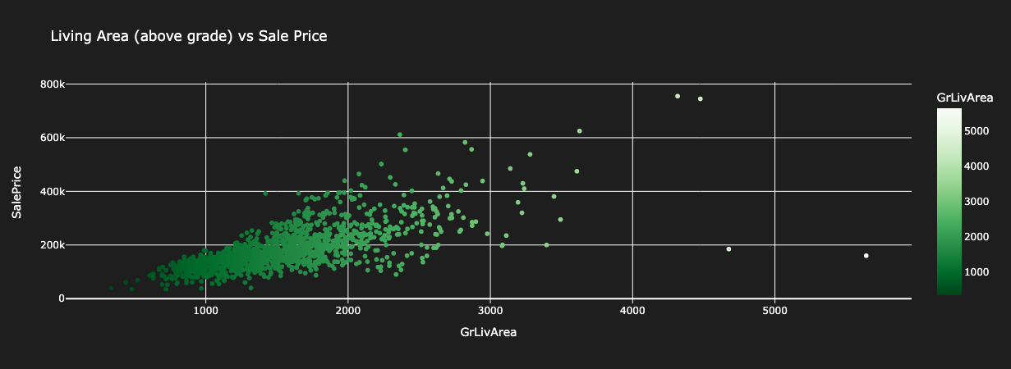
Notes:
This is the graph of the property age vs the sale price

Slide 7
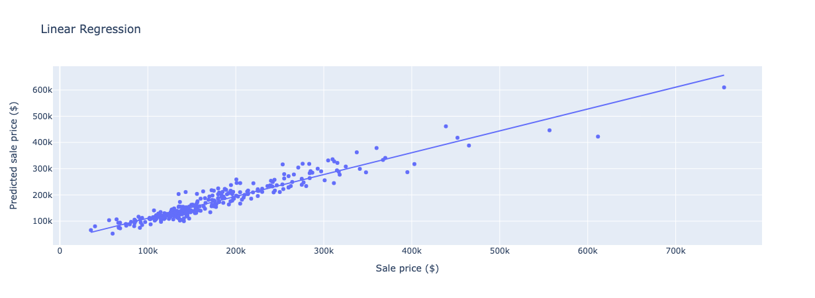
Training model result
Notes:
RMSE: 0.1432961890417828 -- How far off can out model be.
R2: 0.8899661825858642 – how much variance our model captured.
log was used to normalize the data
Principal Component Analysis (PCA) to reduce the collinearity

Slide 8
Contact Info
Name: Angel De La Cruz
Email: Angel.f.Delacruz.2@spaceforce.mil
Github: tao15
Project WebUI: https://house-prediction.taos15.net/ ( will be shutdown shortly after presentantion)

Slide 9
Contact Info
Name: Angel De La Cruz
Email: Angel.f.Delacruz.2@spaceforce.mil
Github: tao15
Project WebUI: https://house-prediction.taos15.net/ ( will be shutdown shortly after presentantion)

