Slide 1

Working with photos and validating requests
Lecturer
Rokas Slaboševičius
Data

Slide 2
Today you will learn
Working with photos and validating requests
How do I upload a photo?
01
How do I download a photo from db?
02
How do I adjust the properties of an uploaded photo?
03

Slide 3

We create an object that we will use to accept the photo upload
Working with photos and validating requests
First we need to make sure that the uploaded object is of the image file type and that it matches our desired size

Slide 4
Request validation
Working with photos and validating requests
Two attributes can be created to validate the file size and type.
The first attribute will be responsible for the size and the second for the type

Slide 5
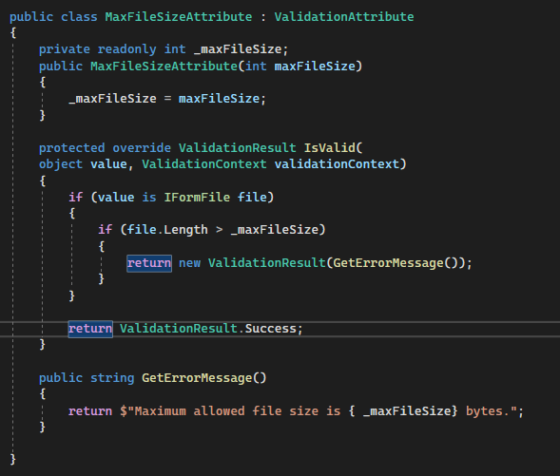
MaxFileSizeAttribute
Working with photos and validating requests

Slide 6
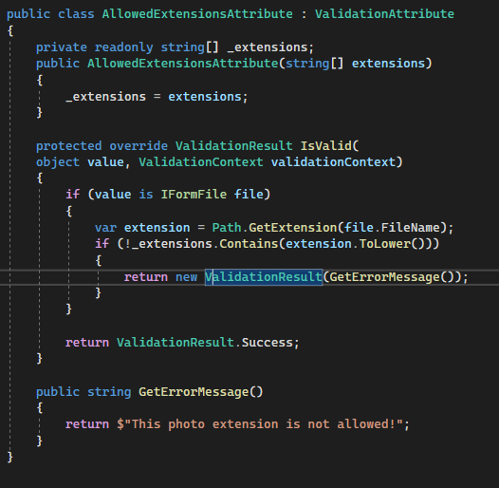
AllowedExtensionsAttribute
Working with photos and validating requests

Slide 7
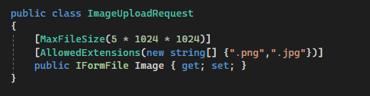
After applying the attributes, the class now looks like this
Working with photos and validating requests
The file size is adjustable by yourself, and there are also more extension types to choose from.

Slide 8
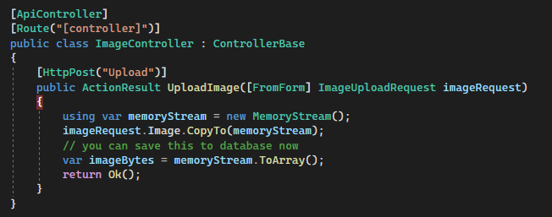
Upload endpoint
Working with photos and validating requests
Endpoint would look like this, it would be worth considering moving the conversion to bits to a service that would call the Save repository method after the conversion

Slide 9
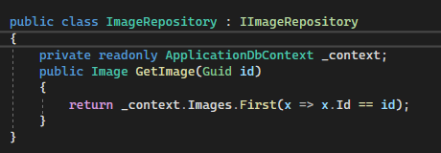
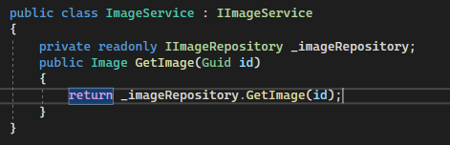
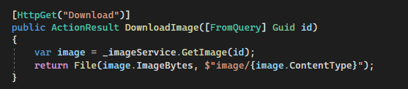
Download endpoint
Working with photos and validating requests
The download endpoint should pick up the bits from the database and return them as File
We start by creating a repository that retrieves data from the database
So we return the result in the controller

Slide 10

Working with photos and validating requests
Task 1
Create an image upload/download API with validations.
A new functionality will be the creation of a thumbnail-type photo from the original.
The thumbnail will need to be stored in another table.
The point of a thumbnail is to be smaller than the original.
You will have to look for this functionality yourself ;)
It must be possible to get both a large photo and a thumbnail individually

