Slide 1

Vijeo Designer: project setting.
July’20 STL TH

Slide 2
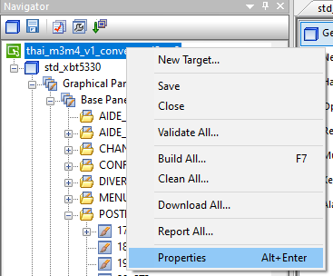
Click Right on Project Navigator and click Properties

Slide 3
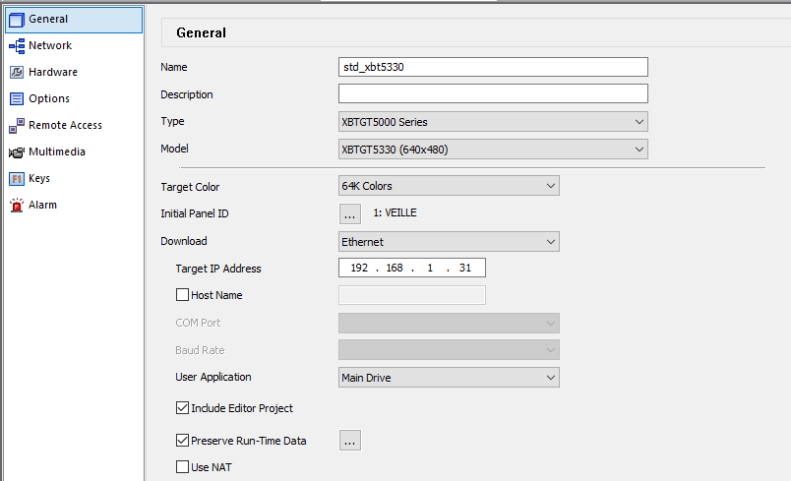
General:
Check box Include Editor Project
Start screen number after HMI power on
Ip Address ‘s HMI
HMI location to keep application
Can upload project from HMI

Slide 4
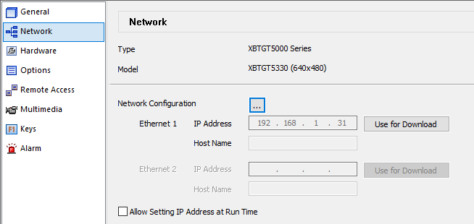
Network :
Configuration Enter Ip address of HMI

Slide 5
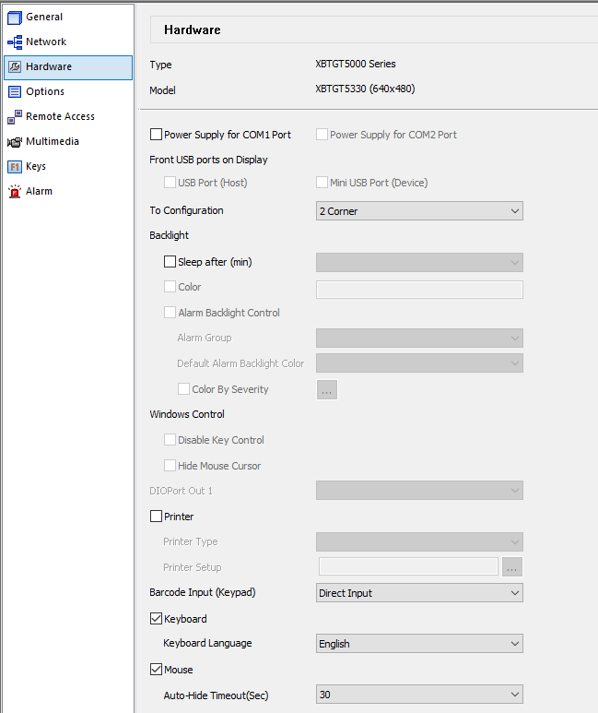
Hardware:
Keyboard Language: English

Slide 6
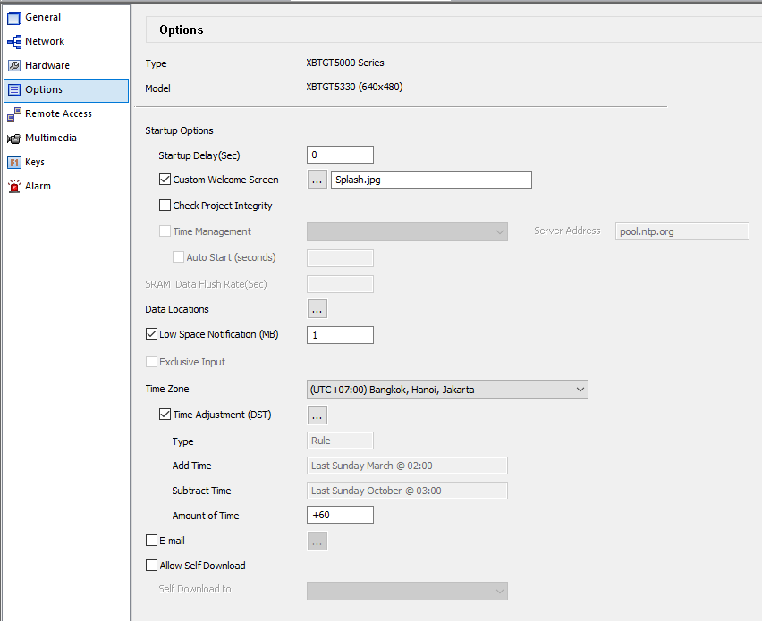
ST:
Check box Allow jump and label

Slide 7

THANK YOU.

