Slide 1

Unity Pro: project setting.
July’20 STL TH

Slide 2
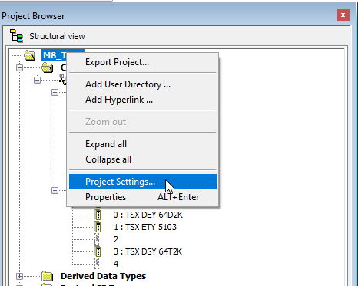
Click Right on Project browser and click project setting…

Slide 3
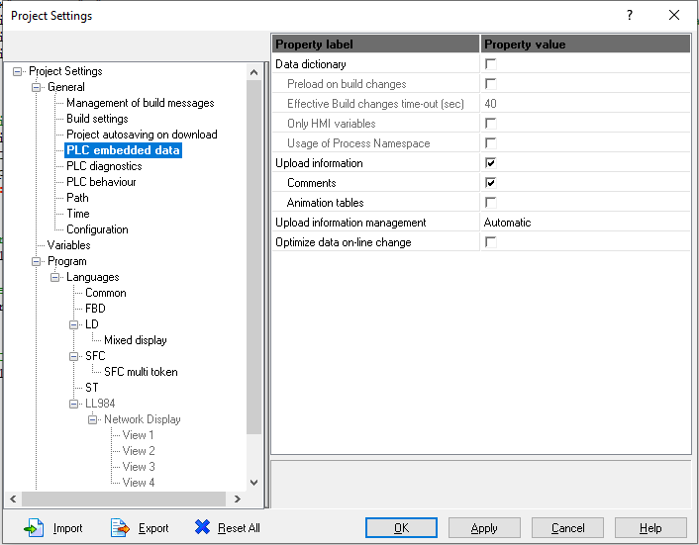
PLC embedded data:
Check box Upload information
Upload information
for enable to upload program from PLC to PC

Slide 4
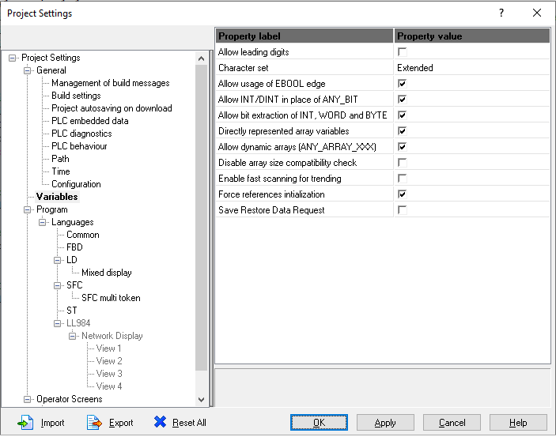
Variables:
check box Directly represented arrays variables and Allow dynamic arrays[ANY_ARRAY_XXX]

Slide 5
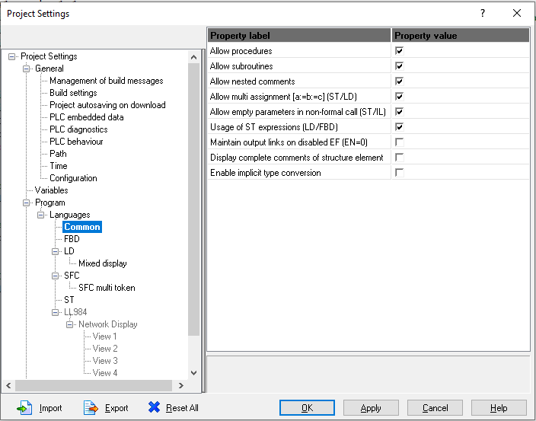
Common: check box Allow nested comments and Allow multi assignment.

Slide 6
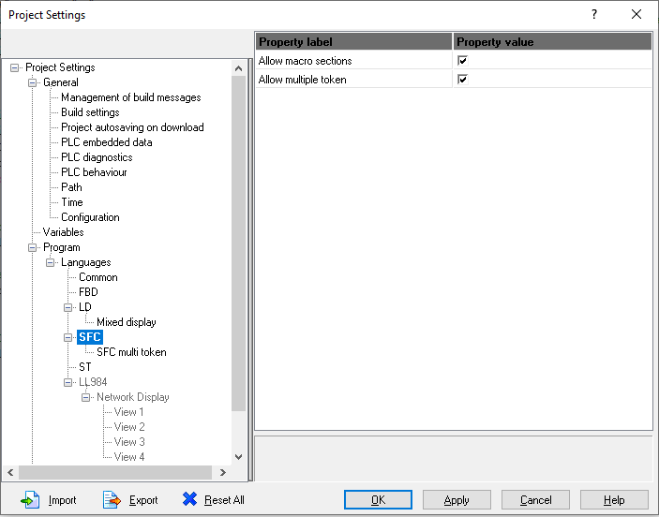
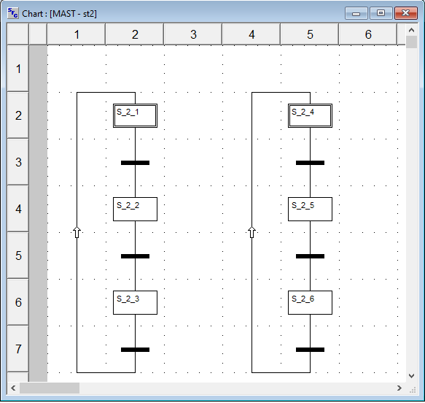
SFC : check box Allow multiple token
Can create initial step more than one in Sections

Slide 7
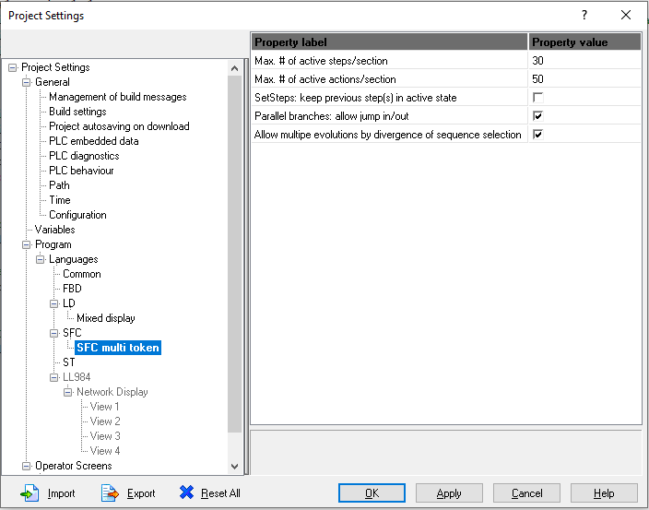
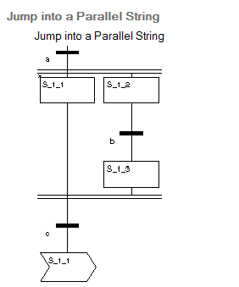
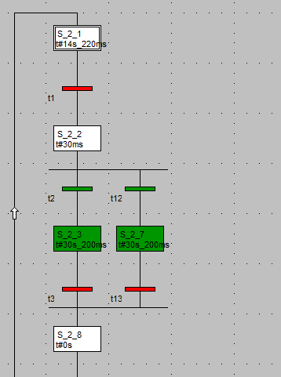
SFC multi token:
uncheck SetSteps: keep previous step(s) in active state
all currently active steps are deactivated when you set new steps (Animation Panel or function block).

Slide 8
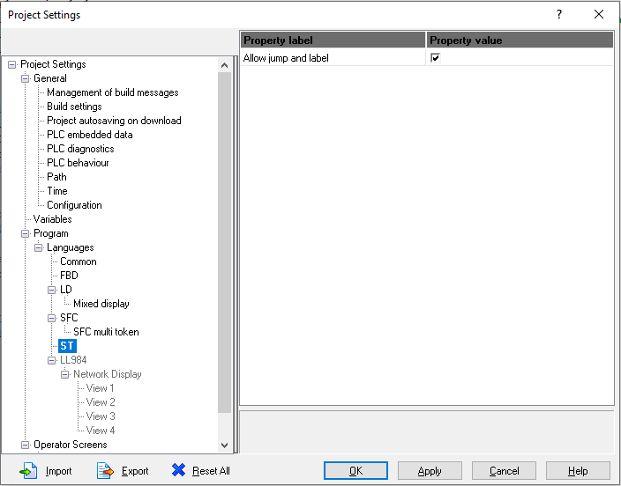

ST:
Check box Allow jump and label

Slide 9
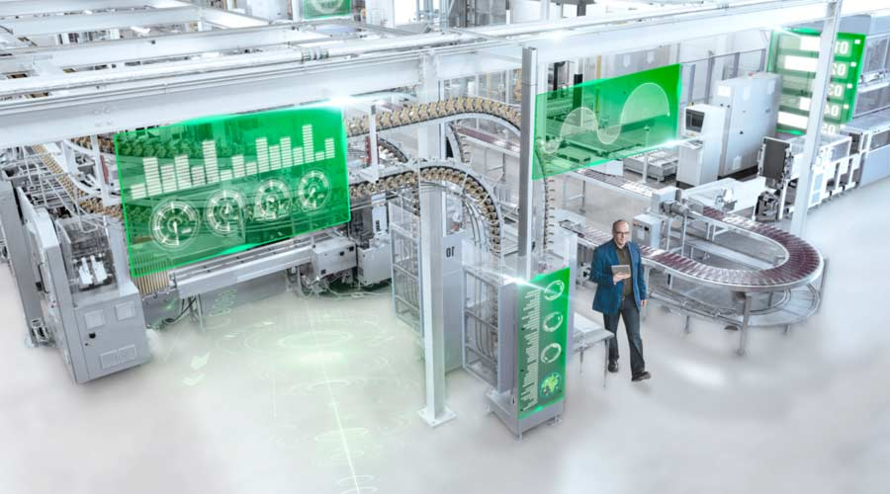
THANK YOU.

