Slide 1

Function Box.
May’20 STL TH

Slide 2
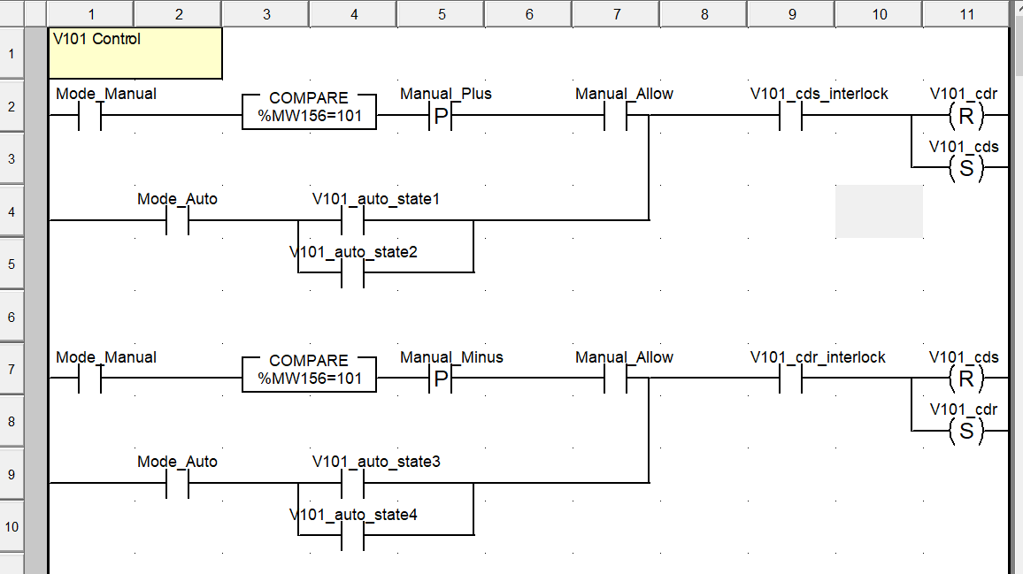
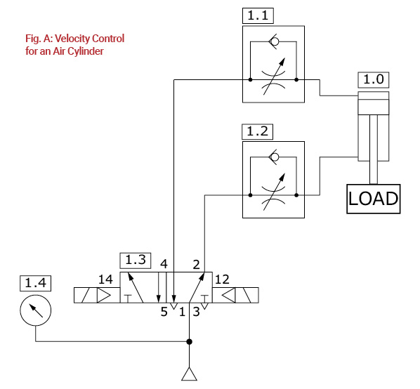
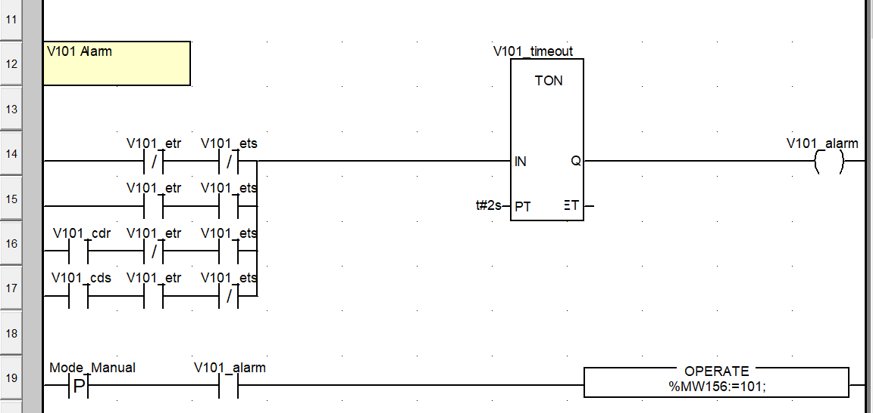
Station no
Device control
V101
V101_etr
V101_ets
Input
%Ix.x.x
V101_cds
V101_cdr
Output
%Qx.x.x

Slide 3
Manual Control +
V101
Interlock
V101_etr
V101_ets
Interlock
Manual Control -
V101_cds
V101_cdr
Output Control

Slide 4
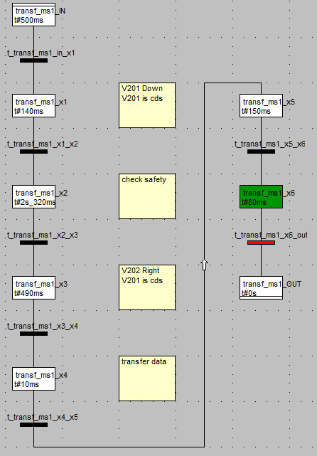
Auto
Control +
Auto Control -
V101_cdr
V101_cds

Slide 5
V101
V101_etr
V101_ets
V101_cds
V101_cdr
Alarm timeout
Alarm output
Alarm Condision

Slide 6
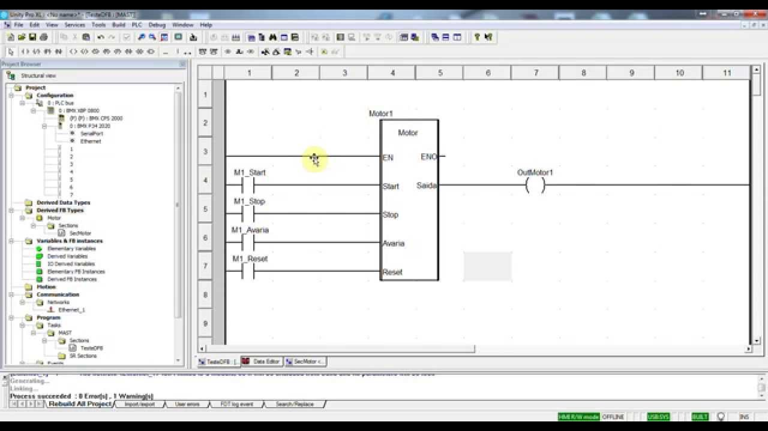
Start to Create Function Box

Slide 7
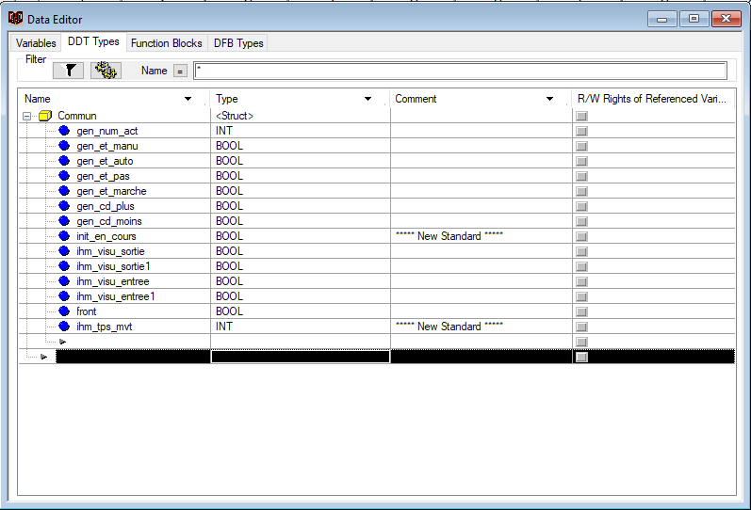
Create DDT

Slide 8
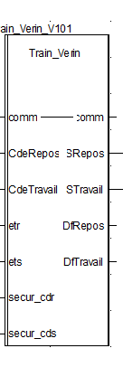
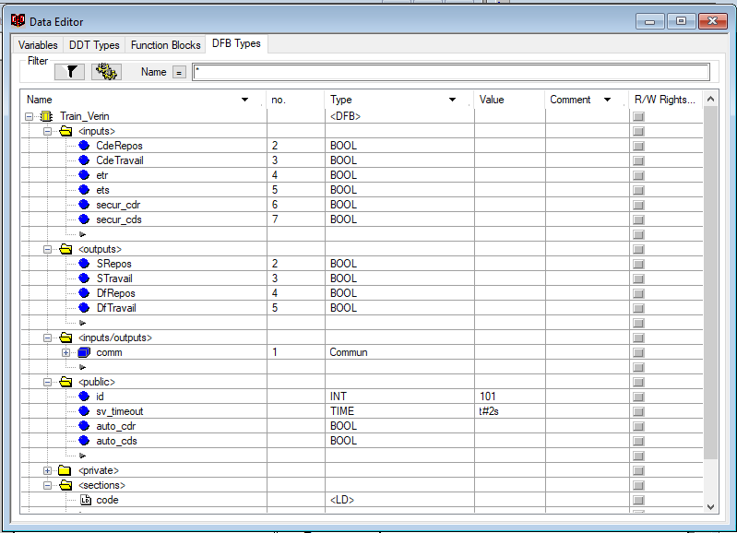
Create DFB
1
1
2
2
3
3
4
4
5
5
6
7

Slide 9
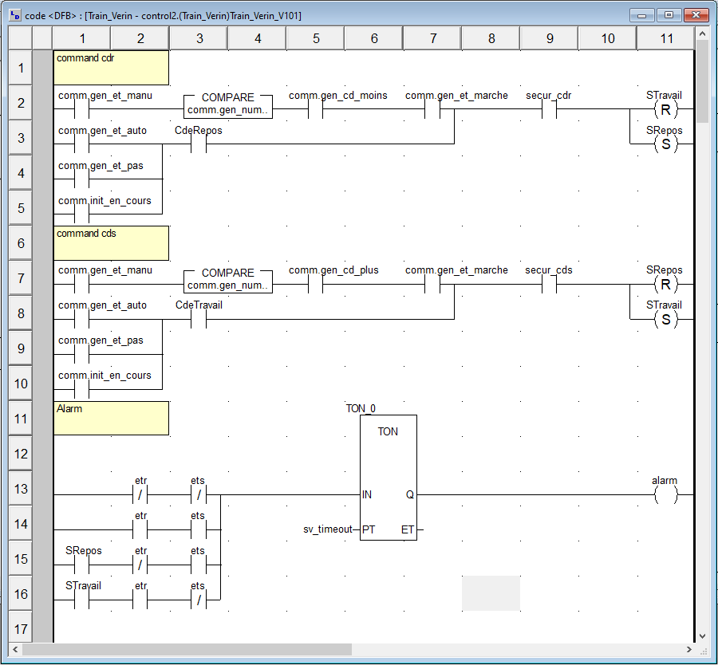
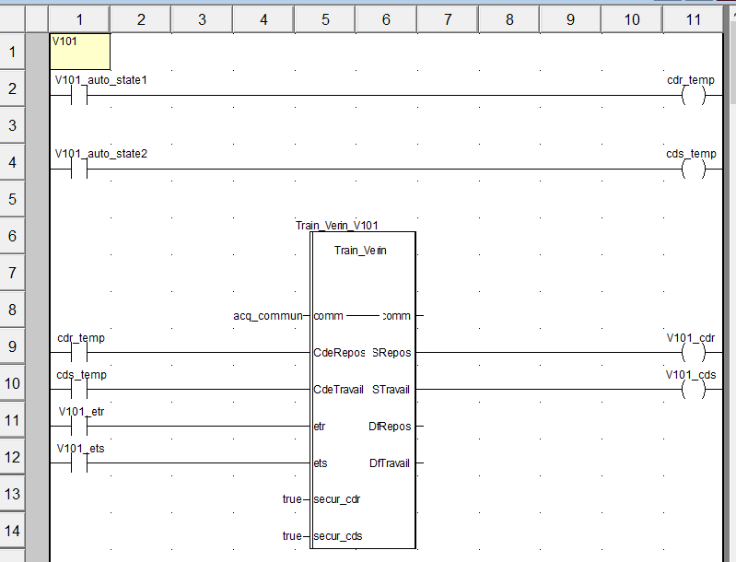
Write Code

Slide 10
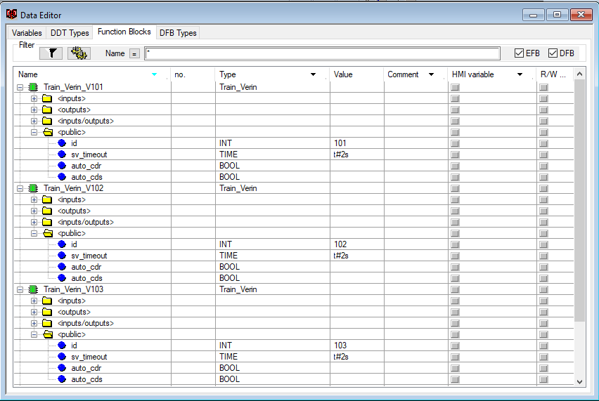
Change id
Change id

Slide 11
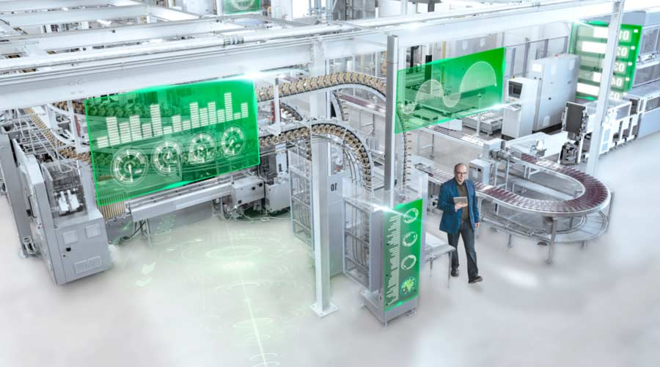
THANK YOU.

