Slide 1
Basic SFC in STL
2016/11/24

Slide 2
Historique
GRAphe Fonctionnel de Commande d’Étape-Transition
1977 L’AFCET propose les bases d'un outil qu'elle appelle GRAFCET.
1982 NF C03-190: Norme française
1987 IEC 848: Norme européenne (reprend une partie de la norme NF)
2002 IEC 60848 – langage de spécification GRAFCET pour diagrammes fonctionnels en séquence.
2006 maintenance …

Slide 3
SEQUENTIAL FUNCTION CHARTS(SFC)
Sequential function chart, or SFC, is a graphical “language” that provides a diagrammatic representation of control sequences in a program.
Basically, sequential function chart is a flowchart-like framework that can organize the subprograms or subroutines (programmed in LD, FBD, IL, and/or ST) that form the control program.

Slide 4
The SFC programming framework contains three main elements that organize the control program
Steps
A step is a stage in the control process.
Transitions
After the PLC executes a step/action, it must receive a transition before it will proceed to the next step.
Actions
Each step may or may not have an action associated with it. An action is a set of control instructions prompting the PLC to execute a certain control function during that step.

Slide 5
Introduction
E/S
Steps
r0
Transitions
r0
A
r1
B
Actions
B
r2
r1
connection
A
r2
receptivities

Slide 6







Graphic symbols used in SFCs in unity pro
Initial Step
Macrostep
Step
Beginning Macrostep
Ending Macrostep
Transition
Jump to a Step

Slide 7
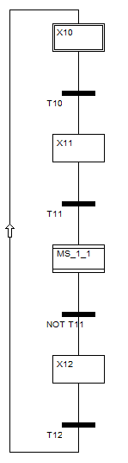

Initial Step
Transition
Step
Macrostep

Slide 8
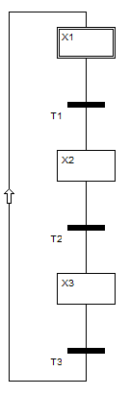
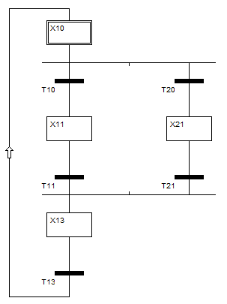
DIVERGENCES AND CONVERGENCES
A divergence is when an SFC element has many links going out of it, while a convergence is when an element has many links coming into it.
One link between each step
Multiple links between each steps

Slide 9
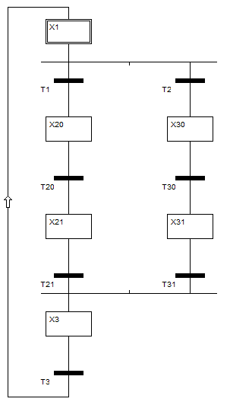
OR Divergences and Convergences
OR Divergence (one step to several transitions)
OR Convergence (several transitions to one step)

Slide 10
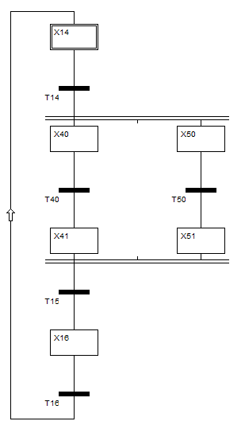
AND Divergences and Convergences
AND Divergence (one transition to several steps)
AND Convergence (several steps to one transition)

Slide 11
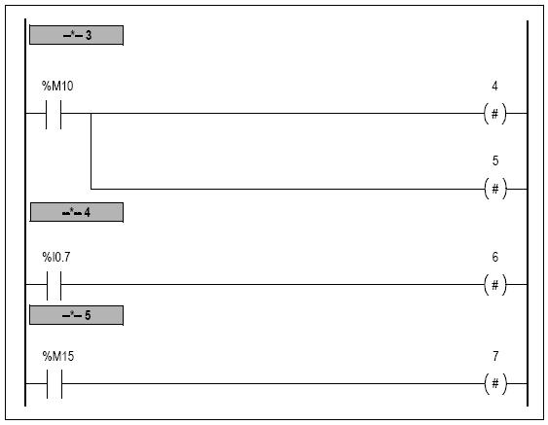
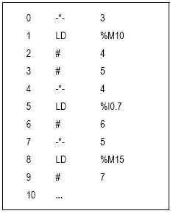
Grafcet (control sequence) Twidosoft Languages

