Slide 1
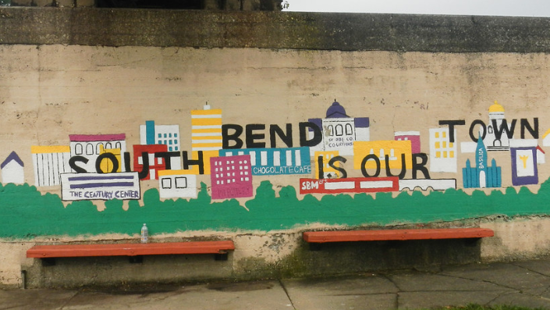
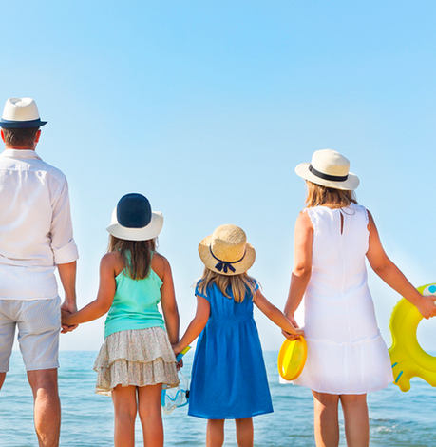
Cheapest Place to Retire in US

Slide 2
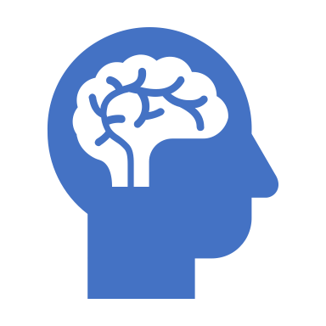

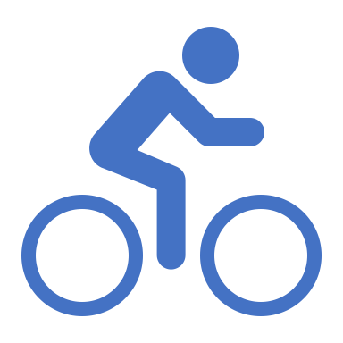

Recommendations
Mental & Physical Wellness Programs
Increase Awareness of Social Programs
Add Bicycle Lanes and Green Spaces
Notes:
First, reduce crimes by providing community engagement and mental wellness activities, such as workshop on mental health, how to remain healthy, yoga sessions, poker socials, bikeathon etc.
Second, generate village development awareness to the residents through flyer and community surveys.
And, lastly, Introduce more bike lanes and neighborhood parks and nature trails.

Slide 3


What are happiness drivers?
How to improve happiness?
How you can help?

Slide 4
Family/social aspects have the highest impact on overall happiness scores

Slide 5
Happiness Index Measurement via Amount of Green Space
Happiness Index
Green Space (%)
(Hashemi, Behrouz, Yang, Wohn, Cha, 2020)
Notes:
Citations:
Fesharaki, S. F., Behrouz, A., Yang, J., Wohn, D. Y., & Cha, M. (2020). Green Space and Happiness of Developed Countries. 2020 IEEE International Conference on Big Data and Smart Computing (BigComp). doi:10.1109/bigcomp48618.2020.00-67

Slide 6
John’s Happier Town
Mental & Physical Wellness Programs
Yoga Sessions
Social Activities (Poker)
Increase Awareness of Social Programs
If 70% of South Bend residents participated in one VBA recreation activity per month that would be an increase of
300%
Add Bicycle Lanes & Green Space
Bicycle lanes on streets with active sidewalks
Nature trails to promote outdoor activities
Notes:
First, reduce crimes by providing community engagement and mental wellness activities, such as workshop on mental health, how to remain healthy, yoga sessions, poker socials, bikeathon etc.
Second, generate village development awareness to the residents through flyer and community surveys.
And, lastly, Introduce more bike lanes and neighborhood parks and nature trails.

Slide 7


Proposed Budget
Recreation:
$3,000,000
Marketing & Event:
$1,000,000

Slide 8

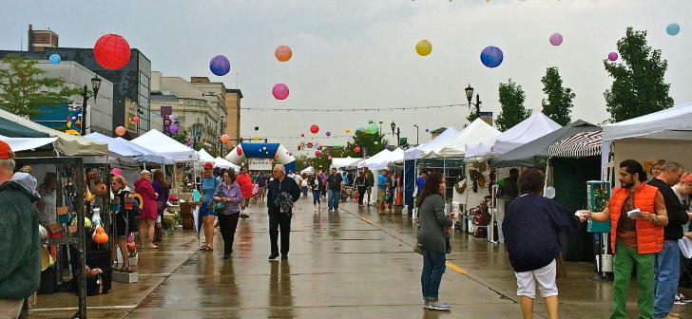
Mental Wellness and Community
Engagement Activities
Village Development Awareness Programs
More Bike Lanes and Nature Trails

