Slide 1
Introduction to Data Science:
Final Project - Report
Group 4 (West) : Ankur Sharma
Nat Rivera
Tao Tang

Slide 2
Agenda
Data Description
Exploratory Data Analysis
Classification Methods:
Decision Tree
Random Forest
K Nearest Neighbors
Summary

Slide 3
Data Description
569 observations from Fine Needle Aspiration (FNA) of breast tissue masses.
10 characteristics measurements: radius, texture, perimeter, area, smoothness, compactness, concavity, concave points, symmetry, fractal dimension.
Each characteristics: mean, standard error, maximum.

Slide 4
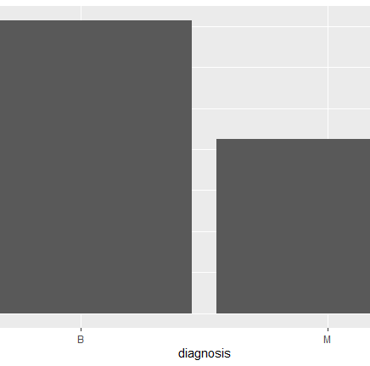
Exploratory Data Analysis - I
Proportion of benign vs malignant cases
357 benign (B)
212 malignant (M)
Notes:
The graph shows that there are more benign cases than malignant cases in the data set. Now, lets analyze the relationship of various variables that determine whether it is benign or malignant.

Slide 5
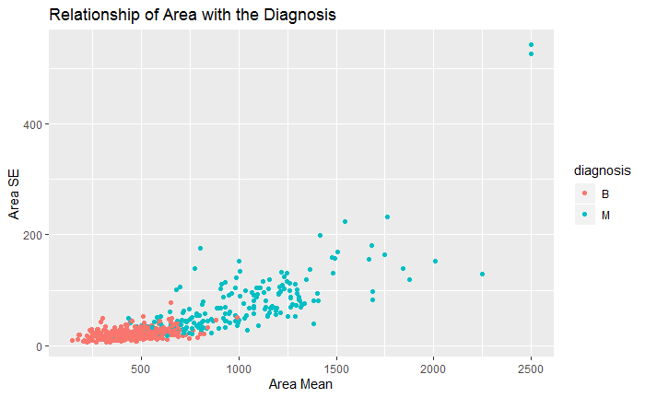
Exploratory Data Analysis - II
Analyze how benign and malignant cases are determined
The graph shows the relationship of the variable Area with its diagnosis.
Notes:
The graph clearly indicates that more the reading of the area mean is , more malignant the cases are. There are some outliers however, where lower area mean are considered malignant, may be its driven by some other parameters.

Slide 6
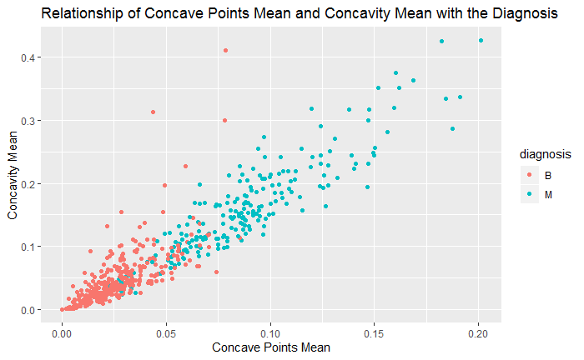
Exploratory Data Analysis - III
Analyze how benign and malignant cases are determined
The graph shows the relationship of Concave Points and Concavity Mean with its diagnosis.
Notes:
The graph indicates that more of the reading on x and y axis , more malignant the cases are. However, there are some overlaps where though the lower reading on x axis has resulted in the Malignant cases which clearly indicates that for getting the accurate prediction, we need to look at multiple variables and not just one or two variables.

Slide 7
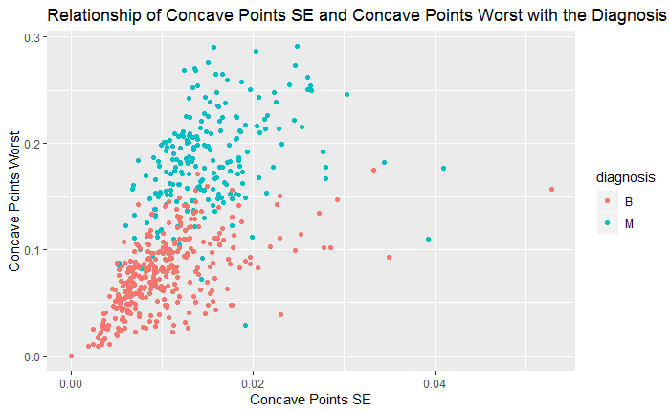
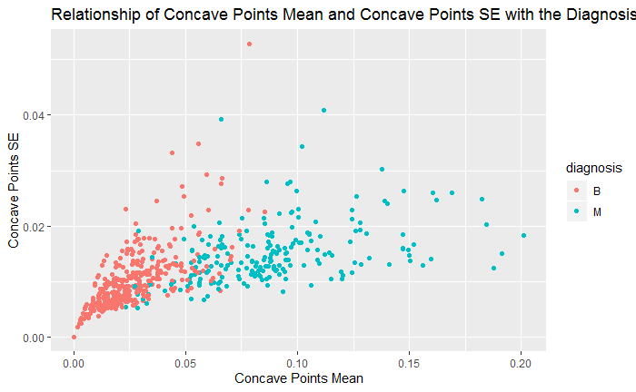
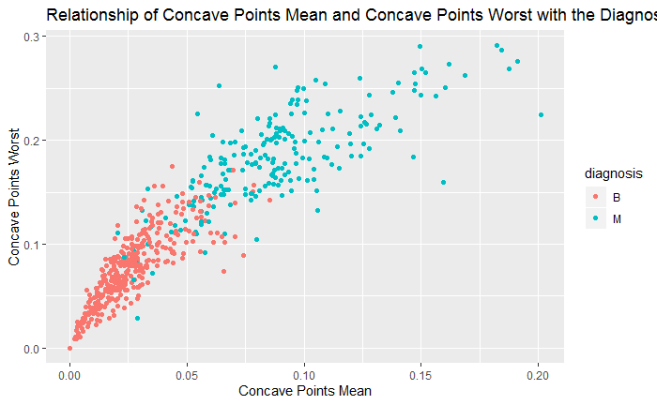
Exploratory Data Analysis - IV
The correlation of mean , standard error and maximum
Notes:
If you see here, there is a positive correlation between Worst, SE and Mean variables.

Slide 8
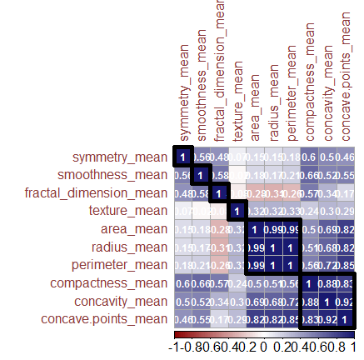
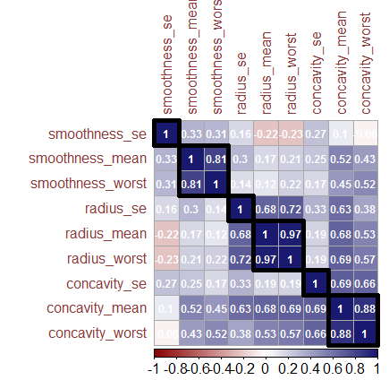
Exploratory Data Analysis - IV
The correlation plot shows the correlation of various variables and how they are correlated to each other.
Notes:
If you see here, there are certain variables that are collinear, like area, radius, perimeter. You can also see that most of the variables are positively correlated with each other. For analysis, it will be better to fit all 30 variables into the model and let model decide which variables to pick for the model.

Slide 9
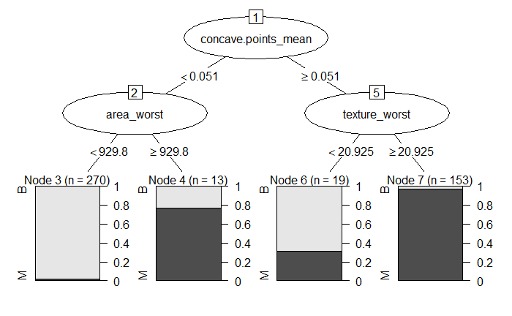
Decision Tree - I
The model fit using the decision tree has split the data on concave.points_mean and has further split it on area_worst and texture_worst. Let's look at the confusion matrix and misclassification using this method.

Slide 10
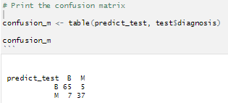

Decision Tree - II
Decision Tree has misclassified 5 of the Malignant Cases as benign.
The misclassification rate is 10%.

Slide 11
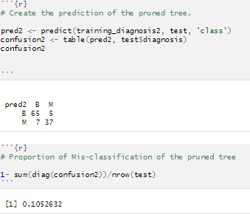
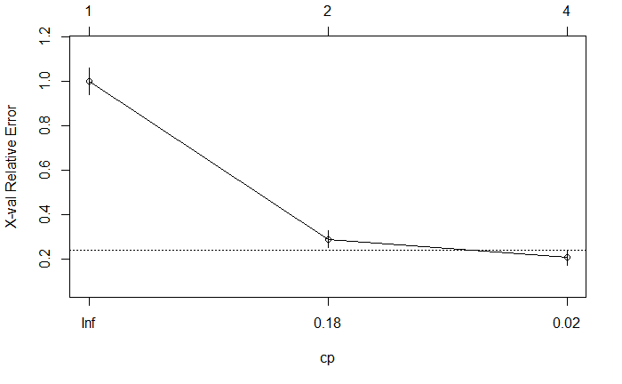
Decision Tree - III
After pruning the tree, the misclassification rate has not improved and is still the same.

Slide 12
Random Forest
Decision trees: Have high variance; Tend to change based on sample
Random Forest – produce less variability
Combine many decision trees into a single model.
Each decision tree in the forest considers a random subset of features, and only has access to a random set of training data points.
The prediction will be closer to the average.

Slide 13
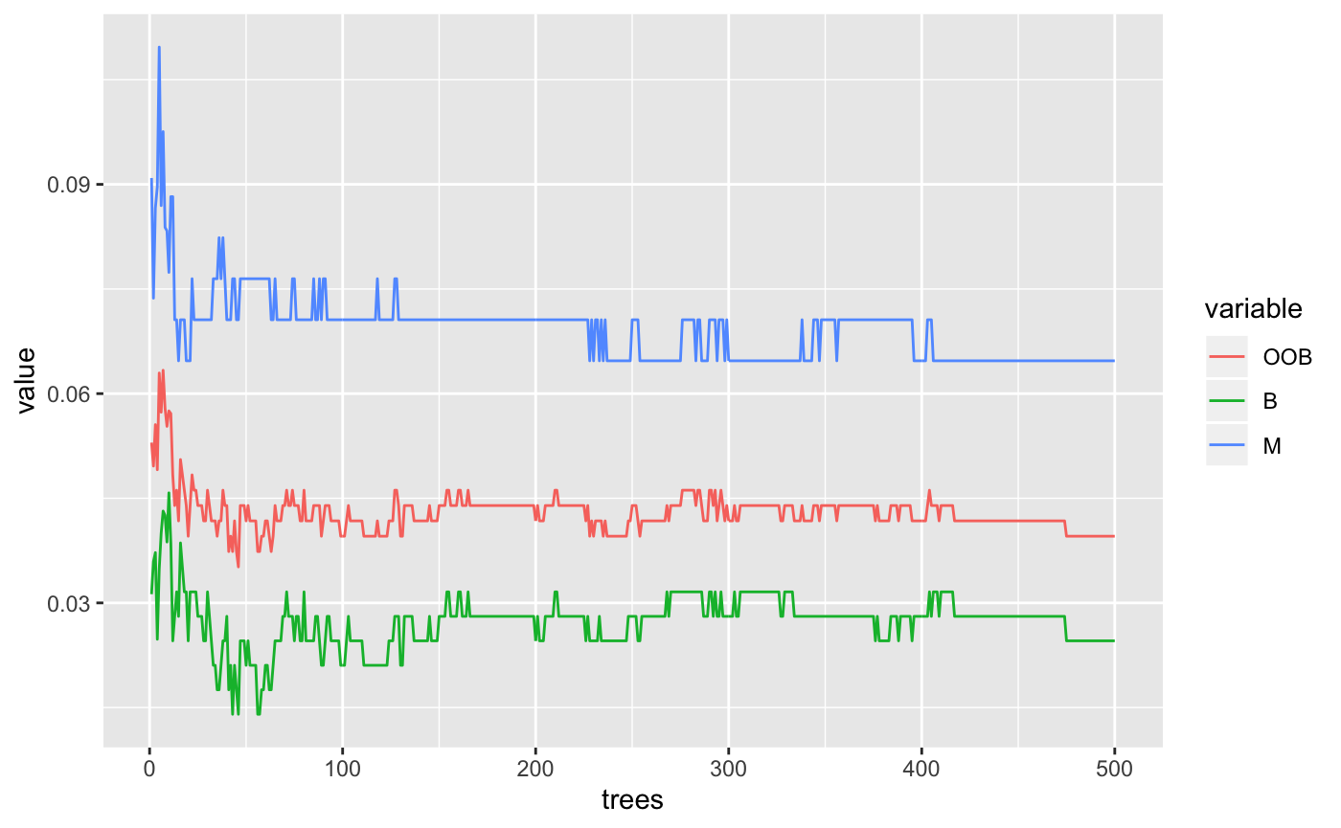
How many trees?
Out of Bag Error
About 1/3 of observations will be left out of any randomly selected sample.
Predict those individuals that are not in the bootstrap sample to produce an estimated of the prediction error.
Notes:
Out of bag(OOB):
About 1/3 of observations will be left out of any randomly selected sample.
OOB error: we can predict those individuals that are not in the bootstrap sample to produce an estimated of the prediction error

Slide 14
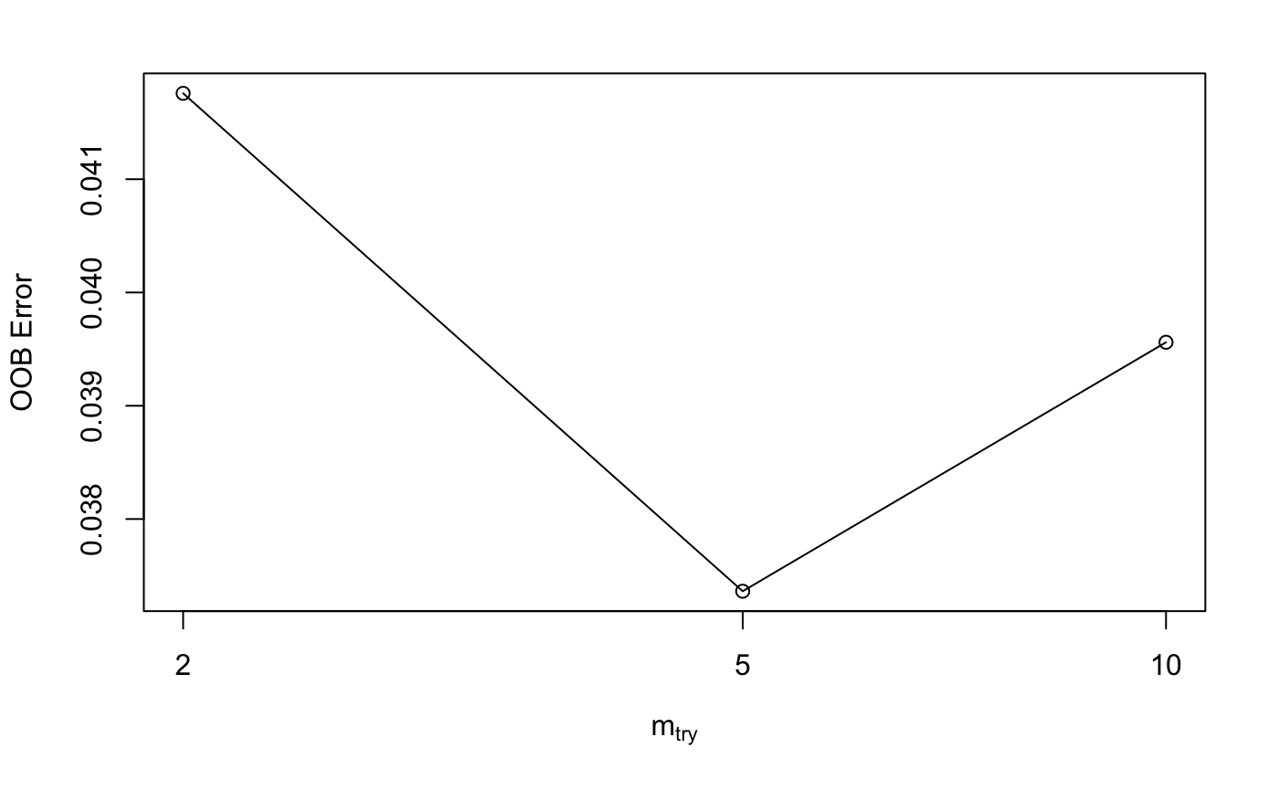
How many predictors will be in each tree?
With least OOB error
Try to use somewhere around the square root of the total number of variables.
Notes:
Typically, we can also try to use somewhere around the square root of the total number of variables 31 here is around 5.

Slide 15
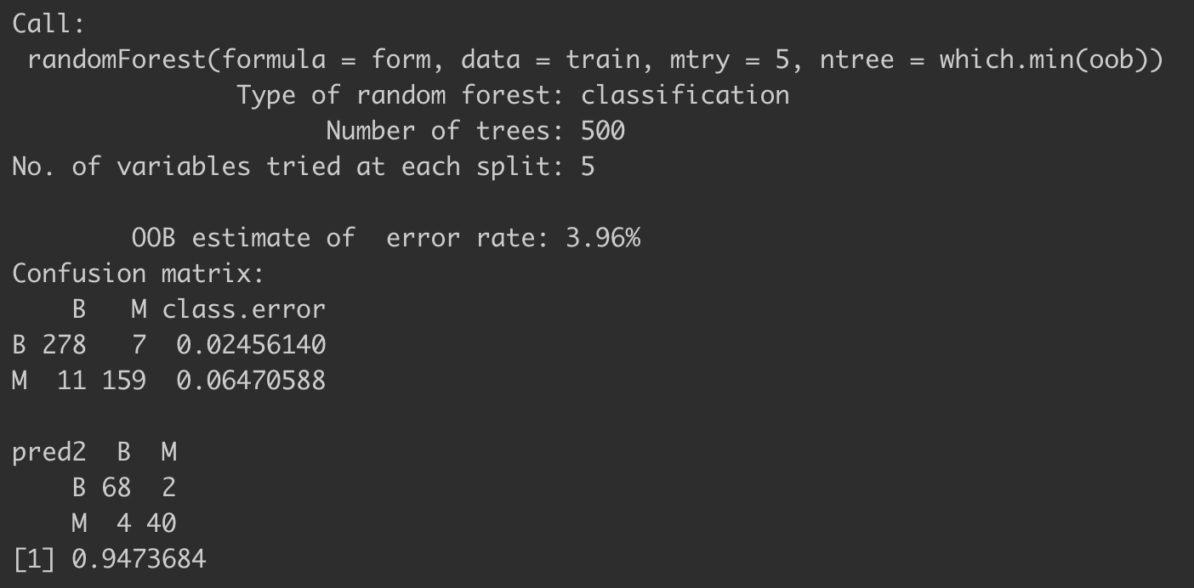
Random Forest Output
rf<- randomForest(form, data=train, mtry=5,ntree=500)
pred2 <- predict(rf, test, 'class')
confusion <- table(pred2, test$diagnosis)
sum(diag(confusion))/nrow(test)
Notes:
OOB Error:
3.96%: That means that the average error in the observations that were not selected in a particular bootstrapped tree was 3.96%.

Slide 16
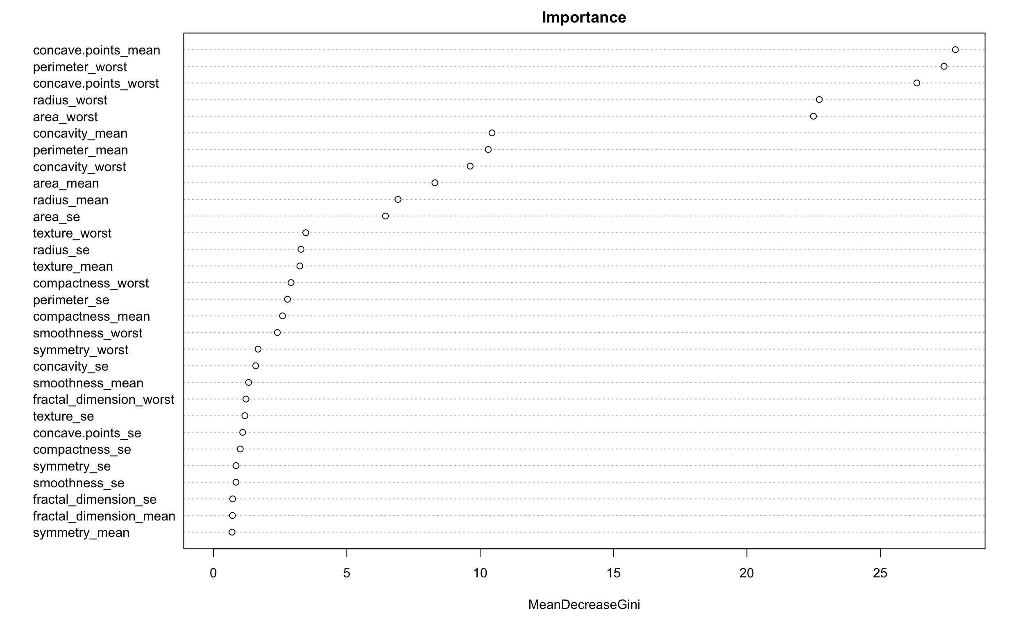
IMPORTANCE
Notes:
From this graphic we can see the most important variables. The size of these numbers will vary depending on how many bootstrap trees we are creating.

Slide 17

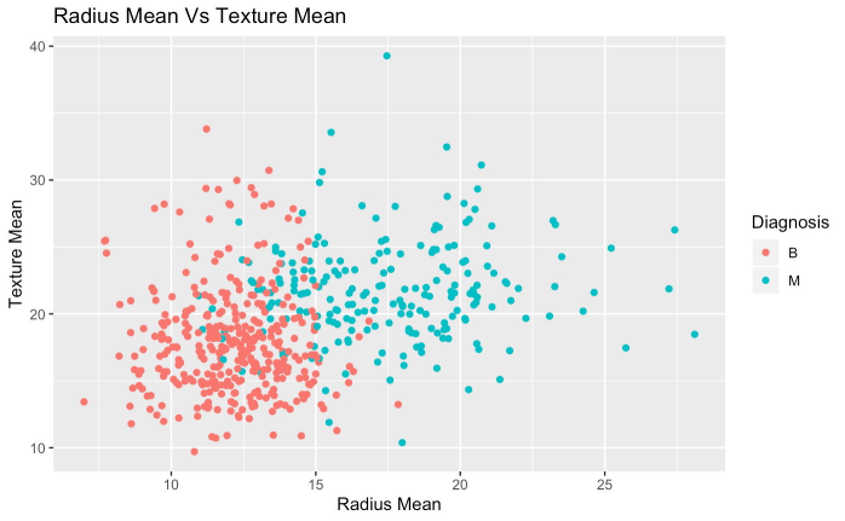
K Nearest Neighbors (KNN)
Use Euclidean Distance formula to identify k nearest neighbors KNN. Among those KNN, predicted response will be the most common response in the KNN.
Euclidean Distance Formula for 2 dimensions

Slide 18
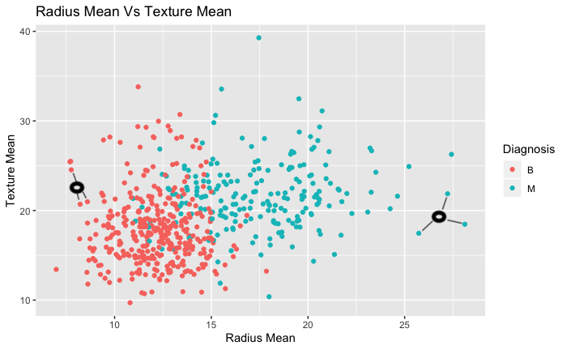
K Nearest Neighbors (KNN)
Select a value for K
Calculate distance to all points in training data
Select K nearest neighbors (KNN)
Prediction will be the common response in KNN.
At point (6,23) the three nearest neighbors are diagnosed as ‘B’
KNN will predict this data point as ‘B’

Slide 19
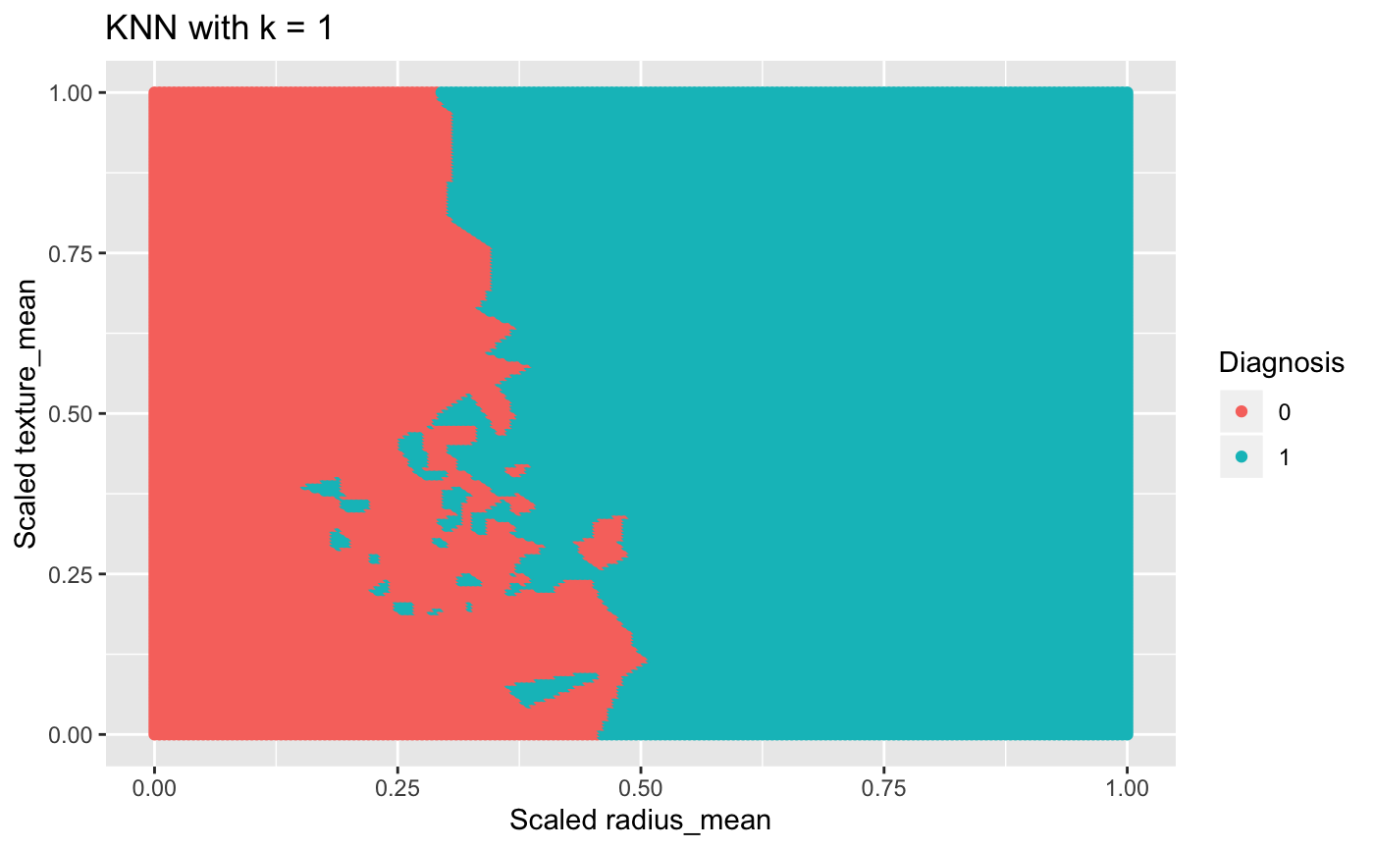

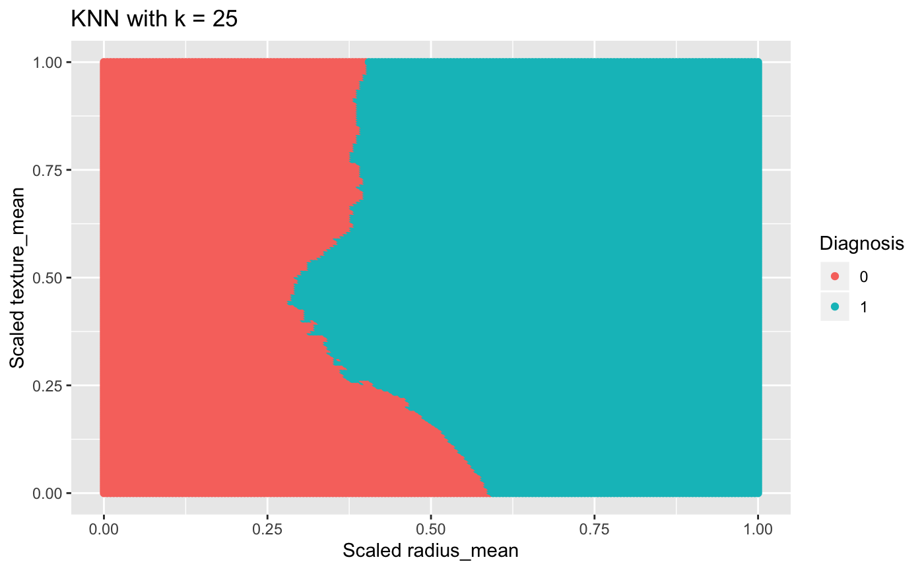
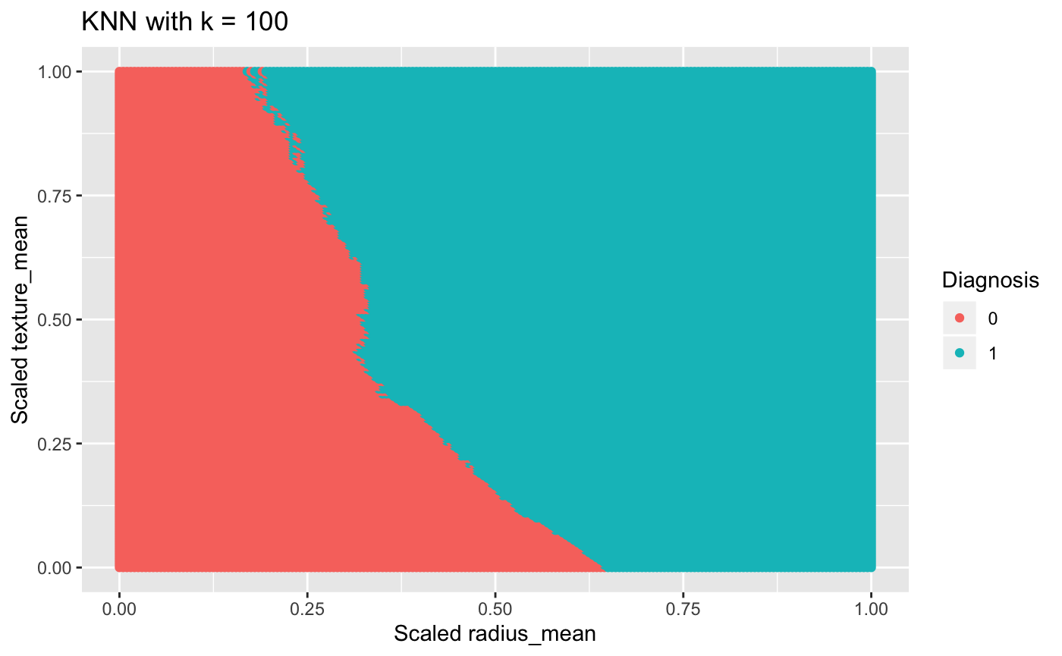

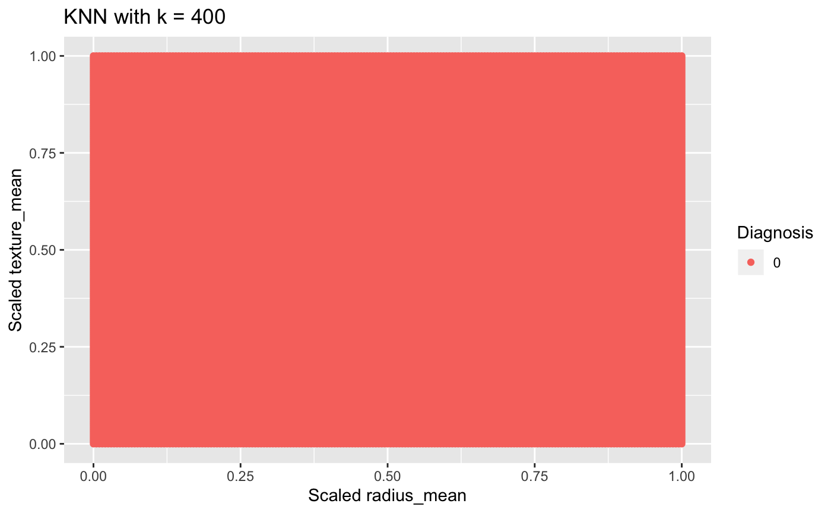
KNN Simulation Predictions on all points

Slide 20
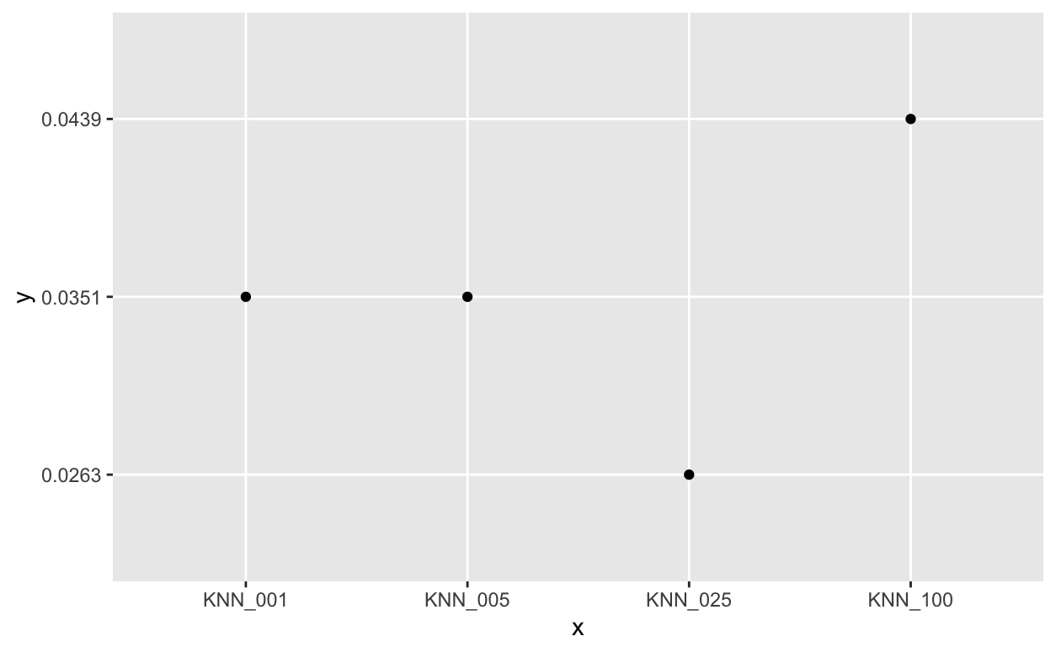
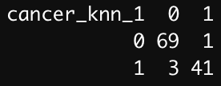
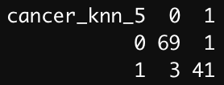
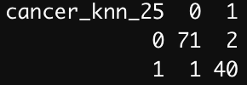
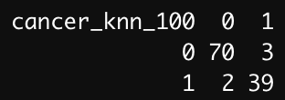
KNN Results Using all 30 variables as predictors
KNN with k = 25 yielded the best misclassification

Slide 21
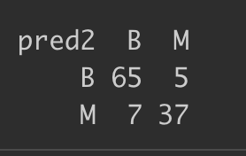
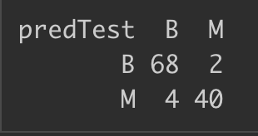
Summary
Decision Tree
misclassification = 0.1053
Random Forest
misclassification = .0527
KNN
misclassification = .0263
0 = Benign
1 = Malignant
Based solely on misclassification,
KNN had the best output.
Assuming misclassifying a malignant as benign is worse than misclassifying a benign tumor as malignant. KNN has the least number of misclassified benign.
Therefore, KNN is the model we recommend to use for this case.

Slide 22
Thank you!

