Slide 1
Demo : OpenSign Server & Java Client
Works with:
OpenSign Sever Version 0.4
and
OSSJClient Version 0.9

Slide 2
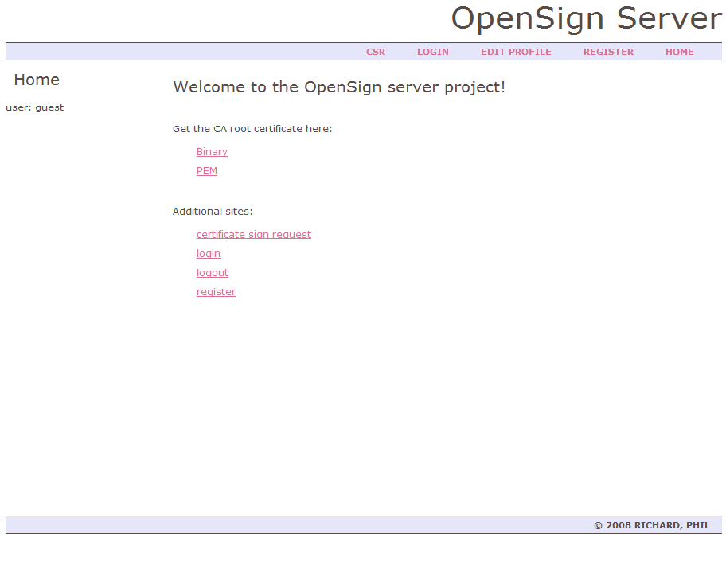
Starting OpenSign Server
Server will fire up at: http://localhost:8080
…/OpenSignServer-0.4>run.bat

Slide 3
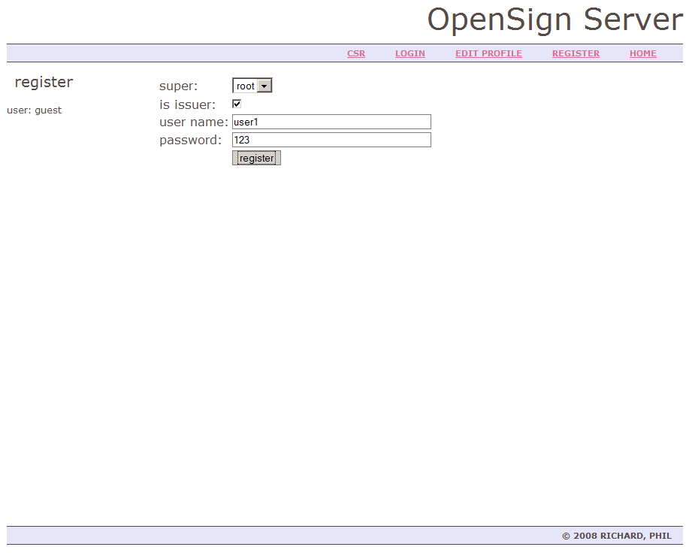
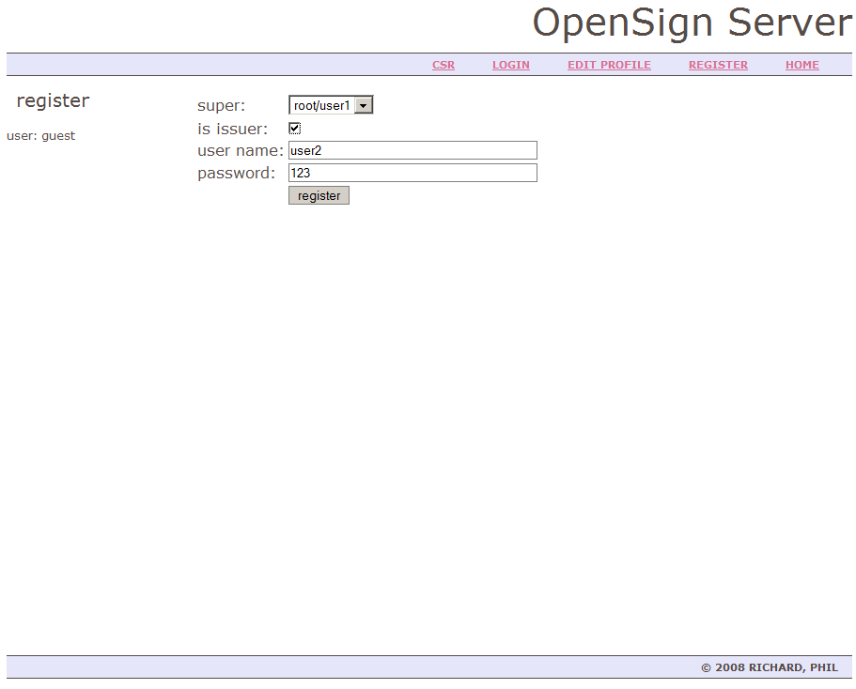
Registering Issuers
Click link “register” in the menu
Make sure the checkbox “is issuer” is checked
Hit enter (demo credentials are in place)
Repeat above steps with previous issuer as “super”

Slide 4
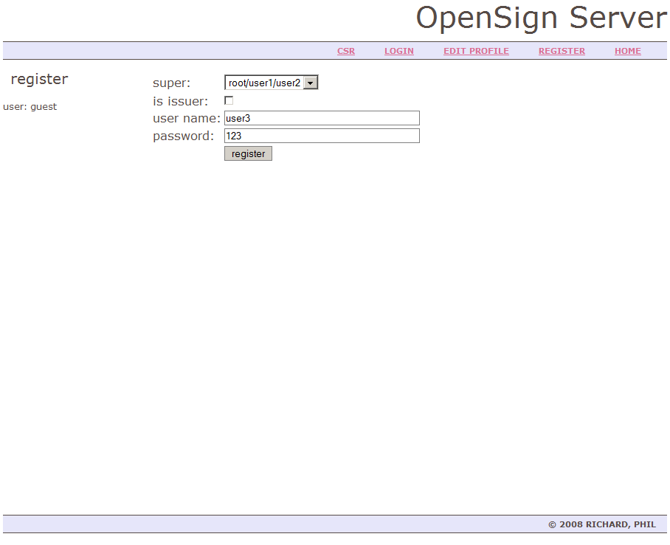
Registering a User
Simply submit the “register” page without checking the “is issuer” check box

Slide 5
OSSJClient
Switch into the jar directory in the client folder and enter:
This will print the usage of the client application
To get the usage text for a specific command enter:
Wheras [command] may be: getcert, verifycert or csr
…/OSSJClient-0.9/jar>java -jar OSSJClient-0.9.jar
…/OSSJClient-0.9/jar>java -jar OSSJClient-0.9.jar [command]
D:\projects\owasp\test\OSSJClient-0.9\jar>java -jar OSSJClient-0.9.jar csr
Opensign Java Client Tool started
Command csr takes following parameter:
Mandatory:
-i [issuer] e.g "root/user1/user2"
-c [csr file] path and name of csr file (must be binary PKCS#10 formatted)
-p [password]
-u [user name]
Optional:
-f [response format] "bin" or "pem" whereas "pem" is default
-o [out put method] "console" or "file"

Slide 6
Command: Get Certificate
This command will get a certificate from the server and store it with the corresponding certificate-name concatenated with the format identifier “.bin” or “.pem” and with the extension “.cer” in the file system
PEM formatted response:
Console output:
java -jar OSSJClient-0.9.jar getcert -r root/user1
java -jar OSSJClient-0.9.jar getcert -r root/user1 –f pem
java -jar OSSJClient-0.9.jar getcert -r root/user1 –f pem –o console

Slide 7
Command: Verify Certificate
This command will verify a certificate in the file system by looking up the whole certificate chain and proving each certificate valid
Each certificate verified is printed to the console
java -jar OSSJClient-0.9.jar verifycert -c root_user1.bin.cer
Certificate to verfify:
[0] Version: 3
SerialNumber: 1219875489407
IssuerDN: C=GB,ST=England,L=London,O=OWASP,OU=Opensign,CN=root
Start Date: Thu Aug 28 00:18:09 CEST 2008
Final Date: Sun Aug 26 00:18:09 CEST 2018
SubjectDN: C=GB,ST=England,L=London,O=OWASP,OU=Opensign,CN=root/user1
Public Key: RSA Public Key
modulus: 9312d57fc75012030cd135e79b3e44c823a49024d10b4e2063910b47b852
…

Slide 8
Generation of a CSR
For generating a Certificate Sign Request the keytool from SUN is required
First a signing key is generated and placed in a keystore:
Now, a CSR is generated:
keytool -genkeypair -keystore os_keystore
keytool -certreq -keystore os_keystore -file user3.csr

Slide 9
Command: CSR
This command sends a CSR to the OpenSign server and once the command is authorised a certificate is issued in return
This certificate can be accessed further on at (binary):
http://localhost:8080/root/user1/user2/user3?property=cert
Or PEM formatted:
http://localhost:8080/root/user1/user2/user3?property=cert&responseFormat=PEM
java -jar OSSJClient-0.9.jar csr -i root/user1/user2 -c user3.csr -u user3 –p 123

