Slide 1

Travel Assistant
Tao Sun

Slide 2
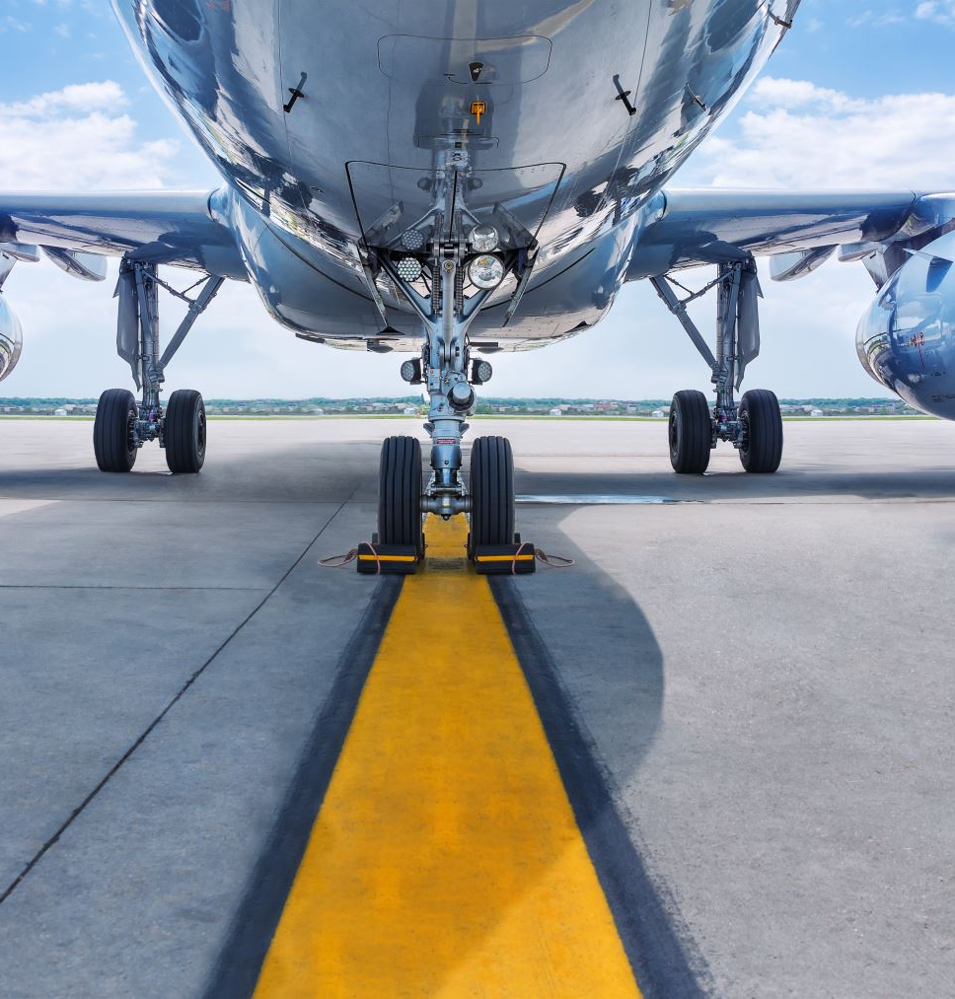
Background
As the impact of COVID-19 recedes, the travel industry is beginning to bottom out. People across the country are starting to plan their holiday travel. When they fly to a city, they need to plan their days in advance to make sure they hit all the attractions they want to visit and some delicious restaurants. Thus, this project was born. I named this project Travel Assistant. The travel assistant is dedicated to helping you optimize your daily travel route so that you can save more time and energy on transportation.

Slide 3
Target Clients
Tourists: Individuals and groups who want to go on vacation
Business Travelers: Individuals or groups who need to conduct business activities in different locations in a city.
Tour Operators: Individuals or groups who help their clients with travel planning.

Slide 4
Model Introduction
Inputs: Distance Matrix from Google Map API, Location coordinates
Decision Variables: Order of visitation, Binary variables to decide next place to visit
Objective: Minimize the total distance
Constraints:
-Visitors can not return to the locations they have visited.
-Hotel address is a start point, and end point can not set to hotel
-Each Location can only be visited one time

Slide 5
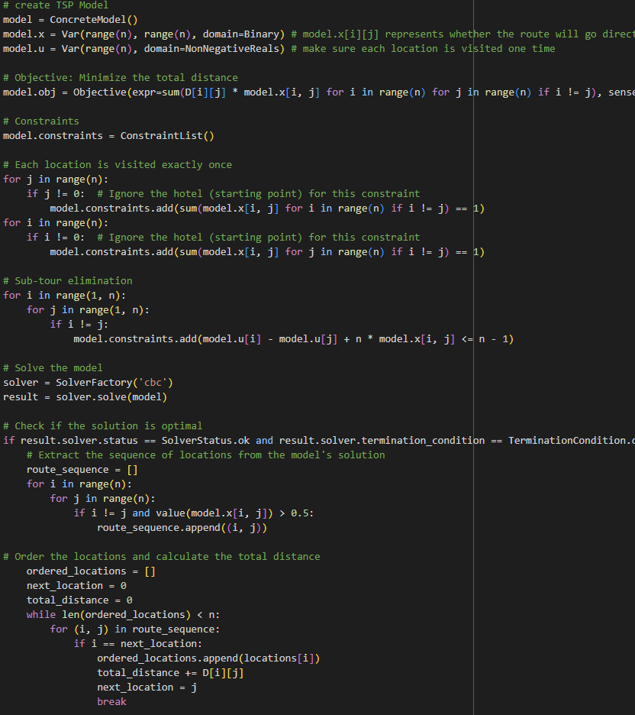
Optimization Algorithms In The Model
Create a Binary Matrix and multiply it with the coordinates corresponding to the distance matrix to find the minimum distance
Because Hotel is set as the starting point, the sum of each row and column of the Binary Matrix except hotel should be equal to 1.
I apply Miller-Tucker-Zemlin formulation into model for sub-tour elimination. This algorithm helps the model plan paths

Slide 6

Build Optimization Model in Python
Reasons:
Sovler tools in Excel can only help solve simple optimization problem without using VBA. In this model, we need to apply subtour elimination to make sure it’s a path. (See an example model in supporting excel file)
Python support many visualization tools and APIs
Python can do more complex computations
How:
Model used googlemaps, pyomo, folium packages

Slide 7
Key Assumptions
Visitors should strictly follow the itinerary provided and are not allowed to make spontaneous changes or deviations.
The model does not consider driving time and other time data
The model only considers the shortest path problem
Hotel is a start point, and it is not a end point.

Slide 8
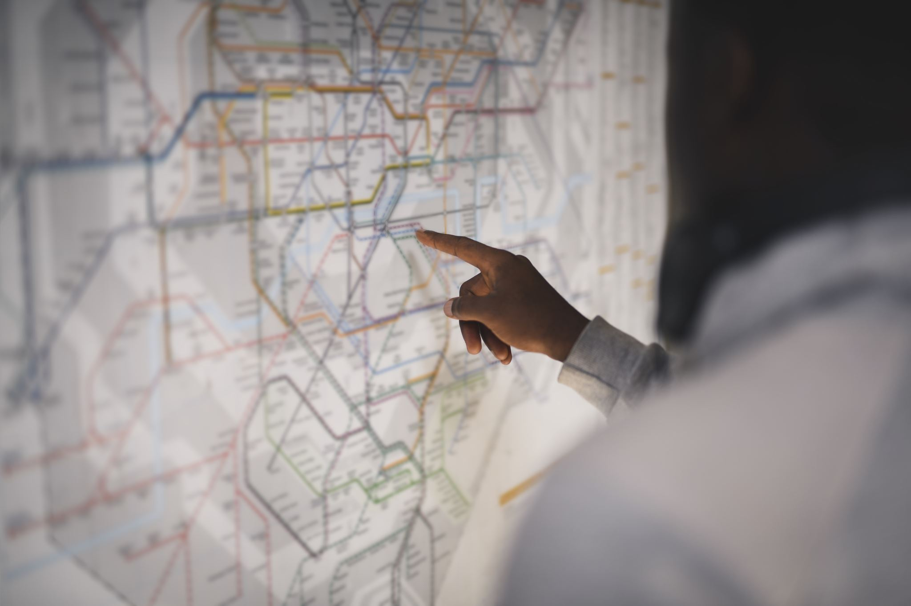
Challenges
Apply Miller-Tucker-Zemlin formulation into TSP model
Complete model algorithms
Virtualize the Map
Try to add time windows into model

Slide 9
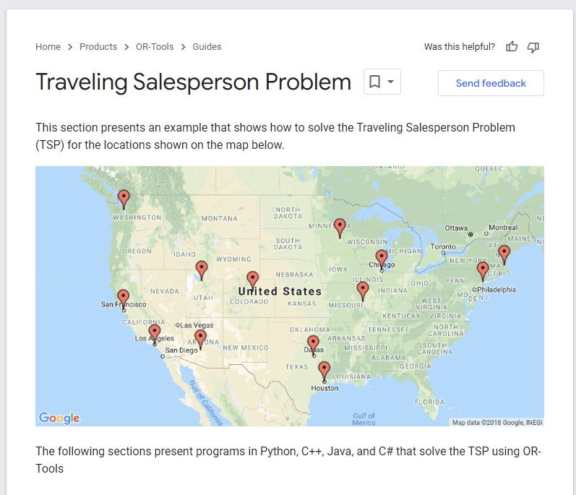
Highlights
Collect distance and coordinates data from Google Maps API
Build a dynamic map with the shortest path
Find ideas and Methods from google OR-Tools pages

Slide 10

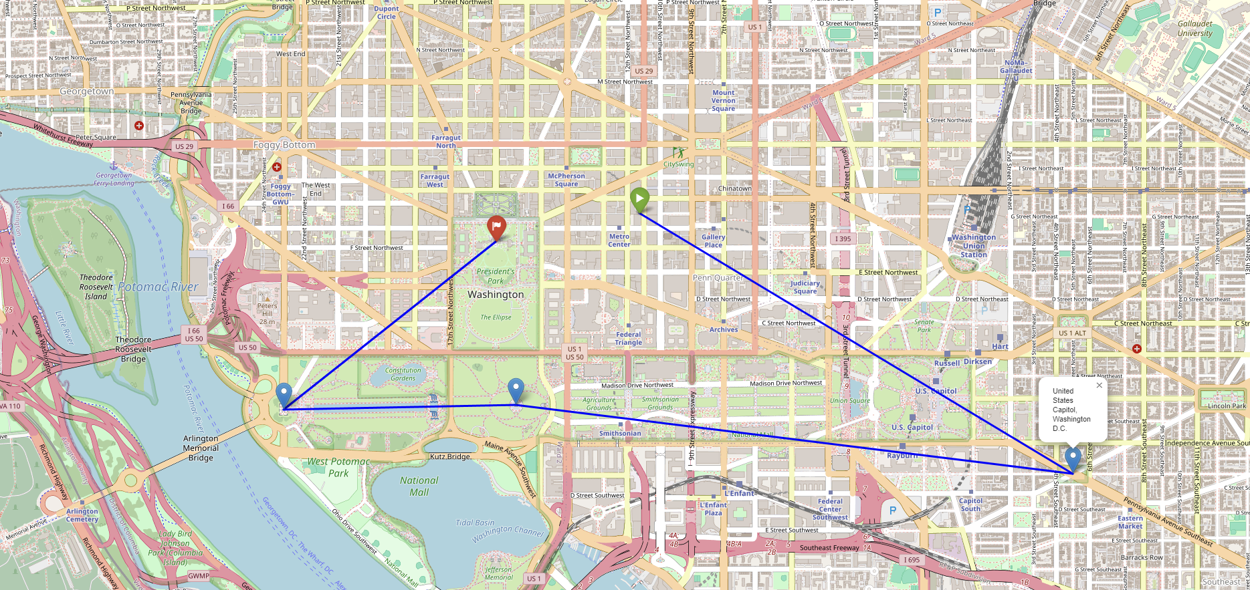
How To Use The Model
Clients can simply run the program, which will prompt them to enter the hotel address and several location addresses. After these details are provided, the model will calculate the shortest path and generate a map to display the route.
Example: I plan to travel to Washington DC. I plan to stay at the Marriott Hotel and visit four locations including the White House, Lincoln Memorial, Washington Monument, and the U.S. Capitol. I only need to enter the corresponding addresses in the two boxes, and the model will automatically display the map of the shortest path. Among them, the green mark is the hotel and the red mark is the destination.
Your Inputs:
Outputs:

Slide 11
Benefits & Limitations
Benefits:
Users can reduce time on travel planning. Now they just need to put the places they want to go into the program.
In business, travel agencies can use models to better plan travel plans to increase competitiveness.
In addition, the model introduces Google API to improve accuracy.
Limitations:
The model does not consider time factors or Time Window
Users are required to have experience using python.

Slide 12
Next Steps
I plan to continue improving the model including introducing a Time window.
Apply models to websites and apps to reach a more general audience.
The model will consider more modes of travel than just driving.

Slide 13
Supporting Files
Excel file: Simple model shows the idea of python code
Python file: The whole model with comments for every code you can run it directly
Word file: Main references from Google maps APIs and paper that help improve my algorithms.

