Slide 1

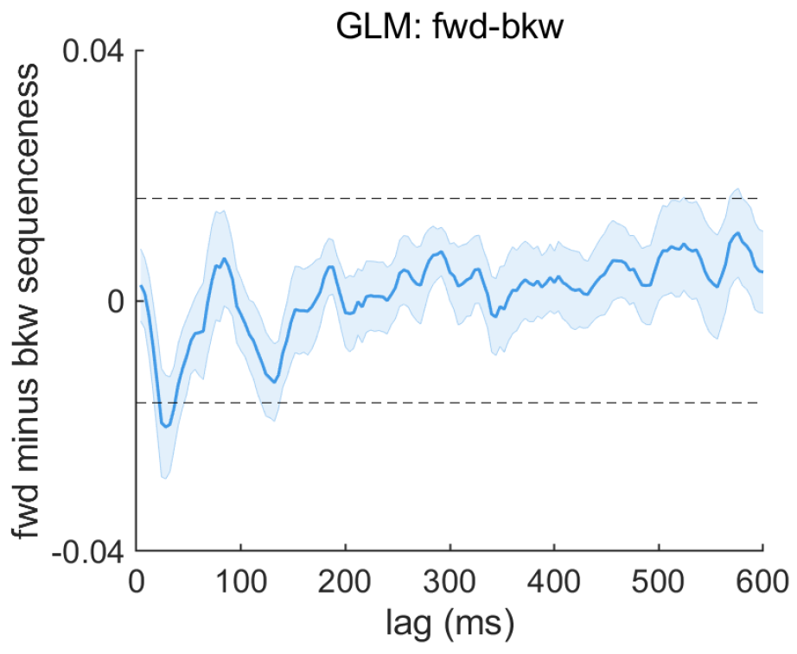

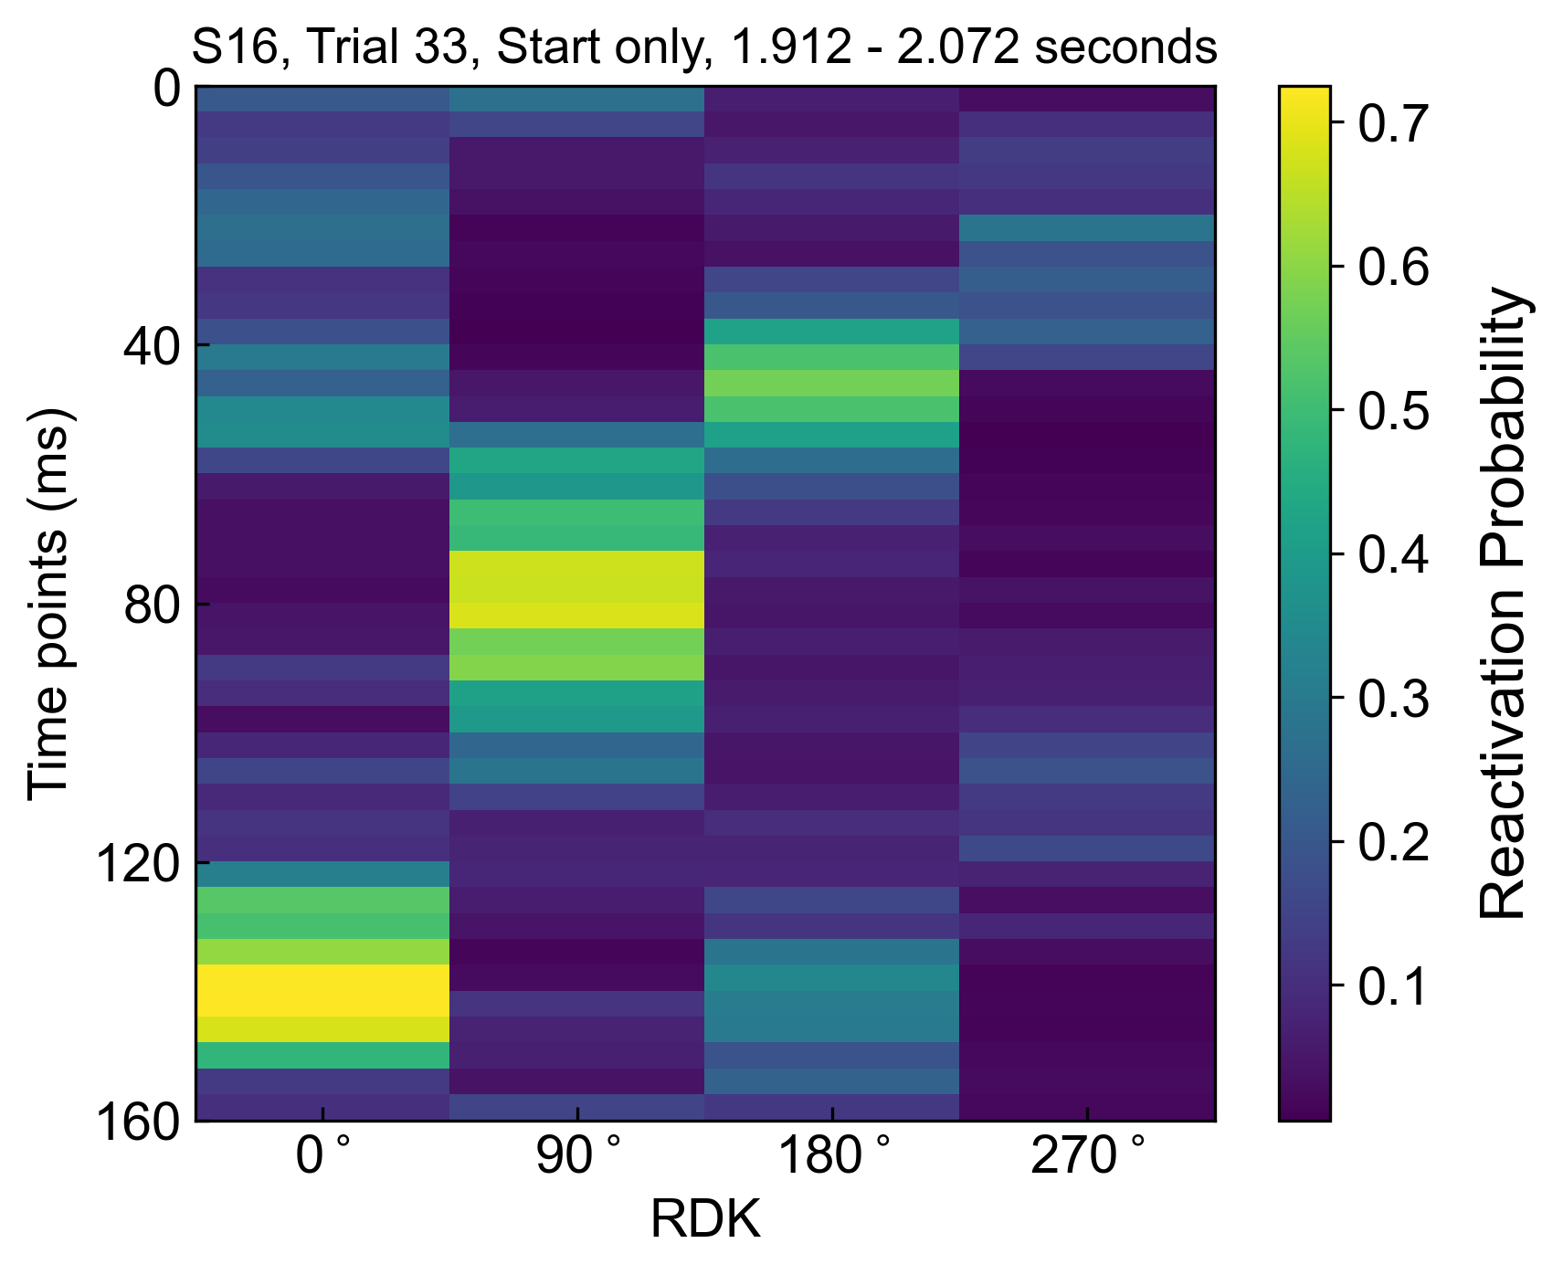
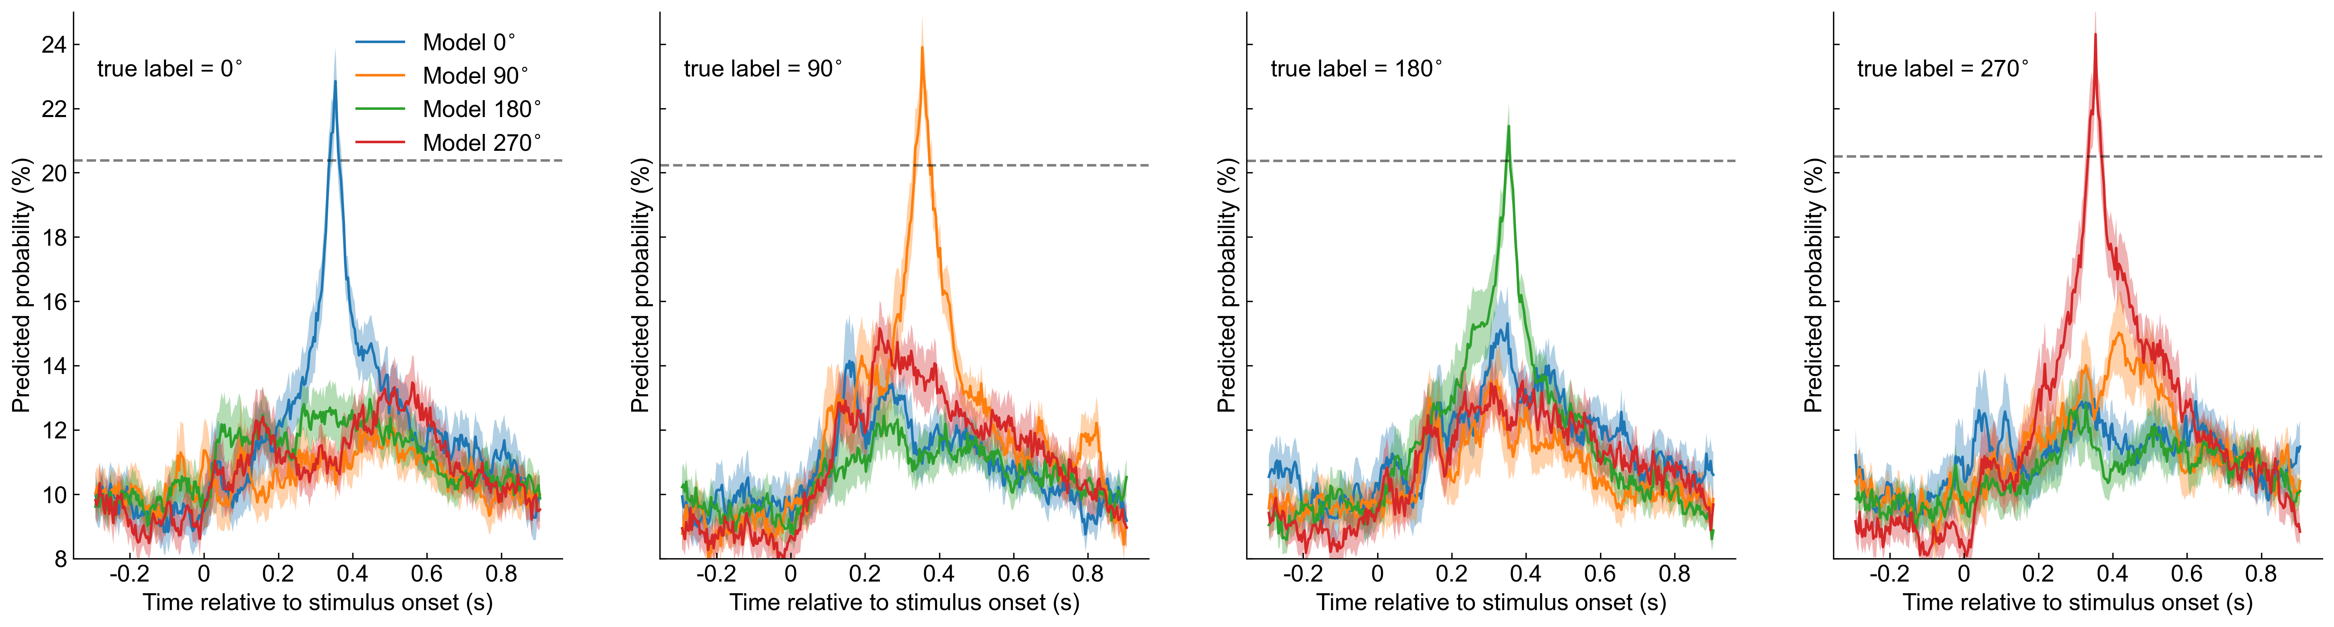
A
C
Full sequence (F)
Flash start RDK (S)
Flash end RDK (E)
Start-only condition
Forward
sequenceness
2.8 s
Backward
B
D

