Slide 1
Rhau Data Analysis
VERSION 1

Slide 2
Overview
Setting common sub-terms for the sequences
Why we choose 9 bases on either side of n90 regions
Splitting the dataset
Initial results
Further investigation of Non_matched Regions
Potential problem with data

Slide 3
…CCAAATACTAATACGACTCACTATAGGATTAAGGAGGTGATATTTATG
CATCCGGGCCATCTGAAAGGCAGCGAAATTGGCATGTGGTATGCGAAAAAACAGTGTATTCTTTATTTTCTTCGTGATCTTCTTTTTGAT
TGCGGTGGAGGAGGAGGTAGCTAGGGACGGGGGGCGGGAGGCGGGAAGG…
Break down of Sequences
Sequence is broken down into 3 lines to make it easier to read and increase the font
@LH00157:478:22MH22LT4:6:1101:9092:1196 Forward Sequence
Underlined text are the bases in the forward read. The remaining are added for understanding and expalination

Slide 4
…CCAAATACTAATACGACTCACTATAGGATTAAGGAGGTGATATTTATG
CATCCGGGCCATCTGAAAGGCAGCGAAATTGGCATGTGGTATGCGAAAAAACAGTGTATTCTTTATTTTCTTCGTGATCTTCTTTTTGAT
TGCGGTGGAGGAGGAGGTAGCTAGGGACGGGGGGCGGGAGGCGGGAAGG…
Break down of Sequences
Red and Yellow Denotes before the N90 Random sequence
Underlined white background text is the N90 random regions
Blue and Greens denote the bases after the random sequence

Slide 5
…CCAAATACTAATACGACTCACTATAGGATTAAGGAGGTGATATTTATG
Break down of Before base
5’ Primer before the barcode. Bases not included in FQ files and cut from breakdown for brevity
Bright Red and Yellow Denotes 5’ Common sequence
Yellow is the final 9 bases used for 5’. 9 is chosen as the largest number that is even divisible by 3 that is in forward and reverse sequence
Dark Red is the barcode used to denote which run

Slide 6
TGCGGTGGAGGAGGAGGTAGCTAGGGACGGGGGGCGGGAGGCGGGAAGG…
Break down of After Sequence
Cyan Denotes the first 9 bases of the 3’ common sequence which are present in both forward and reverse
Seagreen is the 3’ barcode
Blue and Cyan is the 3’ Common Sequence
Additional bases present but not read

Slide 7
CCAAATA…GTGATATTTATG…N90…TGCGGTGGAGGA
Why 9 Bases on either ends
9 Bases is the largest N % 3 == 0 number for each common sequence overlap
Forward Sequence
TGATATTTATG…N90…TGCGGTGGAGGA…GGGTACG
Reverse Sequence where the ssequnce is reverse and bases swapped

Slide 8
Data Split set
The first step we did was to split Rhau18_12aa-R3-R7_R1.fq and Rhau18_12aa-R3-R7_R1.fq along the barcodes
We used the barcodes within the shared primer excel file
We compared the first 4 bases to the barcodes and where there wasn’t a direct match we assigned non_matched label
Run Number | Forward Barcode | Reverse Barcode | Swapped and flipped Reverse Barcode
R3 | CCAT | TAGG | CCTA
R4 | CCAA | AAGG | CCTT
R5 | CGAT | GCAT | ATGC
R6 | CGTT | TTCG | CGAA
R7 | ATAC | GAAT | ATTC

Slide 9
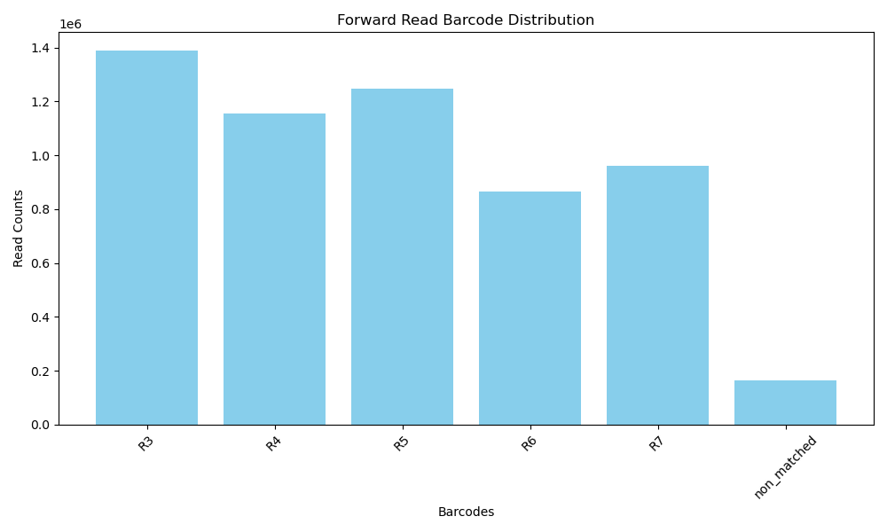
Significant number of non_matched sequence

Slide 10
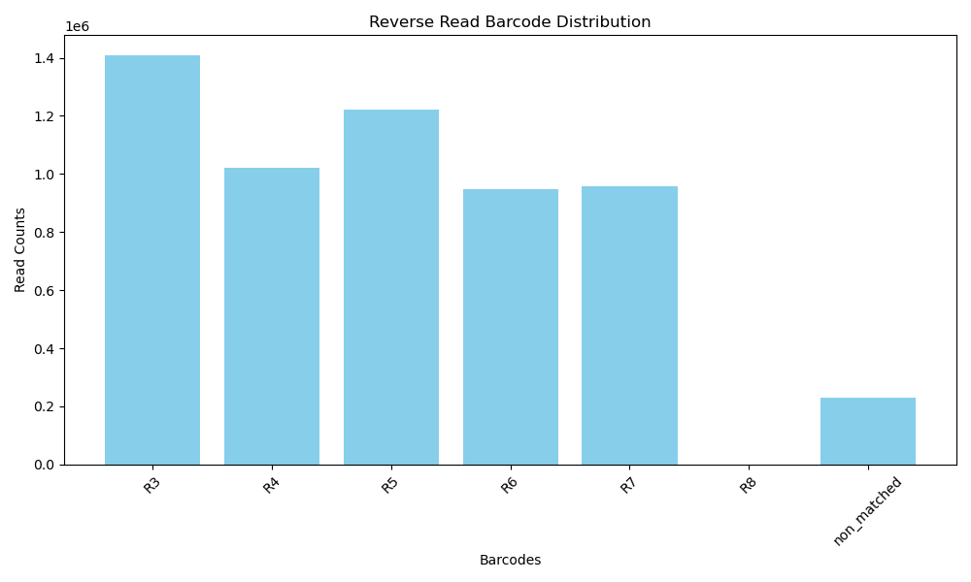
Significant number of non_matched sequence present in both

Slide 11
Non_matched corrections
We attempted to correct and address the significant amout of unmatched sequences through two methods
Check the Hamming distance (number of different bases) between read barcode and known round barcode
  Corrected 55k of 174K mis-read bases
Use the other file to determine the correct round. If a sequence is in R3 and the reverse is unmatched then assume it is R3
  Matched apon sequence identifier
  Created a quick visualization to test but ….

Slide 12
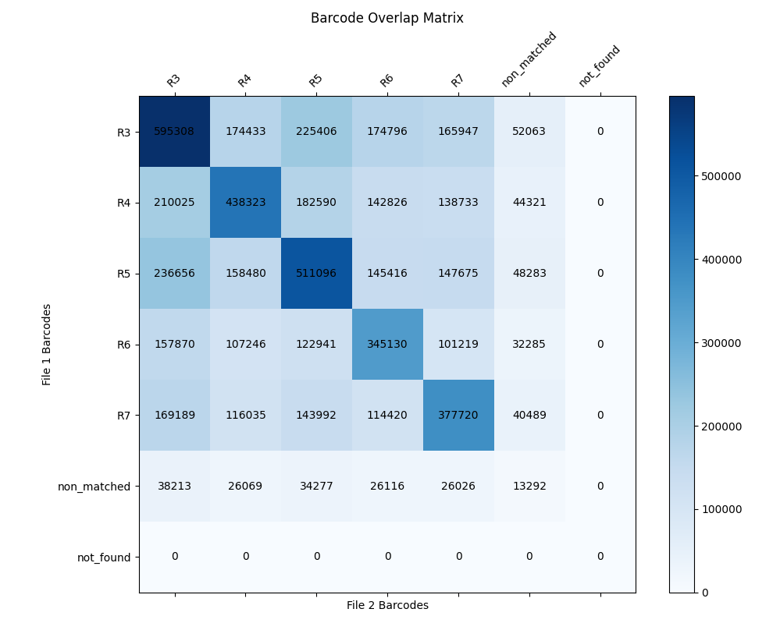
The round number based on Reverse File
The round number based on forward File

Slide 13
Number of sequences read at R3 for both files
PROBLEM : Number of sequences read as R3 in forward but R5 in reverse

Slide 14
Data sets
Only <40% of sequences match rounds between forward and reverse
To validate our data processing script we created 3 dataset and looked at base scores
3 Runs
  Complete Forward and Reverse – Previously Shown
  Raw sample of 12 sequences stratified on Reverse barcodes with matching forward sequences
  Raw sample of 12 sequences stratified on Reverse barcodes with forward sequences to match reverse barcodes (CONTROL)

Slide 15
Datasets
Identifer | Sample Forward Barcode | Reverse Barcode |  | Control Forward Barcode | Reverse Barcode
@LH00157:478:22MH22LT4:6:1101:19976:1098 | R3 - CCAT | R3 - TAGG | R3 - CCAT | R3 - TAGG
@LH00157:478:22MH22LT4:6:1101:3363:1112 | R3 - CCAT | R3 - TAGG | R3 - CCAT | R3 - TAGG
@LH00157:478:22MH22LT4:6:1101:9683:1098 | R7 - ATAC | R4 - AAGG | R4 - CCAA | R4 - AAGG
@LH00157:478:22MH22LT4:6:1101:13252:1112 | R3 - CCAT | R4 - AAGG | R4 - CCAA | R4 - AAGG
@LH00157:478:22MH22LT4:6:1101:9092:1196 | R4 - CCAA | R5 - GCAT | R5 - CGAT | R5 - GCAT
@LH00157:478:22MH22LT4:6:1101:23003:1210 | R6 - CGTT | R5 - GCAT | R5 - CGAT | R5 - GCAT
@LH00157:478:22MH22LT4:6:1101:46317:1168 | R3 - CCAT | R6 - TTCG | R6 - CGTT | R6 - TTCG
@LH00157:478:22MH22LT4:6:1101:39568:1224 | R7 - ATAC | R6 - TTCG | R6 - CGTT | R6 - TTCG
@LH00157:478:22MH22LT4:6:1101:38637:1126 | R5 - CGAT | R7 - GAAT | R7 - ATAC | R7 - GAAT
@LH00157:478:22MH22LT4:6:1101:32018:1154 | R7 - ATAC | R7 - GAAT | R7 - ATAC | R7 - GAAT
@LH00157:478:22MH22LT4:6:1101:33547:1112 | R5 - CGAT | Non_Matched | Non_Matched | Non_Matched
@LH00157:478:22MH22LT4:6:1101:15210:1252 | R5 - CGAT | Non_Matched | Non_Matched | Non_Matched

Slide 16
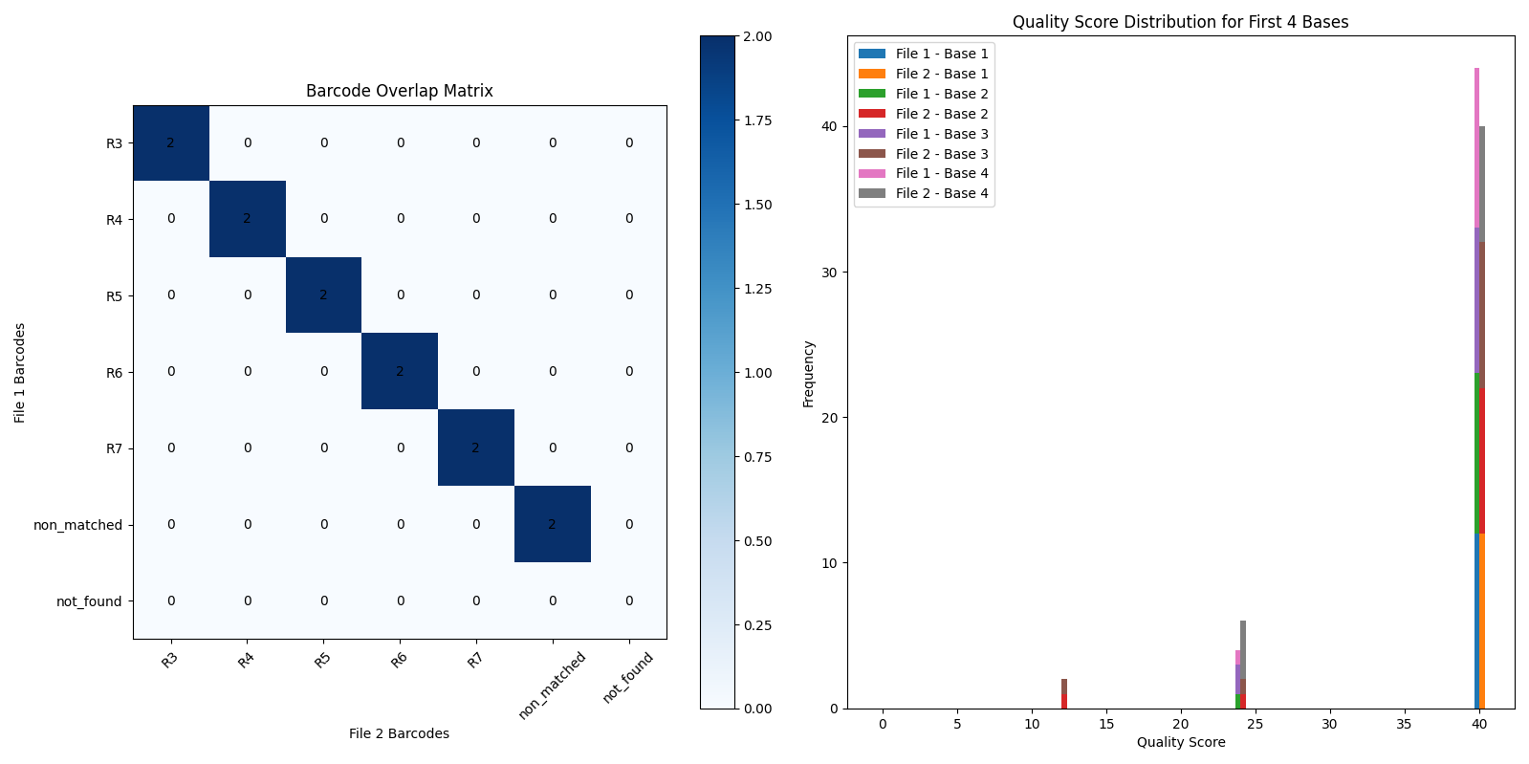
Control

Slide 17
Control
In an ideal setting the line should be perfectly diagonal meaning for each sequence the predicted rounds are the same for each file

Slide 18
Control
A supporting graph displaying the Phred Scores of each base in the barcode. The median is 40 and mean of 38. Denoting strong confidence in the bases.
This is a less important graph

Slide 19
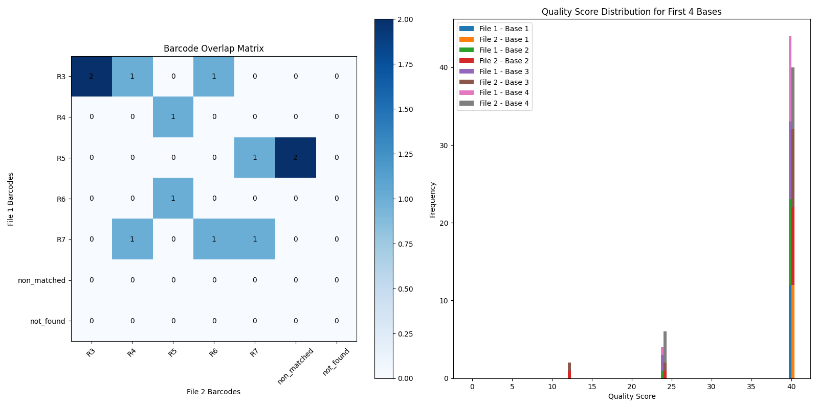
Small Sample
The row counts match the table
2 | 2 | 2 | 2 | 2 | 0
4
1
3
1
3
0
0
With Smaller manually checked method, the trend is still present showing correct working of the methodology

Slide 20
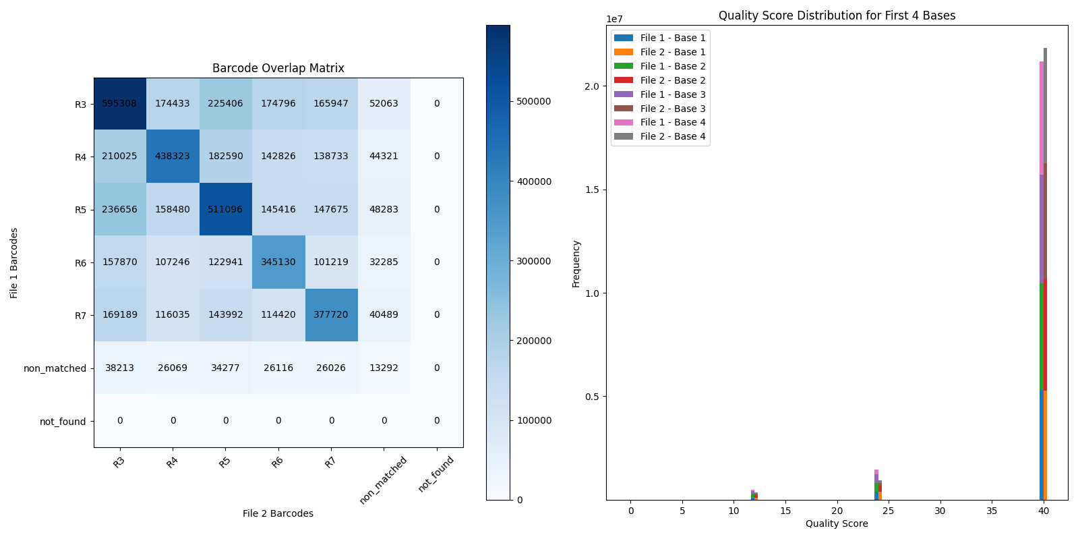
Full Sample Both Graphs

Slide 21
Small Sample

