Slide 1

Time-Dependent Sensitivity Analysis of OECD Benchmark using BISON and RAVEN
P. Talbot, K. Gamble, C. Rabiti, C. Wang, A. Alfonsi, J. Cogliati, D. Mandelli, A. Prinja
ANS Winter 2016, Nov. 10, Las Vegas, NV

Slide 2
RAVEN and Uncertainty Quantification
Uncertainty in system response
Uncertainty in initial and boundary condition
Uncertainty in model parameters
Stochastic events
Possibly dealing with discrete variable
Highly non linear systems
Probability distribution of the final status
Uncertainty in initial condition

Slide 3
Nomenclature
is the response from a model (e.g., PCT)
Uncertain inputs to model:
Material Properties
Boundary Conditions
Initial Conditions
Goal: What range of values can have as a result of uncertainties in ?

Slide 4
Stochastic Polynomials
Expand model as combination of polynomials
Polynomial Representation
Given a quantity of interest:
Represent as combination of polynomials:
Simpler to evaluate
Easy to get statistical moments
Less effort and more accurate than Monte Carlo
Notes:
Important points:
- Polynomials are orthonormal
- Coefficients c_k are obtained by integration
- Polynomial set \Lambda is chosen by the user (or adaptively)

Slide 5
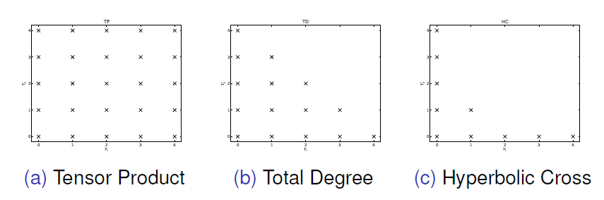
Stochastic Collocation
Effectiveness depends on:
Regularity of quantity of interest
Polynomial expansion order
Polynomial combination indices
Sparse Grid quadrature types (Gauss, Clenshaw)
Number of uncertain inputs
Tensor Product: Overkill
Total Degree: For Analytic Responses
Hyperbolic Cross: For Irregular Responses
Notes:
This slide is an opportunity to talk about when SCgPC works well, and how we choose polynomials for expansion

Slide 6
High-Dimensional Model Reduction (HDMR)
Expand model according to subsets of the input space
Notes:
Important to mention:
- Each subset term u_n contains all of the effects on u(Y) from y_n
- Expansion is exact if all terms kept
- Often only second-order terms required
- High-order integrals not practical -> instead, use cut-HDMR

Slide 7
Cut-HDMR
More computationally accessible
Let be a reference point (mean of each input)
is all inputs at reference except
Notes:
Important to mention:
- Still true: Each subset term u_n contains all of the effects on u(Y) from y_n
- Still true: Expansion is exact if all terms kept
- No difficult integrals to perform
- Subset terms u_n can be represented by SCgPC expansions

Slide 8
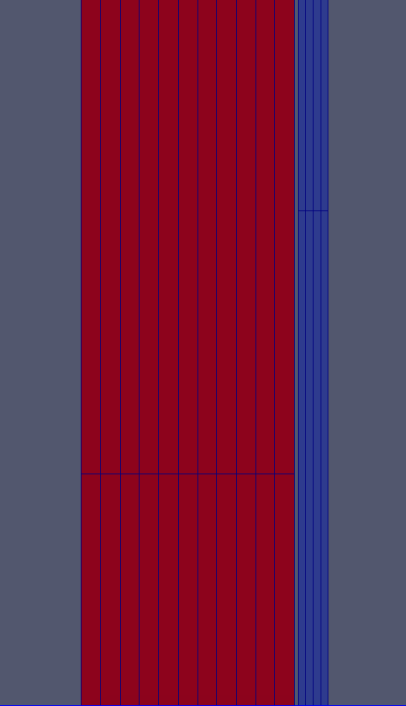
Case: OECD Benchmark
2a: Steady-State PWR Fuel Pin
200 day period
Initial power ramp
Two steps down
2-D R-Z Axisymmetric Mesh
Solved by BISON
Responses of Interest:
Clad creep strain
Fuel centerline temperature
Clad elongation
Fission gas released
Notes:
Benchmark report: Blyth et al, Benchmark for Uncertainty Analysis in Modelling (UAM) for Design, Operation, and Safety Analysis of LWRs. Volume II: Specification and Support Data for the Core Cases (Phase II). 2014

Slide 9
Uncertainty in Case 2a
17 independent uncertain inputs
See next slide for details
HDMR with SCgPC
Requires only 35 evaluations of BISON
LHS comparison requires 300

Slide 10
Uncertain Inputs
Uncertain Parameter | Mean | Std. Dev.
Clad Thermal Conductivity | 16 | 2.5
Cladding Thickness | 6.7e-4 | 8.3e-6
Cladding Roughness | 5e-7 | 1e-7
Clad Creep Rate (Scaling) | 1 | 0.15
Fuel Thermal Conductivity (Scaling) | 1 | 0.05
Fuel Density | 10299.24 | 51.4962
Fuel Thermal Expansion | 1e-5 | 7.5e-7
Fuel Pellet Radius | 4.7e-3 | 3.335e-6
Fuel Pellet Roughness | 2e-6 | 1.6667e-7
Solid Fuel Swelling | 5.58e-5 | 5.77e-6
Gas Thermal Conductivity (Scaling) | 1 | 0.025
Gap Thickness | 9e-5 | 8.33e-6
Mass Flux | 3460 | 57.67
Rod Fill Pressure | 1.2e6 | 4e4
System Pressure | 1.551e7 | 51648.3
System Power (Scaling) | 1 | 0.016667
Inlet Temperature | 558 (min) | 564 (max)
Notes:
Important Notes:
- Uncertainties given in the benchmark

Slide 11
Results: Mean over Burnup
Notes:
All factors have scaling factor so they all fit on one plot.
Note the jumps around power transients.

Slide 12
Results: Variance over Burnup
Notes:
Again scaled so they all fit on one plot.
Note the huge increase in variance around power transients.

Slide 13
Sensitivity over Burnup: Fuel Centerline Temp
Notes:
Highlights:
- Fuel conductivity dominates most of the time
- System power spikes in importance around power transients
- Gap thickness important until around 0.01 FIMA, where fuel expands to hit clad

Slide 14
Sensitivity over Burnup: Fission Gas Release
Notes:
Highlights:
- Fuel conductivity dominates after clad contact
- Before contact, gap thickness, creep rate both also important

Slide 15
Sensitivity over Burnup: Clad Creep Strain
Notes:
Highlights:
- Creep rate almost always dominant
- Gap thickness important starting after clad contact and through second power downstep
- Clad conductivity initially important but less so after contact

Slide 16
Sensitivity over Burnup: Clad Elongation
Notes:
Highlights:
- Clear change in physics before and after clad contact
- Before contact, clad conductivity and system power dominate
- Fuel density grow in importance until contact
- After contact, gap thickness and creep rate slowly change positions

Slide 17
Conclusions
Time-Dependent Sensitivity Analysis
Provides additional insight
Demonstrates changes in dominant physics
Explains large response variances during simulation
HDMR as Time-Dependent Analysis Tool
Requires many fewer samples
Time-dependent at no greater cost than static analysis
RAVEN capabilities make time-dependent HDMR analysis easy to use

