Slide 1
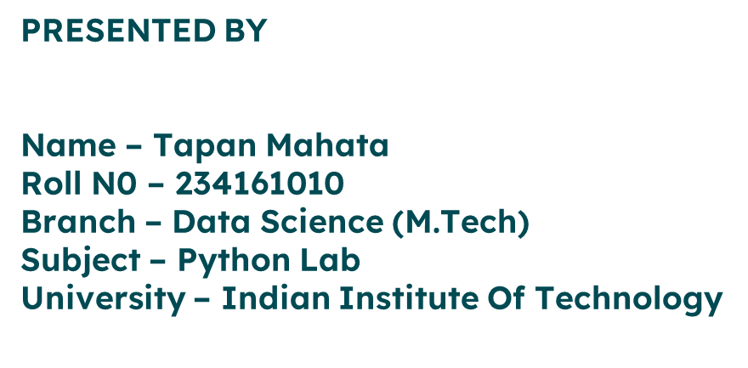

Population Analysis
Data science project on world and Indian population.

Slide 2

Table of contents
1 Introduction & motivation
2 About dataset
3 Solution approach
4 Pseudocode
5 Highlight from my code
6 Results
7 Observations

Slide 3
INTRODUCTION
This project aims to analyze and visualize demographic data related to the population of every country and Population of Indian states, number of households, number of rural and urban areas , ratio of male and female . The main objective of this project is to gain insights into the population distribution across the world and Indian states . By visualizing the data, we can identify any notable trends or patterns and explore the demography .
Motivation
In January, Mr. Musk tweeted, "Population collapse is a major risk to the future of civilization." He also shared a link to World Bank data, which showed that the world's fertility rate was at its lowest since the 1960s. May be this is true for developed western countries but on the other hand India has become the world's most populous country this year – surpassing China, which has held the distinction since at least 1950 . This leads to the motivation of creating this project and see the status of world population and its dynamic nature including India using the power of Data science.

Slide 4
About Dataset
I have taken two distinct data sets 1 . world population dataset I have taken this dataset from the website worldometer.com using web scraping.
The data is based on the latest United Nations Population Division estimated.
Link : https://www.worldometers.info/world-population/population-by-country/
2. Indian population dataset
This Dataset is retrived from official government website of india. This data has information about the Number of villages, towns, households, population and area (India, states/UTs, districts and Sub-districts) which can be used to analyze the types of population in rural and urban areas of India. This Dataset consists of total 15 columns and 19,996 rows of data.
Link : https://censusindia.gov.in/nada/index.php/catalog/42526#metadata-description
Format : Excel

Slide 5
SOLUTION APPROACH
Data Collection:
World Population Data:
Utilized web scraping techniques (BeautifulSoup in Python) to extract data from worldometer.com.
Transformed the scraped data into a 2D list for further analysis.
Indian Population Data:
Acquired data from the official Indian government website censusindia in the form of an Excel file.
Processed the Excel data to create relevant tables for analysis.
2. Data Preparation:
World Population Analysis:
Created various lists and structures from the scraped data for easy access and manipulation.
Prepared specific data sets to facilitate comprehensive analysis and visualization.
Indian Population Analysis:
Extracted relevant information from the Excel data, creating tables suitable for analysis.
Organized and formatted the data to generate insights and visualization.

Slide 6
SOLUTION APPROACH
3. Data Analysis and Visualization:
World Population Insights:
Utilized the prepared data to generate meaningful plots and visualizations.
Analyzed trends, comparisons, and projections to highlight key findings.
Indian Population Trends:
Employed the curated Indian population data to create informative visual representations.
Explored demographic changes, regional variations, or any significant patterns identified.
4. Challenges Faced:
Web Scraping Hurdles:
Addressed challenges encountered during web scraping, such as site structure changes or data formatting issues.
Implemented strategies to ensure successful extraction and data cleanliness.
Data Structuring and Analysis:
Overcame complexities in organizing diverse data sets into usable formats.
Resolved issues related to data consistency, formatting, or missing values.

Slide 7
PSEUDOCODE
Scrapy.py
FUNCTION scrap(url):
response = GET request to the 'url'
IF response status code is 200:
CREATE BeautifulSoup object 'soup' using response text with 'html.parser'
OPEN 'population_data.txt' in write mode as 'file'
WRITE the string representation of 'soup' into the file
CLOSE the file
ELSE:
PRINT "Access failure"
url = "https://www.worldometers.info/world-population/population-by-country"
CALL scrap(url)

Slide 8
Project.py
READ HTML data from 'population_data.html' and store it in 'html_data'
CREATE BeautifulSoup object 'soup' using 'html_data' with 'html.parser'
DEFINE FUNCTION clean_row(row):
# Cleans HTML rows and converts them to lists
DEFINE VARIABLES to store specific columns from the 'table'
DEFINE FUNCTION main():
# Calls various functions to generate visualizations from the imported data
DEFINE FUNCTION populationDistribution():
# Generates a scatter plot to show population distribution
DEFINE FUNCTION populationBar():
# Generates a bar plot displaying the top 10 countries by population

Slide 9
Project.py
DEFINE FUNCTION fertilityVsPopulationChange():
# Performs regression analysis on fertility rate vs yearly population change
DEFINE FUNCTION fartalityVsMiddleAge():
# Performs regression analysis on fatality rate vs average middle age of countries
DEFINE FUNCTION import_data():
# Imports and preprocesses Indian population data from an Excel file
DEFINE FUNCTION population_vs_state():
# Plots bar chart displaying total population by state in India
DEFINE FUNCTION male_vs_female_population():
# Plots bar chart comparing male and female population by state in India
DEFINE FUNCTION village():
# Plots bar chart comparing inhabited and uninhabited villages by state in India
CHECKS if the script is being run as the main module:
# Calls 'main()' function to execute the defined visualization functions

Slide 10
Heighlight of my code
soup=BeautifulSoup(html_data,'html.parser')
def clean_row(row):
row_str=str(row)
row_str=row_str.replace(",","")
row_str=row_str.replace(" ","")
row_str=row_str.replace("\n","")
row_str=re.sub(r'<.*?>', ',',row_str)
row_str=row_str.replace(",,",",")
row_str=row_str.replace(",,",",")
row_str=row_str[1:-1]
row_data=row_str.split(",")
return row_data
table=[]
ind=0
for row in soup.find_all('tr'):
if ind==0 :
ind+=1
continue
table.append(clean_row(row))

Slide 11
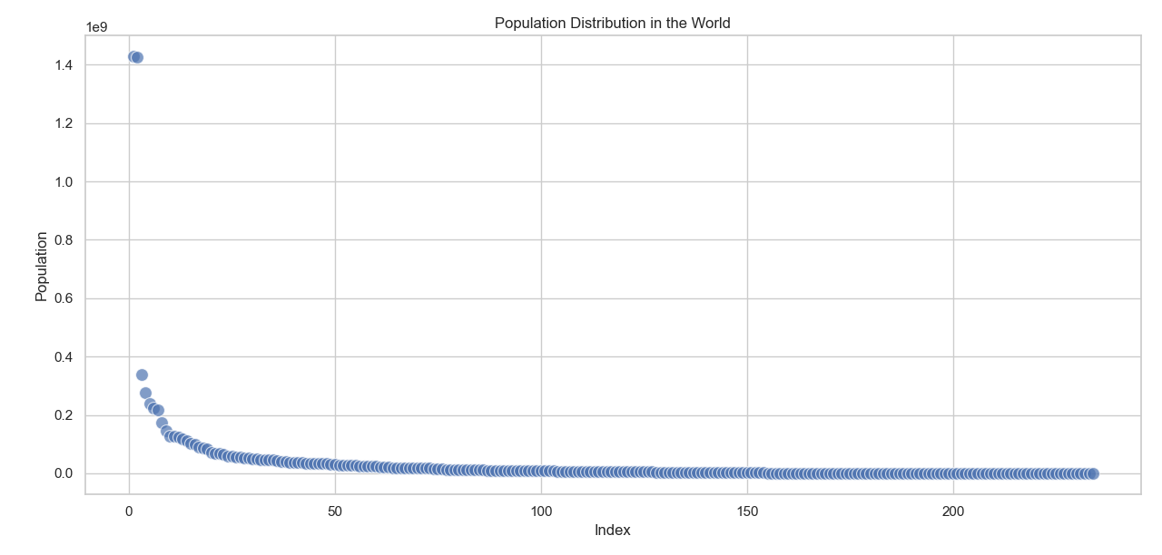
Results

Slide 12
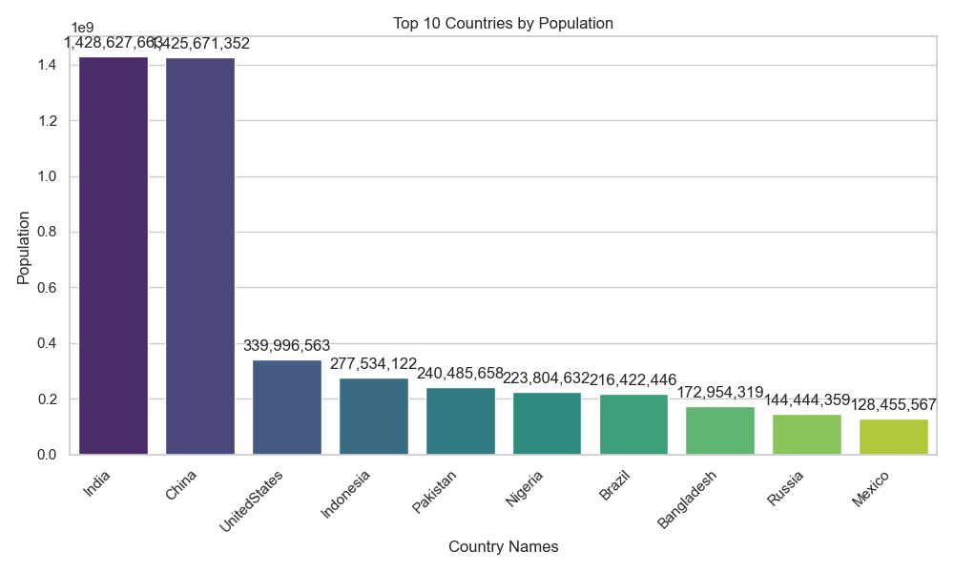

Slide 13
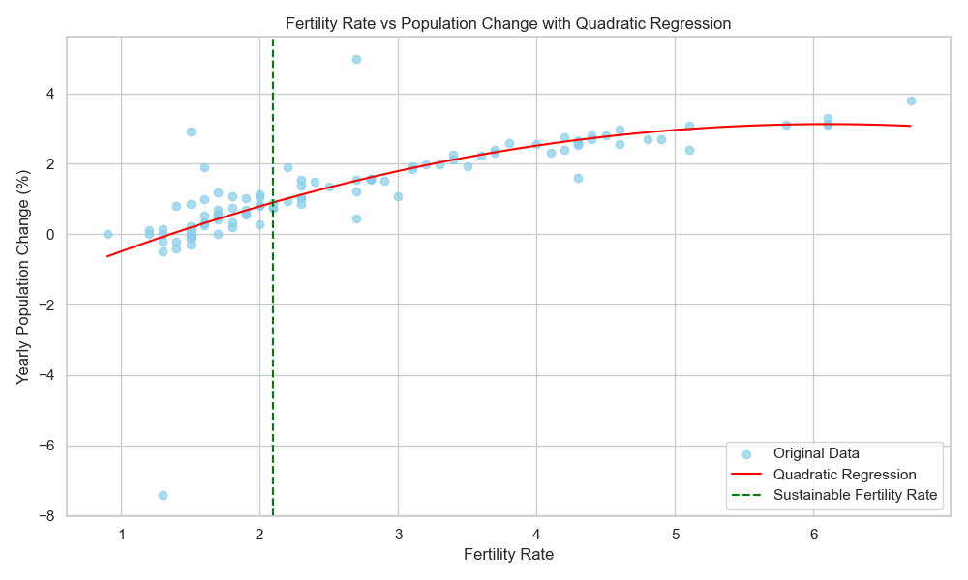

Slide 14
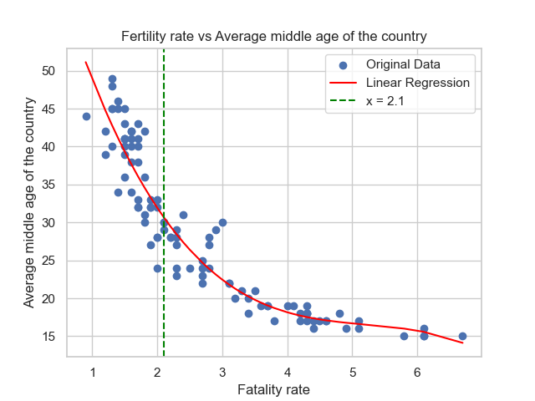

Slide 15
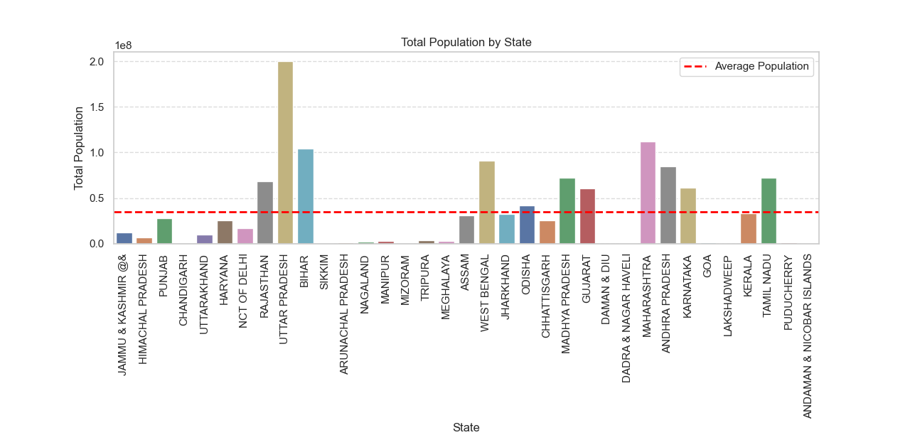

Slide 16
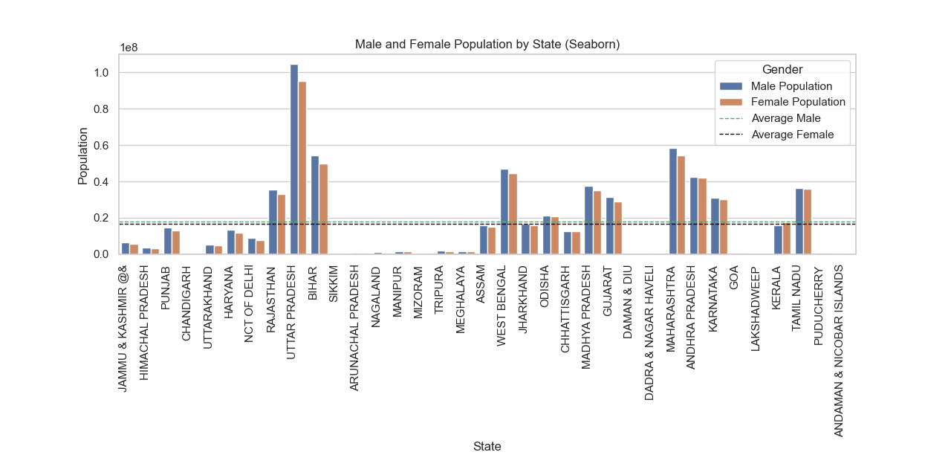

Slide 17
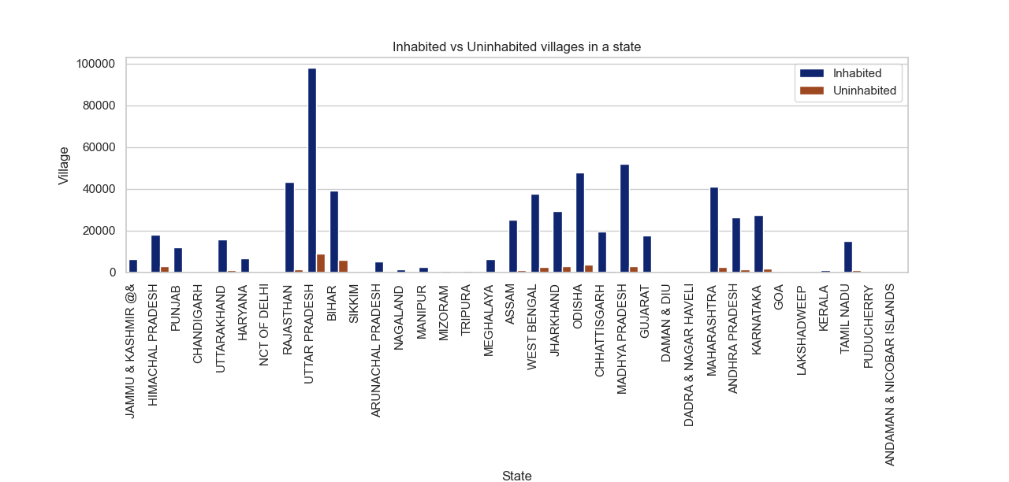

Slide 18
OBSERVATION
According to UN sustainable fertility rate is 2.1
According to this project :
Estimated Population Growth Rate at Sustainable Fertility Rate: 0.9029163910436564 % Which is correct according to UN .
Average middle age at sustainable fertility rate 30.695118365005513 %
Key Learnings and Takeaways:
Web Scraping Skills Enhancement:
Gained proficiency in web scraping techniques and their application in data collection.
Data Manipulation and Visualization Proficiency:
Improved skills in handling and analyzing diverse data sets to derive meaningful insights.
Project Management and Problem Solving:
Learned effective strategies to manage and resolve challenges encountered during data-driven projects.

