Slide 1
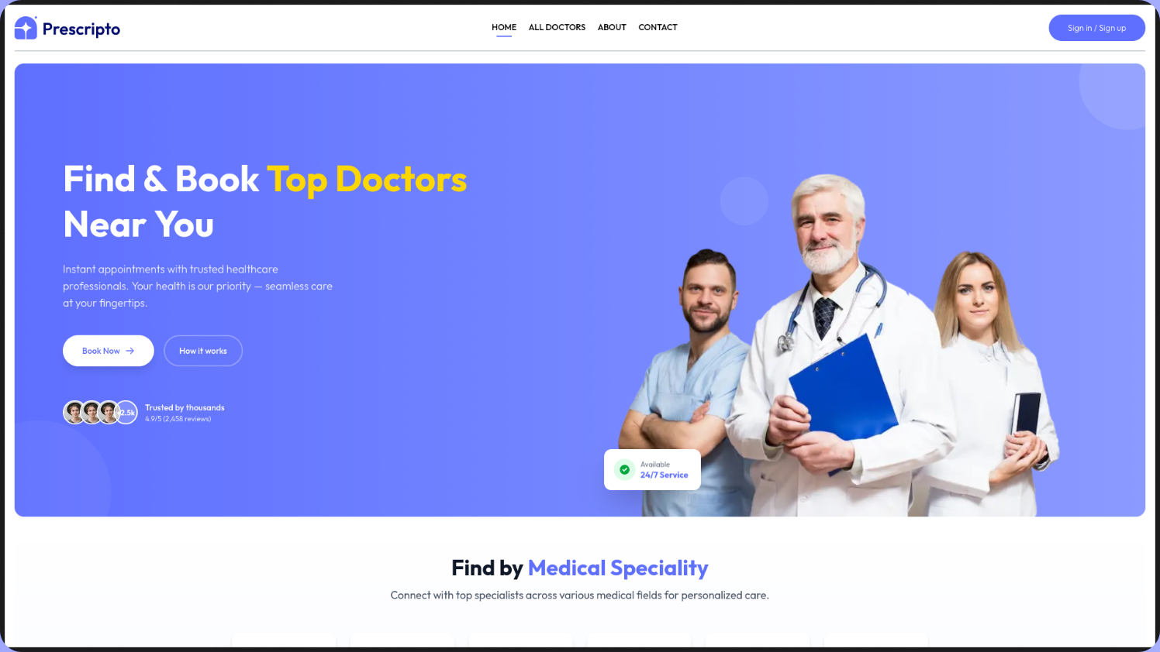
B.TECH MAJOR PROJECT
Prescripto
Doctor Appointment Booking System
PRESENTED BY
ACADEMIC YEAR
Tapas Jyoti
2025–2026
Notes:
Introduce Prescripto: a doctor appointment booking system with multi-role access and online payments.

Slide 2
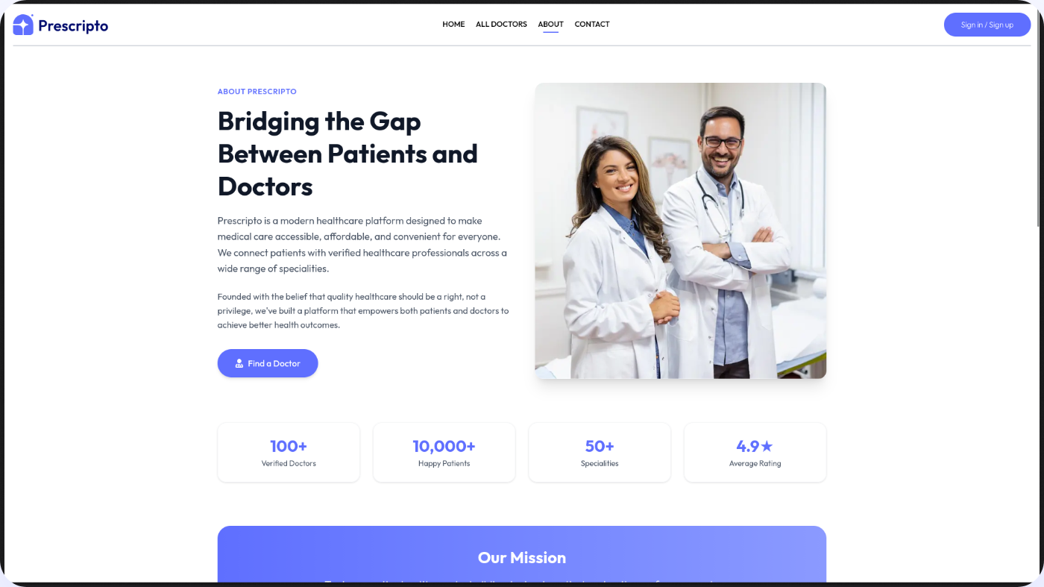
01 · INTRODUCTION
Introduction
THE SHIFT
Digitalization is changing how patients access healthcare.
THE PROBLEM
Manual scheduling, double-bookings and no visibility into fees or credentials.
THE SOLUTION
A marketplace connecting patients to specialists, with real-time slots and digital payment.
THE GOAL
A robust, scalable, secure MERN platform for healthcare logistics.
Notes:
Healthcare is going digital, but local clinic booking is still manual. Prescripto connects patients and doctors with live slots and payments.

Slide 3
02 · PROBLEM STATEMENT
Problem Statement & Motivation
01
02
03
No transparency
Scheduling conflicts
Payment friction
Fees and reviews unknown until the visit.
Manual reception ledgers cause overlaps and double-booking.
Cash-only systems lengthen waiting times.
MOTIVATION
Next.js for SEO-driven doctor discovery, plus multi-role access control and atomic database operations.
Notes:
Three challenges at local clinics, and why Next.js plus a strong backend was chosen.

Slide 4
03 · OBJECTIVES
Project Objectives
01
Role-based architecture
Dashboards for patients, doctors and admins.
02
Concurrency control
Slot locking in MongoDB prevents double-booking.
03
Secure transactions
Razorpay for prepaid consultations.
04
High performance
Next.js and Tailwind CSS for a fast UI.
05
Cloud assets
Images hosted on Cloudinary.
Notes:
Five objectives.

Slide 5
04 · TECHNOLOGIES
Technology Stack
FRONTEND
STYLING
BACKEND
DATABASE
Next.js 14
Tailwind v4
Node.js
MongoDB Atlas
React 18
Express.js 5
Mongoose ODM
AUTHENTICATION
PAYMENTS
FILES
JWT · bcrypt
Razorpay
Multer
Cloudinary SDK
Notes:
The stack, layer by layer.

Slide 6
05 · ARCHITECTURE
System Architecture
⇄
⇄
PRESENTATION
APPLICATION
DATA
Next.js
Express.js
MongoDB
SSR and client UI
HTTP requests and role-based middleware
Users, doctors, appointment states
External · payments
External · image CDN
Razorpay
Cloudinary
Notes:
Next.js front, Express API with role middleware, MongoDB, and two external services.

Slide 7
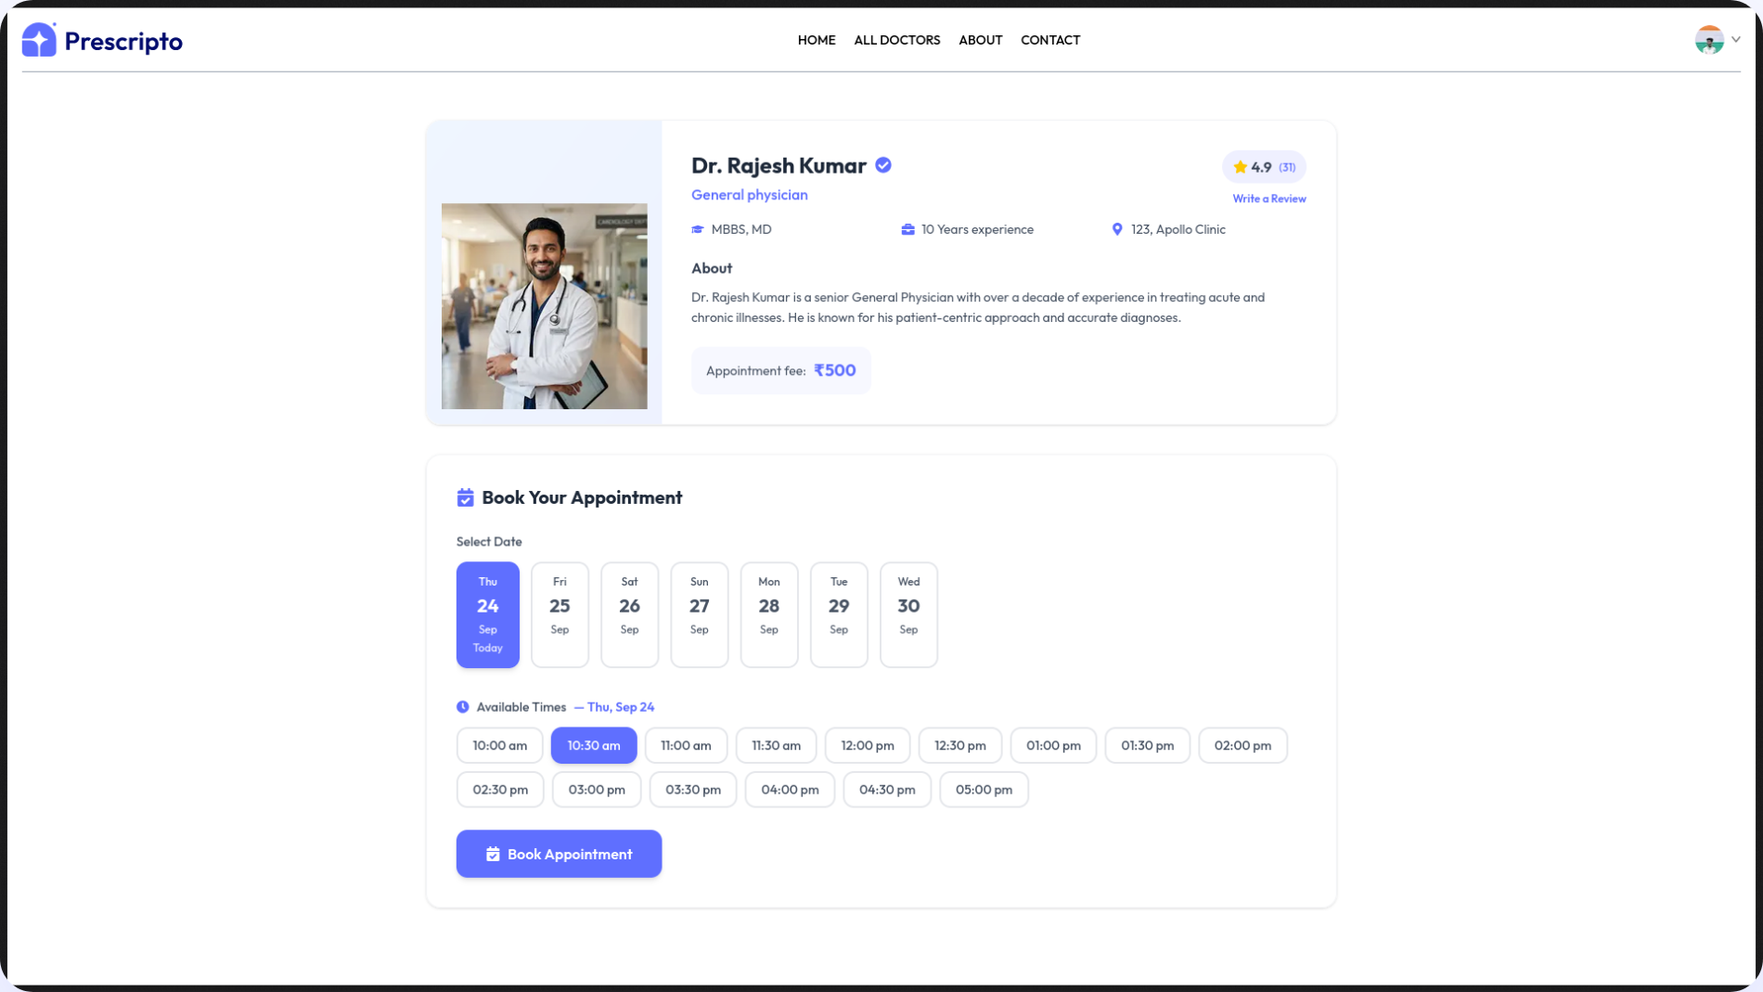
06 · PATIENT MODULE
Patient Features
01
Discovery
Filter doctors by speciality
02
Profile transparency
Degree, experience, bio and exact fee
03
Real-time booking
Only currently free slots are shown
04
Digital checkout
Razorpay overlay
05
Dashboard
Profile and appointment status
Doctor profile with live date and time slots
Notes:
Patient journey from discovery to paid booking and dashboard.

Slide 8
07 · DOCTOR & ADMIN
Doctor & Admin Features
DOCTOR MODULE
ADMIN MODULE
Application pipeline
Oversight
Submit credentials for review
All appointments and revenue
Schedule management
Gatekeeping
Today's upcoming appointments
Approve or reject doctor applications to ensure trust
Action controls
Approve
Reject
Completed
Cancel
Notes:
Doctors apply, manage schedules and update statuses; admins oversee everything and gate doctor approvals.

Slide 9
08 · MONGODB
Database Schema
User
Doctor
Appointment
DoctorApplication
name
name
userId → User
Temporary storage for doctors pending admin approval
email
speciality
docId → Doctor
password
experience
slotDate
address
fees
slotTime
dob
slots_booked
payment
phone
userData / docData snapshot
Notes:
Four collections. Appointment stores a snapshot of user and doctor data at booking time.

Slide 10
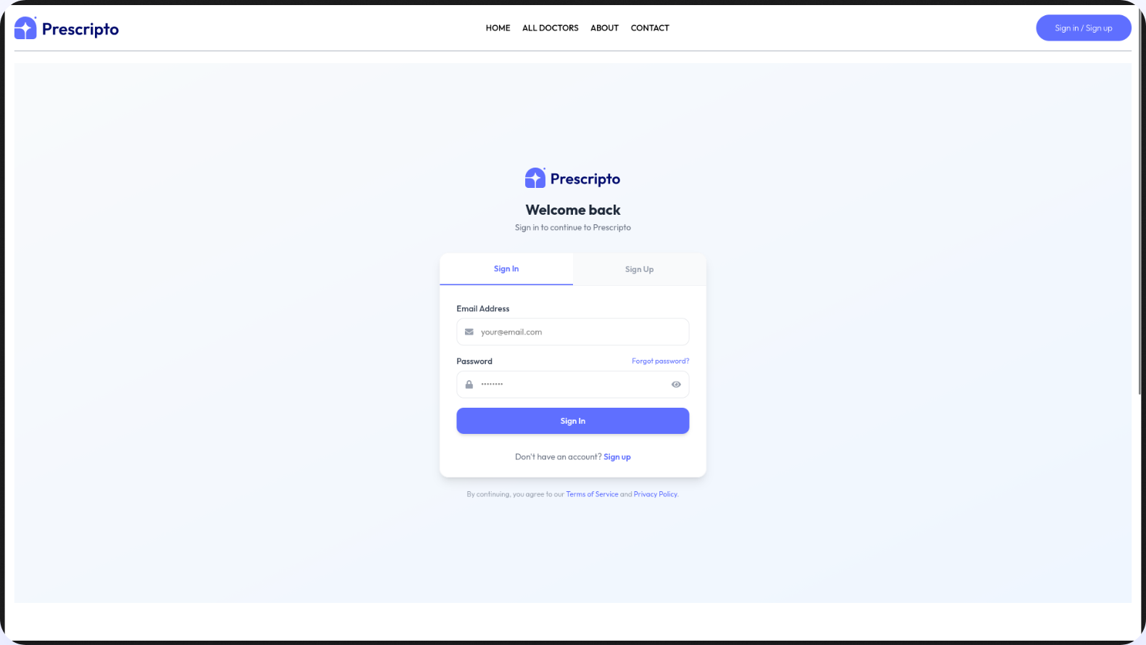
09 · AUTHENTICATION
Authentication & Security
Role-based JWT
patient
doctor
admin
Middleware protection
authDoctor verifies the token so patients can't open a doctor's appointment list.
Password hashing
bcrypt ensures passwords are never stored in plaintext.
Notes:
Role-scoped JWTs, route middleware such as authDoctor, and bcrypt hashing.

Slide 11
10 · CONCURRENCY
The Double-Booking Challenge
Two patients click “Book” on the same 10:00 AM slot at the same moment.
Patient A
POST 10:00
// Doctor.slots_booked by dateconst slots = slots_booked[slotDate]; if (slots.includes(slotTime))
return reject();
slots.push(slotTime);
await doctor.save();
A · Booked
Time pushed and saved
Patient B
POST 10:00
B · Rejected
Slot already taken
Notes:
Two patients click Book on the same 10:00 AM slot. The backend checks slots_booked before writing.

Slide 12
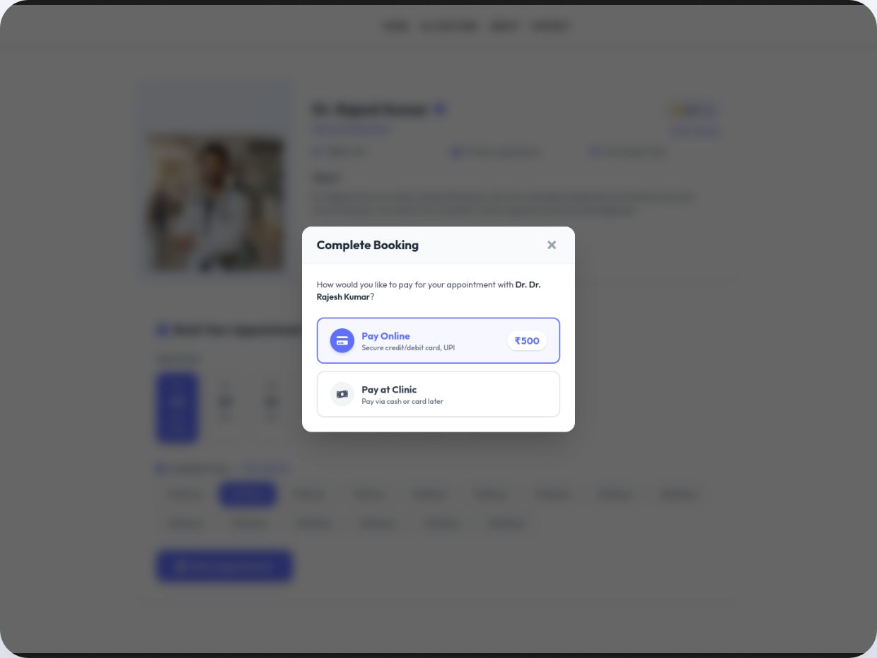
11 · RAZORPAY
Payment Integration
1
Order creation
fees * 100 → Razorpay order_id
2
Client checkout
Patient pays via UPI or card in the modal
3
Verification
crypto.createHmac checks the signature
4
Confirmation
Appointment set to payment: true
Notes:
Four-step Razorpay flow with HMAC signature verification.

Slide 13
12 · FRONTEND
Frontend Excellence with Next.js
Why Next.js instead of standard React
SEO
Routing
Performance
SSR makes doctor profile pages visible to search crawlers immediately.
Folder-based App Router for each dashboard.
Optimized image loading and fast page transitions.
/app/admin
/app/doctor
/app/my-profile
Notes:
Why Next.js over plain React: SEO, folder routing, performance.

Slide 14
13 · CLOUDINARY
Handling Medical Imagery
Quality profile photos build trust on a medical platform.
REJECTED
REJECTED
CHOSEN
Base64 in MongoDB
Server disk
Multer → Cloudinary → URL
Bloats the database
Causes scaling issues
Express intercepts the file, uploads it, and saves only the optimized CDN URL.
Notes:
Base64 bloats the database, disk storage doesn't scale; Cloudinary with Multer stores only a CDN URL.

Slide 15
14 · STATE MANAGEMENT
Context API over Redux
Patients never see admin data, so a heavy global store was unnecessary.
AppContext
User session
Auth token
Approved doctors list
No prop-drilling
Notes:
Roles are cleanly separated, so a lightweight AppContext is enough.

Slide 16
15 · TESTING
Testing & Validation
Backend scripts
API security
Payment edge cases
Validate slot locking and the application pipeline without the UI.
Postman confirms cross-role access is denied, e.g. a patient can't approve a doctor.
Failed signature checks keep appointments marked Pending.
test-appts.js
test-doctor-api.js
Notes:
Script-based API tests, Postman role checks, and payment failure cases.

Slide 17
16 · ROADMAP
Future Enhancements
01
Telemedicine
02
Digital prescriptions
Video consultations via WebRTC or Zoom API.
Secure PDF prescriptions after each visit.
03
Automated reminders
04
Dynamic slots
Email and SMS 24 hours before a slot.
Custom shift durations set by doctors.
Notes:
Four planned extensions.

Slide 18
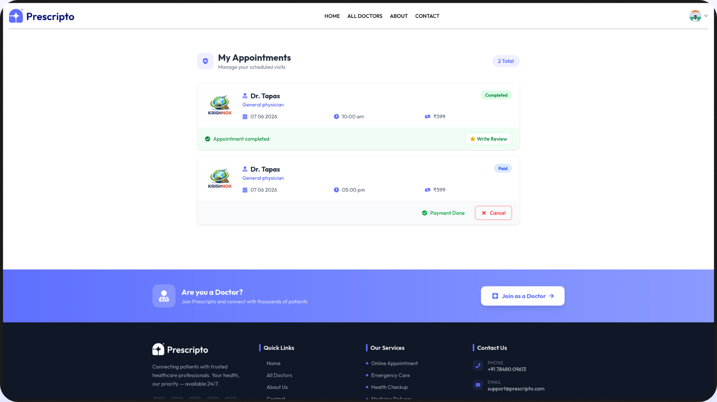
17 · CONCLUSION
Conclusion
Digitalizes local healthcare booking, solving transparency and manual scheduling.
Multi-role access control and robust slot-booking concurrency logic.
Performant, production-ready MERN + Next.js platform.
Notes:
Summarize the three takeaways.

Slide 19
Prescripto
18 · Q&A
Thank You
Questions?
PROJECT
DEVELOPER
Prescripto · Doctor Appointment Booking
Tapas Jyoti
Codebase available upon request
Notes:
Invite questions.

