Slide 1
Student Management System
Presented By:
-Nisha Tapase
-Nikita Varpe
-Anuja Kalekar
-Komal Yelmane
Notes:
We designed this template so that each member of the project team has a set of slides with its own theme. Members, here’s how you add a new slide to just your set:
Mark where you want to add the slide: Select an existing one in the Thumbnails pane, click the New Slide button, then choose a layout. The new slide gets the same theme as the other slides in your set.
Careful! Don’t annoy your fellow presenters by accidentally changing their themes. That can happen if you choose a different theme from the Design tab, which changes all of the slides in the presentation to that look.

Slide 2
INTRODUCTION
Student Management system can handle all the details about a student. The details include student Id, Student name , Student email, Student address etc.
The student management system is an automated version of manual student management system.
It also securely stores and manages personal and other related details for your student.
Spring Boot is considered as a light-weight framework which results in less complexity in maintaining the data.

Slide 3
REQUIREMENTS
HARDWARE REQUIREMENTS | SOFTWARE REQUIREMENTS
OPERATING SYSTEM: WINDOWS 10 | SPRING TOOL SUITE(STS)
HARD DISK | JAVA JDK(1.8)
RAM : 8 GB | MySQL Server, Postman, Visual Studio code

Slide 4
EXISTING SYSTEM vs PROPOSED SYSTEM
System Analysis is a detailed study of the various operations performed by a system and their
relationships within and outside of the system. Here the key question is- what all problems exist in the
present system? What must be done to solve the problem? Analysis begins when a user or manager begins a
study of the program using existing system.
In our proposed system we have the provision for adding the details of the students by
themselves. So, the overhead of the school authorities and the teachers is become less. Another advantage of
the system is that it is very easy to edit the details of the student and delete a student when it found
unnecessary. The marks of the student are added in the database and so students can also view the marks
whenever they want

Slide 5
TECHNOLOGIES USED
Spring Tool Suite(4)
Spring Boot is a java framework used for develop standalone application.
Need strong knowledge in OOPS & Java concept then only working with spring framework.
Mostly all applications are developed by spring boot. Because it was very secure no one hack the information. That’s why all of payment related software using java.

Slide 6
In the beginning spring was hard to learn. But after working with few months you can easily understand all queries.
Spring Boot is an open source Java-based framework used to create a micro Service.
It is developed by Pivotal Team and is used to build stand-alone and production ready spring applications.

Slide 7
MySQL
MySQL creates a database for storing and manipulating data, defining the relationship of each table.
Clients can make requests by typing specific SQL statements on MySQL.
The server application will respond with the requested information and it will appear on the clients' side.

Slide 8
MySQL works with an operating system to implement a relational database in a computer's storage system, manages users, allows for network access and facilitates testing database integrity and creation of backups.
MySQL is ideal for both small and large applications

Slide 9
POSTMAN
Postman is an API client that makes it easy for developers to create, share, test and document APIs.
With this open-source solution, users can create and save simple and complex HTTP/s requests, as well as read their responses.
When you are signed into your account, you are able to access your files. You can execute Postman API tests anytime, anywhere.

Slide 10
Postman is very convenient when it comes to executing APIs. Once you’ve entered and saved them.
you can simply use them over and over again, without having to remember the exact endpoint, headers, or API keys.

Slide 11
Angular
Angular is a widely used JavaScript framework for front-end development. In this article on the Angular project, we’re building an Admin dashboard using Angular 10. Before you go ahead with application building, make sure you are familiar with Angular's core concepts. You could check out articles on various topics like Angular Components, Routing, Services, Bootstrap, and more.

Slide 12
ANNOTATION USED
@Entity: This annotation specifies the table in the database with which this entity is mapped.
@Id :The @Id annotation is inherited from javax.persistence.Id, indicating the member field below is the primary key of the current entity.
@Column: This is used for Adding the column the name in the table of a particular MySQL database.

Slide 13
@GeneratedValue: Provides for the specification of generation strategies for the values of primary keys.
@Service: It is used with classes that provide basic functionalities.
@Autowired:Enables us to inject dependecies.
@PostMapping:It maps the HTTP POST requests on the specific handler method

Slide 14
@RestController: It is used to make restful web services.
@GetMapping: Maps the HTTP GET requests on handler method.
@RequestMapping: It is used to map the web requests.
@PutMapping: It is used to create a web service endpoint that creates or updates.
@DeleteMapping: It is used to create a web service endpoint that deletes a resource.

Slide 15
@RequestMapping(method = RequestMethod.PATCH)
@SpringBootApplication: This annotation is used to mark a configuration class that declares one or more.
@Bean : methods and also triggers auto-configuration and component scanning.
@Generated: It is used to mark source code that has been generated

Slide 16
MODULE USED
Entity
The entities are the persistence objects stores as a record in the database.
Persistence Unit: It defines a set of all entity classes. In an application, EntityManager instances manage it.
The set of entity classes represents the data contained within a single data store.

Slide 17
Repository
Spring boot framework provides us repository which is responsible to perform various operations on the object.
Repository classes are auto detected by spring framework through classpath scanning.

Slide 18
Service
Spring boot service component is defined as a class file that includes the @Service annotation and allows developers to add business functionalities.
The annotation is used with the classes that provide these business functionalities.

Slide 19
Controller
In Spring Boot, the controller class is responsible for processing incoming REST API requests, preparing a model, and returning the view to be rendered as a response.
The controller classes in Spring are annotated either by the @Controller or the @RestController annotation.

Slide 20
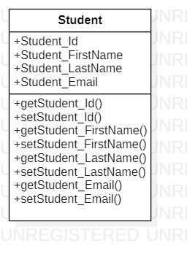
CLASS DIAGRAM

Slide 21
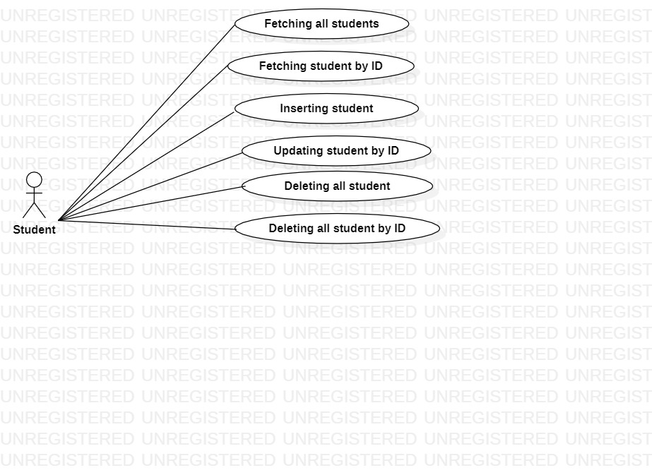
USE CASE DIAGRAM

Slide 22
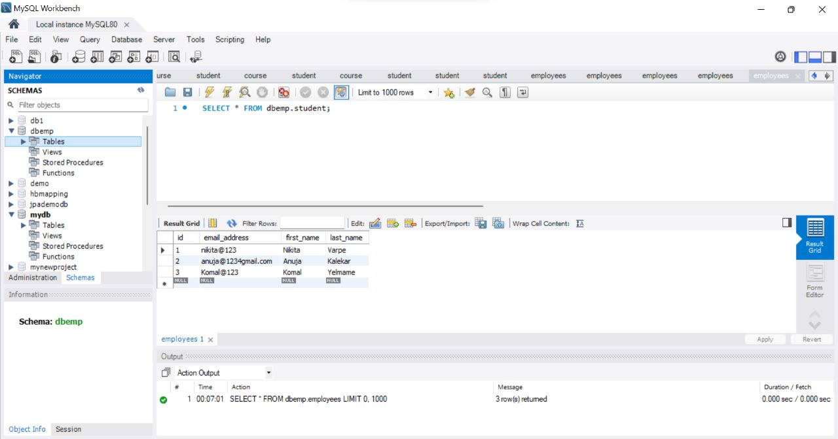
SCREENSHOT

Slide 23
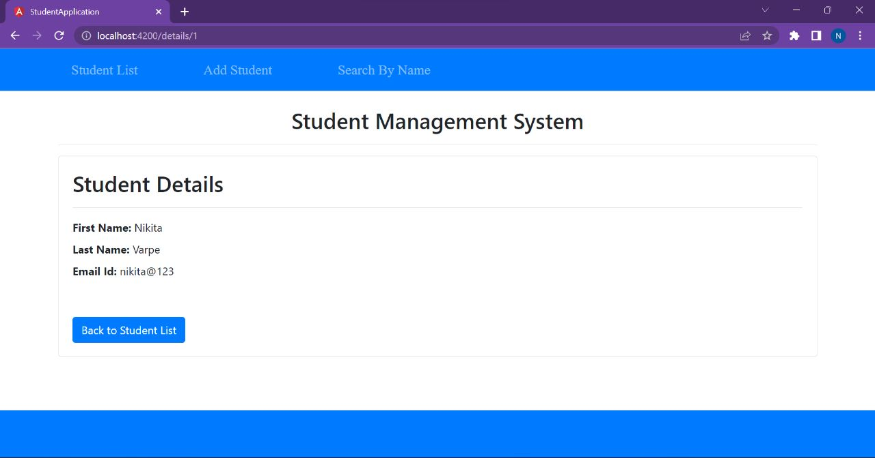

Slide 24
CONCLUSION
This project has been created to digitalize the database of Students.
Software provides Student management system for inserting, deleting, searching and updating records of students.

Slide 25
Thank you

