Slide 1
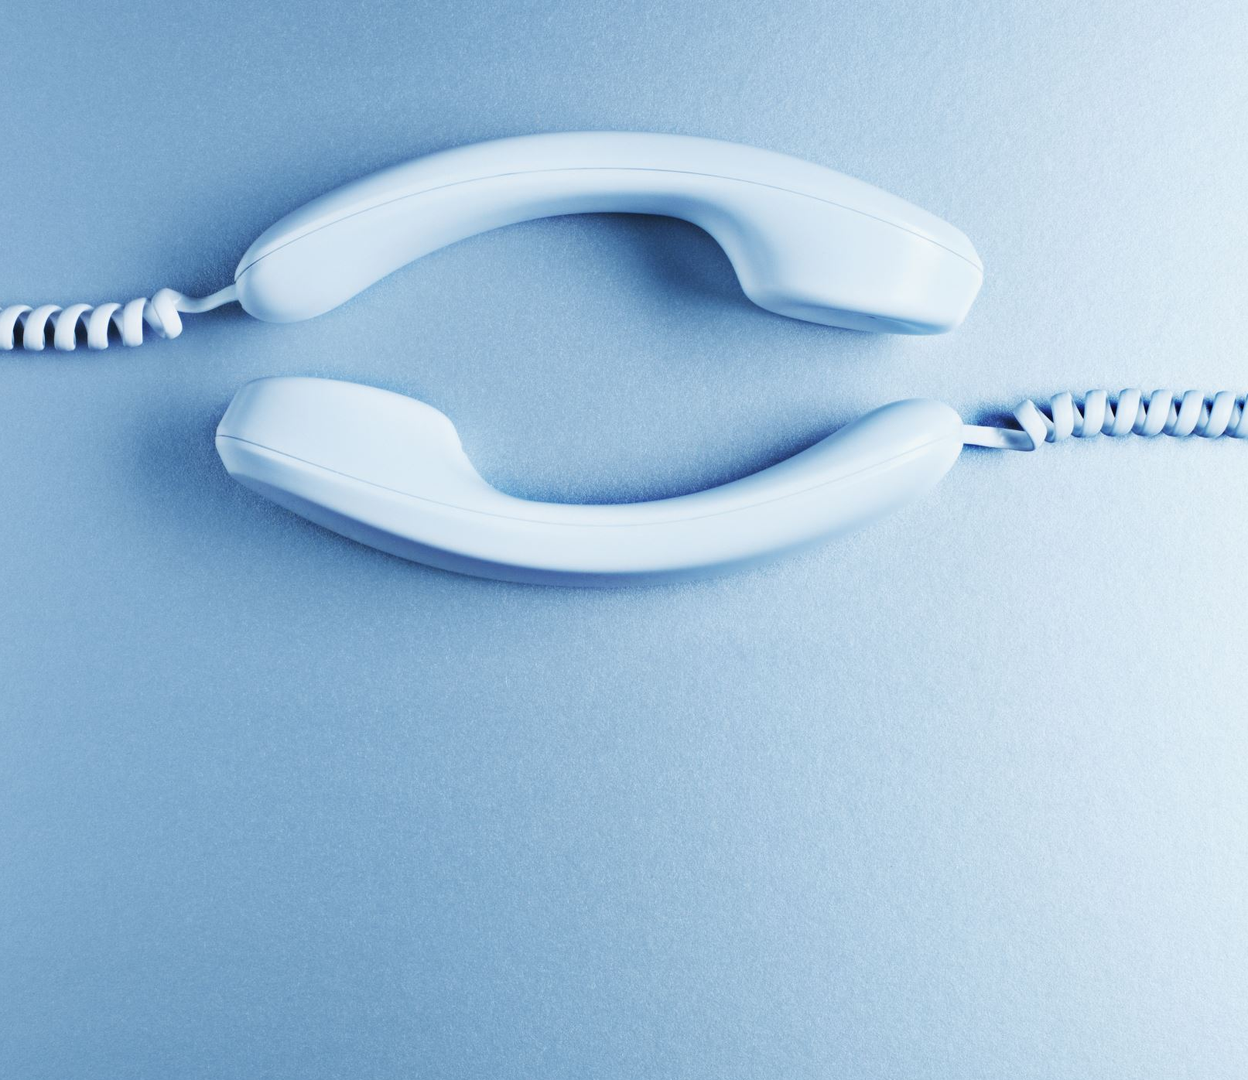
Caller Log Application
Group 1:
Carlos Abaffy
Harsh Patel
Ishneet Kaur
Tapaswee Dixit

Slide 2

Introduction
Monitoring calls in an organization is extremely important. Organizations that do not have call monitoring generally have difficulty tracking customer interactions and monitoring the performance of their employees.
Our plan is to develop a caller log, which is a valuable tool for any organization that handles a high volume of phone calls, as it allows them to maintain a detailed record of all incoming and outgoing calls.
The users can search out the contact details from the directory and make any updates in the call logs.

Slide 3
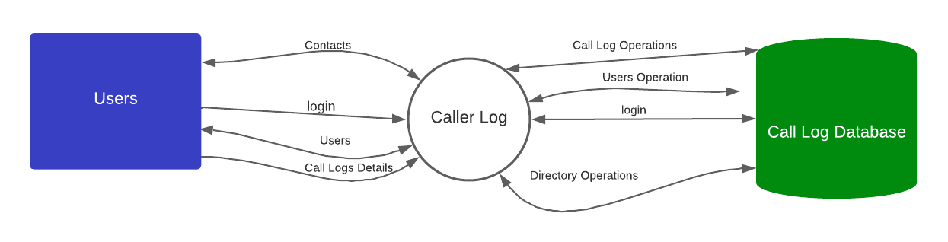
Context Diagram: Level 0

Slide 4
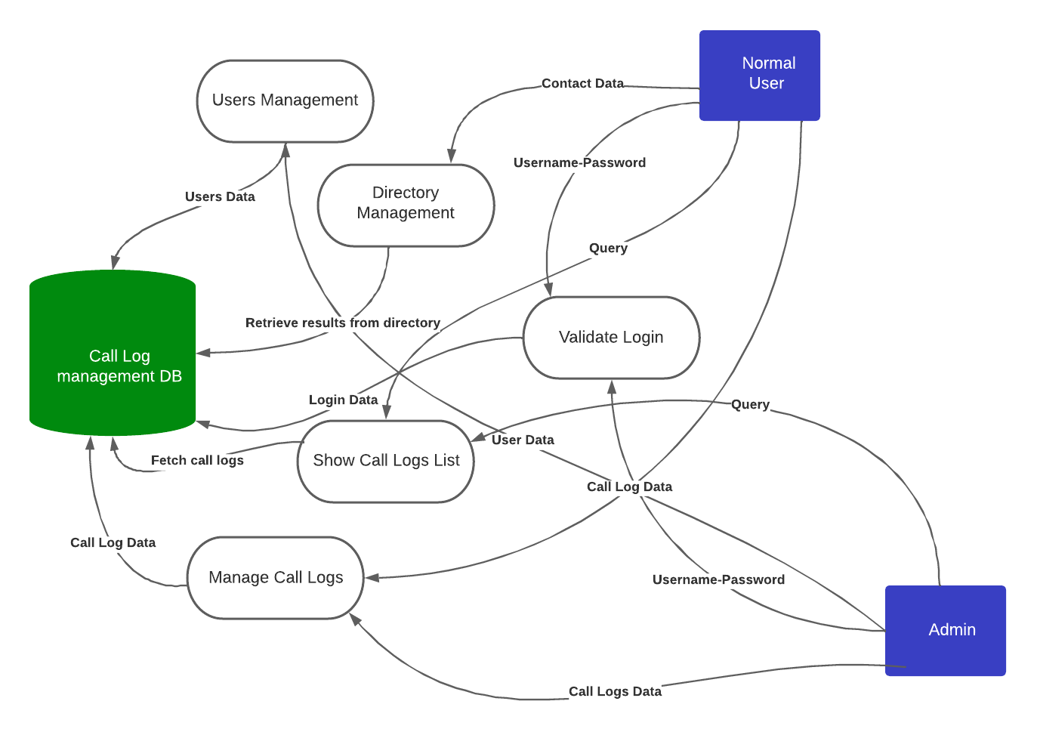
Context Diagram: Level 1

Slide 5
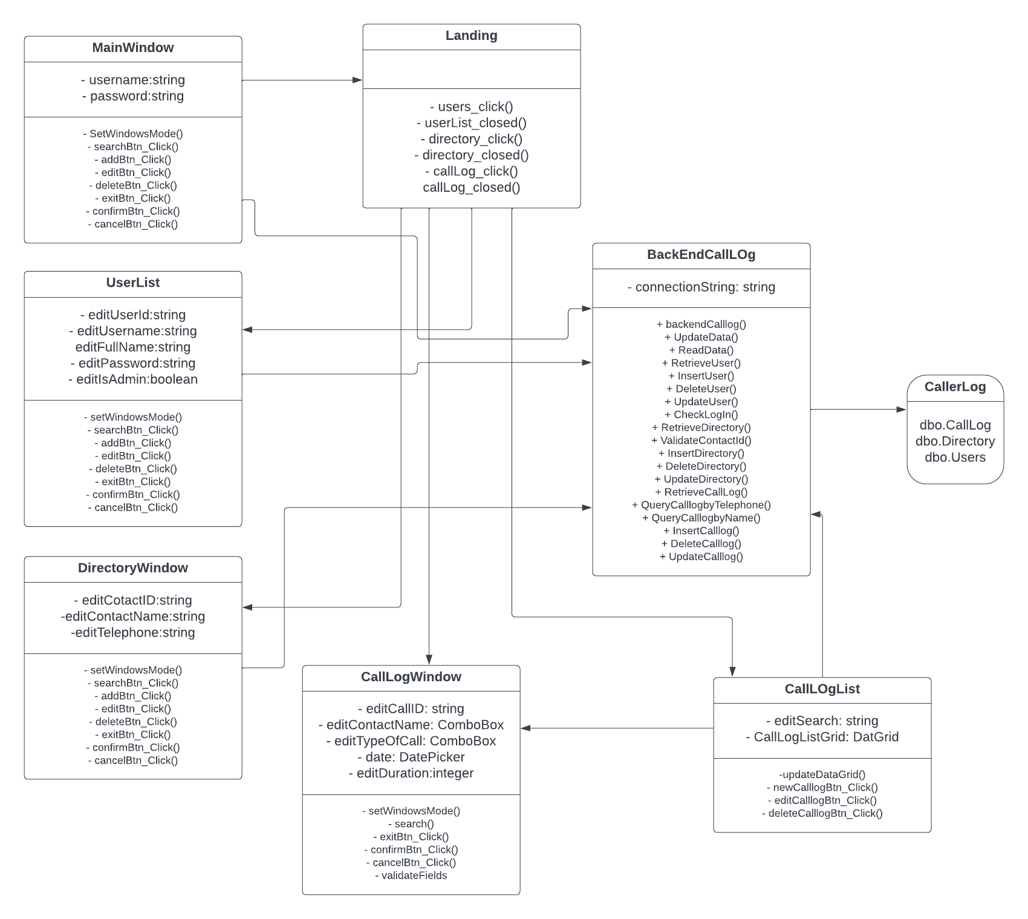
Class Diagram

Slide 6
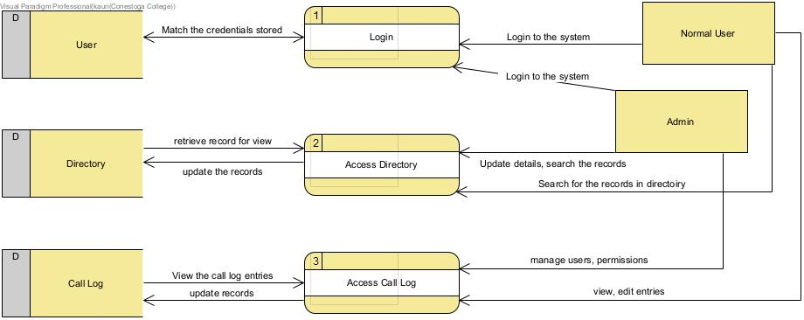
Data Entities

Slide 7
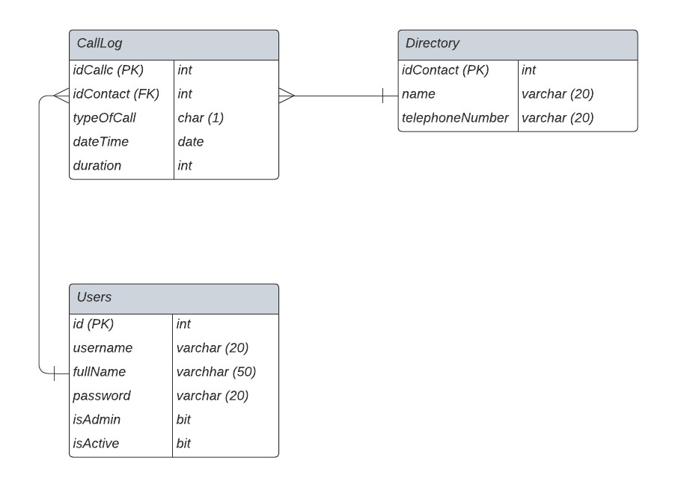
Database SQL server
Three tables are created :

Slide 8
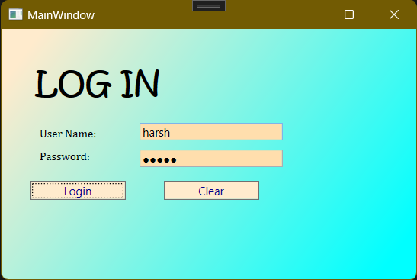
Front end WPF (Visual Studio)
Login screen:

Slide 9
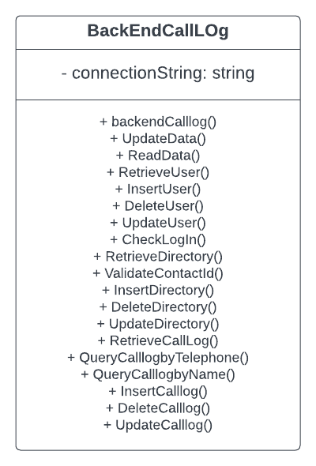
Back end C# (Visual Studio)

Slide 10

Future plans:
Exporting call logs: The user should be able to export the call logs to a file, such as a CSV or Excel file, for further analysis or record keeping.
Adding tags: The user should be able to add tags to calls to categorize them and make them easier to find later.
Sorting calls: The user should be able to sort the list of calls by date, time, or caller name.
Customizing the system: The admin should be able to customize the system to meet the needs of the organization, such as adding new fields to the call log or creating custom reports.
Backing up data: The admin should be responsible for backing up the data in the system regularly to ensure that it can be restored in case of a data loss event.
Monitoring system performance: The admin should watch system performance to ensure that it is running smoothly and efficiently and take steps to optimize performance if necessary.
Managing security: The admin should handle managing system security, such as setting up user authentication and authorization, implementing data encryption, and monitoring for security threats.
Managing system upgrades: The admin should handle managing system upgrades, such as installing updates and patches, and ensuring that the system remains up-to-date and secure.

Slide 11

Thank you

