Slide 1


1st Instruction Prefetching Championship
May 31st, 2020
Held in conjunction with ISCA 2020
Seth Pugsley (Intel Labs)

Slide 2
Closing and Results
Thank you for your hard work
16 submissions
Top 6 performers presented today
Final score = geomean of speedup for all 83 traces
Prizes for the top 3 prefetchers

Slide 3
Scores
* Perfect L1-I: 1.260x
* 160 KB L1-I: 1.110x
* Next-line PF: 1.055x
Lowest Submitted Score: 1.128x
Highest Submitted Score: 1.207x
Green = presented at IPC-1

Slide 4
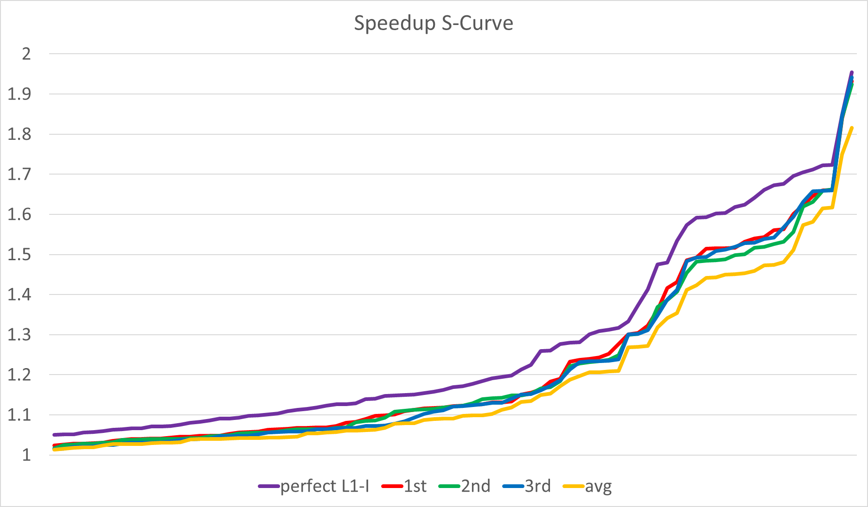
Winners’ S-curves
1st: 1.207x speedup
2nd: 1.201x speedup
3rd: 1.199x speedup
2nd and 3rd take turns having a higher S-curve
1st’s S-curve is more consistently on top

Slide 5
Top 3 prefetchers …

Slide 6
Top 3 prefetchers …
3rd place:
“D-JOLT: Distant Jolt Prefetcher” by Tomoki Nakamura, Toru Koizumi, Yuya Degawa, Hidetsugu Irie, Shuichi Sakai, Ryota Shioya (The University of Tokyo)

Slide 7
Top 3 prefetchers …
3rd place:
“D-JOLT: Distant Jolt Prefetcher” by Tomoki Nakamura, Toru Koizumi, Yuya Degawa, Hidetsugu Irie, Shuichi Sakai, Ryota Shioya (The University of Tokyo)
2nd place:
“The FNL+MMA Instruction Cache Prefetcher” by Andre Seznec (INRIA/IRISA)

Slide 8
Top 3 prefetchers …
3rd place:
“D-JOLT: Distant Jolt Prefetcher” by Tomoki Nakamura, Toru Koizumi, Yuya Degawa, Hidetsugu Irie, Shuichi Sakai, Ryota Shioya (The University of Tokyo)
2nd place:
“The FNL+MMA Instruction Cache Prefetcher” by Andre Seznec (INRIA/IRISA)
1st place:
“Entangled Instruction Prefetcher” by Alberto Ros, Alexandra Jimborean (University of Murcia)

Slide 9
Thank you!
Congratulations to the winners!

