Slide 1


SHIP++: Enhancing Signature-Based Hit Predictor for Improved Cache Performance
CRC-2, ISCA 2017
Toronto, Canada
June 25, 2017
Vinson Young, Georgia Tech
Chia-Chen Chou, Georgia Tech
Aamer Jaleel, NVIDIA
Moinuddin K. Qureshi, Georgia Tech
Notes:
25 minutes total per slot.
20 minute presentation, 4 minute question, 1 minute change.

Slide 2
Importance of Replacement Policy
Increasing # of cores increase memory load
Improving cache hit rate reduces memory load for cheap
Improve access latency ➔ improves performance
Reduce memory accesses ➔ improves power and performance
LRU is commonly used

Slide 3
Problems with LRU Replacement
Working set larger than the cache causes thrashing
miss
miss
miss
miss
miss
LLC_{size}
W_{size}
References to non-temporal data (scans) discards frequently referenced working set
hit
hit
hit
miss
hit
miss
miss
scan
scan
scan
W_{size}
LLC_{size}
scans occur frequently in commercial workloads
Notes:
The first problem with LRU replacement is when the working set is larger than the cache. In such scenarios, LRU causes cache thrashing and always results in misses!
The second problem is when references to non-temporal data, called scans, discards the frequently referenced working set from the cache. Let me illustrate. When the working set is smaller than the LLC it receives cache hits. Successive references to the working set continue to receive cache hits. However, after a one-time reference to a long stream of data, re-references to the working set after the scan result in a miss under LRU replacement. Successive re-references after re-fetching the data from memory result in hits until the next scan. And the problem repeats ☹. After every scan, the frequently referenced working set always misses!
Why is this important? Well, our studies show that scans occur frequently in many commercial workloads.
-wu

Slide 4
Desired Behavior from Cache Replacement
Working set larger than the cache ➔ Preserve some of working set in the cache
hit
hit
hit
hit
hit
miss
miss
miss
miss
miss
W_{size}
LLC_{size}
[ DIP (ISCA’07), DRRIP (ISCA’10) achieves this effect ]
Recurring scans ➔ Preserve frequently referenced working set in the cache
hit
hit
hit
hit
hit
hit
hit
scan
scan
scan
[ SRRIP (ISCA’10) achieves this effect ]
Notes:
Under both these scenarios, the desired behavior from cache replacement is as follows:
If working set is larger than cache, preserve some of it in the cache.
In the presence of recurring scans, the replacement policy should preserve the frequently referenced working set in the cache.
-wu

Slide 5
Dynamic Re-Reference Interval Prediction ( DRRIP )
(SRRIP)
Scan-Resistant
( BRRIP )
Thrash-Resistant
insertion
insertion
0
Imme-
diate
1
Inter-
mediate
2
far
3
distant
No Victim
No Victim
No Victim
re-reference
eviction
re-reference
re-reference
[ Jaleel et al., ISCA’10 ]
Notes:
Since our work builds on top of the re-reference interval framework, I would like to quickly review the RRIP replacement policy. Like LRU which holds the LRU position with each cache line, RRIP replaces the notion of the “LRU” position with a prediction of the likely re-reference interval of a cache line. For example, with 2-bit RRIP, there are four possible re-reference intervals. If a line has re-reference interval 0, it implies the line will be re-referenced soon. If a line has re-reference interval 3, it implies the line will be re-referenced in the distant future. In between distant and immediate there is intermediate and far re-reference intervals.
When selecting a victim, RRIP always selects lines that have a distant re-reference interval for eviction. If no line is found, the states of all lines in the set are incremented until a line with distant re-reference interval is found.
When inserting new lines in the cache, scan-resistant SRRIP dynamically tries to learn the re-reference interval of a line by initially inserting ALL lines with “far” re-reference interval. This is done in an effort to dynamically learn the blocks re-reference interval. If the line has no locality, it will be quickly discarded. However, if the line has locality, on the next re-reference the line is moved to have immediate state, hence preserving it in the cache for a longer time.
-wu

Slide 6
Dynamic Re-Reference Interval Prediction ( DRRIP )
(SRRIP)
Scan-Resistant
( BRRIP )
Thrash-Resistant
insertion
insertion
0
Imme-
diate
1
Inter-
mediate
2
far
3
distant
No Victim
No Victim
No Victim
re-reference
eviction
re-reference
re-reference
[ Jaleel et al., ISCA’10 ]

Slide 7
Signature-based Hit Predictor (SHiP)
PC-classified
Re-use
PC-classified
Scan
insertion
insertion
0
Imme-
diate
1
Inter-
mediate
2
far
3
distant
No Victim
No Victim
No Victim
re-reference
eviction
re-reference
re-reference
[ Wu et al., MICRO’11 ]

Slide 8
Observe Signature Re-Reference Behavior
Observe re-reference pattern in the baseline cache
Address
Load/Store
Cache Tag
Replacement State
Coherence State
LLC

Slide 9
Observe Signature Re-Reference Behavior
Observe re-reference pattern in the baseline cache
Gathering Signature:
Was line re-referenced after cache insertion ( 1-bit )
“Signature” responsible for cache insertion ( 14-bits )
Signature
Address
Load/Store
reuse bit
signature_insert
metadata
LLC

Slide 10
Learn Signature Re-Reference Behavior
Learn signature re-reference behavior
Signature History Counter Table (SHCT)( 16K, 3-bit counters )
Learning with SHCT
SHCT
Cache Hit ➔
SHCT[signature_insert]++
000
SHCTR
Evict (re-use=0) ➔
SHCT[signature_insert]--
Non-zero

Slide 11
Predicting Signature Re-Reference Behavior
Learn signature re-reference behavior
Signature History Counter Table (SHCT)( 16K, 3-bit counters )
SHCT
Predicting with SHCT
SHCTR = 0, predict
NOT re-referenced.
Install state=3
000
SHCTR
SHCTR != 0, predict
signature re-referenced.
Install state=2
Non-zero
Notes:
Leverage SHCT to improve confidence of install

Slide 12
SHiP Improvements
3 improvements under no-prefetching
High-Confidence Install
Balanced SHCT Training
Write-back-aware Install
2 improvements under prefetching
Prefetch-aware Training
Prefetch-aware State-Update

Slide 13
Improvement 1: High-Confidence Installs
Previous: SHiP always installs with state 2 or 3
Observation: RRIP requires re-use before promoting to state 0.
But, some workloads benefit from keeping re-use lines longer
Solution: Leverage SHCT to confidently install at state 0.
Install with state 0, when SHCTR saturated at 7
Notes:
Leverage SHCT to improve confidence of install

Slide 14
Improvement 1: High-Confidence Installs
High-confidence
SHCtr == 7
Re-use
0 < SHctr < 7
Scans
SHCtr == 0
insertion
insertion
insertion
0
Imme-
diate
1
Inter-
mediate
2
far
3
distant
No Victim
No Victim
No Victim
re-reference
eviction
re-reference
re-reference
[ Jaleel et al., ISCA’10 ]
Notes:
Insight: Keep high confidence lines longer

Slide 15
Improvement 2: Balanced SHCT Training
Previous: SHCT Learns on all hits and evictions
Observation: Small number of high-access-frequency lines saturate CTRs (mcf and sphinx)
Solution: Learn from only first-hit and evictions

Slide 16
Improvement 2: Balanced SHCT Training
Learning with SHCT
SHCT
Cache Hit (re-use=0) ➔
SHCT[signature_insert]++
000
SHCTR
Evict (re-use=0) ➔
SHCT[signature_insert]--
Non-zero

Slide 17
Improvement 3: Writeback-Aware Installs
Previous: No differentiation for Writebacks
Observation: Writebacks not in critical path and signal end of a context. Can be bypassed.
Solution: Install writebacks at state 3 (why? Model requires install of writebacks)

Slide 18
Improvement 3: Writeback-Aware Installs
High-confidence
SHCtr == 7
Re-use
0 < SHctr < 7
Scans + Writebacks
(SHCtr == 0) || is_wb
insertion
insertion
insertion
0
Imme-
diate
1
Inter-
mediate
2
far
3
distant
No Victim
No Victim
No Victim
re-reference
eviction
re-reference
re-reference
[ Jaleel et al., ISCA’10 ]
Notes:
Insight: Keep high confidence lines longer

Slide 19
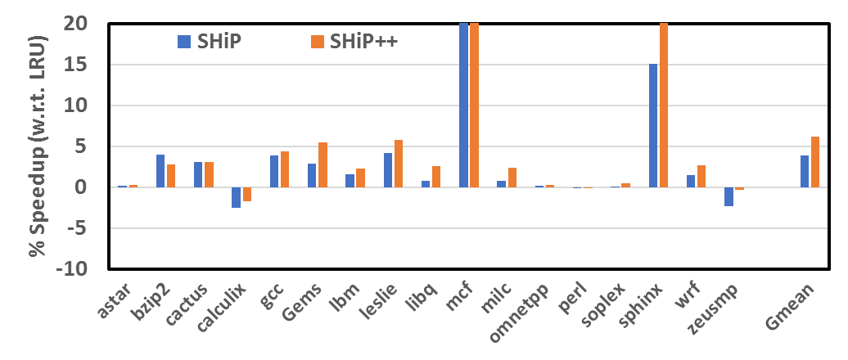
Results (under no prefetching)
38
64
26
SHiP++ achieves 6.2% Speedup over LRU (SHiP is 3.9%)
Notes:
High-confidence installs
Helps calculix, Gems, zeusmp
Better SHCT training (first-hit + eviction)
Helps mcf and sphinx

Slide 20
Improvement 4: Prefetch-Aware Training
Previous: No differentiation for Prefetches
Observation: Demand may have re-use, but prefetched lines may not have re-use
Solution: Learn separately in different halves of SHCT.
Use Signature = (PC << 1) + is_pf

Slide 21
Improvement 4: Prefetch-Aware Training
SHCT
Learning with SHCT
SHCTR
Prefetch half of SHCT
Cache Hit (re-use=0) ➔
SHCT[signature<<1 | is_pf]++
000
SHCTR
Demand half of SHCT
Evict (re-use=0) ➔
SHCT[signature<<1 | is_pf]--
Non-zero

Slide 22
Improvement 4: Prefetch-Aware Training
Predicting with SHCT
Learning with SHCT
Predict re-use for prefetch, separately
Cache Hit (re-use=0) ➔
SHCT[signature<<1 | is_pf]++
SHCTR
000
SHCTR
Predict re-use
Evict (re-use=0) ➔
SHCT[signature<<1 | is_pf]--
Non-zero

Slide 23
Improvement 5: Prefetch-Aware State-Update
Previous: No differentiation for Prefetch
Observation: Prefetches are staying in caches for a long time. First-access to prefetched line is demand access. Baseline SHiP promotes and keeps accurate prefetches past usefulness
Solution: Ignore state-update for first access to prefetched line. Update for subsequent accesses

Slide 24
Improvement 5: Prefetch-Aware State-Update
High-confidence
SHCtr == 7
Re-use
0 < SHctr < 7
Scans + Writebacks
(SHCtr == 0) || is_wb
insertion
On first-access to prefetched:
unset is_pf;
no state-update;
insertion
insertion
0
Imme-
diate
1
Inter-
mediate
2
far
3
distant
No Victim
No Victim
No Victim
re-reference && ! is_pf
eviction
re-reference && ! is_pf
re-reference && ! is_pf
[ Jaleel et al., ISCA’10 ]
Notes:
Insight: Keep high confidence lines longer

Slide 25
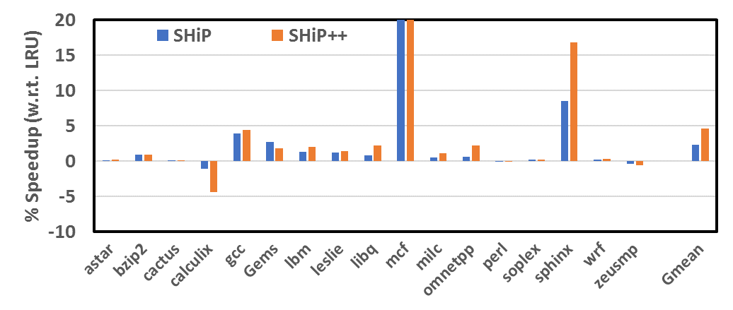
Results (under prefetching)
21
65
SHiP++ achieves 4.6% Speedup over LRU (SHiP is 2.3%)
Notes:
Sphinx and mcf.
Learns their prefetches are not accurate and installs them at low priority.

Slide 26
Summary
SHiP++: improve PC-based classifier for re-use / no-re-use PC’s
High-Confidence Install
Balanced SHCT Training
Write-back-aware Install
Prefetch-aware Training
Prefetch-aware State-Update
6.2 % speedup (base config), 4.6 % speedup (prefetch config)

Slide 27
THANK YOU

