Slide 1

The 2nd Cache Replacement Championship (CRC-2)
Sunday June 24, 2017 (Afternoon)
at the
International Symposium on Computer Architecture (ISCA 2017)

Slide 2
Overview
CRC-2 Traces
CRC-2 Experiments
CRC-2 Scores
SPEC CPU 2006: Configuration 1
SPEC CPU 2006: Configuration 2
SPEC CPU 2006: Configuration 3
SPEC CPU 2006: Configuration 4
CloudSuite: Configuration 3
CloudSuite: Configuration 4
Final Score

Slide 3
CRC-2 Traces
ChampSim
A trace-based simulator for detailed memory subsystem research (and hopefully for future competitions)
Each part in the microarchitecture can be easily modified and evaluated Ex) branch predictor, prefetchers, replacement policy, DRAM scheduling, DRAM cache, etc …
Full source for simulator publicly available
https://github.com/ChampSim/ChampSim
Licensed under the GPL v2
All traces used at http://bit.ly/2t2nkUj

Slide 4
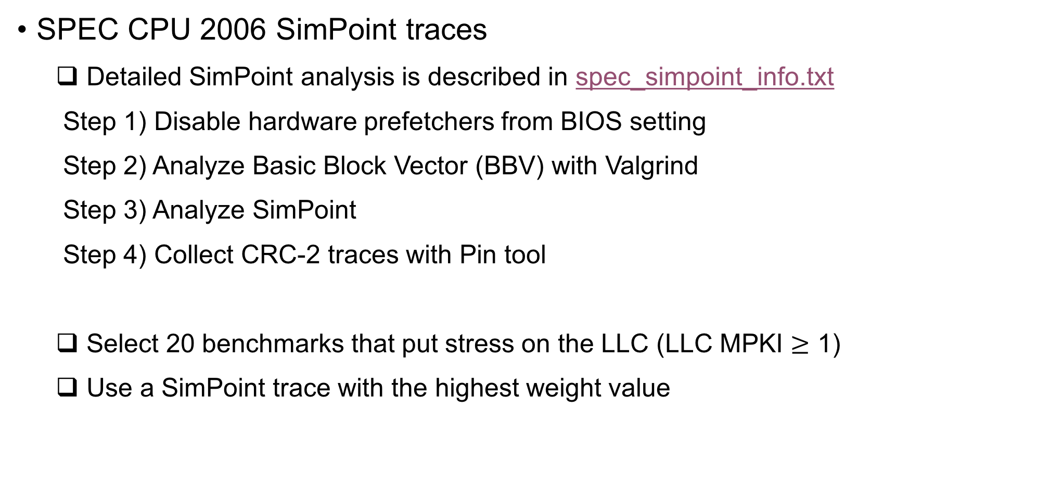
CRC-2 Traces
SPEC CPU 2006 SimPoint traces
Detailed SimPoint analysis is described in spec_simpoint_info.txt
Step 1) Disable hardware prefetchers from BIOS setting
Step 2) Analyze Basic Block Vector (BBV) with Valgrind
Step 3) Analyze SimPoint
Step 4) Collect CRC-2 traces with Pin tool
Select 20 benchmarks that put stress on the LLC (LLC MPKI $≥$ 1)
Use a SimPoint trace with the highest weight value

Slide 5
CRC-2 Traces
CloudSuite traces
Pin tool used in CRC-2 cannot capture OS references Server workloads spend a significant fraction of their time in OS [1, 2]
Thanks to Mark Sutherland, Javier Picorel, and Babak Falsafi at EPFL
Step 1) Run CloudSuite in an execution-driven full system simulator
Step 2) Intercept all instructions and memory references in the simulator
Step 3) Collect CRC-2 traces (6 sampling points) Each sample collects at least 100M instructions
[1] “Temporal Streams in Commercial Server Applications” [Wenisch et al. IISWC ‘08]
[2] “Micro-architectural Analysis of In-memory OLTP” [Sirin et al. SIGMOD ‘16]

Slide 6
CRC-2 Experiments
SPEC CPU 2006 (Single-core)
Run 1B instructions (200M warmup and 1B detailed execution)
Measure the geometric mean IPC speedup over the baseline LRU policy
SPEC CPU 2006 (Multi-core)
Run at least 1B instructions for all cores
Randomly generated 100 multi-programmed workloads
If one of traces finishes faster than others, the fast one will continue its execution and provide pressure to the shared resources
Measure the weighted IPC speedup over the baseline LRU policy

Slide 7
CRC-2 Experiments
CloudSuite (No single-core experiments)
CloudSuite (Multi-core)
Run at least 100M instructions for all cores
If one of traces finishes faster than others, the fast one will continue its execution and provide pressure to the shared resources
Measure the IPC speedup over the LRU (based on the slowest trace)
Measure the average speedup across 6 different samples

Slide 8
CRC-2 Experiments
How many experiments?
15 submissions + LRU + SHiP (17 replacement policies)
20 traces for single-core experiments
2 different single-core configurations 17 * 20 * 2 = 680 single-core experiments
100 random mixes for SPEC CPU 2006 multi-core experiments
5 benchmarks in CloudSuite and each benchmark has 6 sampling points
2 different multi-core configurations 17 * (100 + 5*6) * 2 = 4420 multi-core experiments

Slide 9
CRC-2 Scores
Each contestant will get six scores that measures the geometric mean IPC speedup of their replacement algorithm
SPEC CPU 2006: Configuration 1
SPEC CPU 2006: Configuration 2
SPEC CPU 2006: Configuration 3
SPEC CPU 2006: Configuration 4
CloudSuite: Configuration 3
CloudSuite: Configuration 4

Slide 10
CRC-2 Scores
Each contestant will get six scores that measures the geometric mean IPC speedup of their replacement algorithm
SPEC CPU 2006: Configuration 1
SPEC CPU 2006: Configuration 2
SPEC CPU 2006: Configuration 3
SPEC CPU 2006: Configuration 4
CloudSuite: Configuration 3
CloudSuite: Configuration 4
50% * SPEC
+
Weighted score
50% * CloudSuite

Slide 11
CRC-2 Scores
Each contestant will get six scores that measures the geometric mean IPC speedup of their replacement algorithm
SPEC CPU 2006: Configuration 1
SPEC CPU 2006: Configuration 2
SPEC CPU 2006: Configuration 3
SPEC CPU 2006: Configuration 4
CloudSuite: Configuration 3
CloudSuite: Configuration 4
12.5%
12.5%
12.5%
12.5%
+
Weighted score
25%
25%

Slide 12
CRC-2 Scores

Slide 13
SPEC CPU 2006: Configuration 1

Slide 14
SPEC CPU 2006: Configuration 1
3rd: Multiperspective Reuse Prediction by Daniel Jiménez

Slide 15
SPEC CPU 2006: Configuration 1
2nd: Less is More by Jiajun Wang et al.
3rd: Multiperspective Reuse Prediction by Daniel Jiménez

Slide 16
SPEC CPU 2006: Configuration 1
1st: SHiP++ by Vinson Young et al.
2nd: Less is More by Jiajun Wang et al.
3rd: Multiperspective Reuse Prediction by Daniel Jiménez

Slide 17
SPEC CPU 2006: Configuration 2

Slide 18
SPEC CPU 2006: Configuration 2
3rd: Hawkeye by Akanksha Jain and Calvin Lin

Slide 19
SPEC CPU 2006: Configuration 2
2nd: Multiperspective Reuse Prediction by Daniel Jiménez
3rd: Hawkeye by Akanksha Jain and Calvin Lin

Slide 20
SPEC CPU 2006: Configuration 2
1st: SHiP++ by Vinson Young et al.
2nd: Multiperspective Reuse Prediction by Daniel Jiménez
3rd: Hawkeye by Akanksha Jain and Calvin Lin

Slide 21
SPEC CPU 2006: Configuration 3

Slide 22
SPEC CPU 2006: Configuration 3
3rd: Multiperspective Reuse Prediction by Daniel Jiménez

Slide 23
SPEC CPU 2006: Configuration 3
2nd: ReD by Javier Díaz et al.
3rd: Multiperspective Reuse Prediction by Daniel Jiménez

Slide 24
SPEC CPU 2006: Configuration 3
1st: Hawkeye by Akanksha Jain and Calvin Lin
2nd: ReD by Javier Díaz et al.
3rd: Multiperspective Reuse Prediction by Daniel Jiménez

Slide 25
SPEC CPU 2006: Configuration 4

Slide 26
SPEC CPU 2006: Configuration 4
3rd: SHiP++ by Vinson Young et al.

Slide 27
SPEC CPU 2006: Configuration 4
2nd: ReD by Javier Díaz et al.
3rd: SHiP++ by Vinson Young et al.

Slide 28
SPEC CPU 2006: Configuration 4
1st: Hawkeye by Akanksha Jain and Calvin Lin
2nd: ReD by Javier Díaz et al.
3rd: SHiP++ by Vinson Young et al.

Slide 29
CloudSuite: Configuration 3

Slide 30
CloudSuite: Configuration 3
3rd: SHiP++ by Vinson Young et al.

Slide 31
CloudSuite: Configuration 3
2nd: Multiperspective Reuse Prediction by Daniel Jiménez
3rd: SHiP++ by Vinson Young et al.

Slide 32
CloudSuite: Configuration 3
1st: ReD by Javier Díaz et al.
2nd: Multiperspective Reuse Prediction by Daniel Jiménez
3rd: SHiP++ by Vinson Young et al.

Slide 33
CloudSuite: Configuration 4

Slide 34
CloudSuite: Configuration 4
3rd: SHiP++ by Vinson Young et al.

Slide 35
CloudSuite: Configuration 4
2nd: Less is More by Jiajun Wang et al.
3rd: SHiP++ by Vinson Young et al.

Slide 36
CloudSuite: Configuration 4
1st: Multiperspective Reuse Prediction by Daniel Jiménez
2nd: Less is More by Jiajun Wang et al.
3rd: SHiP++ by Vinson Young et al.

Slide 37
Final Score

Slide 38
Final Score
Marginal performance difference between the Top 5 policies

Slide 39
Final Score
3rd: ReD by Javier Díaz et al.

Slide 40
Final Score
2nd: SHiP++ by Vinson Young et al.
3rd: ReD by Javier Díaz et al.

Slide 41
Final Score
1st: Hawkeye by Akanksha Jain and Calvin Lin
2nd: SHiP++ by Vinson Young et al.
3rd: ReD by Javier Díaz et al.

Slide 42
Final Score
1st: Hawkeye by Akanksha Jain and Calvin Lin
2nd: SHiP++ by Vinson Young et al.
3rd: ReD by Javier Díaz et al.

Slide 43
Final Score
 | Geomean Scores |  |  |  |  |  | Final Scores
 | SPEC CPU 2006 |  |  |  | CloudSuite |  | Measurement |  |  |  | Rank
POLICY | CONFIG 1 | CONFIG 2 | CONFIG 3 | CONFIG 4 | CONFIG 3 | CONFIG 4 | Weighted | Arithmetic | Geomtric | Harmonic | Weighted | Arithmetic | Geomtric | Harmonic
SHiP | 1.0307 | 1.0060 | 1.0694 | 1.0287 | 1.0075 | 1.0046 | 1.0199 | 1.023848 | 1.024258 | 1.024014 | 7 | 7 | 7 | 7
repl4 | 1.0263 | 0.9994 | 1.0373 | 1.0223 | 0.9980 | 0.9980 | 1.0097 | 1.013549 | 1.013427 | 1.013306 | 11 | 12 | 12 | 12
repl5 | 1.0444 | 1.0253 | 1.0823 | 1.0415 | 1.0097 | 1.0124 | 1.0297 | 1.035932 | 1.035645 | 1.035362 | 4 | 4 | 4 | 4
repl6 | 1.0309 | 1.0081 | 1.0327 | 1.0175 | 0.9980 | 0.9943 | 1.0092 | 1.013578 | 1.013469 | 1.013360 | 12 | 11 | 11 | 11
repl7 | 1.0096 | 1.0014 | 1.0218 | 1.0164 | 0.9982 | 1.0012 | 1.0060 | 1.008093 | 1.008056 | 1.008020 | 14 | 14 | 14 | 14
repl8 | 1.0020 | 0.9878 | 0.9844 | 0.9786 | 0.9883 | 0.9904 | 0.9888 | 0.988605 | 0.988580 | 0.988555 | 16 | 16 | 16 | 16
repl10 | 1.0469 | 1.0199 | 1.0748 | 1.0462 | 1.0085 | 1.0117 | 1.0285 | 1.034654 | 1.034389 | 1.034125 | 5 | 5 | 5 | 5
repl11 | 1.0236 | 1.0097 | 1.0423 | 1.0337 | 1.0021 | 1.0042 | 1.0152 | 1.019265 | 1.019153 | 1.019042 | 9 | 8 | 8 | 8
repl12 | 1.0357 | 1.0145 | 1.0698 | 1.0564 | 1.0076 | 1.0087 | 1.0261 | 1.032101 | 1.031821 | 1.031543 | 6 | 6 | 6 | 6
repl13 | 1.0343 | 1.0160 | 1.0904 | 1.0650 | 1.0106 | 1.0092 | 1.0307 | 1.037585 | 1.037145 | 1.036711 | 3 | 3 | 3 | 3
repl14 | 1.0286 | 1.0114 | 1.0332 | 1.0239 | 0.9991 | 1.0004 | 1.0120 | 1.016085 | 1.015998 | 1.015910 | 10 | 10 | 10 | 10
repl15 | 1.0495 | 1.0254 | 1.0799 | 1.0639 | 1.0088 | 1.0099 | 1.0320 | 1.039570 | 1.039222 | 1.038876 | 2 | 2 | 2 | 2
repl16 | 1.0114 | 1.0000 | 1.0218 | 1.0119 | 0.9975 | 0.9980 | 1.0045 | 1.006773 | 1.006733 | 1.006694 | 15 | 15 | 15 | 15
repl17 | 1.0403 | 1.0217 | 1.0964 | 1.0723 | 1.0084 | 1.0080 | 1.0329 | 1.041183 | 1.040662 | 1.040147 | 1 | 1 | 1 | 1
repl19 | 1.0187 | 1.0067 | 1.0105 | 1.0149 | 1.0004 | 1.0063 | 1.0080 | 1.009577 | 1.009559 | 1.009541 | 13 | 13 | 13 | 13
repl20 | 1.0210 | 1.0036 | 1.0565 | 1.0231 | 1.0029 | 1.0078 | 1.0157 | 1.019130 | 1.018965 | 1.018802 | 8 | 9 | 9 | 9

Slide 44
Thanks for your participation!

