Slide 1

FreshHarvest
Logistics
Opening Brief
A business intelligence project that connects daily fresh produce operations to clear management decisions.
Built with SQL, a Data Warehouse and Power BI
O Setshedi • TM Seepe • TH Motaung • FM Folo • DL Mpapha

Slide 2


FRESHHARVEST LOGISTICS | COMPANY BRIEF
The business context before the technical solution
WHAT THE COMPANY DOES
Fresh produce movement from farms to markets
FreshHarvest Logistics is an agricultural logistics business. It supports the movement of fresh fruits, vegetables and herbs from suppliers and farms through storage, transport and delivery until they reach customers.
Transport logistics and route coordination
Inventory, warehouse and cold-storage support
Customer orders, invoices and payments
Delivery tracking and fulfilment monitoring
Fresh produce is time-sensitive.
That is why accurate data about stock, orders, delivery and payment status matters.

Slide 3

BUSINESS NEED | FROM TRANSACTIONS TO INSIGHT
Why the business requires historical, aggregated and multidimensional analysis
WHY REPORTING IS NEEDED
Problem statement
The database records activity; management needs meaning
FreshHarvest needs to turn operational data into reliable management information.
The operational system records individual events: one order, one payment, one delivery, one product movement. Management, however, needs a summarised view across many transactions and across time.
Business value
Better planning, better route decisions, stronger stock control and better payment follow-up.
Compare sales by year, quarter and month
Identify products with highest sales value and volume
See which customer groups contribute most
Analyse route performance and delivery areas
Track paid, partially paid and open business
Our focus
Use SQL and Power BI to answer the assignment’s five management questions clearly.

Slide 4
WHAT WE BUILT | SQL AND DATA WAREHOUSE
How the project prepares data before Power BI
DATA FOUNDATION
SQL gives the dashboard a trusted data source
We used the operational SQL database as the source, then loaded historical data into a business intelligence structure. The final warehouse supports analysis across 2025 and 2026.
01
Operational SQL database
02
ETL process
03
FreshHarvest_DW
04
Power BI model
Captures orders, products, customers, stock, delivery and payments.
Extracts and transforms the operational records into reporting data.
Stores FactSales and dimension tables for analysis.
Uses DAX measures, slicers and visuals for management questions.
Main star schema: FactSales + DimDate + DimProduct + DimCustomer + DimRoute + DimStatus

Slide 5
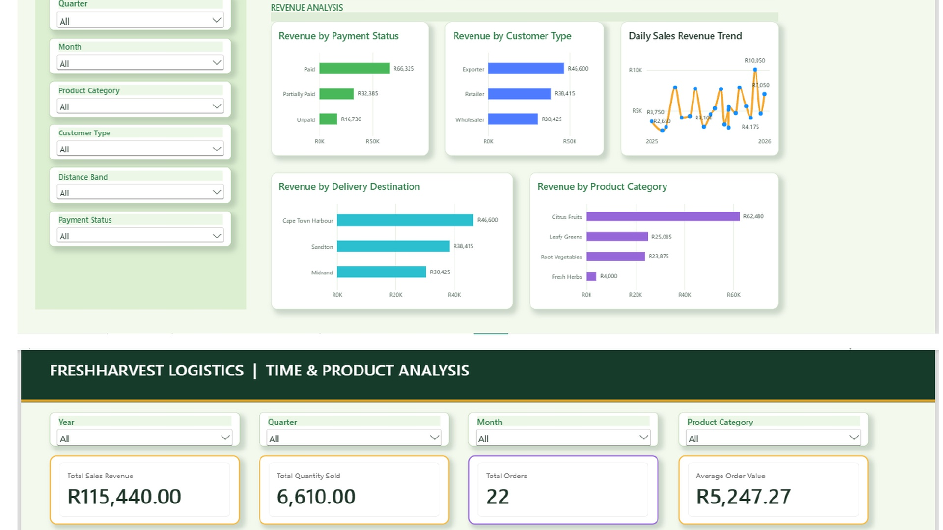
POWER BI OUTPUT | WHAT WE WILL PRESENT
The final dashboard is the practical result of the SQL and warehouse work
PRESENTATION FOCUS
The dashboard helps management answer:
From business context to live dashboard
How sales and quantity change by year, quarter and month
Which products generate highest value and volume
Which customer groups contribute most revenue
Which delivery routes and areas perform best
How order and payment status affect the business
Our presentation will first explain the business and data problem, then show how SQL and Power BI work together to support management decisions.
FreshHarvest business overview
Why broader analysis is needed
SQL database and data warehouse design
Power BI dashboard and key management insights
After these opening slides, we will move into the live Power BI report.

