Slide 1
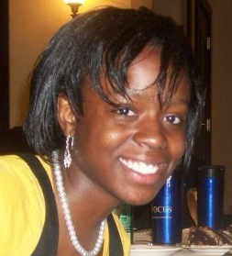
Imani Palmer
5th Year PhD student at University of Illinois at Urbana-Champaign (Advisor: Roy Campbell)
BS, University of Pittsburgh, Pittsburgh, PA, 2013
Dissertation: Forensic Analysis of Computer Evidence
Research area: Systems & Networking (Security)
Networking interests: academic-job hunting, industry-job hunting, entrepreneurship
More about myself: working towards a black belt in Tang Soo Do
Homepage: http://ipalmer2.web.engr.illinois.edu/
Contact: ipalmer2@illinois.edu

