Slide 1
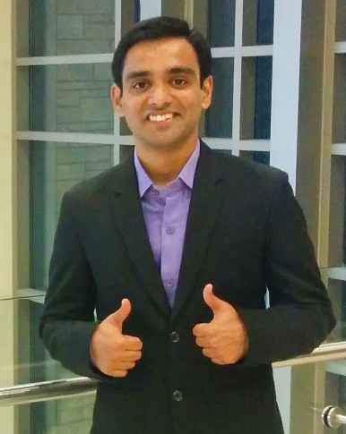
Vijay Rajanna
5th Year PhD student at Texas A&M University, College Station (Advisor: Dr. Tracy Hammond)
MS, Birla Institute of Technology & Science, Pilani, India, 2011
Visvesvaraya Technological University, Karnataka, India, 2008
Dissertation: A Gaze-Assisted Multimodal Approach to Rich and Accessible Human-Computer Interaction
Research area: Human-Computer Interaction
Networking interests: Researcher position (industry).
More about myself: Into running (10+ yrs)
Homepage: www.vijayrajanna.com
Contact: Vijay.drajanna@gmail.com

