Slide 1
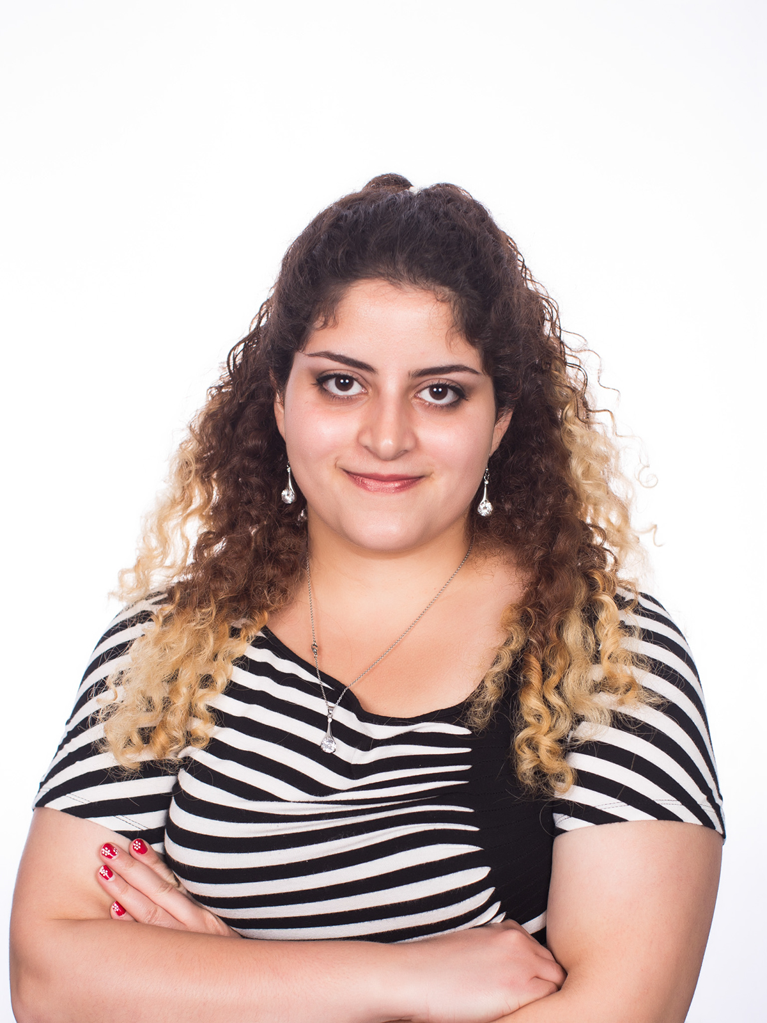
Shadi A. Noghabi
5th year and (hopefully) last year PhD.
University of Illinois at Urbana-Champaign
Prof. Indy Gupta and Prof. Roy Campbell
My Area: Distributed Systems, Cloud Computing, Edge Computing
Awards:
Microsoft Research Dissertation Grant
Mavis Future Faculty Fellowship
http://abdolla2.web.engr.illinois.edu/

