Slide 1
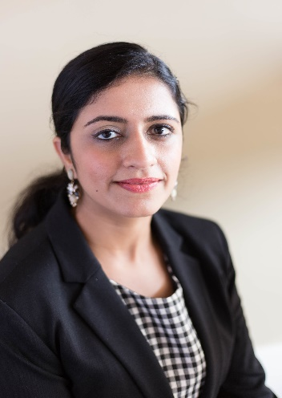
Shubbhi Taneja
3rd Year PhD student at Auburn University, Alabama (Advisor: Xiao Qin)
BS, Maharishi Dayanand University, India, 2012
Dissertation: Thermal-aware resource modeling and management in high-performance computing clusters
Research area: thermal-aware distributed and high-performance computing
Networking interests: academic-job hunting, writing grant proposals, post-doc positions
More about myself: loves travelling
Homepage: coming up shortly
Contact: shubbhi@auburn.edu
Notes:
What are you trying to do? Articulate your objectives using absolutely no jargon.
How is it done today, and what are the limits of current practice?
What's new in your approach and why do you think it will be successful?
Who cares?
If you're successful, what difference will it make?
What are the risks and the payoffs?
How much will it cost?
How long will it take?
What are the midterm and final "exams" to check for success?

Slide 2
PRESENTATION OUTLINE
Introduction
Aims and Objectives
Related Work
Methodology
Proposed Work
Conclusion
Notes:
What problem are you going to tackle?
Why is it a problem?
Why is it important to solve it?
Where are you going to look for answers?
Why are you going to look there?

Slide 3
INTRODUCTION
Growth of Big Data
Rising Cooling Costs of Data Centers
Influence of Hadoop
Introduction to Spark
According to the EPA report, US data centers consumed approximately 2% of total U.S. energy consumption, with 24% increase in the last five years
This demand has also caused increase in the power density of the data centers.
Open-source s/w framework
Build on Google’s GFS and MapReduce
Leverages the power of massive parallel processing to take advantage of Big Data
HDFS is the most common type of file system
Uses inexpensive commodity servers
Memory-optimized data processing engine
Performs better than MapReduce
Minimizes disk reads and writes => high performance access to dynamic, complex data collection
Works with interactive applications as well
Potential to revolutionize big-data’s evolution

Slide 4
OBJECTIVES
Perform thermal profiling of big-data applications on HPC clusters
Minimize cooling costs of data centers by designing energy-efficient job schedulers and thermal models
Develop prediction framework to estimate the heat buildup in data centers
Classify applications based to their resources consumption

Slide 5
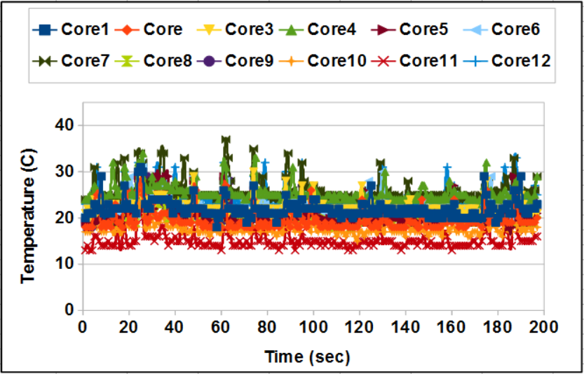
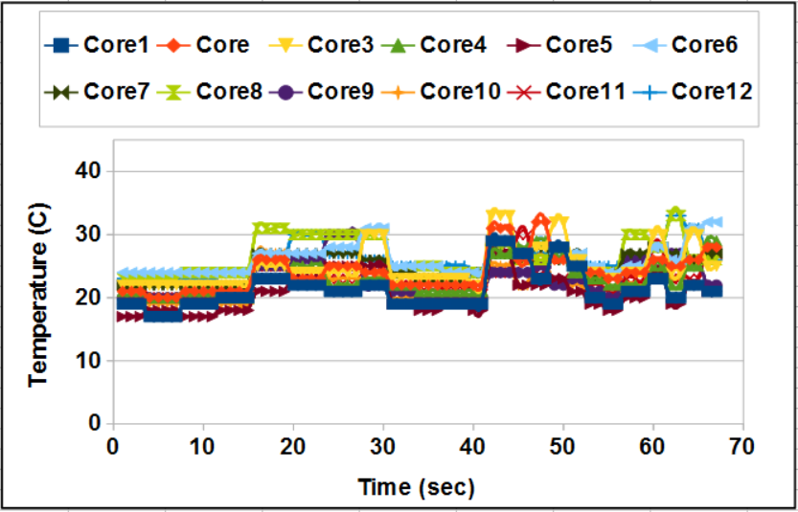
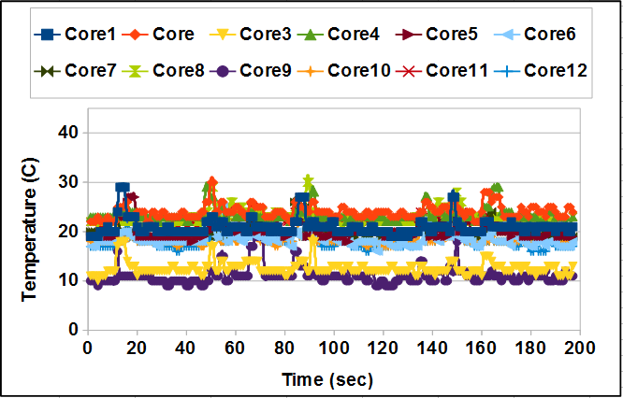
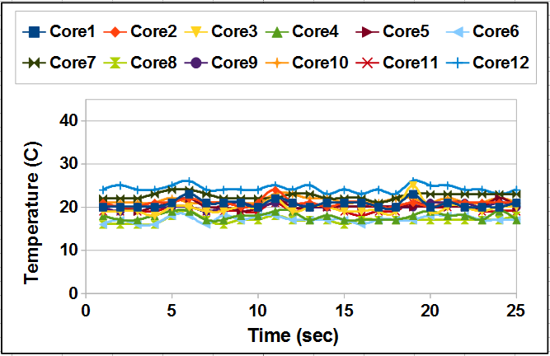
THERMAL PROFILING
PageRank
Wordcount
TeraSort
Sort
Notes:
thermal models are usually used to characterize the thermal profile of the data center.

Slide 6
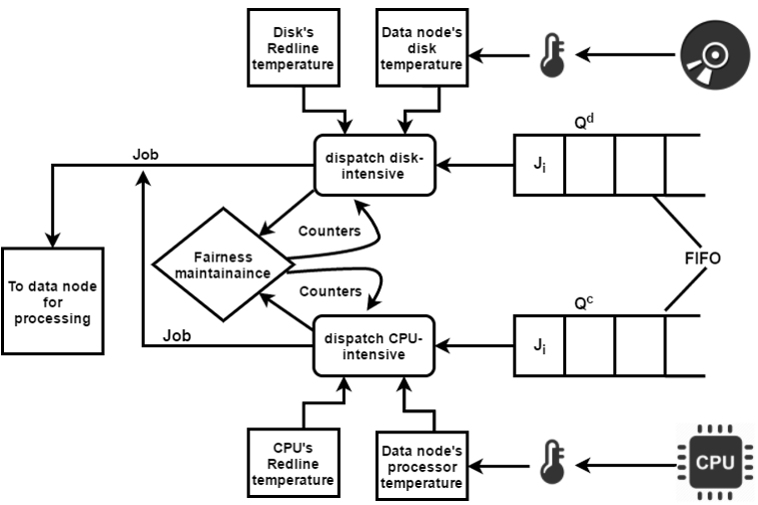
DATA FLOW DIAGRAM OF MY PROPOSED SCHEDULERS

Slide 7
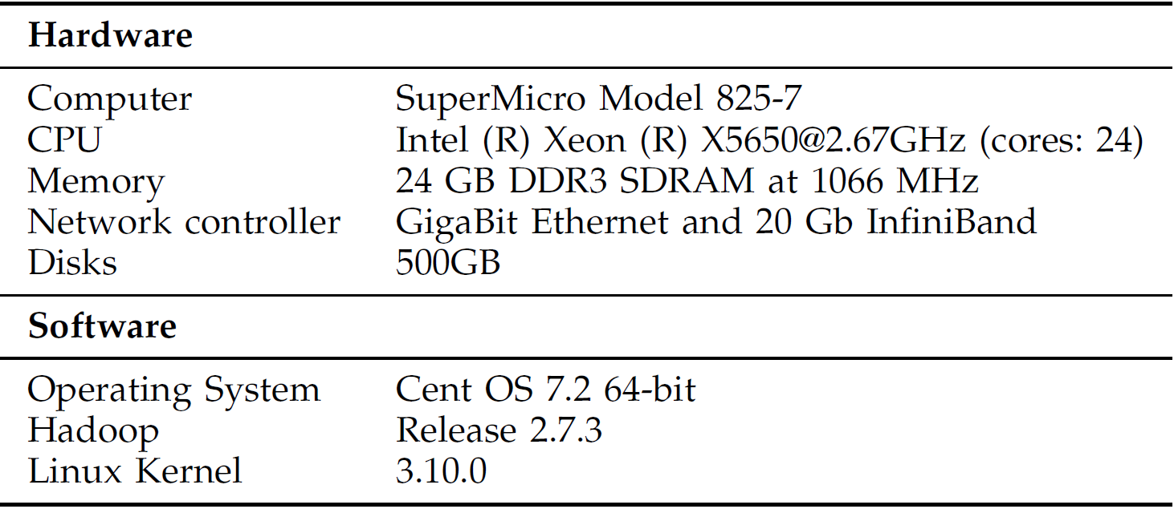
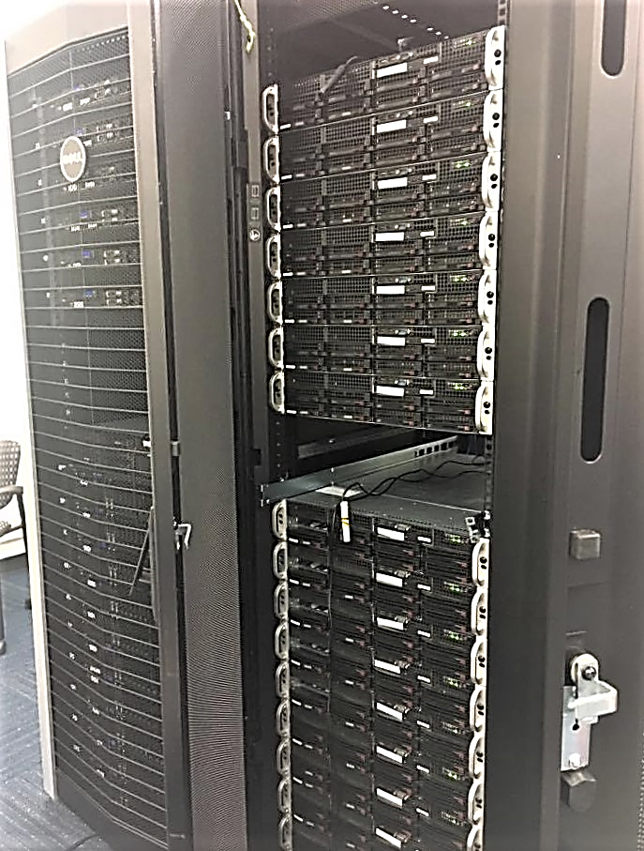
METHODOLOGY
APC Temperature Monitoring System
To keep track of inlet and outlet temperatures
APC Rack PDU
To collect power and energy consumption
Linux Utilities
lm-sensors: CPU core temperatures
Hddtemp: disk temperature
iostat: CPU and disk temperature
Ganglia
To generate graphs at run-time

Slide 8
CLASSIFYING APPLICATIONS
Current Design
Two categories (CPU-intensive and I/O intensive)
CPU and Memory Intensive
CPU and Interactive
Memory and I/O Intensive
Network and Memory
Network Intensive
I/O and Batch
Potential Extension
Multiple job categories
Notes:
As the applications become more sophisticated, our idea of classifying them into just two categories (CPU-intensive and I/O intensive) becomes simplistic. We need to further categorize jobs into categories like: CPU and Memory Intensive, Memory and I/O Intensive, CPU and Interactive, I/O and Batch, Network Intensive and so on.
At present, multi-core CPUs consume the maximum power in data centers. The trend is changing towards memory. Memory can consume more power in future. Use Performance-Power modeling to improve energy efficiency.
Study other big-data processing frameworks like Apache Spark.
Cloud maturing : Migration from HPC to Cloud

Slide 9
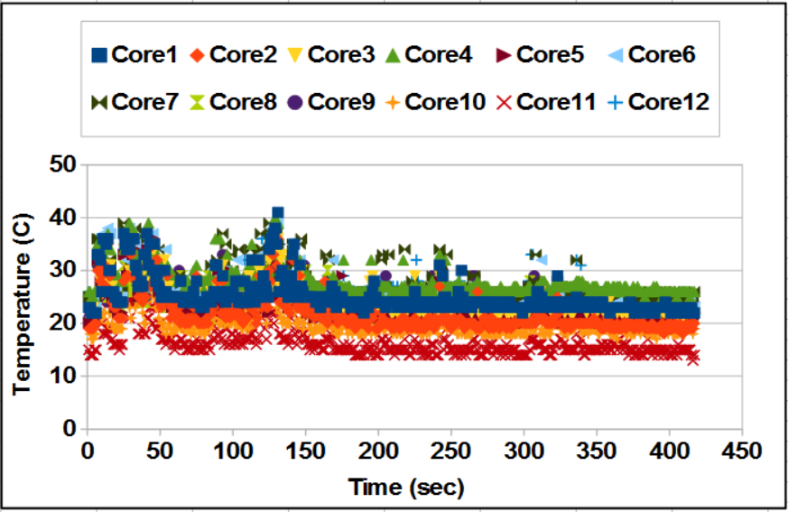
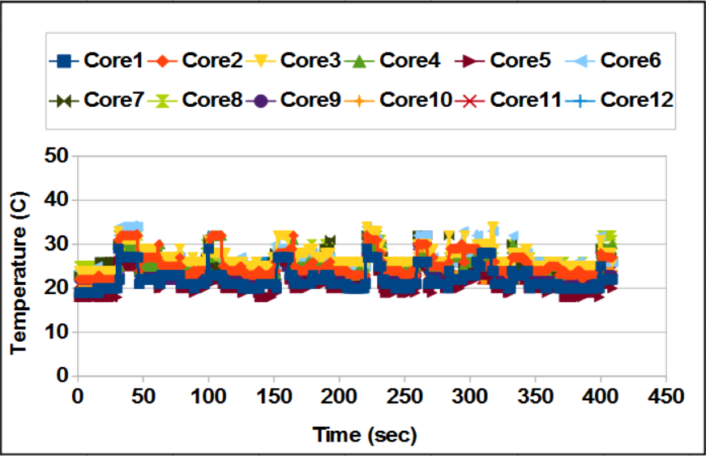
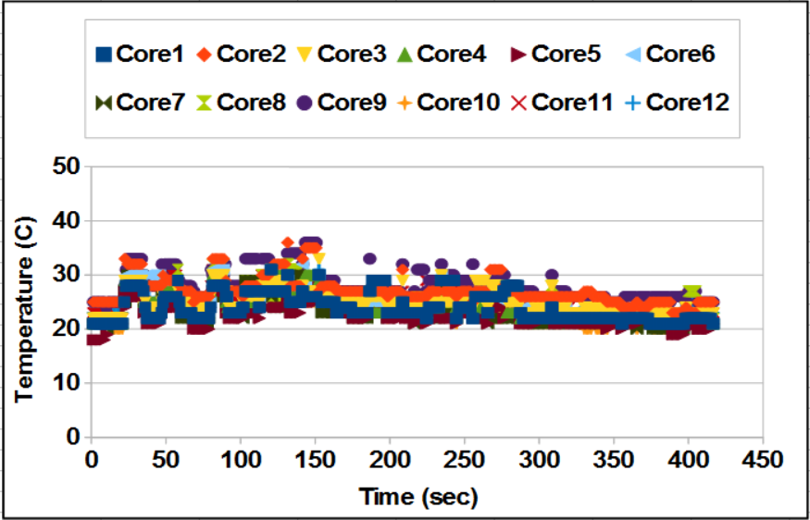
RESULTS
CPUF
tDispatch
IOF

Slide 10
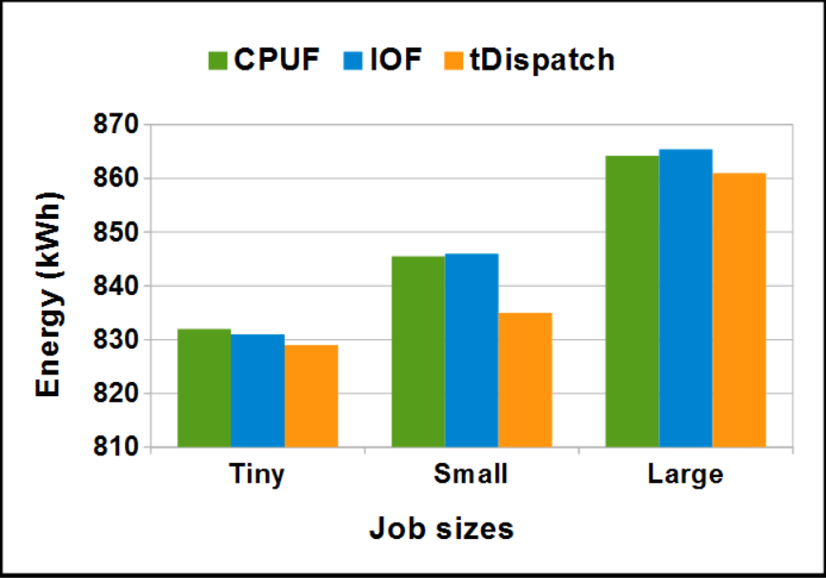
ENERGY SAVINGS
The power and energy consumption were obtained from Rack PDU installed in our HPC room

Slide 11
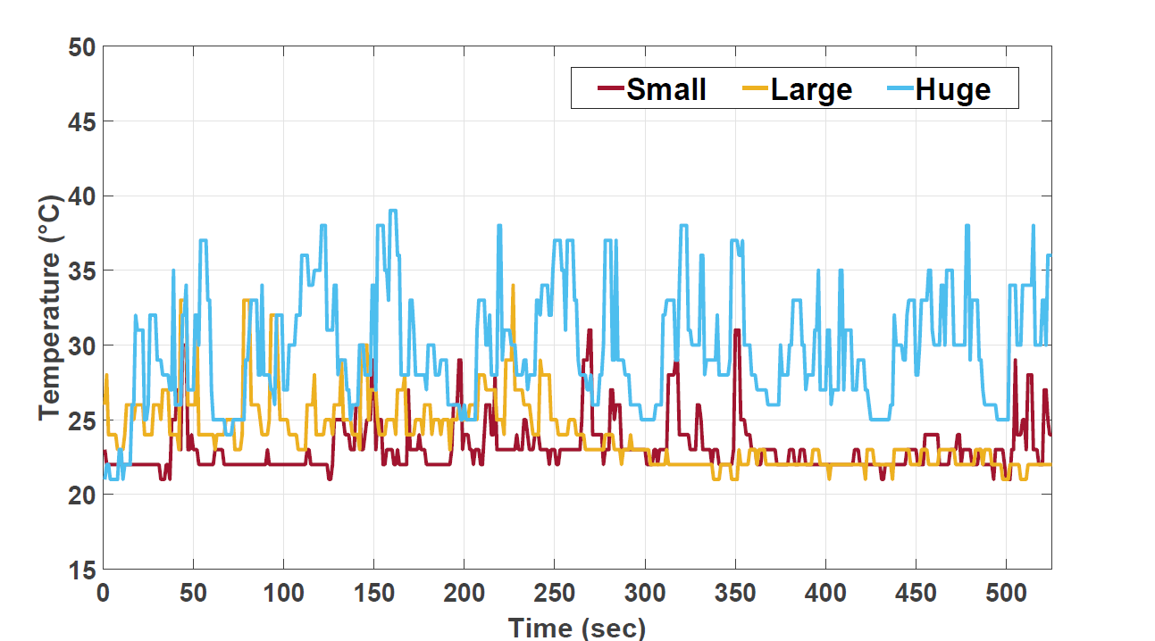
IMPACT OF DATA SIZE
Application: Kmeans Classification
Notes:
At present, multi-core CPUs consume the maximum power in data centers. The trend is changing towards memory. Memory can consume more power in future. Use Performance-Power modeling to improve energy efficiency.
Study other big-data processing frameworks like Apache Spark.
Cloud maturing : Migration from HPC to Cloud

Slide 12
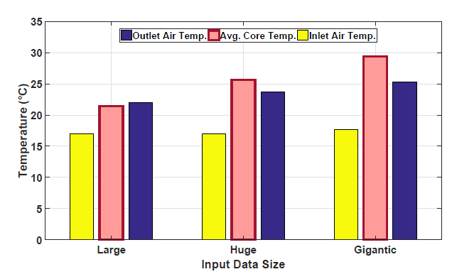
IMPACT OF DATA SIZE
Application: Kmeans Classification
Notes:
At present, multi-core CPUs consume the maximum power in data centers. The trend is changing towards memory. Memory can consume more power in future. Use Performance-Power modeling to improve energy efficiency.
Study other big-data processing frameworks like Apache Spark.
Cloud maturing : Migration from HPC to Cloud

Slide 13
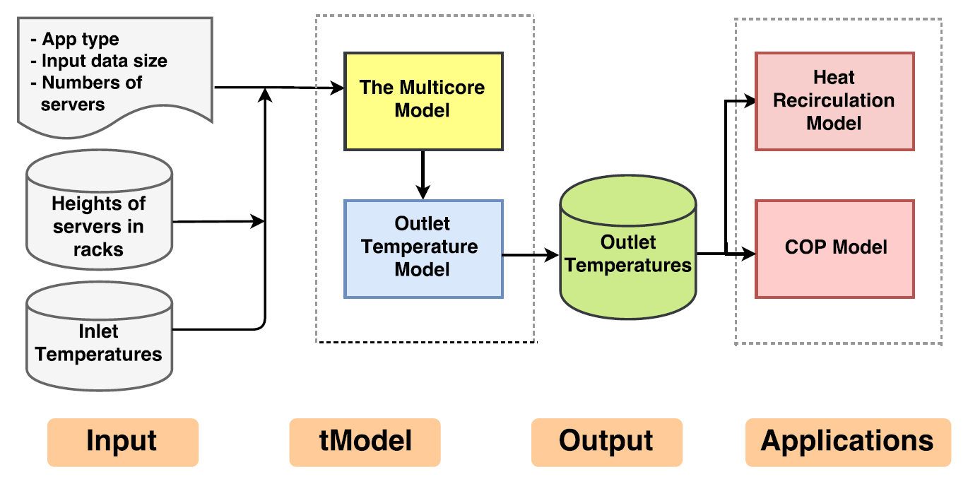

THERMAL MODELING
Notes:
The four factors below make our thermal model indispensable for Hadoop clusters:
excessively high energy cost of large-scale clusters,
pressing needs of reducing thermal monitoring cost,
cooling cost estimation of HPC clusters, and
vital impacts of system utilization on multicore processors and disks of a Hadoop cluster.
We suggest that the outlet air temperature can be modeled as a function of CPU core temperature and inlet air temperature without necessarily relying on CPU utilization and power consumed by a server. We believe utilization-based thermal models may introduce errors due to inaccurate mappings from system utilization to outlet temperatures.
The main strengths of the tModel framework are three-fold. First, temperatures of multicore processors are modeled as a function of system configurations and application access patterns. Second, a thermal model characterizes the relationship among inlet and outlet temperatures as well as multicore processor temperatures. Third, tModel opens an avenue for data center
designers to investigate heat recirculation and cooling cost.

Slide 14
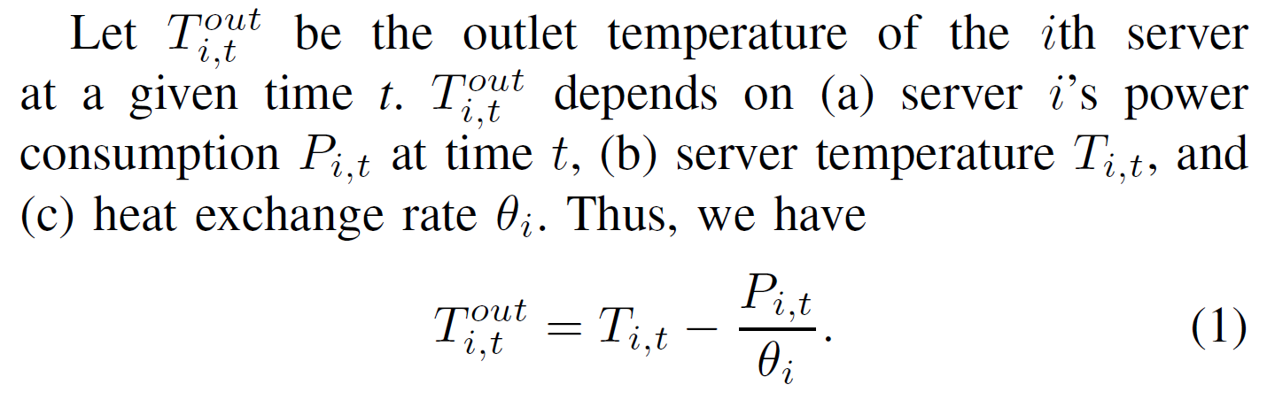
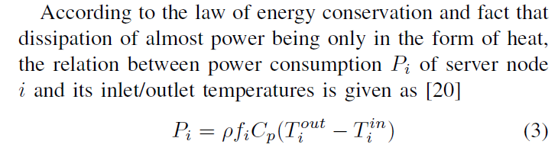

EXISTING ß-Model
Notes:
At present, multi-core CPUs consume the maximum power in data centers. The trend is changing towards memory. Memory can consume more power in future. Use Performance-Power modeling to improve energy efficiency.
Study other big-data processing frameworks like Apache Spark.
Cloud maturing : Migration from HPC to Cloud

Slide 15
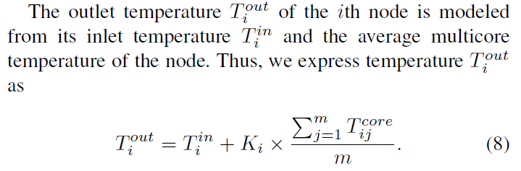


tModel
Where,
Notes:
At present, multi-core CPUs consume the maximum power in data centers. The trend is changing towards memory. Memory can consume more power in future. Use Performance-Power modeling to improve energy efficiency.
Study other big-data processing frameworks like Apache Spark.
Cloud maturing : Migration from HPC to Cloud

Slide 16
Multicore Model (Phase Modeling)
Motivated by the resource-access patterns of big-data applications, which often exhibit iterative characteristics.
The thermal behavior of multicore processors running an application can be modeled by a series of working sets, each of which is comprised of multiple intervals sharing a very similar behavior.
The multicore model captures the phase signatures of each working set for estimating the average temperature for all working sets that repeat during the running time of an application.
Notes:
We make use of the working-set model to represent an
application’s thermal signature. Suppose an application has
a total of m working sets, which are denoted as a mdimensional
vector ~= [1; 2; :::; m]. The ith working set
phii is a vector i = (i; i; i; i), where i is the number
of phases repeatedly executed in the working set, lamdbai
and i are the maximum and minimum core temperatures
in the working set, and i is the length of each phase.

Slide 17
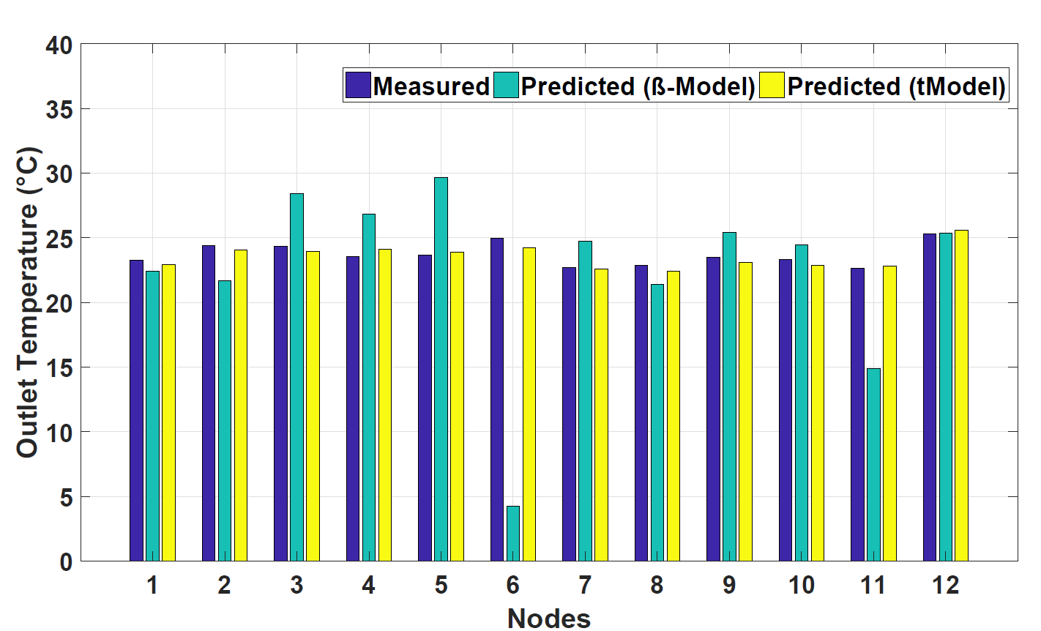
Comparison b/w ß-Model and tModel
Notes:
At present, multi-core CPUs consume the maximum power in data centers. The trend is changing towards memory. Memory can consume more power in future. Use Performance-Power modeling to improve energy efficiency.
Study other big-data processing frameworks like Apache Spark.
Cloud maturing : Migration from HPC to Cloud

Slide 18
PROPOSED RESEARCH DIRECTIONS
Multiple Resource Types
Current Design: Multi-core CPUs
Potential Extension: Memory resources
Big-data processing frameworks
Current Design: Hadoop
Potential Extension 1: Apache Spark
Potential Extension 2: Cloud Architecture
Notes:
At present, multi-core CPUs consume the maximum power in data centers. The trend is changing towards memory. Memory can consume more power in future. Use Performance-Power modeling to improve energy efficiency.
Study other big-data processing frameworks like Apache Spark.
Cloud maturing : Migration from HPC to Cloud

Slide 19
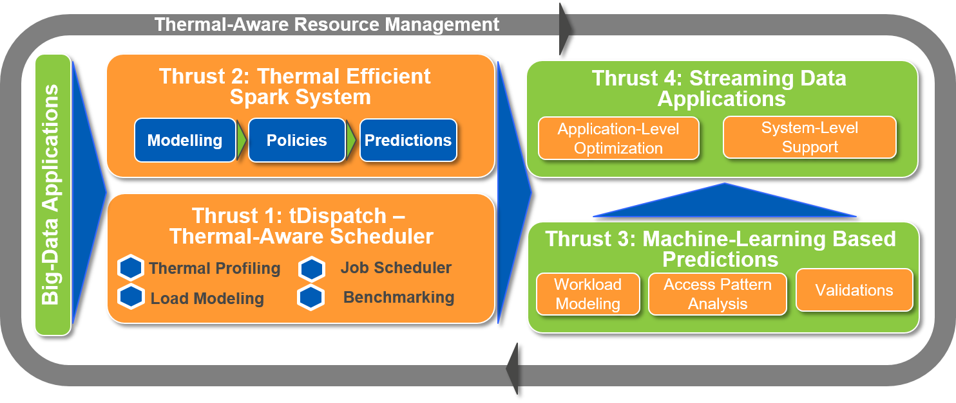
THE PROPOSED TARM-CC FRAMEWORK

Slide 20
PROPOSED RESEARCH TASKS
Thermal Modeling
Thermal Management
Energy Efficiency
Web search
Graph
Streaming
Machine learning
Monitoring inlet
and outlet temperature
to the nodes
Collecting power consumption to estimate the cooling cost for data centers
CPU and Disk util.
Network
Memory
Power
Data locality
Ensuring that nodes operate under safe temperature threshold
Notes:
Examples of
Web Search: Nutch Indexing, Page Rank
ML: Bayes Classification, K-Means, Logistic Regression
Graph: Nweight
Streaming (uses Kafka):Identity (identity), Fixwindow, Repartition, Stateful Wordcount
Using thermal profiling and job classification, I am designing thermal model for Apache Spark; focus is to include a wide variety of jobs including web search, graph, streaming, and machine learning
Calculate inlet and outlet temperature to the nodes; keeping CPU and disk temperature under a safe threshold.
Calculate power and energy consumption

