Slide 1

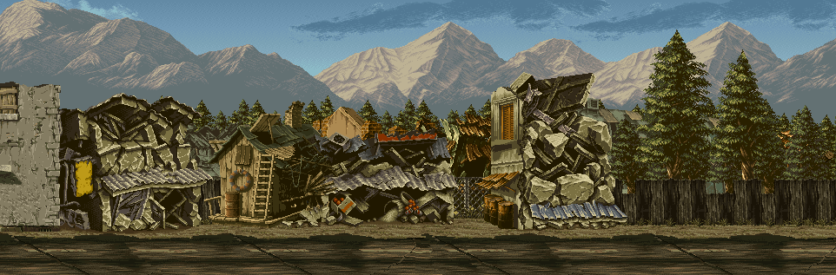
State: 1
NEW GAME

Slide 2
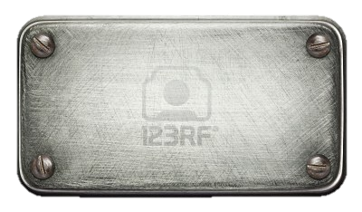


State: 2
Thank you for trying Metal Tank Qt. This is my Final project for CISS 241. This was written in C++ using the Qt framework.
By Todd Pickell 2.20.12
Start

Slide 3


State: 3
Health
Fuel
Ammo
Angle 40
Health
Fuel
Ammo
Angle
46

Slide 4
State: 4
Health
Fuel
Ammo
Angle 40
General Pickle
Health
Fuel
Ammo
Angle
46
General Bad
Congratulations
You Won!
Again?
Exit

