Slide 1



Who is this guy talking?
@tapickell

Slide 2
H. A. Q. T.
Handler |> Action |> Query |> Transform

Slide 3

It is an Idea
Not another Framework

Slide 4

Who’s Idea was this anyways?
@ethangarofolo

Slide 5
H. A. Q. T.
Handler |> Action |> Query |> Transform

Slide 6
Handler
input
|> grabs data that is needed
|> appropriate action

Slide 7
Action
data
|> validation
|> error handling
|> appropriate query/queries

Slide 8
Query
data
|> appropriate transformation
|> execute query

Slide 9
Transform
data
|> transformation

Slide 10
Data flows through this pattern
H
A
N
D
L
E
R
A
C
T
I
O
N
Q
U
E
R
Y
D
A
T
A
I
N
D
A
T
A
O
U
T
|>
|>
TRANSFORM
Database
ETS
GenServer
FlatFile
API call
???
HTTP Request
Event from stream
Message from Queue
Message from other process
???

Slide 11
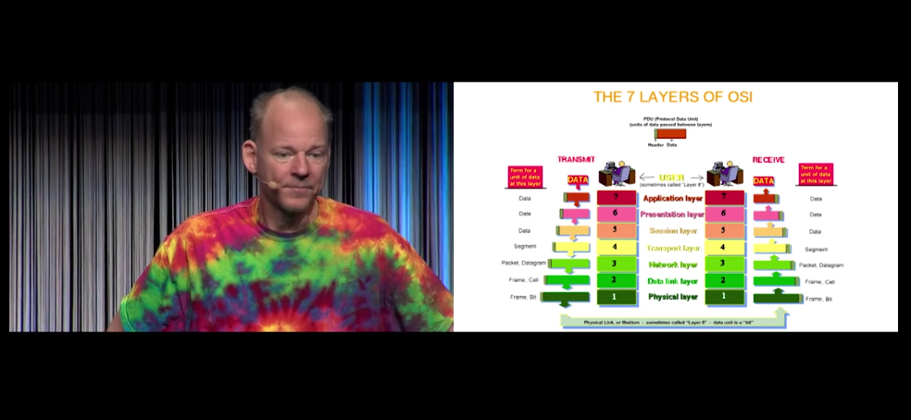
The only architecture I know…
...is layered. - Erik Meijer

Slide 12
Does Erik Meijer own a shirt that is not tie dye?

Slide 13
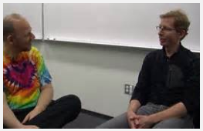
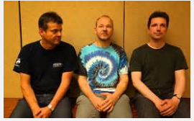
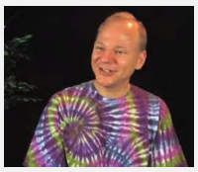
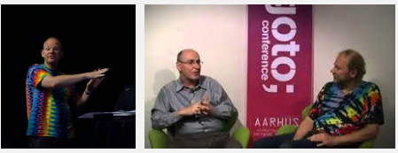
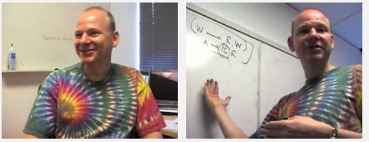
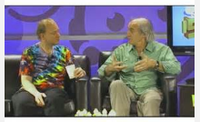
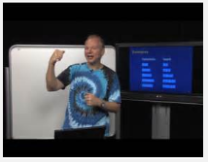
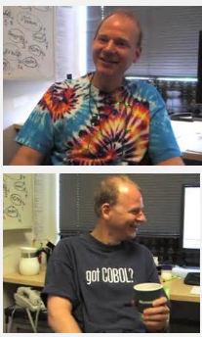
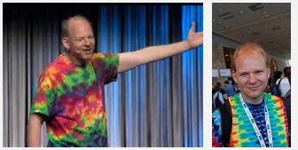
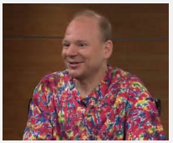
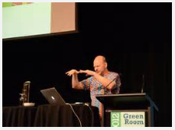
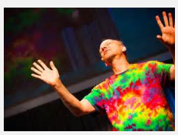
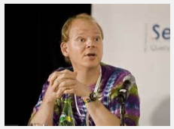
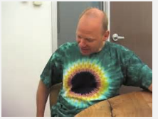
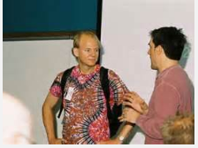

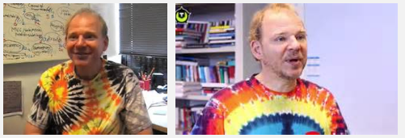

Slide 14
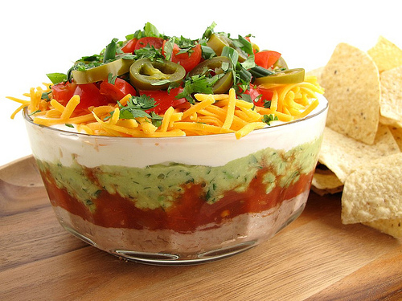
Back to the layers….

Slide 15

Natural Isolation

Slide 16
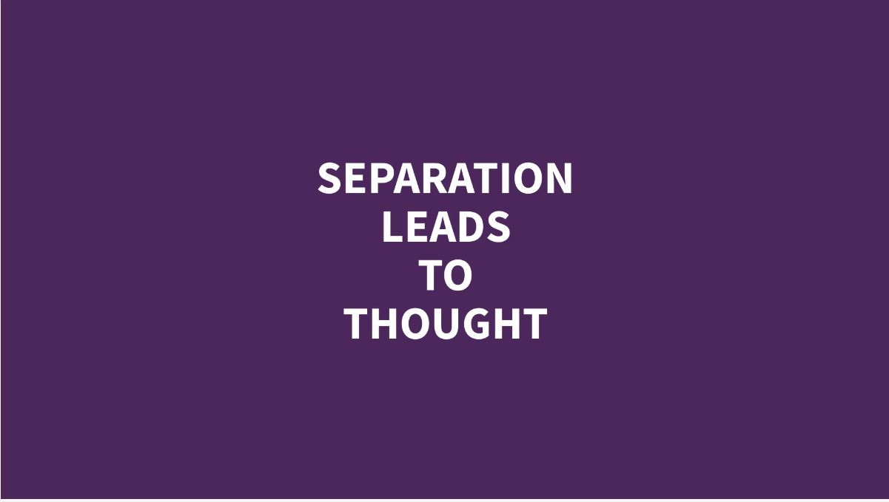

Slide 17
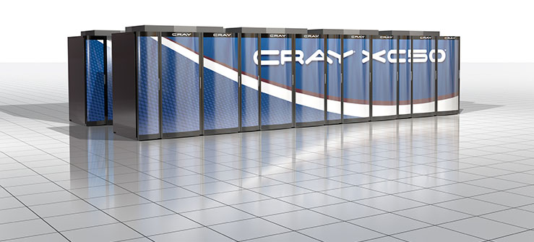
High Performance Computing

Slide 18
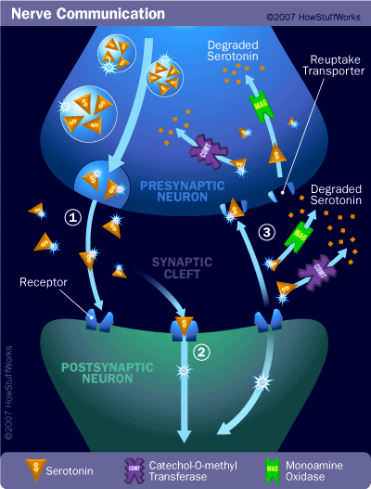
Mind the Gap

Slide 19
The Value is the boundary between modules.

Slide 20
DEMO

Slide 21
It is an Idea
Not another Framework

Slide 22
Who is this guy talking?
@tapickell

