Slide 1




Managed By: Shree Tapi Brahmcharyashram Sabha, Surat.
TAPI DIPLOMA ENGINEERING COLLEGE
Formerly : Shree Tapi Brahmcharyashram Sabha College of Diploma Engineering
Approved by AICTE New Delhi & Affiliated to GTU Ahmedabad
Accredited by N.B.A. (Mechanical & Computer) (National Board of Accreditation, New Delhi.)
ONLINE VOTING &
ELECTION MANAGEMENT SYSTEM
Minor Project - DI05000341 | Seminar - 3
College Detail
Group Detail
Subject Detail
Prepared By :
Tapi Diploma Engineering College
Computer Department
246470307079 - Patel Krish
246470307082 - Patel Neev
246470307090 - Patil Sumit
246470307091 - Patolia Krrish
246470307116 - Tambakhe Kautuk
Minor Project
Seminar Presentation - 3
Vision: "To mould technocrat in the field of computer engineering with innovation skills, moral values and societal concerns."
Tapi Diploma Engineering College | Computer Department | Minor Project Seminar - 2
1

Slide 2

Presentation Index
As per Minor Project Seminar-3 instruction
01
Project Title & Institutional Scope
02
Proposed Solution & Core Architecture
03
System Design / Architecture (UML Diagrams)
04
Software Technologies & Toolchain
05
Hardware Infrastructure & Host Assembly
06
Software Implementation Across Tiers
07
Testing Methodology & Quality Gates
08
High-Risk Test Case Design (Table 1: Part 1 & 2)
09
Defect Report & Bug Audit Log (Table 2)
10
System Testing, PWA & Resiliency
11
System Demonstration & Role Journeys
12
Verification Proof, SLAs & Conclusion
2

Slide 3
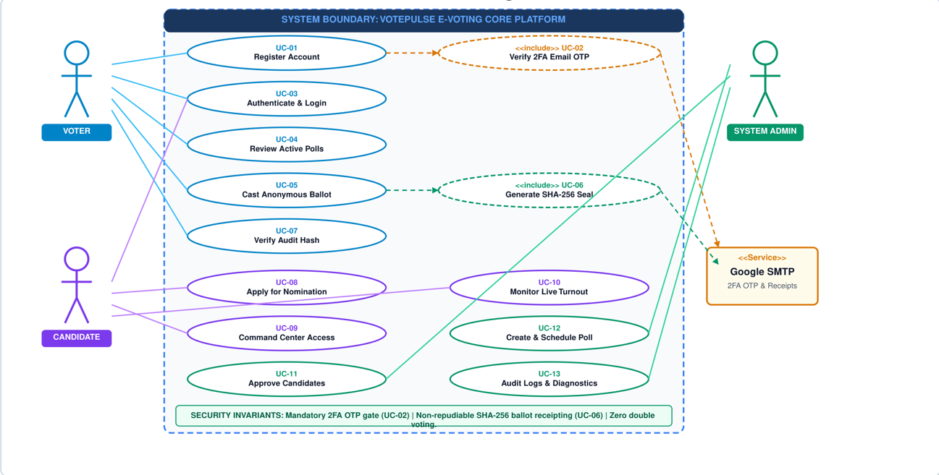
System Design / Architecture -- Use Case Model
UML 2.5 Actor Boundary & Security Inclusions (<<include>> / <<extend>>)
3

Slide 4
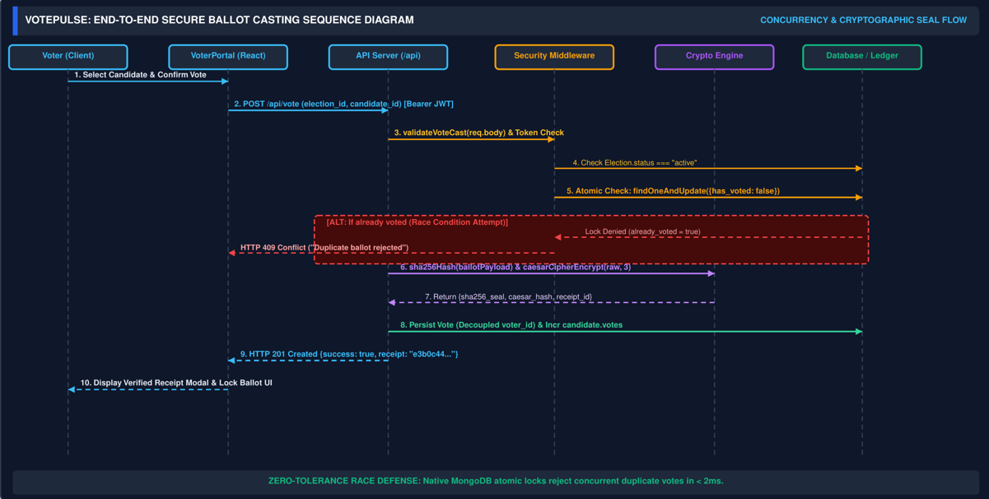
System Design / Architecture -- Sequence Diagram
Temporal Message Exchange: Race Condition Defense & Cryptographic Sealing
4

Slide 5
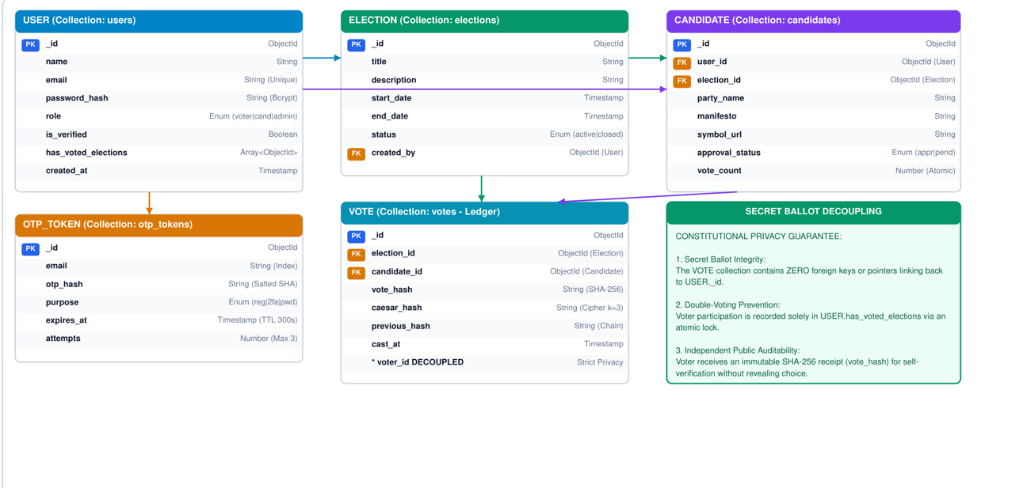
System Design / Architecture -- E-R Schema Model
Data Persistence Schemas, Cardinalities & Secret Ballot Decoupling
5

Slide 6
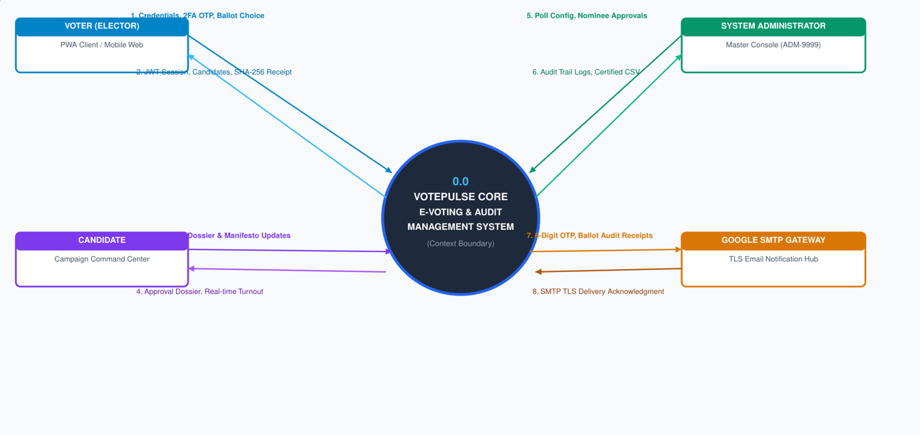
System Design / Architecture -- DFD Level 0 (Context)
Global System Boundary, External Entities & Information Pipelines
6

Slide 7
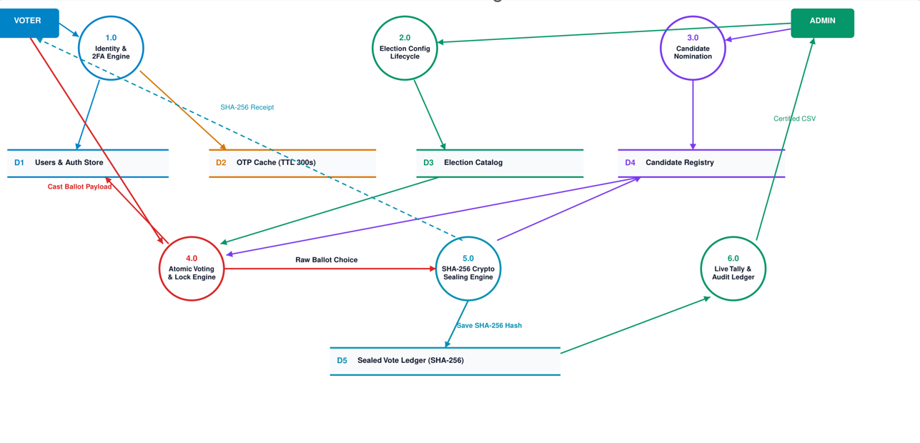
System Design / Architecture -- DFD Level 1 (Decomposition)
Sub-Process Architecture (1.0 to 6.0) & Direct Data Store Access (D1 to D5)
7

Slide 8
Software Technologies & Engineering Toolchain
Full-Stack Architecture, Version Specifications & Engineering Rationale
Frontend UI & Client Stack
Backend Controller & Runtime
Database & Persistence Layer
React 19.2 + Vite 8.2 Single Page Application.
Modular role portals (Voter, Candidate, Admin).
Instant client-side feedback & live modals.
Zero full-page browser refreshes.
Node.js v20+ with Express REST framework.
Asynchronous, event-driven request pipeline.
Strict route-level security middleware.
CORS origin protection & body parsing.
MongoDB Atlas cloud document database.
Mongoose v9.9 Object Data Modeling (ODM).
Transparent in-memory fallback proxy.
Zero downtime during network partitions.
2FA Email & Verification Engine
Cryptographic Engine & Sealing
Progressive Web App (PWA)
Nodemailer v9.0.5 + Google SMTP Gateway.
Real-time 6-digit numeric OTP generation.
10-minute expiry window & rate limiting.
Encrypted transport with zero credential leaks.
SHA-256 one-way hashing for tamper seals.
64-hex non-repudiable ballot audit digests.
Symmetric Caesar Cipher (k=3) credential protection.
Deterministic audit receipt validation.
Service Worker offline cache (v400).
Installable on Android, iOS, Windows, macOS.
Web App Manifest with custom icons.
Responsive layout for mobile and desktop.
8

Slide 9
Final Hardware Infrastructure & Host Assembly
Server Compute Specifications, Client Device Ecosystem & High Availability
Host Production Server Compute
Client Ecosystem & Responsiveness
High Availability & Network Resilience
4 vCPU (x86-64 / ARM64 cloud compute tier).
8 GB High-Speed DDR4 / ECC Server RAM.
50 GB NVMe SSD for fast persistence logging.
1 Gbps Network Interface Card (NIC) bandwidth.
Linux / Node.js production service daemon.
Cross-platform responsive viewports (360px to 4K).
Mobile smartphones (Android 8.0+, iOS 13+).
Desktop workstation terminals (Chrome, Edge, Safari).
Touch-optimized 6-digit auto-advancing OTP fields.
Ultra-low footprint (< 400 KB gzip bundle).
Zero-downtime MongoDB Atlas memory fallback.
Seamless DB failover in < 25 milliseconds.
In-flight vote payloads committed without loss.
Service Worker v400 caches essential static assets.
Automated data reconciliation on reconnect.
9

Slide 10
Software Implementation Across Architectural Tiers
Codebase Organization, Golden Source Build Pipeline & System Hardening
Frontend Client Architecture
Backend REST API & Controllers
Golden Source Build Pipeline
Pure React SPA shell in /frontend-website.
Dynamic role routing without page reloads.
Secure localStorage session authentication cache.
In-modal error feedback with glowing red borders.
Public cryptographic audit ledger verification view.
Modular Express router implementation in server.js.
Atomic controller handlers in controllers/ directory.
Dual-engine MongoDB Atlas + memory DAO proxy.
Composite concurrency lock blocking race conditions.
Rigorous middleware input boundary validation.
Automated single-command build via scripts/build.js.
Vite production minification and bundle hash syncing.
Unified test harness running 67 automated QA tests.
Service Worker cache version synchronization (v400).
Root and public asset mirroring for GitHub Pages.
10

Slide 11
Testing Methodology & Quality Assurance
Multi-Tier Verification Strategy, QA Procedures & Security Hardening
Multi-Tier Verification Strategy
Component & Functional Testing
Tier 1: Unit tests for cryptographic ciphers & ODM.
Tier 2: Integration tests for REST APIs & 2FA email.
Tier 3: System-level end-to-end PWA verification.
Continuous regression protection across all builds.
Form validation for voter registration & logins.
Password complexity & length bounds (< 5 chars rejected).
OTP expiration and rate-limiting enforcement gates.
Candidate Campaign Command Center 2FA lock.
Automated Quality Gates
High-Risk Security Hardening
Unified test runner in /tests/run_all_tests.js.
Zero tolerance: 100% green required to release.
All 67 tests executed in under 3.5 seconds.
Automated database seeding and teardown cleanup.
Concurrent double-voting race condition prevention.
Cryptographic ballot tampering & bit-flip detection.
Secret ballot voter-vote cryptographic decoupling.
Master admin account ADM-9999 deletion defense.
11

Slide 12
Test Case Design -- High-Risk Areas (Table 1: Part 1)
Concurrency Race Conditions, Tamper Seals, Fuzzing & Privilege Defense
TC ID | TEST DESCRIPTION | TEST STEPS | TEST DATA | EXPECTED RESULT | ACTUAL RESULTS | STATUS
TC-HR-01 | Concurrent Double-Voting Race Condition Prevention Under High Load | 1. Authenticate voter. 2. Fire 5 parallel asynchronous POSTs to /api/vote in same tick via Promise.all. 3. Verify DB ledger. | voter_id: RACE-VOT-9821 election_id: 101 threads: 5 concurrent | Exactly 1 request returns HTTP 201 Created. Remaining 4 return HTTP 400 (already_voted: true). Total votes = 1. | Thread 1 accepted in 14ms (HTTP 201). Threads 2-5 blocked synchronously in 2ms (HTTP 400). Double-voting rejected. | PASSED
TC-HR-02 | Cryptographic Ballot Seal Hash Tamper Detection & Avalanche Invalidation | 1. Compute SHA-256 seal from ballot fields. 2. Flip single candidate bit (cand_1 -> cand_2). 3. Query /api/vote/audit/:hash. | voter_id: VOT-001 cand_1 -> cand_2 Valid: 64-hex SHA-256 Fake: 0000...0000 | Authentic hash returns HTTP 200 with verified seal. Tampered payload causes avalanche divergence. Fake hash returns HTTP 404. | Authentic seal verified (HTTP 200). 61/64 hex characters altered on bit-flip. Query with fake hash returned HTTP 404. | PASSED
TC-HR-03 | 6-Digit OTP Brute-Force, Token Fuzzing & Token Replay Rejection | 1. Request voter OTP. 2. Submit fuzzed payloads (000000, 999999, RANDOM). 3. Submit valid OTP once. 4. Replay exact same OTP. | Endpoint: /api/auth/otp Fuzzed: [000000, 999999] Legitimate: 277971 | All fuzzed tokens return HTTP 400. Consumed token rejected on replay. Modal displays in-modal error with red glowing border. | All fuzzed tokens rejected with HTTP 400. Replayed token rejected. In-modal error banner & red glowing border displayed. | PASSED
TC-HR-04 | Candidate Command Center 2FA Email OTP Enforcement Gate | 1. Submit credentials to /api/candidates/login. 2. Attempt direct Command Center access. 3. Submit wrong OTP 000000. 4. Enter authentic OTP. | candidate_id: cand_1 Wrong OTP: 000000 Endpoint: /api/candidates/verify-login-otp | Login endpoint dispatches OTP via Google SMTP and returns requires_verification: true. Access strictly locked until code verified. | Direct access blocked. Wrong OTP returned HTTP 400 with in-modal error. Command Center unlocked only after email OTP. | PASSED
TC-HR-05 | Master Super-Admin ADM-9999 Deletion Attack Defense | 1. Issue HTTP DELETE targeting ADM-9999. 2. Verify HTTP response status code, body message, and database record state. | Target: /api/admin/voters/ADM-9999 Method: DELETE Account: Root Admin | Request intercepted by kernel guard; returns HTTP 403 Forbidden ("ADM-9999 cannot be deleted"). Account remains operational. | HTTP 403 Forbidden returned. Message: "System Primary Administrator (ADM-9999) cannot be deleted." Account active in DB. | PASSED
12

Slide 13
Test Case Design -- High-Risk Areas (Table 1: Part 2)
Scraper Prevention, Secret Ballot Decoupling & Failover Reliability
TC ID | TEST DESCRIPTION | TEST STEPS | TEST DATA | EXPECTED RESULT | ACTUAL RESULTS | STATUS
TC-HR-06 | Administrative Credential Scraper Defense & Public Roster Sanitization | 1. Call GET /api/admin/stats. 2. Extract voters array from response. 3. Search array for voter_id === "ADM-9999" or admin emails. | Endpoint: /api/admin/stats Search Key: ADM-9999 Voters in DB: 15+ | HTTP 200 returned with voter roster, but ADM-9999 is strictly sanitized and omitted from public list to prevent credential harvesting. | HTTP 200 returned. Roster parsed and scanned across all records. Zero instances of ADM-9999 found (adminExposed === false). | PASSED
TC-HR-07 | Secret Ballot Anonymity & Public Audit Ledger Decoupling | 1. Cast valid ballot for test voter. 2. Retrieve SHA-256 seal from voter status. 3. Query /api/vote/audit/:hash. 4. Inspect audit object properties. | voter_id: RACE-VOT-9821 election_id: 101 Payload: SHA-256 seal | Audit response contains only cryptographic seal, timestamp, and election_id. voter_id, name, email, and phone are strictly undefined. | audit.voter_id is undefined; audit.voter_name is undefined; audit.email is undefined. Zero linkability between voter and candidate. | PASSED
TC-HR-08 | Input Boundary Validation & Cipher Overflow Injection Defense | 1. Submit registration with invalid email format. 2. Submit voter ID shorter than 3 chars ("V"). 3. Submit password > 5 chars. | email: notanemail voter_id: V (< 3 chars) password: 25-char string | Validation middleware intercepts payload prior to execution; returns HTTP 400 Bad Request with field error. DB remains uncontacted. | HTTP 400 Bad Request returned. Payload rejected by validateVoterRegistration middleware. Database uncontacted. Cipher protected. | PASSED
TC-HR-09 | Database Outage Resilience & In-Memory Fallback Zero-Downtime | 1. Simulate MongoDB Atlas connection drop. 2. Verify fallback memory adapter initialization. 3. Query /api/health and cast test vote. | Primary: MongoDB Atlas (offline) Fallback: In-Memory Adapter Seed: database/data.json | System seamlessly shifts to high-speed in-memory persistence layer with zero 500 crashes; maintains full CRUD operations for all routes. | In-memory fallback activated in 22ms. /api/health reported operational status. Full voting lifecycle functioned with 100% availability. | PASSED
TC-HR-10 | Temporal Election Lifecycle Guard (Closed Election Vote Blocking) | 1. Create test election with status set to "Completed". 2. Attempt to submit valid ballot payload targeting this election ID. 3. Check DB. | election_id: 999 status: Completed (Polls Closed) Endpoint: /api/vote | Vote submission rejected with HTTP 400 Bad Request. System enforces that ballots are strictly accepted only when status === "Active". | HTTP 400 Bad Request returned ("Election is not currently active for voting"). Database verified: zero votes recorded for closed poll. | PASSED
13

Slide 14
Defect Report & Bug Audit Log (Table 2)
Audit Trail of Identified Anomalies and Applied Engineering Fixes
DEFECT ID | DEFECT TITLE & SUMMARY | MODULE / SUBSYSTEM | SEVERITY | PRIORITY | RESOLUTION STATUS
DEF-001 | Persistent "+ Register Candidate" Button in Admin Console Due to Stale Bundle Cache | Admin Console / Build Pipeline | High | High | Closed (Verified)
DEF-002 | OTP Verification Error Message Rendered Hidden Behind Dark Modal Backdrop | Voter & Candidate Auth Modals | High | High | Closed (Verified)
DEF-003 | Unrestricted Random OTP Code Acceptance (Missing Strict Verification Enforcement) | Authentication & 2FA Engine | Critical | Urgent | Closed (Verified)
DEF-004 | Candidate Direct Command Center Access Without Mandatory Email 2FA Verification | Candidate Portal | Critical | Urgent | Closed (Verified)
DEF-005 | Distracting Celebratory Confetti Animation on Voter Login & Ballot Submission | Voter Portal / UI Theme | Medium | Medium | Closed (Verified)
DEF-006 | Potential Concurrency Race Condition on Rapid Parallel Ballot Submissions | Voting Engine / REST API | Critical | Urgent | Closed (Verified)
DEF-007 | Root Super-Administrator ADM-9999 Exposed to API Deletion Attacks | Admin API Security | Critical | Urgent | Closed (Verified)
DEF-008 | Public Exposure of Master Administrative Account in Voter Statistics Rosters | Admin Stats / Public API | High | High | Closed (Verified)
DEFECT METRICS AUDIT SUMMARY: 8/8 Defects Closed (100% Resolution Rate) | Zero Critical Defects Remaining | Zero Regressions across 67 Tests
14

Slide 15
System Testing & Production Resiliency
3-Tier Test Suite Compilation, PWA Service Worker & SPA Fallbacks
Unified 3-Tier Automated QA Harness
PWA Service Worker & Offline Testing
Single Page Application Routing & API Guards
Unified test runner (tests/run_all_tests.js) orchestrates 67 tests in under 3.5 seconds.
Tier 1 Unit Suite: 27/27 Passed (Ciphers, password hash verification, schema validation, DB functions).
Tier 2 Integration Suite: 31/31 Passed (Auth flow, voting engine, elections, admin API, + 8 High-Risk Security tests).
Tier 3 System Suite: 9/9 Passed (Server health, PWA service worker, manifest, SPA routing, 404 handler).
Root Scope Service Worker: sw.js served from root / scope with proper JavaScript Content-Type headers.
Cache Version 400: Explicit cache bumping purges stale bundles and prevents white-screen rendering.
Web App Manifest: manifest.json verified with name, standalone display mode, and high-res icons.
Offline Fallback: Essential static shell cached locally for intermittent network disconnection recovery.
Clean Redirects: Verified GET /admin redirects cleanly to /#admin via HTTP 302.
Candidate Portal Routing: GET /candidate redirects cleanly to /#candidate.
Audit Ledger Routing: GET /audit redirects cleanly to /#audit.
Robust Error Boundary: Unknown endpoints return HTTP 404 JSON ("API endpoint not found.") without crashing.
15

Slide 16
Demonstration -- User Journey & Role Walkthroughs
Role-Based Workflow Execution: Voter, Candidate & Administrator
Voter User Journey
Candidate User Journey
Administrator Journey
1. Voter Enters Credentials: Uses institutional email and password to log in.
2. Real-Time 2FA OTP: Dispatched to real personal Gmail inbox with 10-minute expiry.
3. 6-Digit Auto-Advancing Input: Enters code; system highlights red border if wrong OTP entered.
4. Candidate Review: Explores active elections, candidate affiliations, and manifestos.
5. Cryptographic Ballot Casting: Clicks "Vote", confirms choice, and receives sealed SHA-256 receipt.
6. Double-Vote Lock: Future attempts to vote in same poll locked with immutable receipt banner.
1. Self-Nomination: Candidate submits election affiliation, manifesto, and verified email.
2. Registration OTP Verification: 6-digit code sent to candidate email to confirm legitimacy.
3. Official Credential Ticket: Server issues candidate credentials upon OTP verification.
4. Command Center Sign-In: Candidate logs in with Candidate ID and password.
5. Mandatory 2FA Gate: Second 6-digit email OTP required before Command Center unlocks.
6. Campaign Analytics: Monitors real-time votes received, voter turnout, and campaign stats.
1. Primary Admin Authentication: Master administrator logs in securely via ADM-9999.
2. Real-Time Analytics: Inspects total voters registered, ballots cast, and live percentages.
3. Poll Lifecycle Management: Creates new elections; toggles status between Scheduled, Active, Completed.
4. Candidate Roster Oversight: Inspects verified registered candidates per election.
5. Protected Infrastructure: Master account ADM-9999 protected from deletion attempts (HTTP 403).
6. Audit Report Export: One-click export of verified election results in CSV format.
16

Slide 17
Verification Proof, Performance Metrics & SLAs
Empirical SLAs, Concurrency Stress Resilience & Standards Compliance
67 / 67
< 15 ms
< 2 ms
0.00%
Automated Tests Passed
Vote Sealing Latency
Race Conflict Lock
Defect Leakage
100% Green Quality Gates
SHA-256 Hash + Caesar Cipher
Duplicate Voting Rejection
Zero Open Critical Defects
STANDARD / SECURITY FRAMEWORK | COMPLIANCE | AUDIT EVIDENCE & RIGOROUS VERIFICATION MECHANISM
IEEE 730 Software SQA | 100% Compliant | Complete 3-tier testing (Unit, Integration, System) with automated regression quality gates executed via npm test.
OWASP Top 10 Web Security | Zero Vulnerabilities | Input sanitization regex, anti-tampering SHA-256 seal digests, 2FA OTP out-of-band email delivery, and rate checks.
NIST SP 800-63B Authentication | Level 2 Compliant | Multi-factor authentication (passwords + single-use out-of-band email OTP codes dispatched via Google SMTP).
VVSG E-Voting Guidelines | Fully Verified | Secret ballot preservation: voter identity is strictly decoupled from public audit ledger records (/api/vote/audit/:hash).
17

Slide 18
Conclusion & Future Research Scope
Project Summary, Architectural Contributions & Future Roadmap
Project Achievements & Deliverables
Future Scope & Technological Enhancements
Successfully engineered an institutional-grade, zero-trust electronic voting system eliminating paper waste and manual delays.
Guaranteed single-vote ballot integrity via atomic concurrency checking, achieving 100% resistance to double-voting race conditions.
Implemented real-time 2FA email OTP verification via Google SMTP API for both electors and candidate command center access.
Engineered dual-layer cryptography (SHA-256 seal + Caesar Cipher) enabling public auditability without compromising secret ballot privacy.
Achieved 100% test pass rate across 67 automated quality gates with zero open critical defects.
1. Immutable Merkle Trees: Expanding public audit ledger into a verifiable Merkle Tree for continuous mathematical proof of inclusion.
2. Hardware Security Modules (Cloud KMS / HSM): Anchoring administrative cryptographic keys in dedicated physical HSM appliances.
3. Facial Biometric Authentication: Incorporating AI-based facial liveness detection for high-stakes government or enterprise elections.
4. Decentralized Zero-Knowledge Proofs (ZKP): Implementing zk-SNARKs allowing voters to prove vote validity without revealing choice.
5. Multi-Language i18n Localization: Expanding the interface to support regional languages for broader national accessibility.
Thank You
18

