Slide 1
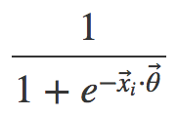
X₁₁
X₁₂
X₁
.
.
.
y₁
X_{1d}
Neural Net Metaphor
Neuron
Synapse
Activation function

Slide 2
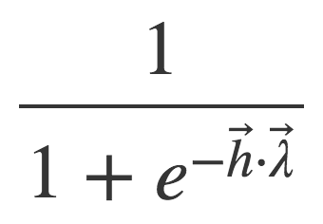
X₁₁
𝛉₁₁
h₁
ƛ₁
X₁₂
h₂
X₁
.
.
.
ƛ_{m}
y₁
h_{m}
𝛉_{dm}
X_{1d}

