Slide 1
developer documentation

Slide 2
Update the cloud connector config from the cloud

Slide 3
Update the cloud connector config from the cloud

Slide 4
Update the cloud connector config from the cloud
SELF UI
cloud connector
tapio
call
RessourceId | EndpointUrl
guid1 | http://y.de
guid2 | http://x.com
call
Endpoint
response
response

Slide 5
Technical categories for data

Slide 6
Technical categories for data
Transparency
&
Control
Technical categories are used to allow customer admins to restrict
Sending data from a machine to tapio
data access for apps
Data will be assigned to technical categories at CloudConnector by the manufacturer
At the moment it will be done inside config at the machine
In future, it will be done in the cloud and transferred to the machine
Technical categories are defined by tapio
Groups of data pints must be assigned to only one category
One data point (OPC UA node) can be assigned to multiple categories
Apps have to declare which technical categories are required
The technical categories will not be used for authorization

Slide 7
Technical categories for data
ProcessData
Softkeys
ProductionData
Work piece information
Order information
ServiceData
Usage data (statistics)
Maintenance information
AssetData
ConditionData
Configuration of a machine
Geometric data of a tool
Master data of an asset
Warnings
Errors
Actions
Current state and values
Job information
Recipes
Sensor data
“static” data at a machine
“dynamic” data at a machine

Slide 8
Technical categories for data
Manufacturer assigns categories to data
Categories assigned to groups
Customer allows sending of data based on categories
Can be decided in activation process
App developers have to declare which categories are used in their apps
Categories are shown in the shop
Assigned in CloudConnector configuration file
Customer can allow or deny access to categories for apps
Permissions are managed in SelfService

Slide 9
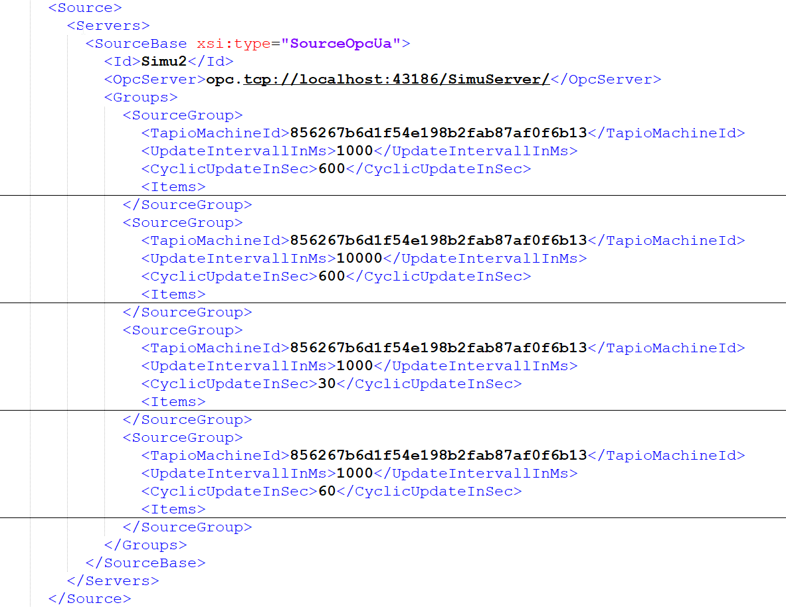
Technical categories for data
Assign categories for each group

Slide 11
Call a command on a machine via cloud connector

Slide 12
Call command
Client (on the machine)
cloud connector
tapio
External sytem
Predefined
call
call
Command
Call
Get Status
OPC UA server
Configuration of available commands
response
CorrelationID
response
OPC UA client
CorrelationID
Return values
call
Status & Result
response
MethodCall
GenericRead
GenericWrite

Slide 13
Call an external endpoint from a machine via cloud connector

Slide 14
Call an external endpoint from a machine via cloud connector
Client (on the machine)
cloud connector
tapio
External sytem
call
RessourceId | EndpointUrl
guid1 | http://y.de
guid2 | http://x.com
call
Endpoint
OPC UA Client
response
response
OPC UA Server
RessourceId
RequestType
PathAndParameters
Headers
Body
Status
StatusDescription
Header
Body

Slide 15
Send shopfloor test-mode-data to a manufacturer application

Slide 16
Send shopfloor test-mode-data to a manufacturer application
Client (on the machine)
cloud connector
tapio
Manufacturer application
tmid In customer subscription
Y
No forwarding of shopfloor test mode data
OPC UA Server
Eventhub
<tapio_sf_test>
N
tmid in manufacturer subscription
Blob storage
OPC UA Client
N
Apps with tagged endpoint in manufacturer subscription
Y
N
Enable <tapio_sf_test> if available
Y
http://shopfloor.customer.com
Forwarding of data

