Slide 1
MPI for Scalable Computing
https://anl.box.com/v/PETASCALE-MPI-2019/
Yanfei Guo Ken Raffenetti Giuseppe Congiu Argonne National Laboratory

Slide 2
Outline
Monday (1.5hrs)
Introduction to MPI
Communicators
Point-to-point communication
MPI Datatypes
Hands-on exercise
Tuesday (2hrs)
Collective Communication
Remote Memory Access (RMA)
Hybrid programming
MPI + accelerators
Hands-on exercises

Slide 3
What is MPI?
MPI is a message-passing library interface standard.
Specification, not implementation
Library, not a language
Classical message-passing programming model
MPI-1 was defined (1994) by a broadly-based group of parallel computer vendors, computer scientists, and applications developers.
2-year intensive process
Implementations appeared quickly and now MPI is taken for granted as vendor-supported software on any parallel machine.
Free, portable implementations exist for clusters and other environments (MPICH, Open MPI)

Slide 4
Timeline of the MPI Standard
MPI-1 (1994), presented at SC’93
Basic point-to-point communication, collectives, datatypes, etc
MPI-2 (1997)
Added parallel I/O, Remote Memory Access (one-sided operations), dynamic processes, thread support, C++ bindings, …
---- Unchanged for 10 years ----
MPI-2.1 (2008)
Minor clarifications and bug fixes to MPI-2
MPI-2.2 (2009)
Small updates and additions to MPI 2.1
MPI-3.0 (2012)
Major new features and additions to MPI (nonblocking collectives, neighborhood collectives, improved RMA, tools interface, Fortran 2008 bindings, etc.)
MPI-3.1 (2015)
Small updates to MPI 3.0

Slide 5
Status of MPI-3.1 Implementations
 | MPICH | MVAPICH | Open MPI | Cray | Tianhe | Intel |  | IBM |  |  | HPE | Fujitsu | MS | MPC | NEC | Sunway | RIKEN | AMPI
 |  |  |  |  |  | IMPI | MPICH-OFI | BG/Q (legacy) ¹ | PE (legacy) ² | Spectrum
NBC | ✔ | ✔ | ✔ | ✔ | ✔ | ✔ | ✔ | ✔ | ✔ | ✔ | ✔ | ✔ | ✔ | ✔ | ✔ | ✔ | ✔ | ✔
Nbr. Coll. | ✔ | ✔ | ✔ | ✔ | ✔ | ✔ | ✔ | ✔ | ✔ | ✔ | ✔ | ✔ | ✘ | ✔ | ✔ | ✔ | ✔ | ✔
RMA | ✔ | ✔ | ✔ | ✔ | ✔ | ✔ | ✔ | ✔ | ✔ | ✔ | ✔ | ✔ | (*) | ✔ | ✔ | ✔ | ✔ | Q2 ‘18
Shr. mem | ✔ | ✔ | ✔ | ✔ | ✔ | ✔ | ✔ | ✔ | ✔ | ✔ | ✔ | ✔ | ✔ | ✔ | ✔ | ✔ | ✔ | Q1 ‘18
MPI_T | ✔ | ✔ | ✔ | ✔ | ✔ | ✔ | ✔ | ✔ | ✔ | ✔ | ✔ | ✔ | * | ✔ | ✔ | ✔ | ✔ | Q2 ‘18
Comm-create group | ✔ | ✔ | ✔ | ✔ | ✔ | ✔ | ✔ | ✔ | ✔ | ✔ | ✔ | ✔ | * | ✔ | ✔ | ✔ | ✔ | ✔
F08 Bindings | ✔ | ✔ | ✔ | ✔ | ✔ | ✔ | ✔ | ✔ | ✘ | ✔ | ✔ | ✘ | ✘ | ✔ | ✔ | ✔ | ✔ | Q2 ‘18
New Dtypes | ✔ | ✔ | ✔ | ✔ | ✔ | ✔ | ✔ | ✔ | ✔ | ✔ | ✔ | ✔ | ✔ | ✔ | ✔ | ✔ | ✔ | ✔
Large Counts | ✔ | ✔ | ✔ | ✔ | ✔ | ✔ | ✔ | ✔ | ✔ | ✔ | ✔ | ✔ | ✔ | ✔ | ✔ | ✔ | ✔ | ✔
MProbe | ✔ | ✔ | ✔ | ✔ | ✔ | ✔ | ✔ | ✔ | ✔ | ✔ | ✔ | ✔ | ✔ | ✔ | ✔ | ✔ | ✔ | Q1 ‘18
NBC I/O | ✔ | ✔ | ✔ | ✔ | ✘ | ✔ | ✔ | ✘ | ✘ | ✔ | ✔ | ✘ | ✘ | * | ✔ | ✘ | ✔ | Q3 ‘18
Release dates are estimates; subject to change at any time “✘” indicates no publicly announced plan to support that feature
Platform-specific restrictions might apply to the supported features
¹ Open Source but unsupported ² No MPI_T variables exposed * Under development (*) Partly done

Slide 6
Web Pointers
MPI Standard : http://www.mpi-forum.org/docs/docs.html
MPI Forum : http://www.mpi-forum.org/
MPI implementations:
MPICH : http://www.mpich.org
MVAPICH : http://mvapich.cse.ohio-state.edu/
Intel MPI: http://software.intel.com/en-us/intel-mpi-library/
Microsoft MPI: https://msdn.microsoft.com/en-us/library/bb524831%28v=vs.85%29.aspx
Open MPI : http://www.open-mpi.org/
IBM MPI, Cray MPI, HP MPI, TH MPI, …
Several MPI tutorials can be found on the web

Slide 7
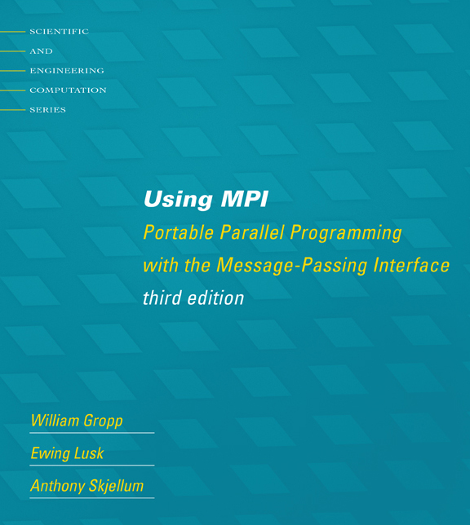
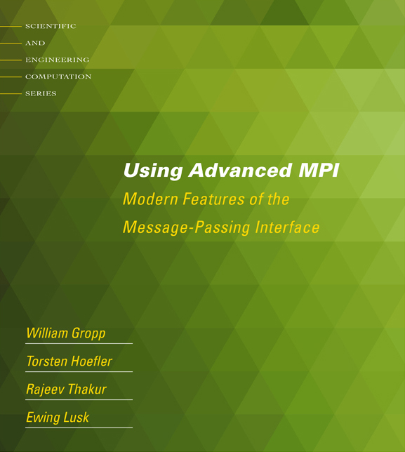
Tutorial Books on MPI (November 2014)
Basic MPI
Advanced MPI, including MPI-2 and MPI-3

Slide 8
Important considerations while using MPI
All parallelism is explicit: the programmer is responsible for correctly identifying parallelism and implementing parallel algorithms using MPI constructs

Slide 9
Compiling MPI Programs
Compilation Wrappers
For C programs:
For C++ programs:
For Fortran programs:
You can link other libraries are required too
To link to a math library:
You can just assume that “mpicc” and friends have replaced your regular compilers (gcc, gfortran, etc.)
% mpicc test.c –o test
% mpicxx test.cpp –o test
% mpifort test.f90 –o test
% mpicc test.c –o test -lm

Slide 10
Compiling MPI Programs on Cray Systems
Compilation Wrappers
For C programs:
For C++ programs:
For Fortran programs:
You can link other libraries
To link to a math library:
Cray MPI libraries are automatically linked
% cc test.c –o test
% c++ test.cpp –o test
% ftn test.f90 –o test
% cc test.c –o test -lm

Slide 11
Running MPI Programs
Launch 16 processes on the local node:
% mpiexec –n 16 ./test
Launch 16 processes on 4 nodes (each has 4 cores)
% mpiexec –hosts h1:4,h2:4,h3:4,h4:4 –n 16 ./test
Runs the first four processes on h1, the next four on h2, etc.
% mpiexec –hosts h1,h2,h3,h4 –n 16 ./test
Runs the first process on h1, the second on h2, etc., and wraps around
So, h1 will have the 1st, 5th, 9th and 13th processes
If there are many nodes, it might be easier to create a host file
% cat hf
h1:4
h2:2
% mpiexec –hostfile hf –n 16 ./test

Slide 12
Interaction with Resource Managers
Resource managers such as SGE, PBS, SLURM or Cray ALPS are common in many managed clusters
MPI automatically detects them and interoperates with them
For example with PBS, you can create a script such as:
#! /bin/bash
% cd $PBS_O_WORKDIR
# No need to provide –np or –hostfile options
% mpiexec ./test
Job can be submitted as:
“mpiexec” will automatically know that the system has PBS, and ask PBS for the number of cores allocated (4 in this case), and which nodes have been allocated
The usage is similar for other resource managers
% qsub –l nodes=2:ppn=2 test.sub

Slide 13
Running MPI Programs on Cray Systems
Launch 16 processes within a job allocation:
% aprun –n 16 ./test

Slide 14
Example: Hello World!
communicators/hello.c
Basic program where each process prints its rank
Notes:
Remember to run example a couple times to show how output is re-ordered.

Slide 15
Introduction to MPI Communicators

Slide 16
MPI Communicators
MPI processes are collected into groups
Each group can have multiple colors (some times called context)
Group + color == communicator (it is like a name for the group)
When an MPI application starts, the group of all processes is initially given a predefined name called MPI_COMM_WORLD
The same group can have many names, but simple programs do not have to worry about multiple names
A process is identified by a unique number within each communicator, called rank
For two different communicators, the same process can have two different ranks: so the meaning of a “rank” is only defined when you specify the communicator

Slide 17
Communicators
% mpiexec -n 16 ./test
When you start an MPI program, there is one predefined communicator MPI_COMM_WORLD
Communicators do not need to contain all processes in the system
0
1
0
1
2
2
3
3
Every process in a communicator has an ID called a “rank”
4
5
Can make copies of this communicator (same group of processes, but different “aliases”)
4
6
5
7
6
7
The same process might have different ranks in different communicators
Communicators can be created “by hand” or using tools provided by MPI (not discussed in this tutorial)
Simple programs typically only use the predefined communicator MPI_COMM_WORLD

Slide 18
Communicators
Can be thought of as independent communication layers over a group of processes
Messages in one layer will not affect messages in another
1
3
3
2
2
7
7
3
0
3
1
6
6
11
1
2
3
7
2
5
0
5
5
10
15
2
6
7
11
0
1
4
7
4
9
10
14
15
4
5
6
6
11
0
1
13
14
15
5
9
10
0
4
8
12
13
14
4
8
9
8
12
13
12

Slide 19
Simple MPI Program Identifying Processes
#include <mpi.h>
#include <stdio.h>
int main(int argc, char ** argv)
{
int rank, size;
MPI_Init(&argc, &argv);
MPI_Comm_rank(MPI_COMM_WORLD, &rank);
MPI_Comm_size(MPI_COMM_WORLD, &size);
printf("I am %d of %d\n", rank + 1, size);
MPI_Finalize();
return 0;
}
Basic requirements for an MPI program

Slide 20
Blocking Point-to-Point Operations

Slide 21
MPI Basic Send/Receive
Simple communication model
Application needs to specify to the MPI implementation:
How do you compile and run an MPI application?
How will processes be identified?
How will “data” be described?
Process 0
Process 1
Send(data)
Receive(data)

Slide 22
Point-to-point Communication
Point-to-point communication in MPI is like email exchange
One process sends a copy of the data to another process (or a group of processes), and the other process receives it
Communication requires the following information:
Sender has to know:
Whom to send the data to (receiver’s process rank)
What kind of data to send (100 integers or 200 characters, etc)
A user-defined “tag” for the message (think of it as an email subject; allows the receiver to understand what type of data is being received)
Receiver “might” have to know:
Who is sending the data (OK if the receiver does not know; in this case sender rank will be MPI_ANY_SOURCE, meaning anyone can send)
What kind of data is being received (partial information is OK: I might receive up to 1000 integers)
What the user-defined “tag” of the message is (OK if the receiver does not know; in this case tag will be MPI_ANY_TAG)

Slide 23
More Details on Describing Data for Communication
MPI Datatype is very similar to a C or Fortran datatype
int → MPI_INT
double → MPI_DOUBLE
char → MPI_CHAR
More complex datatypes are also possible:
E.g., you can create a structure datatype that comprises of other datatypes → a char, an int and a double.
Or, a vector datatype for the columns of a matrix
The “count” in MPI_SEND and MPI_RECV refers to how many datatype elements should be communicated

Slide 24
MPI Basic (Blocking) Send
MPI_Send(const void *buf, int count,
MPI_Datatype datatype, int dest, int tag,
MPI_Comm comm)
The message buffer is described by (buf, count, datatype).
The target process is specified by dest and comm.
dest is the rank of the target process in the communicator specified by comm.
tag is a user-defined “type” for the message
When this function returns, the data has been delivered to the system and the buffer can be reused.
The message may not have been received by the target process.

Slide 25
MPI Basic (Blocking) Receive
MPI_Recv(void *buf, int count, MPI_Datatype datatype,
int source, int tag, MPI_Comm comm, MPI_Status *status)
Waits until a matching (on source, tag, comm) message is received from the system, and the buffer can be used.
source is rank in communicator comm, or MPI_ANY_SOURCE.
Receiving fewer than count occurrences of datatype is OK, but receiving more is an error.
status contains further information:
Who sent the message (can be used if you used MPI_ANY_SOURCE)
How much data was actually received
What tag was used with the message (can be used if you used MPI_ANY_TAG)
MPI_STATUS_IGNORE can be used if we don’t need any additional information

Slide 26
Simple Communication in MPI
#include <mpi.h>
#include <stdio.h>
int main(int argc, char ** argv)
{
int rank, data[100];
MPI_Init(&argc, &argv);
MPI_Comm_rank(MPI_COMM_WORLD, &rank);
if (rank == 0)
MPI_Send(data, 100, MPI_INT, 1, 0, MPI_COMM_WORLD);
else if (rank == 1)
MPI_Recv(data, 100, MPI_INT, 0, 0, MPI_COMM_WORLD, MPI_STATUS_IGNORE);
MPI_Finalize();
return 0;
}
Notes:
Important concept is that each process is running the same program. Difference in rank determines behavior.

Slide 27
Example: Basic Send/Receive
blocking_p2p/sendrecv.c
Simple send/receive program to show basic data transfer

Slide 28
Parallel Sort using MPI Send/Recv
Rank 0
8
23
19
67
45
35
1
24
13
30
3
5
O(N log N)
Rank 0
Rank 1
8
19
23
35
45
67
1
3
5
13
24
30
O(N/2 log N/2)
Rank 0
8
19
23
35
45
67
1
3
5
13
24
30
O(N)
Rank 0
1
3
5
8
13
19
23
24
30
35
45
67

Slide 29
Parallel Sort using MPI Send/Recv (contd.)
#include <mpi.h>
#include <stdio.h>
int main(int argc, char ** argv)
{
int rank, a[1000], b[500];
MPI_Init(&argc, &argv);
MPI_Comm_rank(MPI_COMM_WORLD, &rank);
if (rank == 0) {
MPI_Send(&a[500], 500, MPI_INT, 1, 0, MPI_COMM_WORLD);
sort(a, 500);
MPI_Recv(b, 500, MPI_INT, 1, 0, MPI_COMM_WORLD, MPI_STATUS_IGNORE);
/* Serial: Merge array b and sorted part of array a */
}
else if (rank == 1) {
MPI_Recv(b, 500, MPI_INT, 0, 0, MPI_COMM_WORLD, MPI_STATUS_IGNORE);
sort(b, 500);
MPI_Send(b, 500, MPI_INT, 0, 0, MPI_COMM_WORLD);
}
MPI_Finalize(); return 0;
}

Slide 30
Example: Sorting with Two Processes
blocking_p2p/sort_2_procs.c
Sorting using two processes

Slide 31
Status Object
The status object is used after completion of a receive to find the actual length, source, and tag of a message
Status object is MPI-defined type and provides information about:
The source process for the message (status.MPI_SOURCE)
The message tag (status.MPI_TAG)
Error status (status.MPI_ERROR)
The number of elements received is given by:
MPI_Get_count(MPI_Status *status, MPI_Datatype datatype, int *count)
status return status of receive operation (status) datatype datatype of each receive buffer element (handle)
count number of received elements (integer)(OUT)

Slide 32
Using the “status” field (contd.)
#include <mpi.h>
#include <stdio.h>
int main(int argc, char ** argv)
{
[..snip..]
if (rank < world_size - 1) { /* worker process */
MPI_Send(data, rand() % 100, MPI_INT, world_size - 1, rank / 2,
MPI_COMM_WORLD);
}
else { /* master process */
for (i = 0; i < world_size – 1; i++) {
MPI_Recv(data, 100, MPI_INT, MPI_ANY_SOURCE,
MPI_ANY_TAG, MPI_COMM_WORLD, &status);
MPI_Get_count(&status, MPI_INT, &count);
printf(“worker ID: %d; task ID: %d; count: %d\n”,
status.MPI_SOURCE, status.MPI_TAG, count);
}
}
[..snip..]
}

Slide 33
Example: Master-worker Computation
blocking_p2p/master_worker_simple.c
Master-worker example
Each task is computed by three workers
Every worker knows statically what task it needs to compute
Results accumulated by the master
The amount of data sent by each worker is arbitrary, but less than 100 integers

Slide 34
Section Summary
MPI is simple
Many (if not all) parallel programs can be written using just these six functions, only two of which are non-trivial:
MPI_INIT – initialize the MPI library (must be the first routine called)
MPI_COMM_SIZE - get the size of a communicator
MPI_COMM_RANK – get the rank of the calling process in the communicator
MPI_SEND – send a message to another process
MPI_RECV – send a message to another process
MPI_FINALIZE – clean up all MPI state (must be the last MPI function called by a process)
For performance, however, you need to use other MPI features

Slide 35
Nonblocking Point-to-Point Operations

Slide 36
Blocking vs. Nonblocking Communication
MPI_SEND/MPI_RECV are blocking communication calls
Return of the routine implies completion
When these calls return the memory locations used in the message transfer can be safely accessed for reuse
For “send” completion implies variable sent can be reused/modified
Modifications will not affect data intended for the receiver
For “receive” variable received can be read
MPI_ISEND/MPI_IRECV are nonblocking variants
Routine returns immediately – completion has to be separately tested for
These are primarily used to overlap computation and communication to improve performance

Slide 37
Blocking Communication
In blocking communication
MPI_SEND does not return until buffer is empty (available for reuse)
MPI_RECV does not return until buffer is full (available for use)
A process sending data will be blocked until data in the send buffer is emptied
A process receiving data will be blocked until the receive buffer is filled
Exact completion semantics of communication generally depends on the message size and the system buffer size
Blocking communication is simple to use but can be prone to deadlocks
if (rank == 0) {
MPI_SEND(..to rank 1..)
MPI_RECV(..from rank 1..)
Usually deadlocks → else if (rank == 1) {
MPI_SEND(..to rank 0..) ← reverse send/recv
MPI_RECV(..from rank 0..)
}

Slide 38
Blocking Send-Receive Diagram
T0:MPI_Recv
T1:MPI_Send
Once receive is called @ T0, buffer unavailable to user
time
T2
Sender returns @T2, buffer can be reused
T3: Transfer Complete
T4
Receive returns @T4, buffer filled
internal completion is soon
followed by return of MPI_Recv
Sender
Receiver
38
Notes:
38

Slide 39
Nonblocking Communication
Nonblocking operations return (immediately) ‘‘request handles” that can be waited on and queried
MPI_ISEND(buf, count, datatype, dest, tag, comm, request)
MPI_IRECV(buf, count, datatype, src, tag, comm, request)
MPI_WAIT(request, status)
Nonblocking operations allow overlapping computation and communication
One can also test without waiting using MPI_Test
MPI_Test(request, flag, status)
Anywhere you use MPI_Send or MPI_Recv, you can use the pair of MPI_Isend/MPI_Wait or MPI_Irecv/MPI_Wait

Slide 40
Nonblocking Send-Receive Diagram
High Performance Implementations Offer Low Overhead for Nonblocking Calls
T0:MPI_Irecv
T2:MPI_Isend
T1:Returns
Sender returns @T3, buffer unavailable
T3
time
Sender completes @T5, buffer available after MPI_Wait
T5
T6
T6:MPI_Wait
T9: Wait returns
T7: Transfer Finishes
T8
MPI_Wait, returns @ T8 here, receive buffer filled
internal completion is soon
followed by return of MPI_Recv
Sender
Receiver
40
Notes:
40

Slide 41
Multiple Completions
It is sometimes desirable to wait on multiple requests:
MPI_Waitall(count, array_of_requests, array_of_statuses)
MPI_Waitany(count, array_of_requests, &index, &status)
MPI_Waitsome(incount, array_of_requests, outcount,
array_of_indices, array_of_statuses)
There are corresponding versions of TEST for each of these

Slide 42
Message Completion and Buffering
For a communication to succeed:
Sender must specify a valid destination rank
Receiver must specify a valid source rank (including MPI_ANY_SOURCE)
The communicator must be the same
Tags must match
Receiver’s buffer must be large enough
A send has completed when the user supplied buffer can be reused
Just because the send completes does not mean that the receive has completed
Message may be buffered by the system
Message may still be in transit
*buf = 3;
MPI_Send(buf, 1, MPI_INT …)
*buf = 4; /* OK, receiver will always
receive 3 */
*buf = 3;
MPI_Isend(buf, 1, MPI_INT …)
*buf = 4; /* Receiver may get 3, 4, or
anything else */
MPI_Wait(…);

Slide 43
A Nonblocking communication example
int main(int argc, char ** argv)
{
[...snip...]
if (rank == 0) {
for (i=0; i< 100; i++) {
/* Compute each data element and send it out */
data[i] = compute(i);
MPI_Isend(&data[i], 1, MPI_INT, 1, 0, MPI_COMM_WORLD,
&request[i]);
}
MPI_Waitall(100, request, MPI_STATUSES_IGNORE)
}
else if (rank == 1){
for (i = 0; i < 100; i++)
MPI_Recv(&data[i], 1, MPI_INT, 0, 0, MPI_COMM_WORLD,
MPI_STATUS_IGNORE);
}
[...snip...]
}

Slide 44
Section Summary
Nonblocking communication is an enhancement over blocking communication
Allows for computation and communication to be potentially overlapped
MPI implementation might, but is not guaranteed to overlap
Depends on what capabilities the network provides
Depends on how the MPI library is implemented (e.g., some libraries might tradeoff between better overlap and better basic performance)
Critical for event-driven programming
Multiple outstanding operations, and the application performs a corresponding task depending on what completes next

Slide 45
Example Code: Regular Mesh Algorithms
Many scientific applications involve the solution of partial differential equations (PDEs)
Many algorithms for approximating the solution of PDEs rely on forming a set of difference equations
Finite difference, finite elements, finite volume
The exact form of the differential equations depends on the particular method
From the point of view of parallel programming for these algorithms, the operations are the same
Five-point stencil is a popular approximation solution
nonblocking_p2p/stencil.c

Slide 46
The Global Data Structure
Each circle is a mesh point
Difference equation evaluated at each point involves the four neighbors
The red “plus” is called the method’s stencil
Good numerical algorithms form a matrix equation Au=f; solving this requires computing Bv, where B is a matrix derived from A. These evaluations involve computations with the neighbors on the mesh.

Slide 47
The Global Data Structure
Each circle is a mesh point
Difference equation evaluated at each point involves the four neighbors
The red “plus” is called the method’s stencil
Good numerical algorithms form a matrix equation Au=f; solving this requires computing Bv, where B is a matrix derived from A. These evaluations involve computations with the neighbors on the mesh.
Decompose mesh into equal sized (work) pieces

Slide 48
Step 1: Domain Decomposition
Parameters for domain decomposition:
N = Size of the edge of the global problem domain (assuming square)
PX, PY = Number of processes in X and Y dimension
N % PX == 0, N % PY == 0
Where am I? (Global offset)
Who (which ranks) are my neighbors?
Use MPI_PROC_NULL for boundary
Notes:
Row-major

Slide 49
Necessary Data Transfers

Slide 50
Step 2: The Local Data Structure
Each process has its local “patch” of the global array
“bx” and “by” are the sizes of the local array
Always allocate a halo around the patch
Array allocated of size (bx+2)x(by+2)
Each process also have send/recv buffers for each neighbor
by
bx
Check the alloc_bufs function to see how buffers are allocated

Slide 51
Calculation
Two buffers alternating
aold for current value
anew for newly value in this iteration (will become aold in next iter)
Check the update_grid function to see how it is done

Slide 52
Step 3: Data Transfers with MPI_Isend/MPI_Irecv
Provide access to remote data through a halo exchange (5 point stencil)
Note the differences in send/recv buffers, the requirement of data packing.

Slide 53
Step 3: Data Transfers with MPI_Isend/MPI_Irecv (cont’d)
Data exchange with neighbors using corresponding send/recv buffers
How to complete the communication? (MPI_Wait? MPI_Waitall?)
Does order matters?

Slide 54
Step 4: Calculating Total Heat
Using MPI_Allreduce to calculate total heat

Slide 55
Datatypes

Slide 56
Introduction to Datatypes in MPI
Datatypes allow users to serialize arbitrary data layouts into a message stream
Networks provide serial channels
Same for block devices and I/O
Several constructors allow arbitrary layouts
Recursive specification possible
Declarative specification of data-layout
“what” and not “how”, leaves optimization to implementation (many unexplored possibilities!)
Choosing the right constructors is not always simple

Slide 57
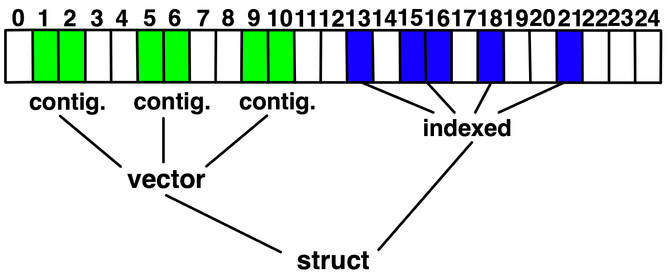
Derived Datatype Example
Notes:
Lower Bound – Beginning of the datatype definition
Size – Size of the datatype definition
Extent – Stride from the beginning of the data to the end

Slide 58
MPI’s Intrinsic Datatypes
Why intrinsic types?
Heterogeneity, nice to send a Boolean from C to Fortran
Conversion rules are complex, not discussed here
Length matches to language types
No sizeof(int) mess
Users should generally use intrinsic types as basic types for communication and type construction!
MPI_BYTE should only be used for data that are raw bytes
MPI-2.2 added some missing C types
E.g., unsigned long long
Notes:
Make it clear that avoiding MPI_BYTE is good programming; there is no performance consequence (technically, in fact, MPI_BYTE could be ever so slightly faster). But there are cases where MPI_BYTE is correct; using MPI_CHAR instead would be incorrect.

Slide 59
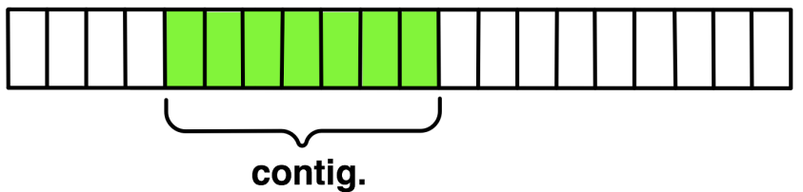
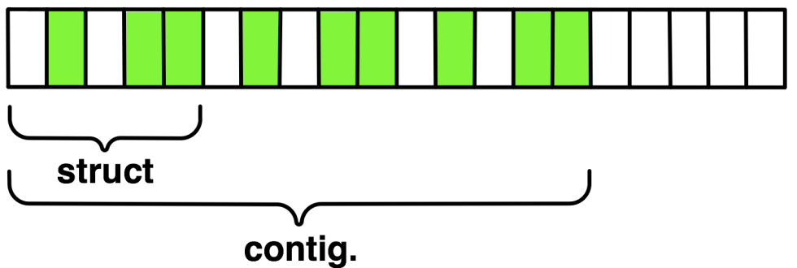
MPI_Type_contiguous
Contiguous array of oldtype
Should not be used as last type (can be replaced by count)
MPI_Type_contiguous(int count, MPI_Datatype
oldtype, MPI_Datatype *newtype)
Notes:
MPI_TYPE_CONTIGUOUS(7, MPI_INT, &newtype)

Slide 60
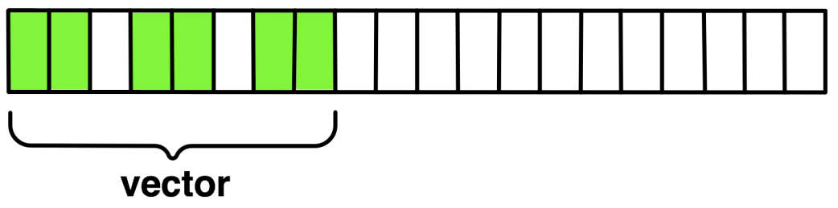
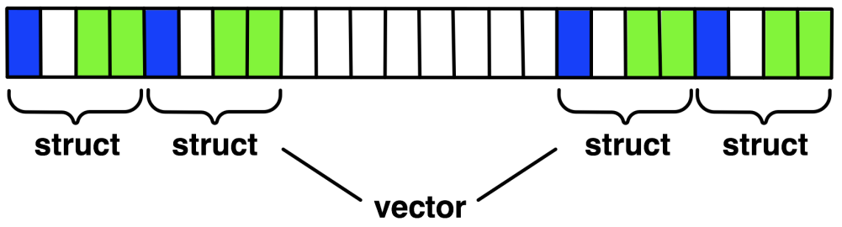
MPI_Type_vector
MPI_Type_vector(int count, int blocklength, int stride, MPI_Datatype oldtype, MPI_Datatype *newtype)
Specify strided blocks of data of oldtype
Very useful for Cartesian arrays
Notes:
MPI_TYPE_VECTOR(3, 2, 1, MPI_INT, &newtype)
MPI_TYPE_VECTOR(2, 2, 2, struct, &newtype)

Slide 61
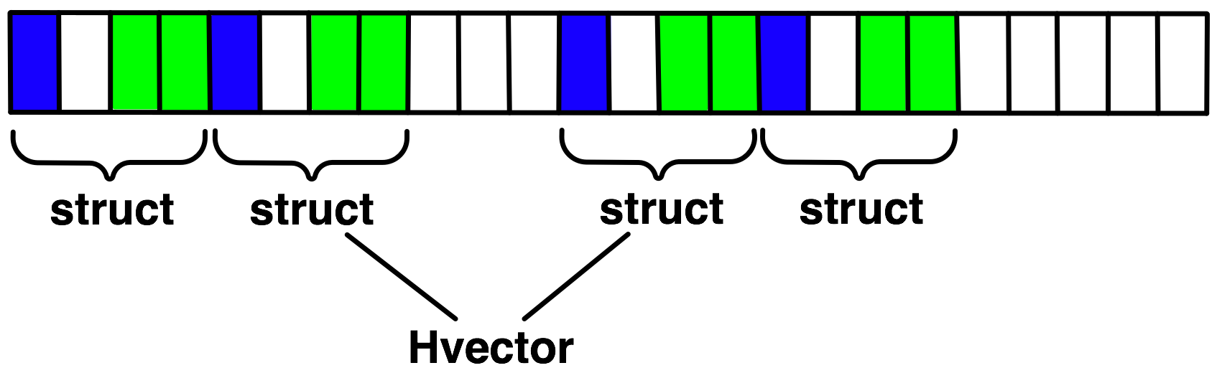
MPI_Type_create_hvector
Create non-unit strided vectors
Useful for composition, e.g., vector of structs
MPI_Type_create_hvector(int count, int blocklength, MPI_Aint stride, MPI_Datatype oldtype, MPI_Datatype *newtype)
Notes:
MPI_TYPE_CREATE_HVECTOR(2, 2, sizeof(gap in bytes), struct, &newtype)

Slide 62
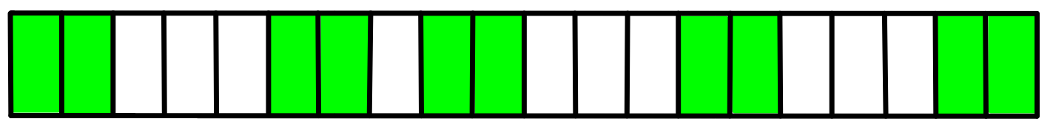
MPI_Type_create_indexed_block
Like MPI_Type_indexed but blocklength is the same
blen=2
displs={0,5,9,13,18}
MPI_Type_create_indexed_block(int count, int blocklength,
int *array_of_displacements, MPI_Datatype oldtype,
MPI_Datatype *newtype)
Notes:
MPI_TYPE_CREATE_INDEXED_BLOCK(5, blen, displs, MPI_INT, &newtype)

Slide 63
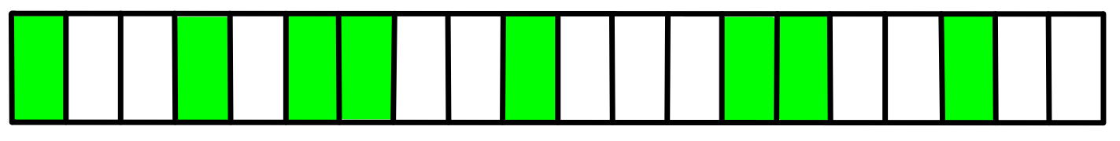
MPI_Type_indexed
MPI_Type_indexed(int count, int *array_of_blocklengths,
int *array_of_displacements, MPI_Datatype oldtype,
MPI_Datatype *newtype)
Pulling irregular subsets of data from a single array (cf. vector collectives)
Dynamic codes with index lists, expensive though!
blen={1,1,2,1,2,1}
displs={0,3,5,9,13,17}
Notes:
MPI_TYPE_INDEXED(6, blen, displs, MPI_INT, &newtype)

Slide 64
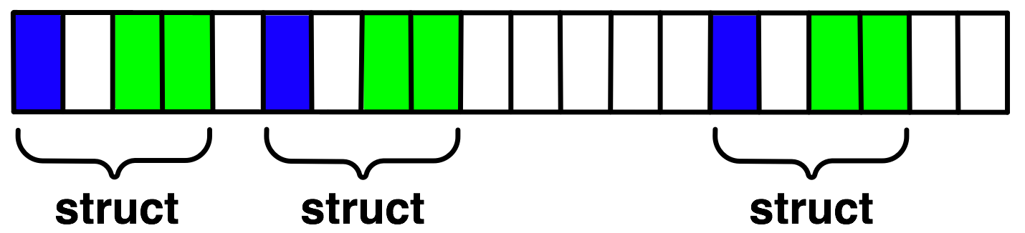
MPI_Type_create_hindexed
Indexed with non-unit displacements, e.g., pulling types out of different arrays
MPI_Type_create_hindexed(int count, int *arr_of_blocklengths, MPI_Aint *arr_of_displacements, MPI_Datatype oldtype, MPI_Datatype *newtype)
Notes:
MPI_TYPE_CREATE_HINDEXED(3, {1, 1, 1}, {0, 1, 5 bytes}, struct, &newtype)

Slide 65
MPI_Type_create_struct
Most general constructor, allows different types and arbitrary arrays (also most costly)
MPI_Type_create_struct(int count, int array_of_blocklengths[],
MPI_Aint array_of_displacements[], MPI_Datatype array_of_types[], MPI_Datatype *newtype)
Notes:
MPI_TYPE_CREATE_STRUCT(2, {1, 1}, {0, 2}, {MPI_INT, MPI_LONG}, &newtype)

Slide 66
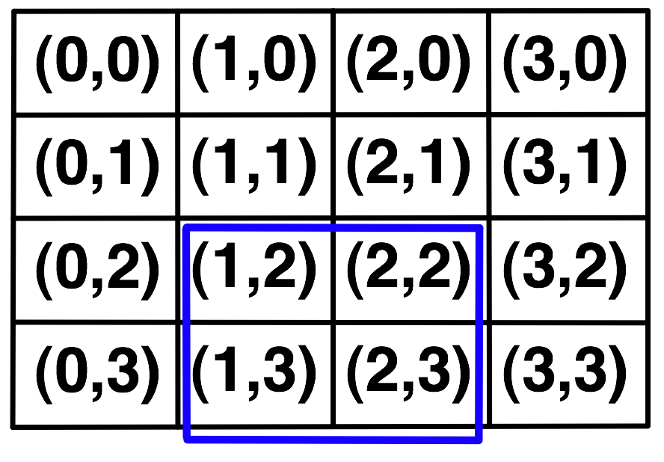
MPI_Type_create_subarray
Specify subarray of n-dimensional array (sizes) by start (starts) and size (subsize)
MPI_Type_create_subarray(int ndims, int array_of_sizes[],
int array_of_subsizes[], int array_of_starts[], int order,
MPI_Datatype oldtype, MPI_Datatype *newtype)
Notes:
MPI_TYPE_CREATE_SUBARRAY(2, {4, 4}, {2, 2}, {3, 2}, MPI_ORDER_C, MPI_INT, &newtype)

Slide 67
MPI_Type_create_darray
Create distributed array, supports block, cyclic and no distribution for each dimension
Very useful for I/O
MPI_Type_create_darray(int size, int rank, int ndims,
int array_of_gsizes[], int array_of_distribs[], int
array_of_dargs[], int array_of_psizes[], int order,
MPI_Datatype oldtype, MPI_Datatype *newtype)
Notes:
MPI_TYPE_CREATE_DARRAY(4, rank, 2, {4, 4}, {MPI_DISTRIBUTE_BLOCK, MPI_DISTRIBUTE_BLOCK}, {MPI_DISTRIBUTE_DFLT_DARG*2}, {2, 2}, MPI_ORDER_C, MPI_INT, &newtype)

Slide 68
Commit, Free, and Dup
Types must be committed before use
Only the ones that are used explicitly in a call!
MPI_Type_commit may perform time-consuming optimizations (but few implementations currently exploit this feature)
MPI_Type_free
Free MPI resources of datatypes
Does not affect types built from it
MPI_Type_dup
Duplicates a type
Library abstraction (composability)
Notes:
- Figure: dup, stempel

Slide 69
Datatype Performance in Practice
Datatypes can provide performance benefits, particularly for certain regular patterns
However, many implementations do not optimize datatype operations
If performance is critical, you will need to test
Even manual packing/unpacking can be slow if not properly optimized by the compiler – make sure to check optimization reports or if the compiler doesn’t provide good reports, inspect the assembly code
For parallel I/O, datatypes do provide large performance benefits in many cases

Slide 70
Exercise: Stencil with Derived Datatypes (1)
In the basic version of the stencil code
Used nonblocking communication 👍
Used manual packing/unpacking of data 👎
Let’s try to use derived datatypes
Specify the locations of the data instead of manually packing/unpacking
What datatype do we need here?
by
What datatype do we need here?
bx

Slide 71
Exercise: Stencil with Derived Datatypes (2)
Nonblocking sends and receives
Data location specified by MPI datatypes
Manual packing of data no longer required
Start from nonblocking_p2p/stencil.c
Solution in derived_datatype/stencil.c

Slide 72
Example: Basic Send/Receive
blocking_p2p/sendrecv.c
Simple send/receive program to show basic data transfer

Slide 73
Exercise: Stencil with Derived Datatypes (1)
In the basic version of the stencil code
Used nonblocking communication 👍
Used manual packing/unpacking of data 👎
Let’s try to use derived datatypes
Specify the locations of the data instead of manually packing/unpacking
What datatype do we need here?
by
What datatype do we need here?
bx

Slide 74
Exercise: Stencil with Derived Datatypes (2)
Nonblocking sends and receives
Data location specified by MPI datatypes
Manual packing of data no longer required
Start from nonblocking_p2p/stencil.c
Solution in derived_datatype/stencil.c

Slide 75
Collectives and Nonblocking Collectives

Slide 76
Introduction to Collective Operations in MPI
Called by all processes in a communicator
Share similar syntax and semantics with pt2pt operations but have no tags and have stricter type matching rules
May or may not have synchronization effects on the calling processes
Three classes of collective operations: synchronization, data movement, collective computation
Communication and computation is coordinated among a group of processes in a communicator
Non-blocking collective operations have been introduced in MPI-3

Slide 77
MPI Collective Communication Semantics
MPI_Bcast(void *buffer, int count, MPI_Datatype datatype,
int root, MPI_Comm comm)
Distributes data from one process (the root) to all others in a communicator
MPI_Reduce(const void *sendbuf, void *recvbuf, int count,
MPI_Datatype datatype, MPI_Op op, int root,
MPI_Comm comm)
Combines data from all processes in the communicator and returns it to one process
In many numerical algorithms, SEND/RECV can be replaced by BCAST/REDUCE, improving both simplicity and efficiency

Slide 78
Synchronization
MPI_Barrier(MPI_Comm comm)
Blocks until all processes in the group of communicator comm call it
A process cannot get out of the barrier until all other processes have reached barrier
Note that a barrier is rarely, if ever, necessary in an MPI program
Adding barriers “just to be sure” is a bad practice and causes unnecessary synchronization. Remove unnecessary barriers from your code
One legitimate use of a barrier is before the first call to MPI_Wtime to start a timing measurement. This causes each process to start at approximately the same time
Avoid using barriers other than for this

Slide 79
Collective Data Movement
P0
A
A
P1
Broadcast
A
P2
A
P3
A
P0
A
B
C
D
Scatter
A
P1
B
P2
C
Gather
P3
D

Slide 80
More Collective Data Movement
P0
A
A
B
C
D
P1
B
Allgather
A
B
C
D
P2
C
A
B
C
D
P3
D
A
B
C
D
P0
A0
A1
A2
A3
A0
B0
C0
D0
P1
B0
B1
B2
B3
Alltoall
A1
B1
C1
D1
P2
C0
C1
C2
C3
A2
B2
C2
D2
P3
D0
D1
D2
D3
A3
B3
C3
D3

Slide 81
Collective Computation
P0
A
ABCD
P1
Reduce
B
P2
C
P3
D
P0
A
A
P1
B
AB
Scan
P2
C
ABC
P3
D
ABCD

Slide 82
MPI Collective Routines
Many Routines, including: MPI_ALLGATHER, MPI_ALLGATHERV, MPI_ALLREDUCE, MPI_ALLTOALL, MPI_ALLTOALLV, MPI_BCAST, MPI_EXSCAN, MPI_GATHER, MPI_GATHERV, MPI_REDUCE, MPI_REDUCE_SCATTER, MPI_SCAN, MPI_SCATTER, MPI_SCATTERV
“All” versions deliver results to all participating processes
“V” versions (stands for vector) allow the chunks to have different sizes
“W” versions for ALLTOALL allow the chunks to have different sizes in bytes, rather than units of datatypes
MPI_ALLREDUCE, MPI_REDUCE, MPI_REDUCE_SCATTER, MPI_REDUCE_SCATTER_BLOCK, MPI_EXSCAN, and MPI_SCAN take both built-in and user-defined combiner functions

Slide 83
MPI Built-in Collective Computation Operations
MPI_MAX
MPI_MIN
MPI_PROD
MPI_SUM
MPI_LAND
MPI_LOR
MPI_LXOR
MPI_BAND
MPI_BOR
MPI_BXOR
MPI_MAXLOC
MPI_MINLOC
MPI_REPLACE, MPI_NO_OP
Maximum
Minimum
Product
Sum
Logical and
Logical or
Logical exclusive or
Bitwise and
Bitwise or
Bitwise exclusive or
Maximum and location
Minimum and location
Replace and no operation (RMA)

Slide 84
Defining your own Collective Operations
Create your own collective computations with: MPI_OP_CREATE(user_fn, commutes, &op); MPI_OP_FREE(&op);
user_fn(invec, inoutvec, len, datatype);
The user function should perform: inoutvec[i] = invec[i] op inoutvec[i]; for i from 0 to len-1
The user function can be non-commutative, but must be associative

Slide 85
Nonblocking Collectives

Slide 86
Nonblocking Collective Communication
Nonblocking communication
Deadlock avoidance
Overlapping communication/computation
Collective communication
Collection of pre-defined optimized routines
Nonblocking collective communication
Combines both advantages
System noise/imbalance resiliency
Semantic advantages

Slide 87
Nonblocking Communication
Semantics are simple:
Function returns no matter what
No progress guarantee!
E.g., MPI_Isend(<send-args>, MPI_Request *req);
Nonblocking tests:
Test, Testany, Testall, Testsome
Blocking wait:
Wait, Waitany, Waitall, Waitsome

Slide 88
Nonblocking Collective Communication
Nonblocking variants of all collectives
MPI_Ibcast(<bcast args>, MPI_Request *req);
Semantics:
Function returns no matter what
No guaranteed progress (quality of implementation)
Usual completion calls (wait, test) + mixing
Out-of order completion
Restrictions:
No tags, in-order matching
Send and vector buffers may not be touched during operation
MPI_Cancel not supported
No matching with blocking collectives
Hoefler et al.: Implementation and Performance Analysis of Non-Blocking Collective Operations for MPI

Slide 89
Nonblocking Collective Communication
Semantic advantages:
Enable asynchronous progression (and manual)
Software pipelining
Decouple data transfer and synchronization
Noise resiliency!
Allow overlapping communicators
See also neighborhood collectives
Multiple outstanding operations at any time
Enables pipelining window
Hoefler et al.: Implementation and Performance Analysis of Non-Blocking Collective Operations for MPI

Slide 90
A Non-Blocking Barrier?
What can that be good for? Well, quite a bit!
Semantics:
MPI_Ibarrier() – calling process entered the barrier, no synchronization happens
Synchronization may happen asynchronously
MPI_Test/Wait() – synchronization happens if necessary
Uses:
Overlap barrier latency (small benefit)
Use the split semantics! Processes notify non-collectively but synchronize collectively!

Slide 91
Nonblocking And Collective Summary
Nonblocking communication
Overlap and relax synchronization
Collective communication
Specialized pre-optimized routines
Performance portability
Hopefully transparent performance
They can be composed
E.g., software pipelining

Slide 92
Exercise: Stencil using Alltoallv
In the basic version of the stencil code
Used nonblocking send/receive for each direction
Let’s try to use single alltoallv collective call
Start from nonblocking_p2p/stencil.c
Solution available in blocking_coll/stencil_alltoallv.c
count = by
count = bx
count = 0

Slide 93
Exercise: Stencil with Derived Datatypes and Collectives
Simplify collective version of stencil
Alltoallv: defines a set of counts and displacements with the same datatype (see blocking_coll/stencil_alltoallv.c)
Alltoallw: defines a set of counts, displacements, and datatypes
Data location specified by MPI datatypes
Manual packing of data no longer required
Start from blocking_coll/stencil_alltoallv.c
Solution in derived_datatype/stencil_alltoallw.c

Slide 94
Exercise: Stencil with Nonblocking Collectives
Use nonblocking collective to overlap computation and communication
Compute inner grid while waiting for completion of data movement
Compute outer grid with updated halo regions
Start from derived_datatype/stencil_alltoallw.c
Solution available in nonblocking_coll/stencil_alltoallw.c
by
Halo regions
Computation of inner grid does not need halo regions
bx

Slide 95
Advanced Topics: One-sided Communication

Slide 96
One-sided Communication
The basic idea of one-sided communication models is to decouple data movement with process synchronization
Should be able to move data without requiring that the remote process synchronize
Each process exposes a part of its memory to other processes
Other processes can directly read from or write to this memory
Process 0
Process 1
Process 2
Process 3
Remotely
Accessible
Memory
Private
Memory
Remotely
Accessible
Memory
Private
Memory
Remotely
Accessible Memory
Private
Memory
Remotely
Accessible Memory
Global Address Space
Private
Memory
Private
Memory
Private
Memory
Private
Memory
Private
Memory

Slide 97
Two-sided Communication Example
Memory
Processor
Processor
Memory
Memory
Segment
Memory
Segment
Memory
Segment
Memory
Segment
Memory
Segment
Send
Recv
Send
Recv
MPI implementation
MPI implementation

Slide 98
One-sided Communication Example
Memory
Processor
Processor
Memory
Memory
Segment
Memory
Segment
Memory
Segment
Memory
Segment
Send
Recv
Send
Recv
MPI implementation
MPI implementation
Notes:
Is the single target memory (compared to the multiple segments in the pt-2-pt case) intended to note this common limitation of the HW support for RDMA?

Slide 99
Comparing One-sided and Two-sided Programming
Process 0
Process 1
SEND(data)
DELAY
Even the sending process is delayed
RECV(data)
Process 0
Process 1
PUT(data)
DELAY
Delay in process 1 does not affect process 0
GET(data)

Slide 100
What we need to know in MPI RMA
How to create remote accessible memory?
Reading, Writing and Updating remote memory
Data Synchronization
Memory Model

Slide 101
Creating Public Memory
Any memory used by a process is, by default, only locally accessible
X = malloc(100);
Once the memory is allocated, the user has to make an explicit MPI call to declare a memory region as remotely accessible
MPI terminology for remotely accessible memory is a “window”
A group of processes collectively create a “window”
Once a memory region is declared as remotely accessible, all processes in the window can read/write data to this memory without explicitly synchronizing with the target process
Process 0
Process 1
Process 2
Process 3
window
Private
Memory
window
Private
Memory
window
Private
Memory
window
Private
Memory
Private
Memory
Private
Memory
Private
Memory
Private
Memory

Slide 102
Window creation models
Four models exist
MPI_WIN_ALLOCATE
You want to create a buffer and directly make it remotely accessible
MPI_WIN_CREATE
You already have an allocated buffer that you would like to make remotely accessible
MPI_WIN_CREATE_DYNAMIC
You don’t have a buffer yet, but will have one in the future
You may want to dynamically add/remove buffers to/from the window
MPI_WIN_ALLOCATE_SHARED
You want multiple processes on the same node share a buffer
performance
flexibility

Slide 103
MPI_WIN_ALLOCATE
MPI_Win_allocate(MPI_Aint size, int disp_unit,
MPI_Info info, MPI_Comm comm, void *baseptr,
MPI_Win *win)
Create a remotely accessible memory region in an RMA window
Only data exposed in a window can be accessed with RMA ops.
Arguments:
size - size of local data in bytes (nonnegative integer)
disp_unit - local unit size for displacements, in bytes (positive integer)
info - info argument (handle)
comm - communicator (handle)
baseptr - pointer to exposed local data
win - window (handle)

Slide 104
Example with MPI_WIN_ALLOCATE
int main(int argc, char ** argv)
{
int *a; MPI_Win win;
MPI_Init(&argc, &argv);
/* collectively create remote accessible memory in a window */
MPI_Win_allocate(1000*sizeof(int), sizeof(int), MPI_INFO_NULL,
MPI_COMM_WORLD, &a, &win);
/* Array ‘a’ is now accessible from all processes in
* MPI_COMM_WORLD */
MPI_Win_free(&win);
MPI_Finalize(); return 0;
}

Slide 105
MPI_WIN_CREATE
MPI_Win_create(void *base, MPI_Aint size, int disp_unit, MPI_Info info, MPI_Comm comm, MPI_Win *win)
Expose a region of memory in an RMA window
Only data exposed in a window can be accessed with RMA ops.
Arguments:
base - pointer to local data to expose
size - size of local data in bytes (nonnegative integer)
disp_unit - local unit size for displacements, in bytes (positive integer)
info - info argument (handle)
comm - communicator (handle)
win - window (handle)

Slide 106
Example with MPI_WIN_CREATE
int main(int argc, char ** argv)
{
int *a; MPI_Win win;
MPI_Init(&argc, &argv);
/* create private memory */
MPI_Alloc_mem(1000*sizeof(int), MPI_INFO_NULL, &a);
/* use private memory like you normally would */
a[0] = 1; a[1] = 2;
/* collectively declare memory as remotely accessible */
MPI_Win_create(a, 1000*sizeof(int), sizeof(int),
MPI_INFO_NULL, MPI_COMM_WORLD, &win);
/* Array ‘a’ is now accessibly by all processes in
* MPI_COMM_WORLD */
MPI_Win_free(&win);
MPI_Free_mem(a);
MPI_Finalize(); return 0;
}

Slide 107
MPI_WIN_CREATE_DYNAMIC
MPI_Win_create_dynamic(MPI_Info info, MPI_Comm comm,
MPI_Win *win)
Create an RMA window, to which data can later be attached
Only data exposed in a window can be accessed with RMA ops
Initially “empty”
Application can dynamically attach/detach memory to this window by calling MPI_Win_attach/detach
Application can access data on this window only after a memory region has been attached
Window origin is MPI_BOTTOM
Displacements are segment addresses relative to MPI_BOTTOM
Must tell others the displacement after calling attach

Slide 108
Example with MPI_WIN_CREATE_DYNAMIC
int main(int argc, char ** argv)
{
int *a; MPI_Win win;
MPI_Init(&argc, &argv);
MPI_Win_create_dynamic(MPI_INFO_NULL, MPI_COMM_WORLD, &win);
/* create private memory */
a = (int *) malloc(1000 * sizeof(int));
/* use private memory like you normally would */
a[0] = 1; a[1] = 2;
/* locally declare memory as remotely accessible */
MPI_Win_attach(win, a, 1000*sizeof(int));
/* Array ‘a’ is now accessible from all processes */
/* undeclare remotely accessible memory */
MPI_Win_detach(win, a); free(a);
MPI_Win_free(&win);
MPI_Finalize(); return 0;
}

Slide 109
Data movement
MPI provides ability to read, write and atomically modify data in remotely accessible memory regions
MPI_PUT
MPI_GET
MPI_ACCUMULATE (atomic)
MPI_GET_ACCUMULATE (atomic)
MPI_COMPARE_AND_SWAP (atomic)
MPI_FETCH_AND_OP (atomic)

Slide 110
Data movement: Put
MPI_Put(const void *origin_addr, int origin_count,
MPI_Datatype origin_dtype, int target_rank,
MPI_Aint target_disp, int target_count,
MPI_Datatype target_dtype, MPI_Win win)
Move data from origin, to target
Separate data description triples for origin and target
Remotely Accessible Memory
Private Memory
Origin
Target

Slide 111
Data movement: Get
MPI_Get(void *origin_addr, int origin_count,
MPI_Datatype origin_dtype, int target_rank,
MPI_Aint target_disp, int target_count,
MPI_Datatype target_dtype, MPI_Win win)
Move data to origin, from target
Separate data description triples for origin and target
Remotely Accessible Memory
Private Memory
Origin
Target

Slide 112
Atomic Data Aggregation: Accumulate
MPI_Accumulate(const void *origin_addr, int origin_count,
MPI_Datatype origin_dtype, int target_rank,
MPI_Aint target_disp, int target_count,
MPI_Datatype target_dtype, MPI_Op op, MPI_Win win)
Atomic update operation, similar to a put
Reduces origin and target data into target buffer using op argument as combiner
Op = MPI_SUM, MPI_PROD, MPI_OR, MPI_REPLACE, MPI_NO_OP, …
Predefined ops only, no user-defined operations
Different data layouts between target/origin OK
Basic type elements must match
Op = MPI_REPLACE
Implements f(a,b)=b
Atomic PUT
Remotely Accessible Memory
+=
Private Memory
Origin
Target

Slide 113
Atomic Data Aggregation: Get Accumulate
MPI_Get_accumulate(const void *origin_addr,
int origin_count, MPI_Datatype origin_dtype,
void *result_addr,int result_count,
MPI_Datatype result_dtype, int target_rank,
MPI_Aint target_disp,int target_count,
MPI_Datatype target_dype, MPI_Op op, MPI_Win win)
Atomic read-modify-write
Op = MPI_SUM, MPI_PROD, MPI_OR, MPI_REPLACE, MPI_NO_OP, …
Predefined ops only
Result stored in target buffer
Original data stored in result buf
Different data layouts between target/origin OK
Basic type elements must match
Atomic get with MPI_NO_OP
Atomic swap with MPI_REPLACE
Remotely Accessible Memory
+=
Private Memory
Origin
Target

Slide 114
Atomic Data Aggregation: CAS and FOP
MPI_Fetch_and_op(const void *origin_addr, void *result_addr,
MPI_Datatype dtype, int target_rank,
MPI_Aint target_disp, MPI_Op op, MPI_Win win)
MPI_Compare_and_swap(const void *origin_addr,
const void *compare_addr, void *result_addr,
MPI_Datatype dtype, int target_rank,
MPI_Aint target_disp, MPI_Win win)
FOP: Simpler version of MPI_Get_accumulate
All buffers share a single predefined datatype
No count argument (it’s always 1)
Simpler interface allows hardware optimization
CAS: Atomic swap if target value is equal to compare value

Slide 115
Ordering of Operations in MPI RMA
No guaranteed ordering for Put/Get operations
Result of concurrent Puts to the same location undefined
Result of Get concurrent Put/Accumulate undefined
Can be garbage in both cases
Result of concurrent accumulate operations to the same location are defined according to the order in which the occurred
Atomic put: Accumulate with op = MPI_REPLACE
Atomic get: Get_accumulate with op = MPI_NO_OP
Accumulate operations from a given process are ordered by default
User can tell the MPI implementation that (s)he does not require ordering as optimization hint
You can ask for only the needed orderings: RAW (read-after-write), WAR, RAR, or WAW

Slide 116
Examples with operation ordering
Process 0
Process 1
PUT(x=1, P1)
x = 0
1. Concurrent Puts: undefined
PUT(x=2, P1)
x = 2
x = 1
PUT(x=2, P1)
2. Concurrent Get and Put/Accumulates: undefined
x = 1
GET(y, x, P1)
y=1
x = 2
GET_ACC (y, x+=2, P1)
x = 2
ACC (x+=1, P1)
3. Concurrent Accumulate operations to the same location : ordering is guaranteed
x += 2
y=2
x += 1

Slide 117
RMA Synchronization Models
RMA data access model
When is a process allowed to read/write remotely accessible memory?
When is data written by process X is available for process Y to read?
RMA synchronization models define these semantics
Three synchronization models provided by MPI:
Fence (active target)
Post-start-complete-wait (generalized active target; rarely used now)
Lock/Unlock (passive target)
Data accesses occur within “epochs”
Access epochs: contain a set of operations issued by an origin process
Exposure epochs: enable remote processes to update a target’s window
Epochs define ordering and completion semantics
Synchronization models provide mechanisms for establishing epochs
E.g., starting, ending, and synchronizing epochs

Slide 118
Fence: Active Target Synchronization
MPI_Win_fence(int assert, MPI_Win win)
Collective synchronization model
Starts and ends access and exposure epochs on all processes in the window
All processes in group of “win” do an MPI_WIN_FENCE to open an epoch
Everyone can issue PUT/GET operations to read/write data
Everyone does an MPI_WIN_FENCE to close the epoch
All operations complete at the second fence synchronization
P0
P1
P2
Fence
Fence

Slide 119
Implementing Stencil Computation with RMA Fence
RMA window
PUT
Target buffers
Origin buffers
PUT
PUT
PUT

Slide 120
Exercise: Stencil with RMA Fence
In the derived datatype version of the stencil code
Used nonblocking communication
Used derived datatypes
Let’s try to use RMA fence
Move data with PUT instead of send/recv
Start from derived_datatype/stencil.c
Solution available in rma/stencil_fence_put.c

Slide 121
Exercise: Stencil with RMA Fence (GET model)
In the derived datatype version of the stencil code
Used nonblocking communication
Used derived datatypes
Let’s try to use RMA fence
Move data with GET instead of send/recv
Start from rma/stencil_fence_put.c
Solution available in rma/stencil_fence_get.c

Slide 122
PSCW: Generalized Active Target Synchronization
MPI_Win_post/start(MPI_Group grp, int assert, MPI_Win win)
MPI_Win_complete/wait(MPI_Win win)
Like FENCE, but origin and target specify who they communicate with
Target: Exposure epoch
Opened with MPI_Win_post
Closed by MPI_Win_wait
Origin: Access epoch
Opened by MPI_Win_start
Closed by MPI_Win_complete
All synchronization operations may block, to enforce P-S/C-W ordering
Processes can be both origins and targets
Target
Origin
Post
Start
Complete
Wait
Notes:
Slide hidden because this is rarely used and requires MPI_Group

Slide 123
Lock/Unlock: Passive Target Synchronization
Active Target Mode
Passive Target Mode
Post
Lock
Start
Wait
Complete
Unlock
Passive mode: One-sided, asynchronous communication
Target does not participate in communication operation
Shared memory-like model

Slide 124
Passive Target Synchronization
MPI_Win_lock(int locktype, int rank, int assert, MPI_Win win)
MPI_Win_unlock(int rank, MPI_Win win)
MPI_Win_flush/flush_local(int rank, MPI_Win win)
Lock/Unlock: Begin/end passive mode epoch
Target process does not make a corresponding MPI call
Can initiate multiple passive target epochs to different processes
Concurrent epochs to same process not allowed (affects threads)
Lock type
SHARED: Other processes using shared can access concurrently
EXCLUSIVE: No other processes can access concurrently
Flush: Remotely complete RMA operations to the target process
After completion, data can be read by target process or a different process
Flush_local: Locally complete RMA operations to the target process

Slide 125
Advanced Passive Target Synchronization
MPI_Win_lock_all(int assert, MPI_Win win)
MPI_Win_unlock_all(MPI_Win win)
MPI_Win_flush_all/flush_local_all(MPI_Win win)
Lock_all: Shared lock, passive target epoch to all other processes
Expected usage is long-lived: lock_all, put/get, flush, …, unlock_all
Flush_all – remotely complete RMA operations to all processes
Flush_local_all – locally complete RMA operations to all processes

Slide 126
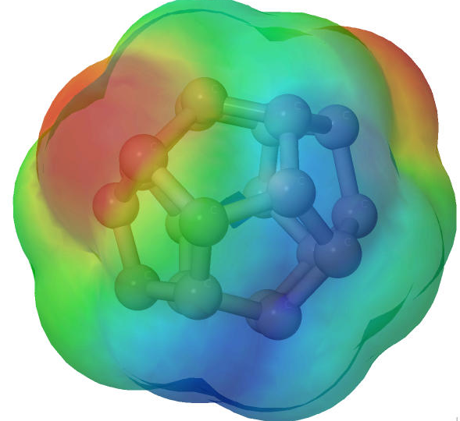
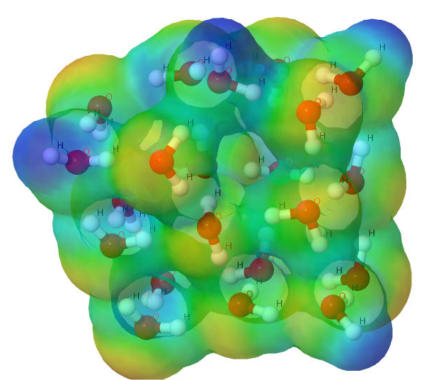
NWChem ^{[1]}
High performance computational chemistry application suite
Quantum level simulation of molecular systems
Very expensive in computation and data movement, so is used for small systems
Larger systems use molecular level simulations
Composed of many simulation capabilities
Molecular Electronic Structure
Quantum Mechanics/Molecular Mechanics
Pseudo potential Plane-Wave Electronic Structure
Molecular Dynamics
Very large code base
4M LOC; Total investment of ~200M $ to date
Carbon C₂₀
Water (H₂O)²¹
[1] M. Valiev, E.J. Bylaska, N. Govind, K. Kowalski, T.P. Straatsma, H.J.J. van Dam, D. Wang, J. Nieplocha, E. Apra, T.L. Windus, W.A. de Jong, "NWChem: a comprehensive and scalable open-source solution for large scale molecular simulations" Comput. Phys. Commun. 181, 1477 (2010)

Slide 127
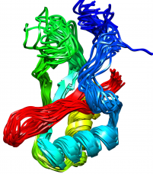
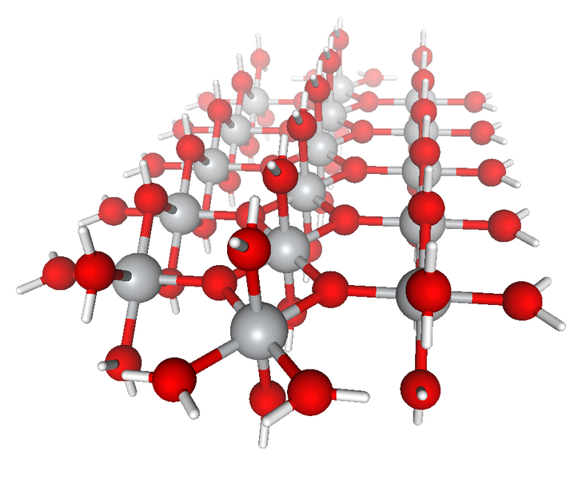
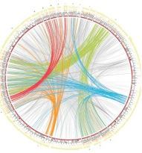



NWChem Communication Runtime
Abstractions for distributed arrays
Global Address Space
Applications
Physically distributed to different processes
Global Arrays ^{[2]}
Hidden from user
ARMCI : Communication interface for RMA^{[3]}
Irregularly access large amount of remote memory regions
ARMCI native ports
…
ARMCI-MPI
IB
DMMAP
MPI RMA
[2] http://hpc.pnl.gov/globalarrays
[3] http://hpc.pnl.gov/armci

Slide 128
Get-Compute-Update
Typical Get-Compute-Update mode in GA programming
All of the blocks are non-contiguous data
Pseudo code
for i in I blocks:
for j in J blocks:
for k in K blocks:
GET block a from A
GET block b from B
c += a * b /*computing*/
end do
ACC block c to C
NXTASK
end do
end do
GET block a
GET
block b
ACCUMULATE
block c
Perform DGEMM in local buffer
Mock figure showing 2D DGEMM with block-sparse computations. In reality, NWChem uses 6D tensors.

Slide 129
Which synchronization mode should I use, when?
RMA communication often has low overheads versus send/recv
Two-sided: Matching, queuing, buffering, unexpected receives, etc…
One-sided: No matching, no buffering, always ready to receive (but must separately sync the communication)
Direct use of RDMA provided by high-speed interconnects (e.g. InfiniBand)
Good two-sided implementations will also use RDMA, but must first match messages
Active mode: bulk synchronization
E.g. ghost cell exchange
Passive mode: asynchronous data movement
Useful when dataset is large, requiring memory of multiple nodes
Also, when data access and synchronization pattern is dynamic
Common use case: distributed, shared arrays
Passive target locking mode
Lock/unlock – Useful when exclusive epochs are needed
Lock_all/unlock_all – Useful when only shared epochs are needed
Notes:
Note that if RMA always has low overheads vs send/recv, it would *always* be faster. You can’t ignore the sync code in the overhead.
RDMA can (and should if the implementation is competent!) be used for pt-2-pt.

Slide 130
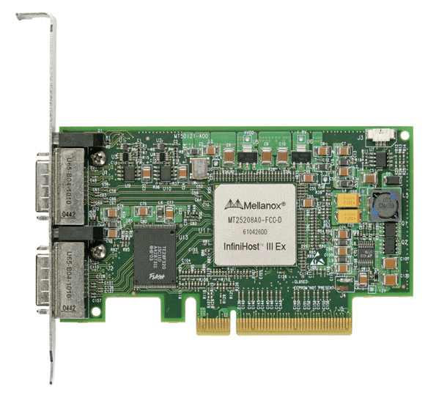
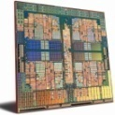
MPI RMA Memory Model
MPI-3 provides two memory models: separate and unified
MPI-2: Separate Model
Logical public and private copies
MPI provides software coherence between window copies
Extremely portable, to systems that don’t provide hardware coherence
MPI-3: New Unified Model
Single copy of the window
System must provide coherence
Superset of separate semantics
E.g. allows concurrent local/remote access
Provides access to full performance potential of hardware
Matches typical SMP nodes
Separate
Unified
Public
Copy
Unified
Copy
Private
Copy
Notes:
Memory model slides hidden because separate model is rarely encountered on today’s machines.

Slide 131
MPI RMA Memory Model (separate windows)
Same source
Same epoch
Diff. Sources
X
Public
Copy
X
Private
Copy
load
store
store
Very portable, compatible with non-coherent memory systems
Limits concurrent accesses to enable software coherence

Slide 132
MPI RMA Memory Model (unified windows)
Same source
Same epoch
Diff. Sources
X
Unified
Copy
load
store
store
Allows concurrent local/remote accesses
Concurrent, conflicting operations are allowed (not invalid)
Outcome is not defined by MPI (defined by the hardware)
Can enable better performance by reducing synchronization

Slide 133
Exercise: Stencil with RMA Fence
In the derived datatype version of the stencil code
Used nonblocking communication
Used derived datatypes
Let’s try to use RMA fence
Move data with PUT instead of send/recv
Start from derived_datatype/stencil.c
Solution available in rma/stencil_fence_put.c

Slide 134
Exercise: Stencil with RMA Fence (GET model)
In the derived datatype version of the stencil code
Used nonblocking communication
Used derived datatypes
Let’s try to use RMA fence
Move data with GET instead of send/recv
Start from rma/stencil_fence_put.c
Solution available in rma/stencil_fence_get.c

Slide 135
Exercise: Stencil with RMA Lock_all/Unlock_all (PUT model)
In the fence and PSCW versions of the stencil code, RMA synchronization involves the target processes
Let’s try to use RMA Lock_all/Flush_all/Unlock_all
Only the origin processes call RMA synchronization
Still need Barrier for process synchronization (e.g., ensure neighbors have completed data update to my local window)
Need Win_sync for memory synchronization
Start from rma/stencil_fence_put.c
Solution available in rma/stencil_lock_put.c

Slide 136
MPI + Accelerators

Slide 137
Introduction
Accelerators are becoming increasingly popular in parallel computing
CPUs
Task-sequential execution model (focus on latency)
Small # of complex compute cores (out-of-order execution)
Deep pipelines
Large caches
Branch prediction hardware
GPUs
Data-parallel execution model (focus on throughput)
Large # of simple compute elements (in-order execution)
Small caches
Shallow pipelines
Large off-chip global High-Bandwidth Memory (HBM)
High FLOPs/W and FLOPs/$
Notes:
Accelerators becoming increasingly prominent in high performance computing
Accelerators are very good at running a single computation in parallel (optimized for data throughput)
CPUs are very good at running sequential tasks (optimized for latency)
For this reason CPUs have a small number of complex cores that can run very generic code efficiently
They have deep multi-staged pipelines to increase the clock frequency
Large caches to minimize the cost incurred by memory accesses
Branch prediction hardware that aims at reducing the number of useless instruction that are fetched and decoded
GPUs have
Large number of simple cores that can run the same computation in parallel at the same time
Small caches
Shallow pipelines
Large high bandwidth memory that offers GPU threads high level of data access parallelism
Better power and cost efficiency than CPUs

Slide 138
Top500 Accelerators Based Systems (June 2019)
#1 - Summit (ORNL USA)
NVIDIA Volta GV100
#2 - Sierra (LLNL USA)
NVIDIA Volta GV100
#6 - Piz Daint (CSCS Switzerland)
NVIDIA Tesla P100
#8 - AI Bridging Cloud Infrastructure (AIST Japan)
NVIDIA Tesla V100
#10 - Lassen (LLNL USA)
NVIDIA Volta V100
Notes:
As indication of this trend we can look at the TOP500 list, recently updated, to see that five out of ten supercomputers in the first 10 positions are powered by accelerators.

Slide 139
Upcoming Exascale Accelerators Based Systems
Aurora (ANL USA)
Intel based technology
https://www.anl.gov/article/us-department-of-energy-and-intel-to-deliver-first-exascale-supercomputer
Frontier (ORNL USA)
AMD based GPU technology
https://www.ornl.gov/news/us-department-energy-and-cray-deliver-record-setting-frontier-supercomputer-ornl
Tianhe-3 (NUDT China)
Custom
Notes:
This trend is also reflected in the architecture of upcoming exascale systems which are also powered by accelerators

Slide 140
Programming Model for Accelerators
Multi-dimensional Dataset
GPUs are well suited for fine grain data level parallelism
Shared Memory, Single Instruction Multiple Data (SIMD) model
Many available compute platforms and programming frameworks (focus on their memory model and interaction with MPI)
NVIDIA CUDA (NVIDIA platform only)
AMD ROCm & HIP
OpenMP
OpenACC
OpenCL & SYCL
y
z
x
MPI*
SIMD
Memory
Memory
Memory
Memory
Memory
Memory
Memory
Memory
GPU
CPU
GPU
CPU
GPU
CPU
GPU
CPU
Network Card
Network Card
Network Card
Network Card
^{(*)}Single Program Multiple Data
Notes:
GPUs are well suited for fine grained data level parallelism in which the different GPU cores work against the solution of a common single function unit, also called Single Instruction Multiple Data model
In the first part of the presentation describe the base mechanisms that allow MPI implementation to interact with GPUs using some hardware optimizations
In the second part of the presentation describe how some GPU programming models support these optimizations while others still need the programmer to explicitly move data between GPU and CPU memory
Emphasize fact that this is not a GPU tutorial and some details of GPU programming are needed to understand how to use MPI with GPU codes. MPI implementations run on the host and are not natively designed for working with other devices like GPUs, so they expect all memory passed to MPI to be host accessible. If the HW provides enough support MPI can just handle GPU pointers to it and do nothing more. If the HW does not provide enough support MPI implementations have to do additional work to move data to host memory before they can access it

Slide 141
Interoperability with MPI
GPUs have separate physical memory subsystem
How to move data between GPUs with MPI?
Memory
Memory
Memory
Memory
GPU
CPU
CPU
GPU
Network Card
Network Card
Real answer: It depends on what GPU library, what hardware and what MPI implementation you are using
Simple answer: For modern GPUs, “just like you would with a non-GPU machine”
Notes:
Ping for questions

Slide 142
Unified Virtual Addressing (UVA)
UVA is a memory address management system supported in modern 64-bit architectures
Requires device driver support
The same virtual address space is used for all processors, host or devices
No distinction between host and device pointers
The user can query the location of the data allocation given a pointer in the unified virtual address space and the appropriate GPU runtime library query APIs (“GPU-aware” MPI library)
0x000 ..
.. 0xFFF
GPU
CPU
GPU
UVA: Single virtual address space for the host and all devices
Notes:
UVA is enabled by a PCIe technology called Unified Virtual Address space.
UVA is a memory address management system supported in 64-bit architecture that have device driver support and simply put creates a window through which the system can see the GPU memory space as it does for host physical memory
Using UVA it is possible for the system to use the same virtual address space to represent both CPU and GPU allocations. Of course GPU pointers are still not usable directly by use code running on the CPU because they are not backed up by physical pages in DRAM memory. Therefore, any dereferencing of such pointers in user code would result in a memory error. However, MPI aware implementation can interact with the GPU runtime to discover whether a pointer is referring to a GPU memory allocation and in that case handle the pointer appropriately

Slide 143
Remote Direct Memory Access with UVA
MPI moving data
CPU copy to pinned memory
GPU pinned memory
Direct Memory Access (DMA)
Only GPU-enabled MPI implementations can take advantage of UVA
User can pass device pointer to MPI
MPI implementation can query for the owner (host or device) of the data
If the data is on the device, the MPI implementation can optimize data transfers
Host Memory
GPU Memory
CPU
void* h_data
void* d_data
Double copy
GPU
Network Card
Network pinned memory
RDMA
Direct Memory Access (DMA)
Host Memory
GPU Memory
CPU
void* d_data
Single copy
GPU
Network Card
Pinned memory available to network and GPU devices
RDMA
RDMA
CPU
Host Memory
GPU Memory
void* d_data
Zero copy
GPU
Network Card
Notes:
Focus on performance concerns
Different level of optimization depending on level of hardware support
Ping for questions
Differentiate between the RDMA in the different scenarios

Slide 144
Intranode Communication with UVA
Intranode Optimization
GPU peer-to-peer data transfers are possible
MPI can directly move data between GPU devices
MPI Process 1
MPI Process 2
Memory
Peer-to-Peer DMA transfer between GPUs
Memory
Memory
GPU
CPU
GPU
Notes:
How is data moved by MPI in the case of GPUs on different root complex?

Slide 145
Heterogeneous Memory Management (HMM)
Next step towards the unification of heterogeneous memory spaces in the Linux Kernel (not yet available)
Support started with version 4.14 through helper functions to be used by device drivers
Support paging in device for migrating memory between host and GPU
Automatic data movement between host and GPU memories (called Unified Memory in CUDA)
Data is automatically migrated between host and GPU on page faults
Moving pages to GPU and back to host is similar to swap-out and swap-in of pages to and from disk
Page fault
Page migration
Page k
Page migration
Page i
Page fault
GPU
CPU
GPU
Single memory space accessible to all devices and host. Transparently managed heterogeneous memory.
Notes:
There is some effort in the linux kernel for unifying heterogeneous memory and make accelerators work more seemingly with CPUs.

Slide 146
MPI + HMM in a Nutshell
In theory, any MPI implementation can transparently work with HMM
The MPI implementation can always assume that the data is on the host (or device)
GPUs take care of moving data between device and host memories
Trying to register memory on the wrong device from the network should simply fail for HMM, but there have been reports of silent failures in this regard for CUDA, so you might need to be careful
Data in HMM can be corrupted if GPU updates pages during network transfer
In practice MPI implementations should never use HMM directly
Managed heterogeneous memory cannot be directly accessed by the network (correctness issue)
Virtual address cannot be pinned to a fixed physical memory region since GPU might need to migrate the data
Intermediate buffer is needed to copy data from HMM
In any case MPI can never know in which device data is physically located
Data management is completely handled by GPU and can cause unnecessary data movement (performance issue)
Notes:
Detailed explanation:
When the MPI implementation receives a pointer to a buffer, it passes it to the underlying network (i.e., the NIC). Before programming the DMA engine, the NIC (driver) has to make sure that memory pages are pinned (not pageable). Since memory pages for HMM can reside either on the host or the device, the NIC has to guess which of the two has the pages. If the NIC asks the GPU (driver), this will lookup the pages in its page table. Page tables in the GPU however may refer to stale data if the referenced pages are on the host instead. However, in this case the NIC might still receive a set of pages and will initiate the data transfer of stale data. Meanwhile, access to GPU page tables will also trigger migration of the interested pages from host to device. Meaning that not only the NIC is accessing stale data, but this data might be further overwritten by the HMM handler that also instructed the DMA to transfer data concurrently.
The MPI implementation should never pass HMM memory to the NIC directly it should always copy data from HMM to a temporary buffer that is pinned and only pass this to the underlying network hardware.
Problem with HMM in principle any address can potentially be HMM so in theory we can never use GPUDirect?

Slide 147
MPI + HMM Assuming Data on Host
MPI can assume data is on host memory
MPI copies data to network pinned memory
Network registration will fail
On a correct guess
The copy will not trigger a page fault to bring data from GPU
On incorrect guess
An expensive page fault will occur
CPU copy to pinned memory
MPI moving data
CPU
Host Memory
GPU Memory
Page k
data
GPU
Network Card
Pinned memory available to network and GPU devices
RDMA
Correct guess: data is on host memory
MPI moving data
CPU copy to pinned memory
GPU page migration
Page fault
Host Memory
GPU Memory
CPU
Page k
Page k
data
GPU
Network Card
Pinned memory available to network and GPU devices
RDMA
MPI moving data from host memory on a wrong guess

Slide 148
MPI + HMM Assuming Data on GPU
MPI can assume data is on some GPU device memory
MPI would need to move data from the GPU device memory to network pinned memory
This can be either host or GPU memory (but not unified memory)
On a correct guess
The copy will not trigger a page fault
On incorrect guess
An expensive page fault will occur when accessing data on the GPU device memory
Most MPI implementations assume memory to reside on the GPU
MPI moving data
Direct Memory Access (DMA)
Host Memory
GPU Memory
Page k
CPU
data
GPU
Network Card
Pinned memory available to network and GPU devices
RDMA
Correct guess: data is on the target GPU
MPI moving data
GPU page migration
Page fault
Host Memory
GPU Memory
Page k
Page k
CPU
data
DMA
GPU
Network Card
Pinned memory available to network and GPU devices
RDMA
MPI moving data from host memory on a wrong guess

