Slide 1
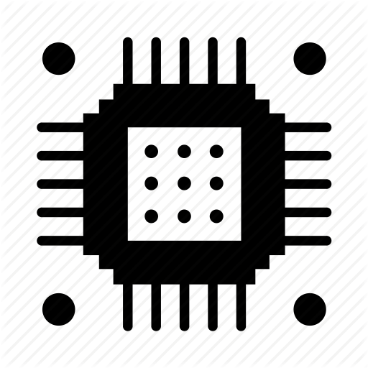
TAPIT
INTERNET OF THINGS
LECTURE 8:
NODEMCU and BLYNK APP

Slide 2
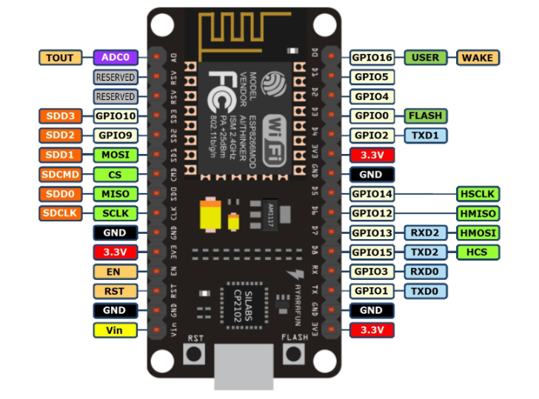
PIN OUT
TAPIT

Slide 3
BLYNK
TAPIT
Blynk is a Platform with iOS and Android apps to control nodeMCU, and the likes over the Internet.
Blynk was designed for the Internet of Things.
Its features:
Supports majority of development boards like Arduino, esp8266
Easy to use
Awesome widgets like LCD, push buttons, labelled value, graphs
Not restricted to local Wifi network
Direct pin manipulation with no code writing
Easy to integrate and add new functionality using virtual pins

Slide 4
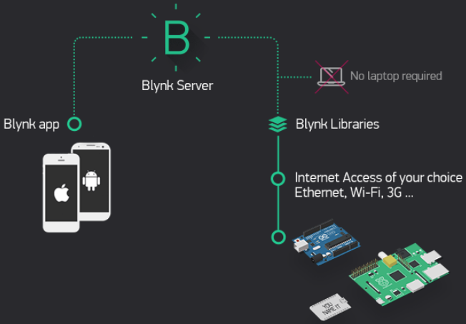
How does BLYNK work?
TAPIT
Now imagine: every time you press a Button in the Blynk app, the message travels to space the Blynk Cloud, where it magically finds its way to your hardware. It works the same in the opposite direction and everything happens in a blynk of an eye.
Notes:
There are three major components in the platform:
Blynk App - allows to you create amazing interfaces for your projects using various widgets we provide.
Blynk Server - responsible for all the communications between the smartphone and hardware. You can use our Blynk Cloud or run your private Blynk server locally. It’s open-source, could easily handle thousands of devices and can even be launched on a Raspberry Pi.
Blynk Libraries - for all the popular hardware platforms - enable communication with the server and process all the incoming and outcoming commands.

Slide 5
TAPIT
There are three major components in the platform:
Blynk App - allows to you create amazing interfaces for your projects using various widgets we provide.
Blynk Server - responsible for all the communications between the smartphone and hardware. You can use our Blynk Cloud or run your private Blynk server locally. It’s open-source, could easily handle thousands of devices and can even be launched on a Raspberry Pi.
Blynk Libraries - for all the popular hardware platforms - enable communication with the server and process all the incoming and outcoming commands.

Slide 6
“Ok, I want it. What do I need to get started?”
1. Hardware.
Blynk supports more than 400 boards already, including support for Arduino, Particle, ARM mbed, TI Energia, MicroPython, Node.js, OpenWRT and many Single Board Computers. Blynk works over the Internet. This means that the hardware you choose should be able to connect to the internet. Some of the boards will need an Ethernet or Wi-Fi Shield to communicate, others are already Internet-enabled.

Slide 7
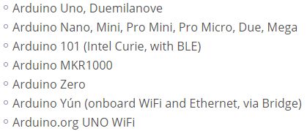
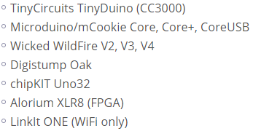
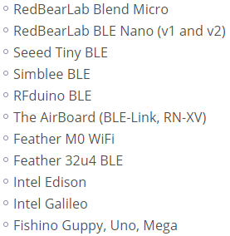
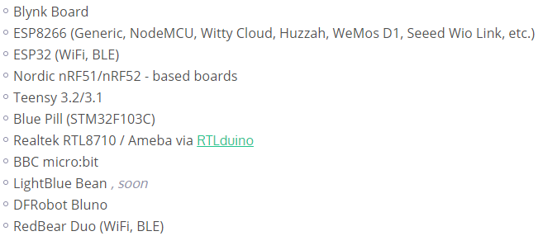
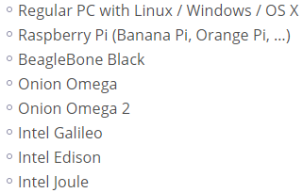

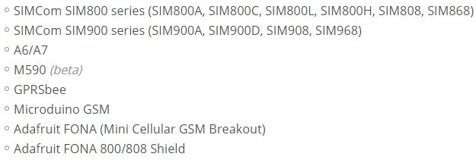
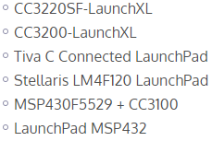
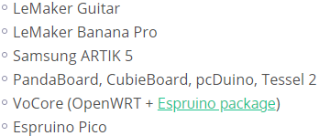
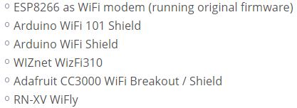

Slide 8
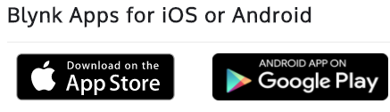
“Ok, I want it. What do I need to get started?”
2. A Smartphone
The Blynk App is a well designed interface builder. It works on both iOS and Android.

Slide 9
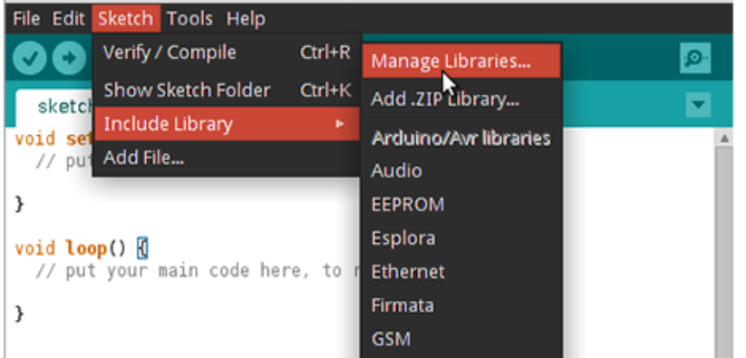
3. Blynk Library

Slide 10




Controllers
Button
Works in push or switch modes. Allows to send 0/1 (LOW/HIGH) values. Button sends 1 (HIGH) on press and sends 0 (LOW) on release.
Timer
Timer triggers actions at a specific time. Even if smartphone is offline. Start time sends 1 (HIGH). Stop time sends 0 (LOW).
Slider
Similar to potentiometer. Allows to send values between MIN and MAX.
Joystick
Control servo movements in 4 directions

Slide 11




Displays
Value Display
Displays incoming data from your sensors or Virtual Pins.
Gauge
A great visual way to display incoming numeric values.
LED
A simple LED for indication. You need to send 0 in order to turn LED off. And 255 in order to turn LED on. Or just use Blynk API as described below :
LCD
This is a regular 16x2 LCD display made in our secret facility in China

Slide 12

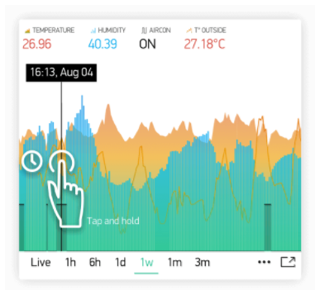
SuperChart
SuperChart is used to visualise live and historical data. You can use it for sensor data, for binary event logging and more.
Terminal
Displays data from your hardware. Allows to send any string to your hardware.
Video Streaming
Simple widget that allows you to display any live stream. Widget supports RTSP (RP, SDP), HTTP/S progressive streaming, HTTP/S live streaming.
Level Display
Displays incoming data from your sensors or Virtual Pins.

Slide 13

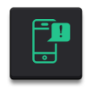

Notifications
Push Notifications
Push Notification widget allows you to send push notification from your hardware to your device.
Twitter
Twitter widget connects your Twitter account to Blynk and allows you to send Tweets from your hardware.
Email
Email widget allows you to send email from your hardware to any address.

Slide 14
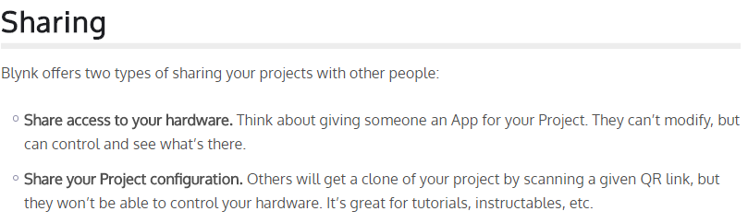
RTC
Real-time clock allows you to get time from server. You can preselect any timezone on UI to get time on hardware in required locale. No pin required for RTC widget.
Music Player
Simple UI element with 3 buttons - simulates music player interface.

Slide 15
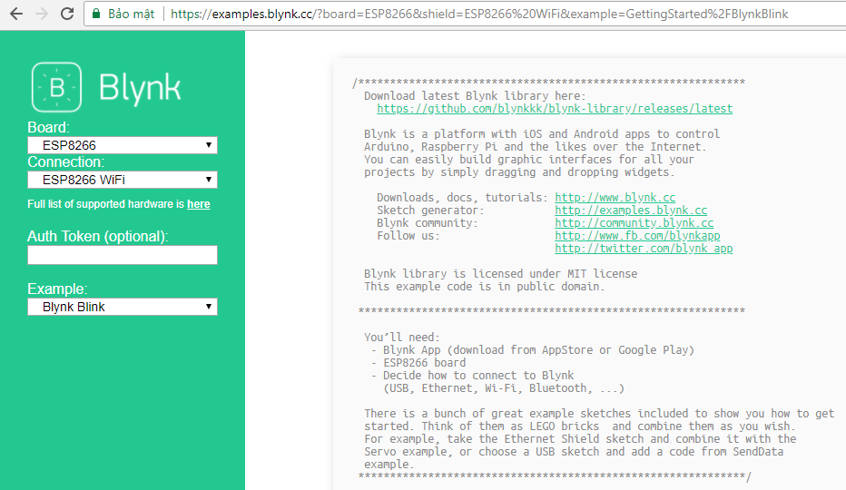

Slide 16
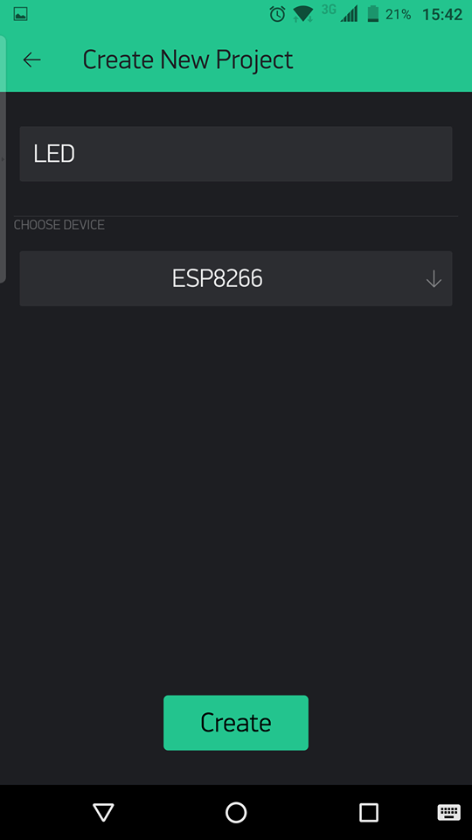
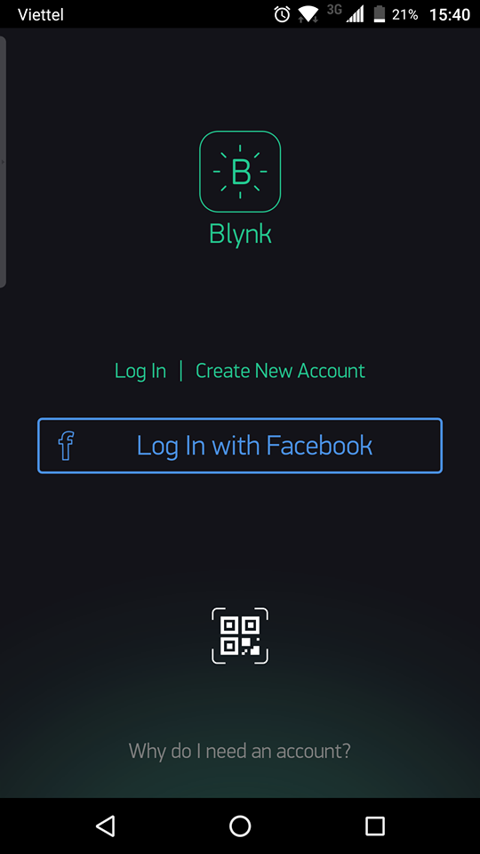
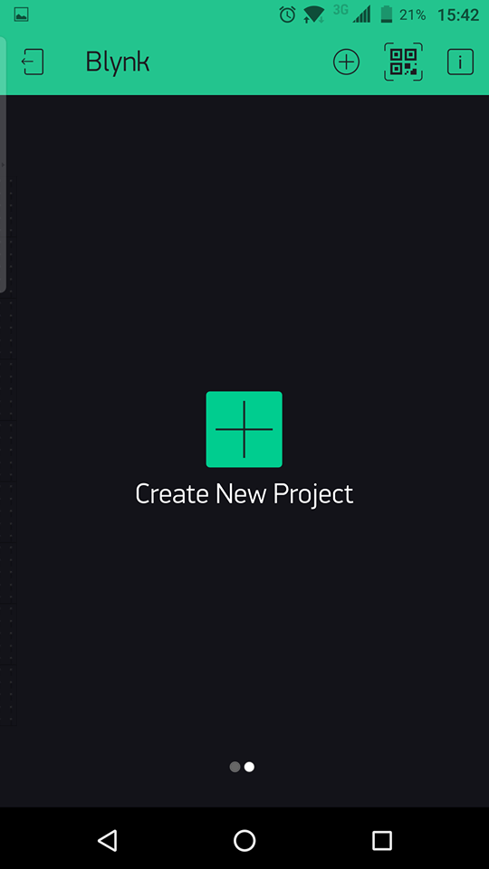
TAPIT

Slide 17
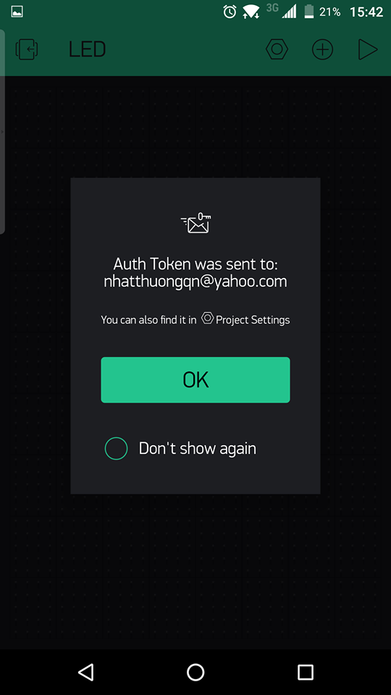
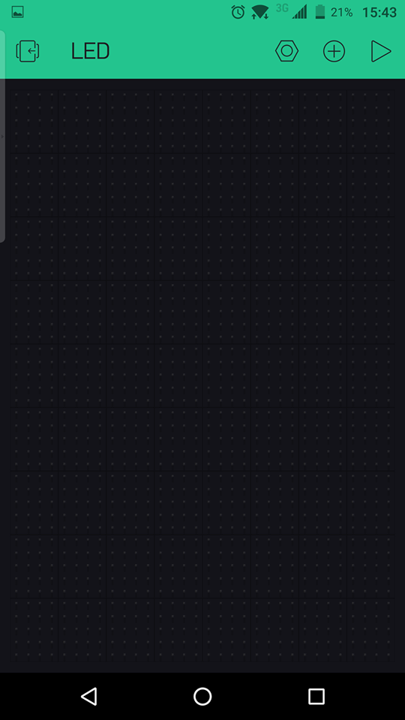
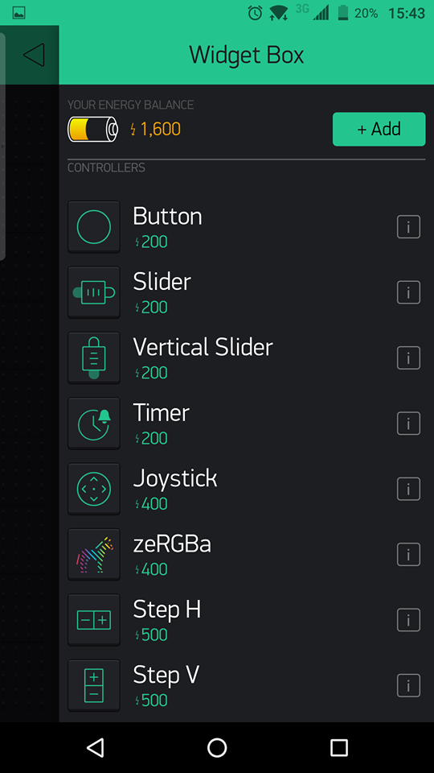
TAPIT

Slide 18
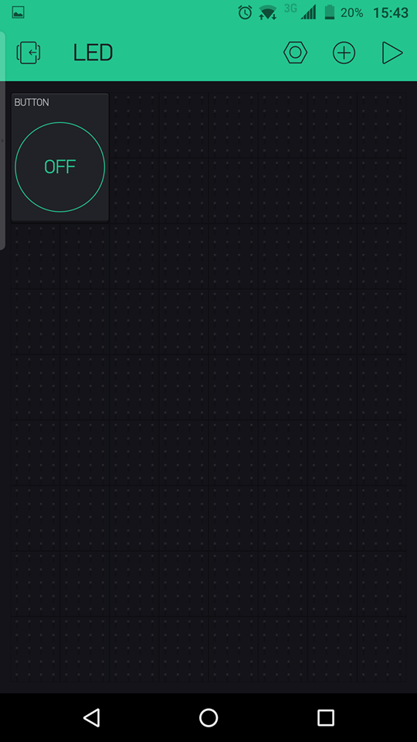
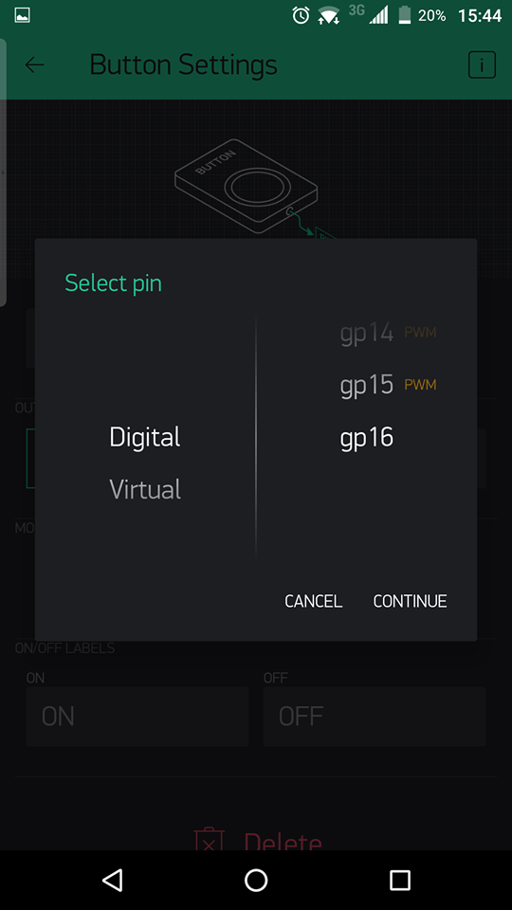
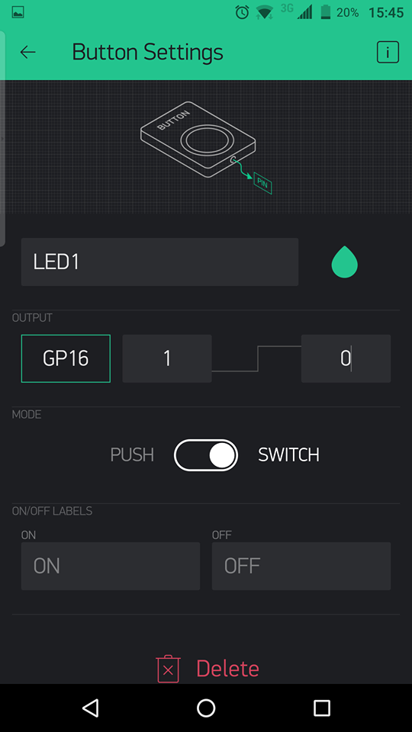
TAPIT

Slide 19
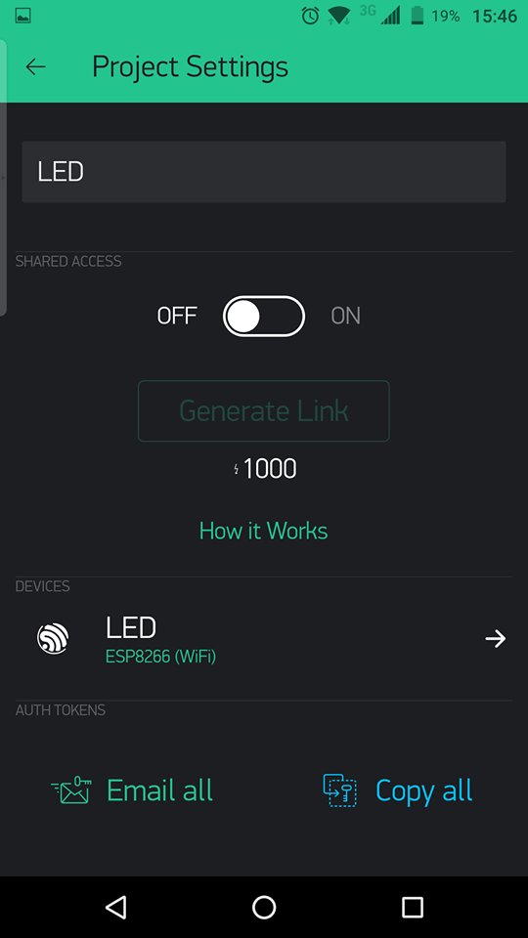
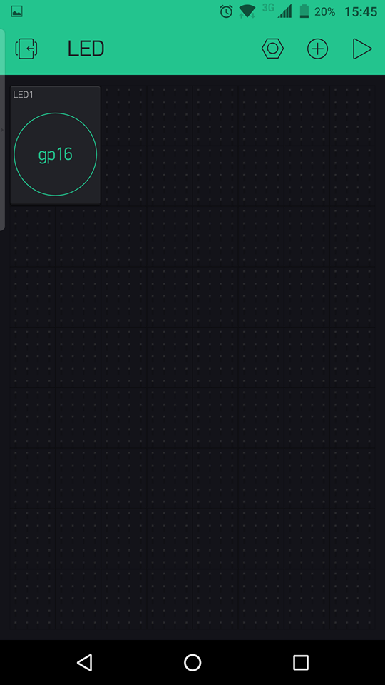
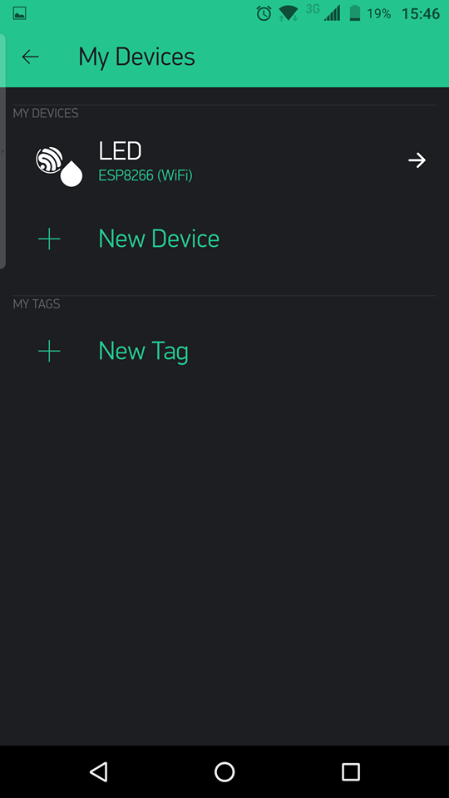
TAPIT

Slide 20
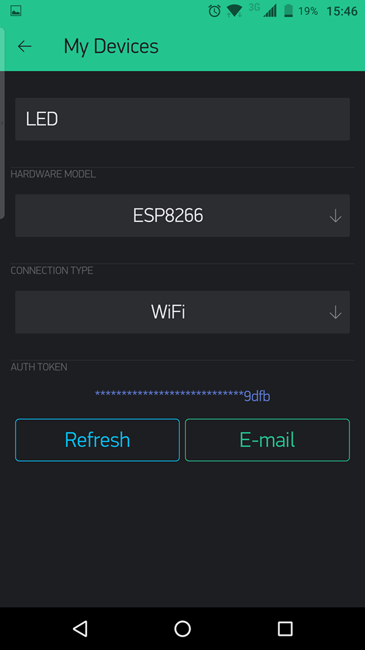
TAPIT

Slide 21
TAPIT
Blynk Library Arduino IDE:
Sketch -> Include Library -> Manage Libraries, Search Blynk then install.

Slide 22
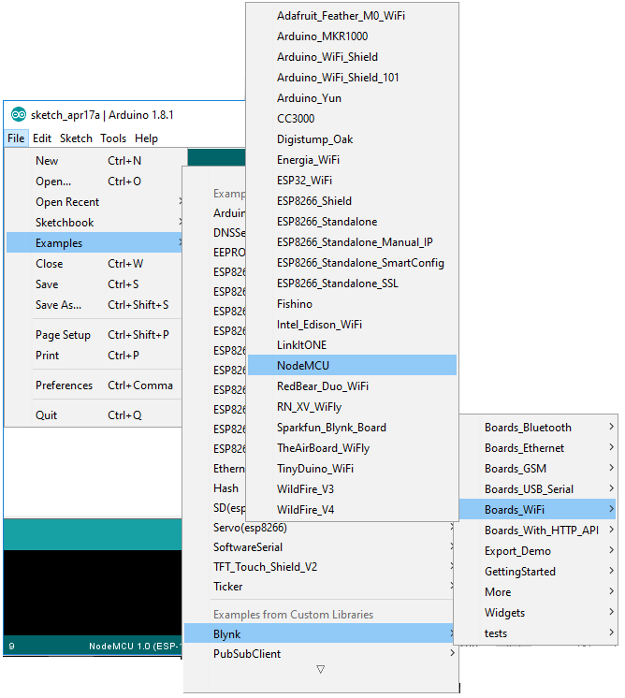
TAPIT

Slide 23

TAPIT
Notes:
http://docs.blynk.cc/

