Slide 1

TAPIT
INTERNET OF THINGS
MODULE 7
MQTT PROTOCOL

Slide 2
IoTs Protocols:
TAPIT
AMQP: Advanced Message Queuing Protocol
HTTP: HyperText Transfer Protocol
CoAP: Constrained Appications Protocol
XMPP: Extensible Messaging and Presence Protocol
MQTT: Message Queue Telemetry Transport
DDS: Data distribution Service
…..

Slide 3
MQTT Introduction:
TAPIT
MQTT is an open-sourced protocol for passing messages between multiple clients through a central broker.
It was designed to be simple and easy to implement.
The MQTT architecture is broker-based and uses long-lived outgoing TCP connection to the broker.
Notes:
MQTT is an open-sourced protocol for passing messages between multiple clients through a central broker. It was designed to be simple and easy to implement.
The MQTT architecture is broker-based and uses long-lived outgoing TCP connection to the broker. MQTT also supports hierarchical topics.

Slide 4
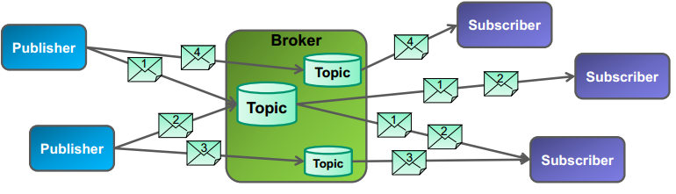
MQTT : publish/subscribe
TAPIT
Notes:
MQTT is an open-sourced protocol for passing messages between multiple clients through a central broker. It was designed to be simple and easy to implement.
The MQTT architecture is broker-based and uses long-lived outgoing TCP connection to the broker. MQTT also supports hierarchical topics.

Slide 5
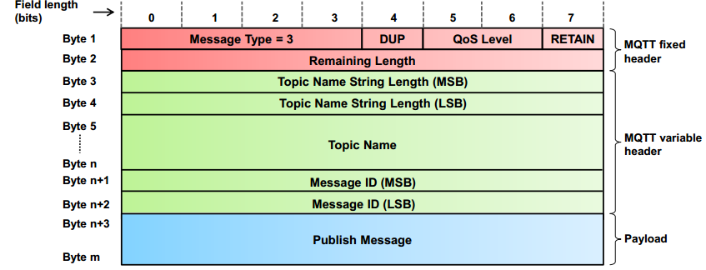
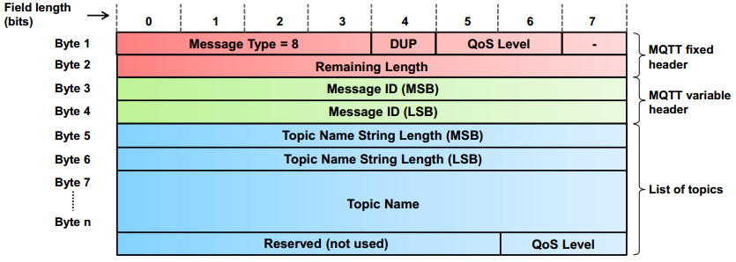
MQTT : publish/subscribe
TAPIT
Publish message
Subscribe message

Slide 6
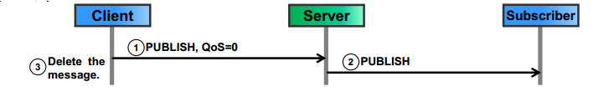
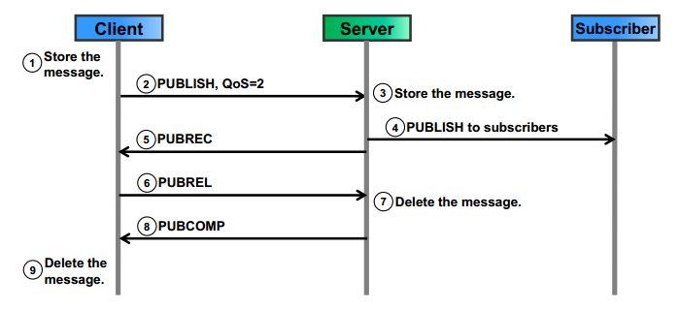
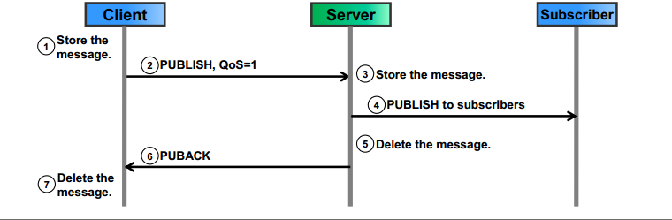
MQTT : Quality of Service
TAPIT
QoS 0 (At most one)
QoS 1 (At least one)
QoS 2 (Exactly-once)
Notes:
Why is Quality of Service important?
QoS is a major feature of MQTT, it makes communication in unreliable networks a lot easier because the protocol handles retransmission and guarantees the delivery of the message, regardless how unreliable the underlying transport is. Also it empowers a client to choose the QoS level depending on its network reliability and application logic.
QoS 0 – at most once
The minimal level is zero and it guarantees a best effort delivery. A message won’t be acknowledged by the receiver or stored and redelivered by the sender. This is often called “fire and forget” and provides the same guarantee as the underlying TCP protocol.

Slide 7
MQTT : Topics
TAPIT
A topic is a UTF-8 string, which is Broker use to filter messages for each connected client.
Consists one or more topic levels, separated by a forward slash.
Example topics:
Home/Kitchen/Temprature
/Car/BMW/Color/
Danang/Lienchieu/380TDT/Tapit168

Slide 8
MQTT : Topics/Wildcards
TAPIT
Wildcards use to subscribe to more topics at once.
Can only be used when subscribing to topics and is not permitted when publishing a message.
Two different kind: single level and multi level

Slide 9

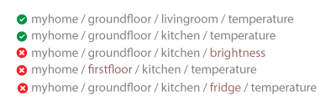
MQTT : Topics/Wildcards
TAPIT
Single level: + Substitude for one topic level

Slide 10

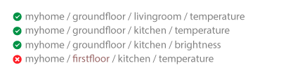
MQTT : Topics/Wildcards
TAPIT
Multi level: # Covers an arbitrary number of topic levels.
Required: Always the last character in the topic and it is preceded by a forward slash.

Slide 11

TAPIT
Notes:
http://www.hivemq.com/mqtt-essentials/

