Slide 1

TAPIT
INTERNET OF THINGS
Lecture 12:
OPENHAB (tt)

Slide 2

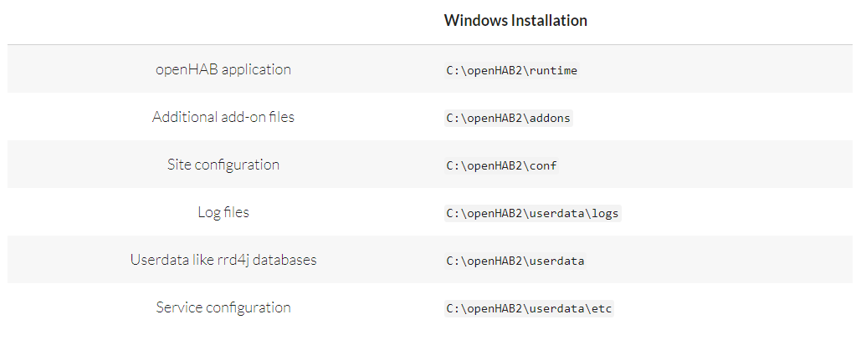
TAPIT
Notes:
\runtime: Chứa các file thực thi của hệ thống như start, stop, status,...
\addons: Chứa các addons file như binddings, actions, persistence,...
\conf: Chứa các file cấu hình như things, sitemap, items, rules,...
\userdata: Hoạt động như một rrd4j databases: là một hệ thống lưu trữ và ghi nhật ký dữ liệu thay đổi theo thời gian thực hiệu suất cao.
\userdata\logs: Chứa các file logs để theo dõi hoạt động của OH2 và phục vụ debug.

Slide 3
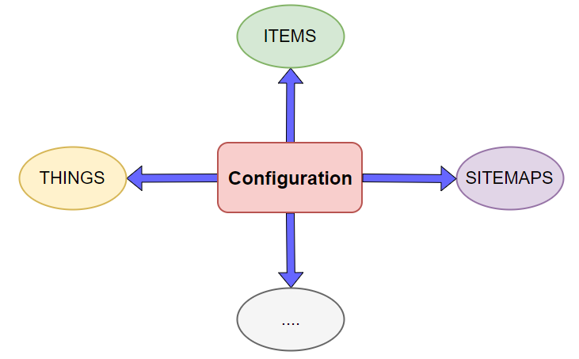
TAPIT

Slide 4
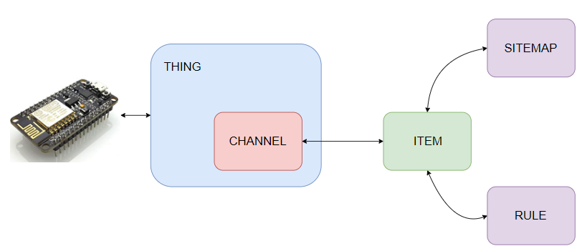
TAPIT
Things: represent the physical layer of an openHAB system, tell openHAB. Connected to openHAB through bindings
Channels: represent the different functions the Thing provides
Items: used to control Things and consume their information (via Sitemap or Rule)
Notes:
http://docs.openhab.org/configuration/things.html

Slide 5
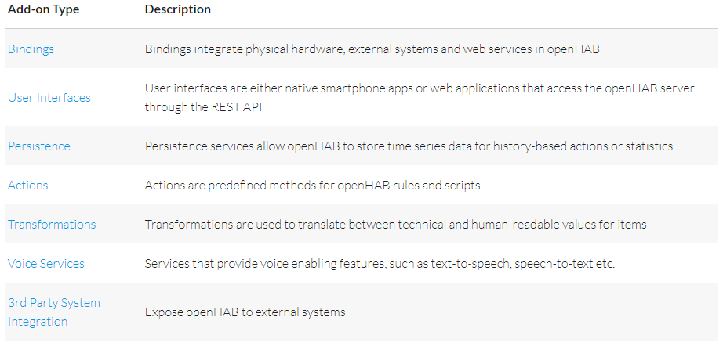
ADD-ONS
TAPIT
- All add-ons for openHAB 2 are part of the distribution.
This includes all new 2.0 bindings as well as all 1.x add-ons that were reported to be compatible.
Add-ons can be easily installed through the Paper UI
Notes:
http://docs.openhab.org/addons/index.html

Slide 6
STEP
TAPIT
Identify the binding required for the Thing
Install the binding if it has not already been installed
Define and configure the Thing
Identify the Channels provided by the Thing
Link Item to the Thing's Channels

Slide 7

TAPIT
RULES
"Rules" are used for automating processes: Each rule can be triggered, which invokes a script that performs any kinds of tasks, e.g. turn on lights by modifying your items, do mathematical calculations, start timers etcetera
Rules are placed in the folder $OPENHAB_CONF/rules and have .rules extension
Notes:
http://docs.openhab.org/configuration/sitemaps.html

Slide 8

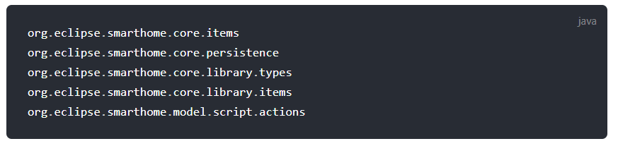
RULES
The syntax
TAPIT
A rule file is a text file with the following structure:
Imports
Variable Declarations
Rules
The Imports section contains import statement just like in
Java
Notes:
http://docs.openhab.org/configuration/sitemaps.html

Slide 9
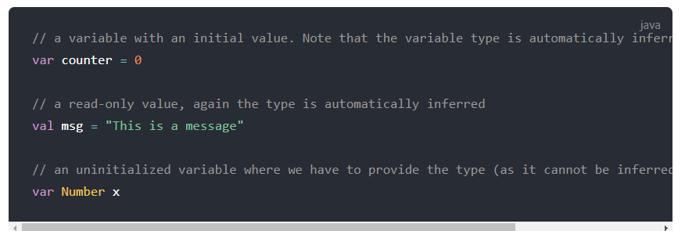
RULES
The syntax
TAPIT
Variable Declarations:
Variables should be accessible to all rules in the file
Variables can declare with or without intial values and data type
Notes:
http://docs.openhab.org/configuration/sitemaps.html

Slide 10
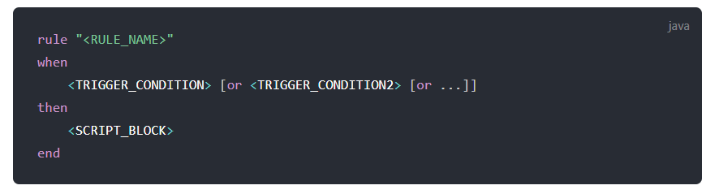
RULES
The syntax
TAPIT
The Rules section contains a list of rules
Notes:
http://docs.openhab.org/configuration/sitemaps.html

Slide 11
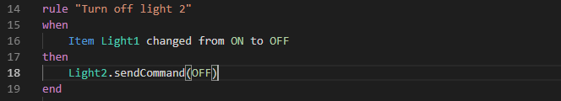
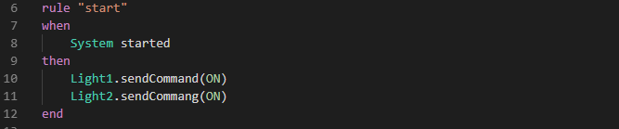
RULES
Example
TAPIT
Notes:
http://docs.openhab.org/configuration/sitemaps.html

Slide 12
LOGGING IN OPENHAB
TAPIT
There are two ways to check log entries:
Through files stored on the file system
During runtime in the Karaf Console
File System
Log files are written to userdata/log or /var/log/openhab2
Two log files:
events.log
openhab.log
Notes:
http://docs.openhab.org/configuration/sitemaps.html

Slide 13

TAPIT

