Slide 1
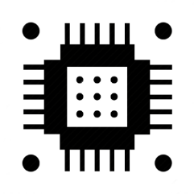



CÔNG TY TNHH KỸ THUẬT TAPIT
MODULE 3: INTERUPT, SERIAL, ADC
NGÔ VĂN TRUNG
0707.899.555
vantrung1001@gmail.com
fb.com/trungngo.dtvt

Slide 2
INTERRUPT
attachInterrupt( digitalPinToInterrupt( PIN ), ISR, MODE );
Khai báo sử dụng Interrupt cho chân digital
PIN: Chân GPIO có hỗ trợ Interrupt
MODE: LOW, HIGT, CHANGE, RISING, FALLING
ISR: Chương trình ngắt
Một số lưu ý khi viết ISR:
Không chứa hàm delay();
Hàm millis() không được tăng trong ISR
Không làm việc với UART trong ISR
Nên sử dụng từ khóa volatile để khai báo biến khi sử dụng biến đó trong ISR
ISR phải được định nghĩa trên cùng và phải khai báo từ khóa ICACHE_RAM_ATTR

Slide 3
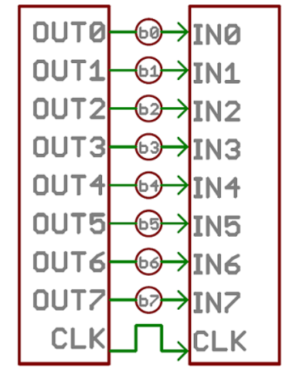
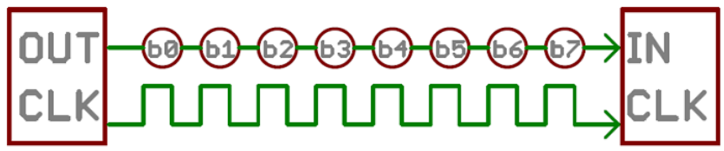
PARALLEL & SERIAL

Slide 4
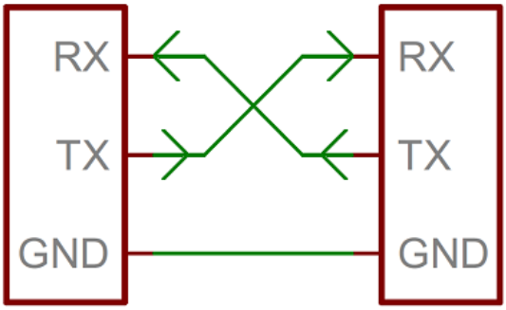
UART
- Two UARTs communicate directly with each other
- Only two wires are needed to transmit data between two UARTs
- Data flows from the Tx pin of the transmitting UART to the Rx pin of the receiving UART

Slide 5
RULES OF SERIAL
The asynchronous serial protocol has a number of built-in rules - mechanisms that help ensure robust and error-free data transfers. These mechanisms, which we get for eschewing the external clock signal, are:
- Data bits
- Synchronization bits
- Parity bits
- Baud rate
Both devices on a serial bus are configured to use the exact same protocols

Slide 6
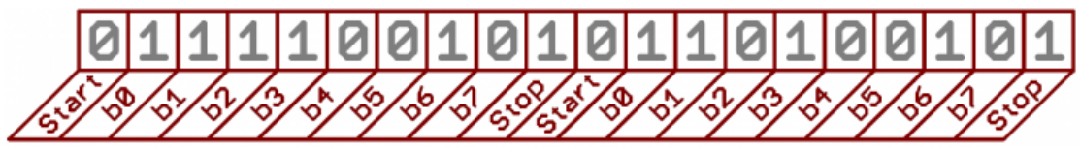
RULES OF SERIAL
9600 8N1
- 9600 baud, 8 data bits, no parity, and 1 stop bit
- Is one of the more commonly used serial protocols
?
?

Slide 7
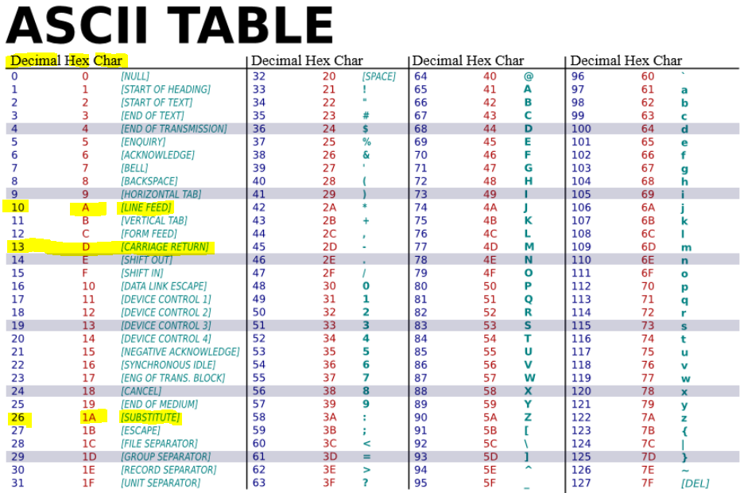

Slide 8
OK
Notes:
- The baud rate specifies how fast data is sent over a serial line. It’s usually expressed in units of bits-per-second (bps). If you invert the baud rate, you can find out just how long it takes to transmit a single bit. This value determines how long the transmitter holds a serial line high/low or at what period the receiving device samples its line.
- Baud rates can be just about any value within reason. The only requirement is that both devices operate at the same rate. One of the more common baud rates, especially for simple stuff where speed isn’t critical, is 9600 bps. Other “standard” baud are 1200, 2400, 4800, 19200, 38400, 57600, and 115200.
- The higher a baud rate goes, the faster data is sent/received, but there are limits to how fast data can be transferred. You usually won’t see speeds exceeding 115200 - that’s fast for most microcontrollers. Get too high, and you’ll begin to see errors on the receiving end, as clocks and sampling periods just can’t keep up.

Slide 9
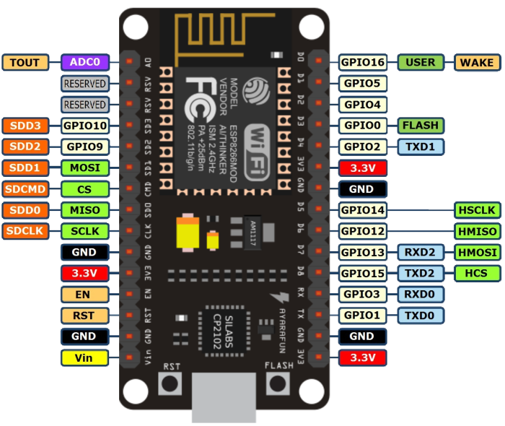
NODEMCU UART PORT
NodeMCU has TWO hardware UART:
UART0 on GPIO1, GPIO3
(or GPIO13, GPIO15 alternative)
Cannot be used at the same time
Convert: Serial.swap()
UART1 on GPIO2 and GPIO8 but GPIO8 is used to flash chip
=> Only transmit in GPIO2

Slide 10
SERIAL
Serial.begin( SPEED );
Khởi tạo chức năng Serial
SPEED: bits per second (baud rate): 4800, 19200, 38400, 9600, 115200
Serial.print( VAL ); Serial.println( VAL );
Truyền dữ liệu bằng serial
VAL: giá trị cần truyền
Serial.available();
Trả về số kí tự có trong bộ đệm
Serial.read();
Trả về kí tự đầu tiên trong bộ đệm
Serial.readString();
Trả về tất cả kí tự có trong bộ đệm

