Slide 1

Notes:
Hey everyone! Quick intro: I'm a high school student like you — I'm training for the International Olympiad in AI, and today I want to show you the single coolest thing I've learned: how a computer actually sees a picture. No background needed. If you can multiply small numbers, you can follow every step of this. By the end, you'll be able to explain how a photo becomes the word "cat" — and I'll show you models I trained myself.

Slide 2
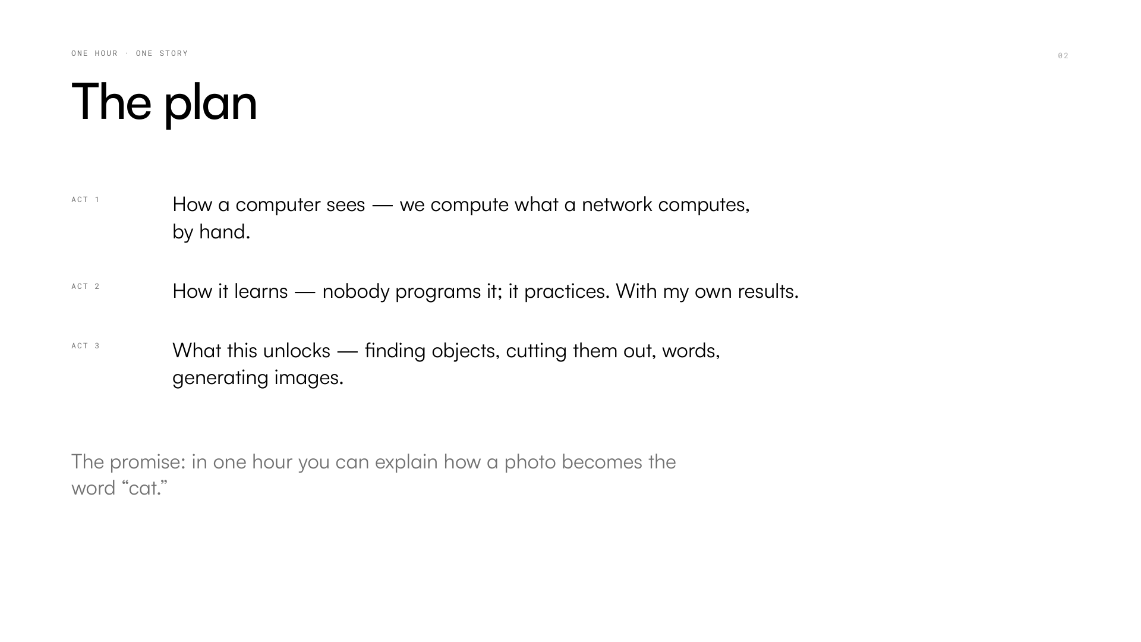
Notes:
Here's the plan. Instead of racing through fifty terms, we'll learn ONE idea properly — the trick at the heart of all computer vision — and we'll actually compute it together by hand, on screen. Then I'll show you how a network learns that trick by itself, including real numbers from models I trained on my own computer. And at the end, quick trailers: the same trick powering face filters, self-driving cars, and AI image generators. Sound good? Let's go.

Slide 3
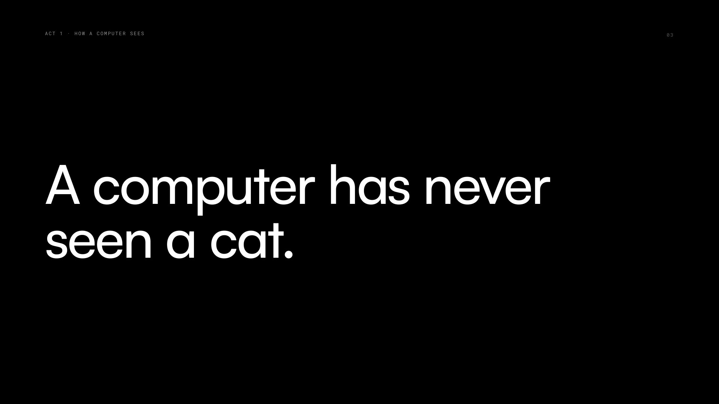
Notes:
Let's start with something that sounds obvious but isn't: a computer has never seen anything. No screen inside, no little person watching. When your phone unlocks by recognizing your face, there is no picture anywhere inside the chip — there are only numbers. So the real question of this whole talk is: how do you get from a pile of numbers to the idea "cat"? Let me show you exactly what the computer gets.

Slide 4
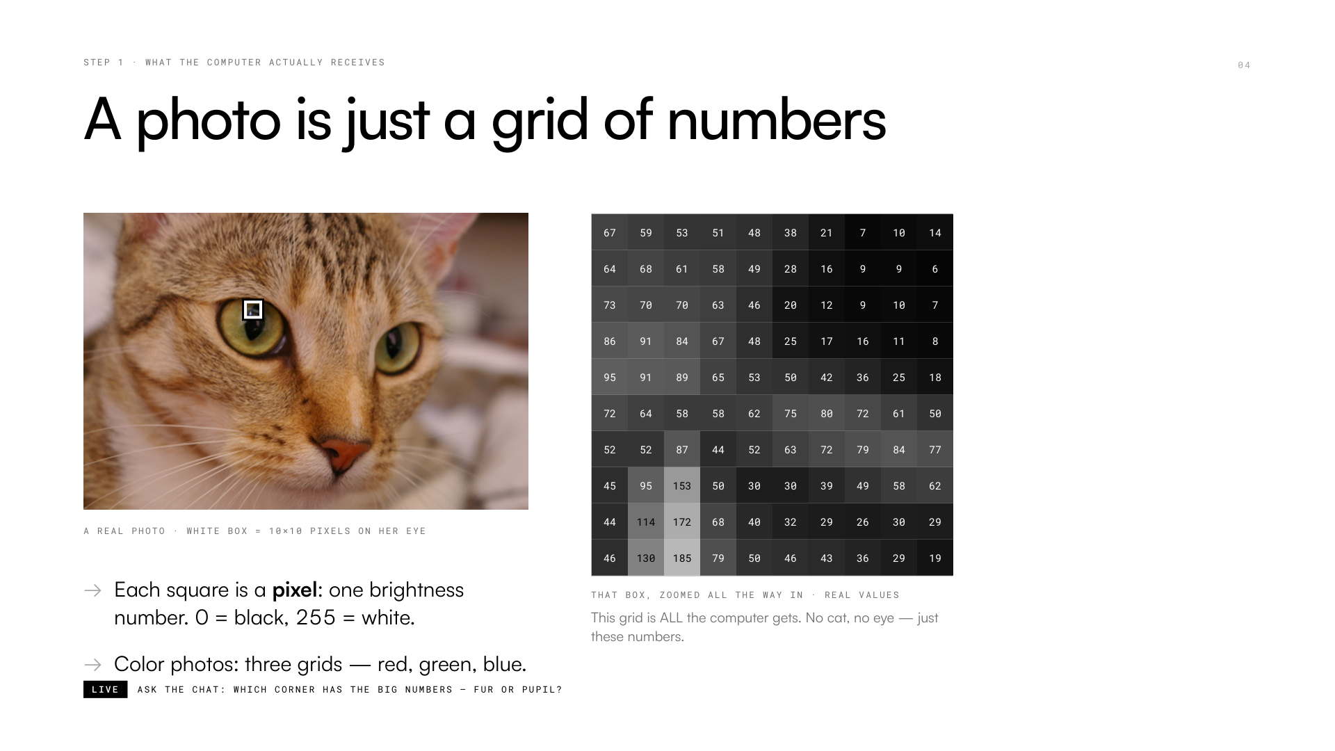
Notes:
This is a real photo — meet Chelsea, the most famous cat in computer science. I marked a tiny 10-by-10 square on her eye and zoomed all the way in. Quick game: bright pixels get big numbers, 255 is pure white, 0 is pure black. Which corner of this crop has the big numbers? Type it in the chat… Right — the fur side! Around 60–70. And the pupil crashes to 6, 7, 9. This grid of numbers is literally ALL the computer receives. Everything else today is: what do you DO with these numbers?

Slide 5
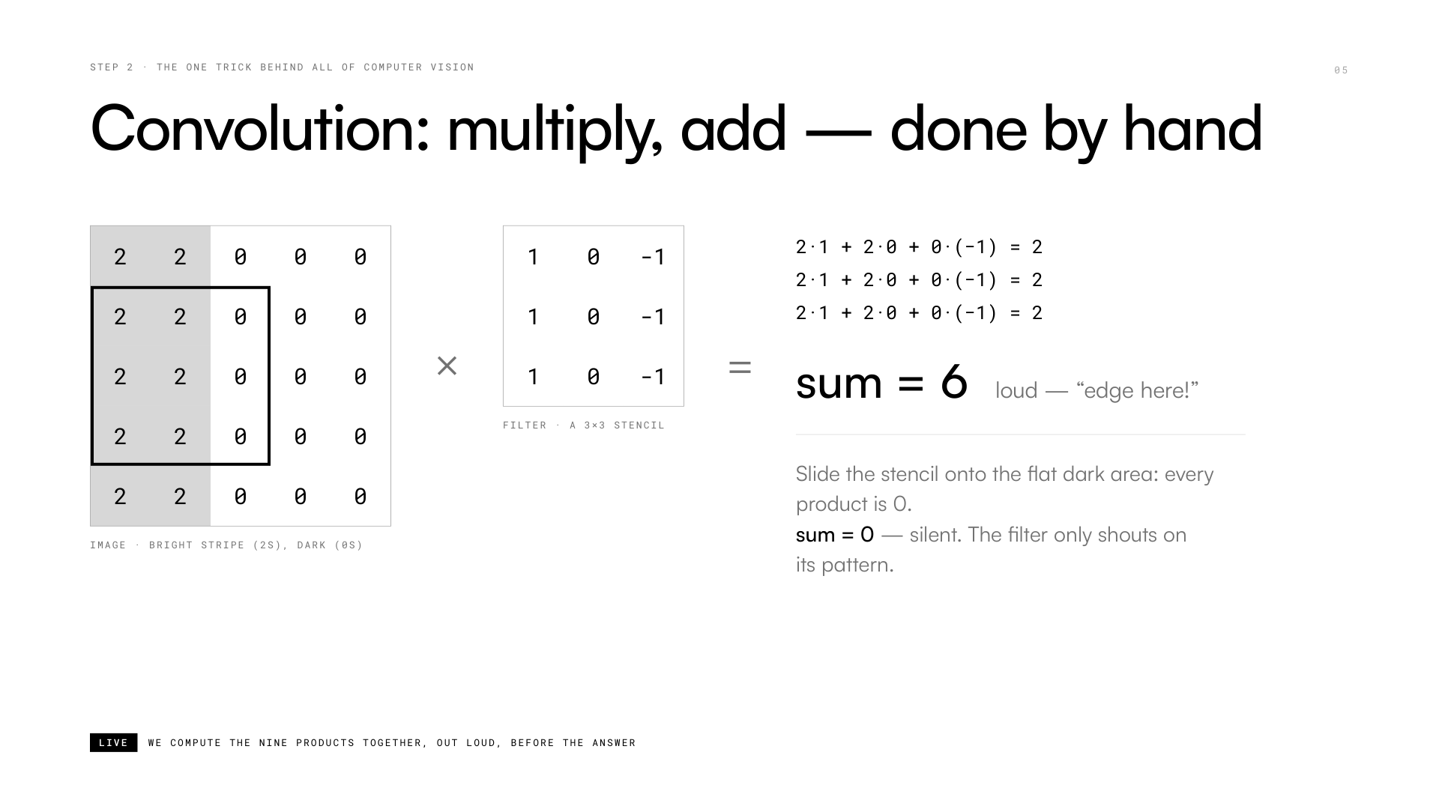
Notes:
This is the heart of ALL computer vision, and we're going to compute it together — it's just times tables. The image has a bright stripe (2s) next to a dark area (0s). The filter is nine numbers. Lay it on the image, multiply each pair of cells, add the nine results. Let's do it in chat: two times one is…? Keep going… total: six! Now slide it onto the flat dark area: everything is zero. So this filter outputs LOUD where there's a vertical edge and SILENT where there isn't. Congratulations — you just ran a convolution, the exact operation inside every vision AI.

Slide 6
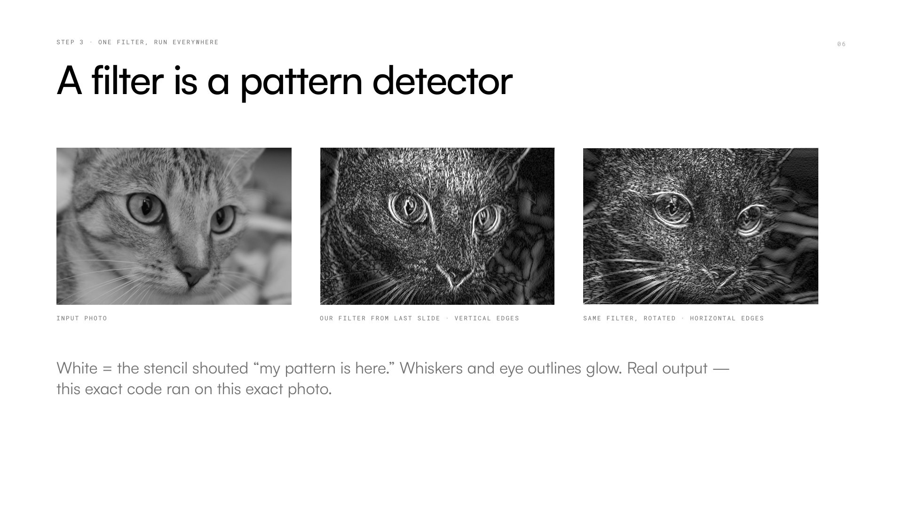
Notes:
Now take the exact filter we just computed by hand and slide it across the entire cat photo — thousands of little multiply-and-adds. The result is this glowing map: white means "my pattern is HERE." Look — the whiskers and the eye outlines light up, because those are vertical-ish edges. Flip the filter on its side and suddenly it finds horizontal edges instead. This is real output, by the way — I ran this exact code on this exact photo. One filter, one pattern. So… what if we used lots of filters, in layers?

Slide 7
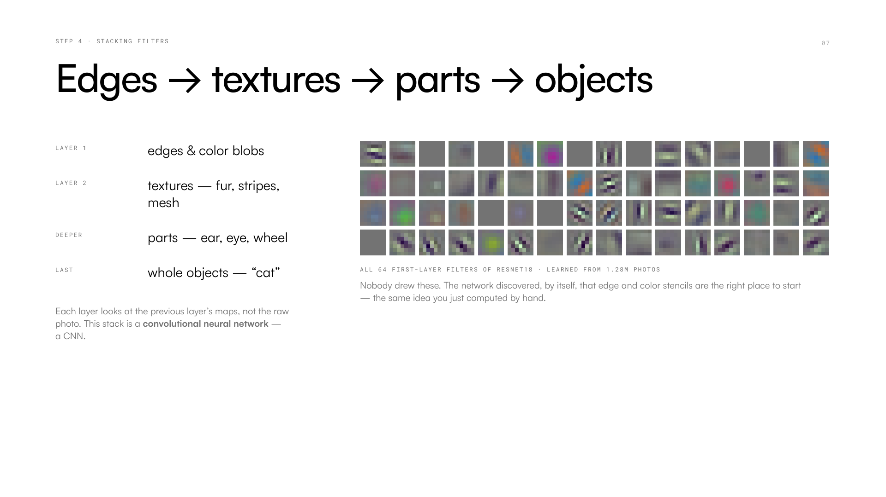
Notes:
Here's the beautiful part. Stack filters in layers: the first layer finds edges, the next layer looks at the EDGE MAPS and finds combinations — textures like fur or stripes — then parts like an ear, then "cat." That whole stack is called a convolutional neural network, a CNN. And these tiles? The actual first-layer filters from a famous network trained on 1.28 million photos. Nobody drew these. They look like edge and color detectors because the network DISCOVERED that edges are the right place to start. Which raises the big question: how?

Slide 8
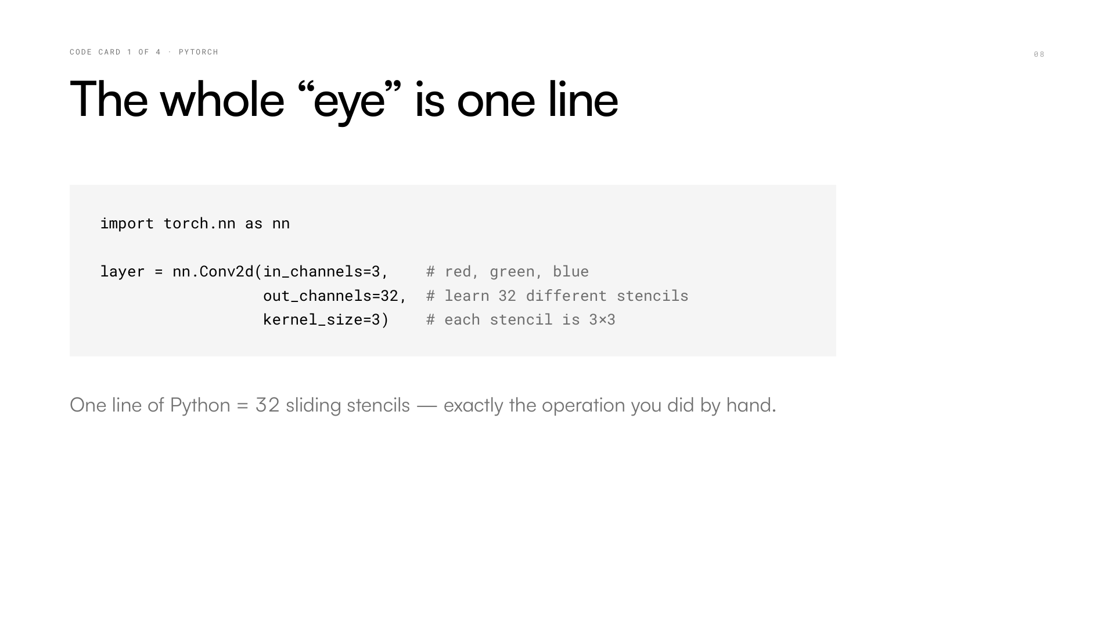
Notes:
Before we move on — I want to demystify the code, because it's shockingly short. This single line creates a convolution layer: 32 different 3-by-3 stencils that slide over a color image. That's it. What you computed by hand on slide five is exactly what this line does, just 32 filters at once and very fast. When people say "I built a neural network," they're stacking a handful of lines like this one. You could type this tonight.

Slide 9
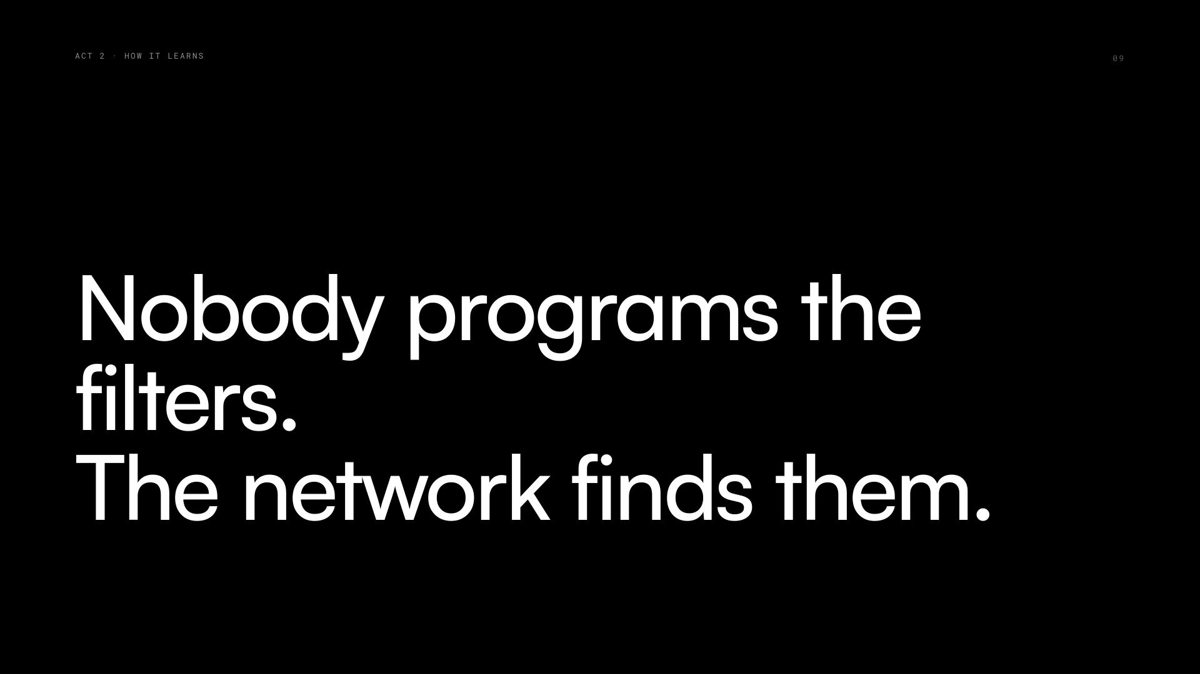
Notes:
So here's the twist that makes this AI and not just clever programming. On slide five, I chose the filter numbers. But in a real network, NOBODY chooses them. All 32 stencils — millions of numbers in the full stack — start as pure random noise. And then the network learns them. By itself. From examples. Act two is about how that works, and I promise: no equations. It's basically a game you already know.

Slide 10
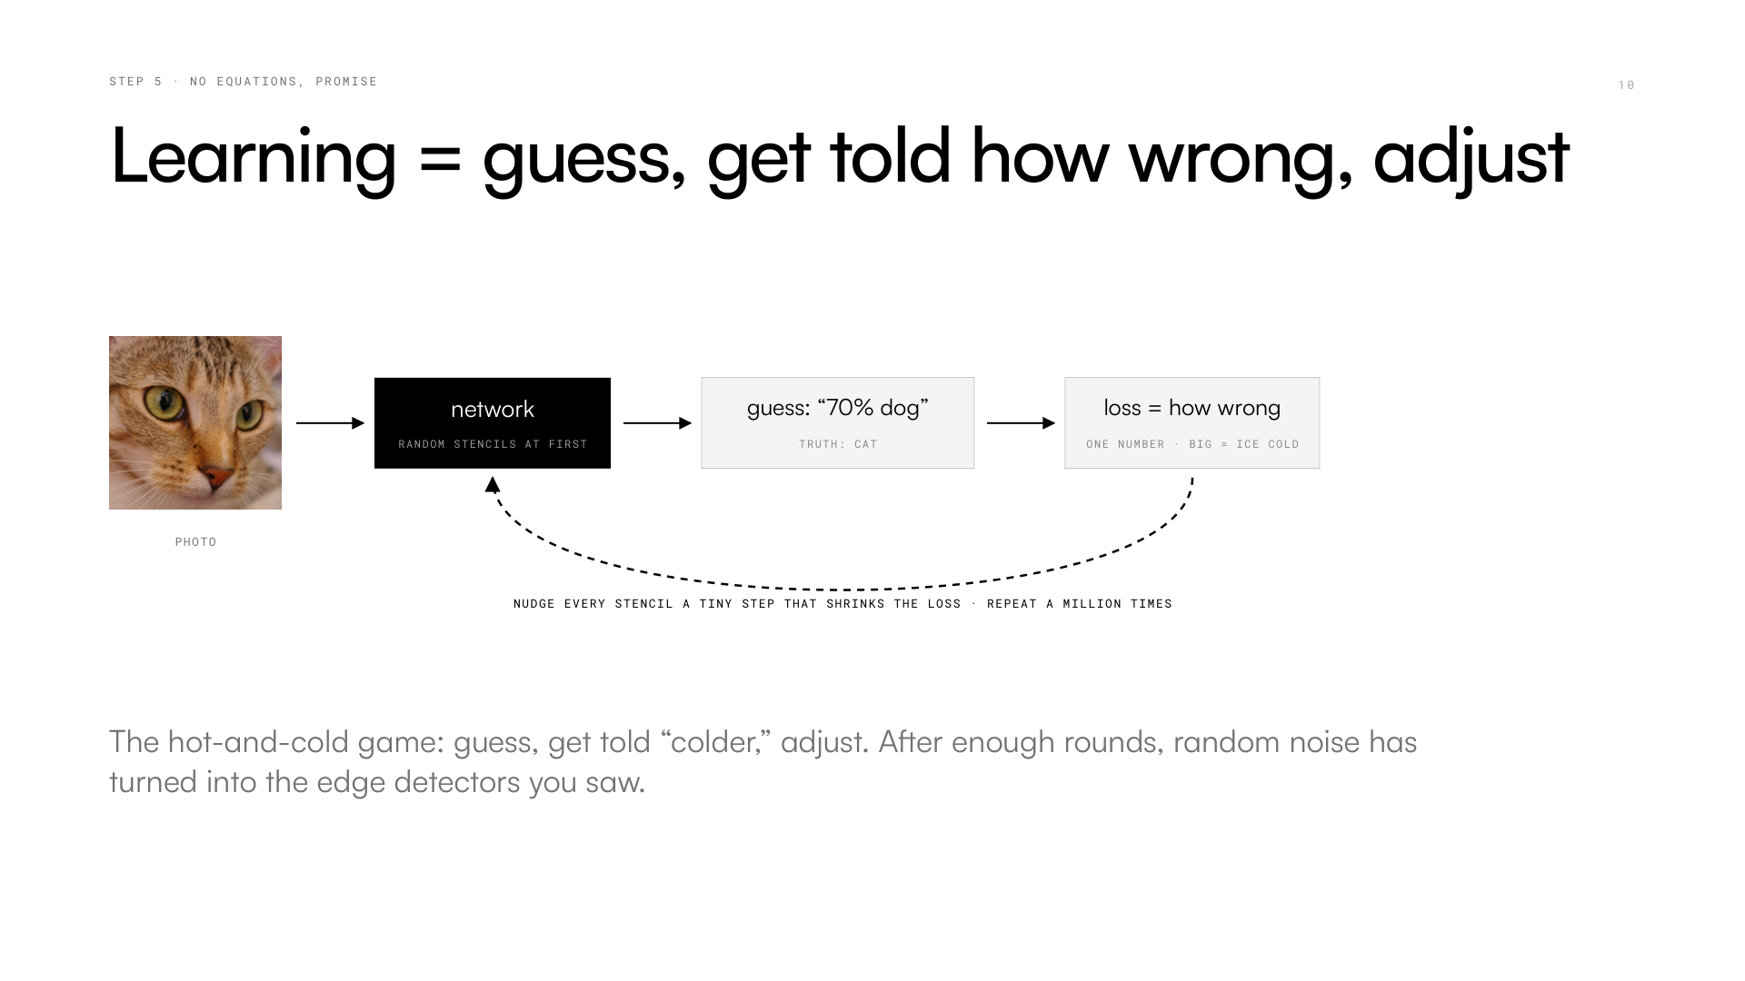
Notes:
Learning is the hot-and-cold game. Remember hiding something and shouting "warmer… colder…"? Same thing. The network guesses "dog." We know it's a cat, so we hand it one number — the loss — which just means "how wrong were you." Big loss: ice cold. Then the magic step: there's a recipe (it's called backpropagation, that's the only name I'll drop) that tells every single filter number which direction to nudge to be slightly less wrong. One photo, tiny nudge. A million photos later, those random stencils have turned into the edge detectors you saw — nobody put them there.

Slide 11
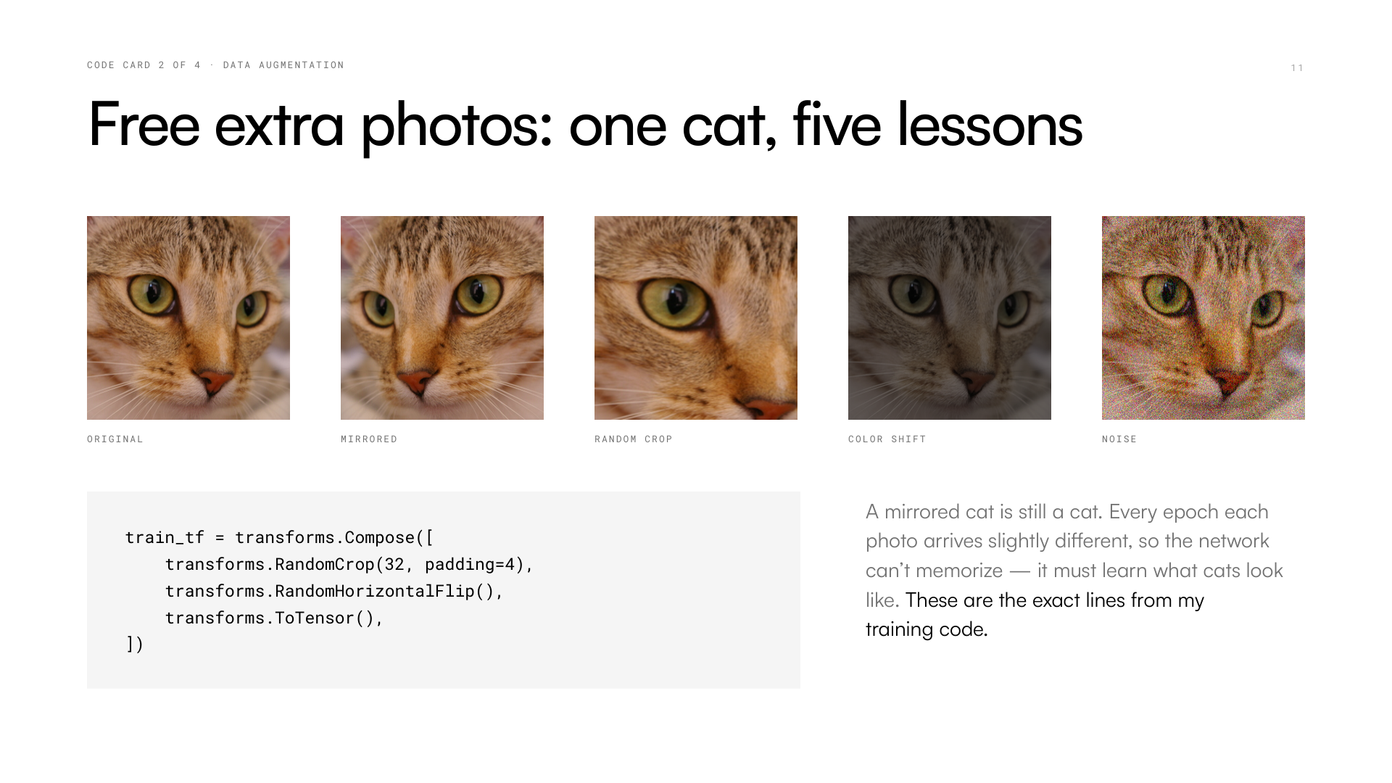
Notes:
One practical trick before my results, because I use it in my own training. If you show a network the same photos over and over, it cheats — it memorizes them, like memorizing answer keys instead of understanding the subject. The fix is delightfully dumb: a mirrored cat is still a cat. So every time a photo is used, we randomly flip it, crop it, shift the colors, sprinkle noise. Same five lines in my actual training code, shown here on the same cat. Free infinite-ish data, and the network is forced to learn what cats LOOK like.

Slide 12
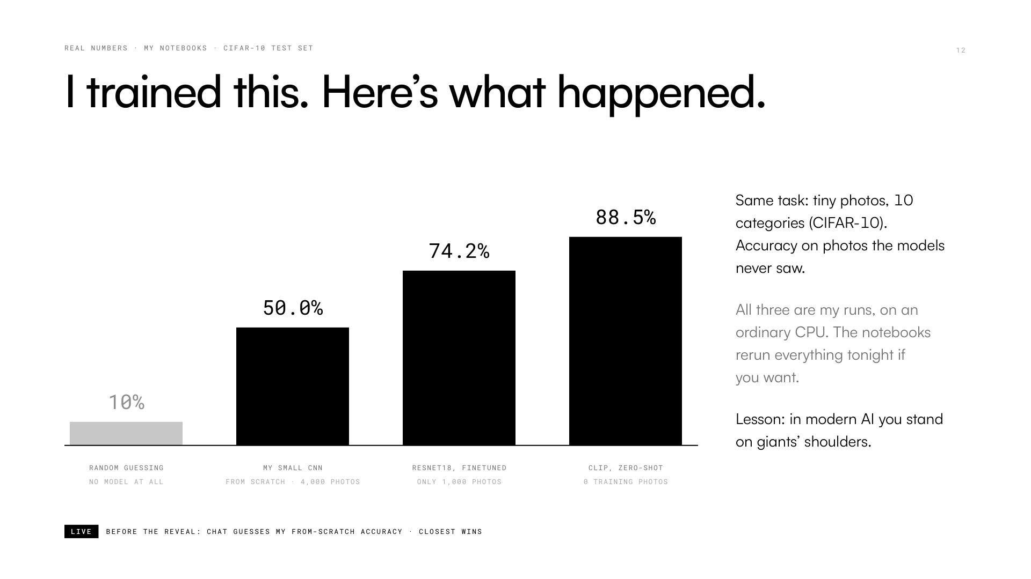
Notes:
Time for receipts. The task: tiny photos, ten categories — cat, ship, truck… Random guessing scores 10%. I built the small CNN from act one and trained it myself. Guess what it scored — closest in chat wins… 50%! Five times better than chance, from scratch, in about a minute of training. Then the plot twist: I took ResNet18, already trained on 1.28 million photos, swapped its last layer, fed it only a QUARTER of the data — 74.2%. And CLIP, which I'll show you soon, got 88.5% with ZERO training photos. Lesson: in modern AI you stand on giants' shoulders.

Slide 13
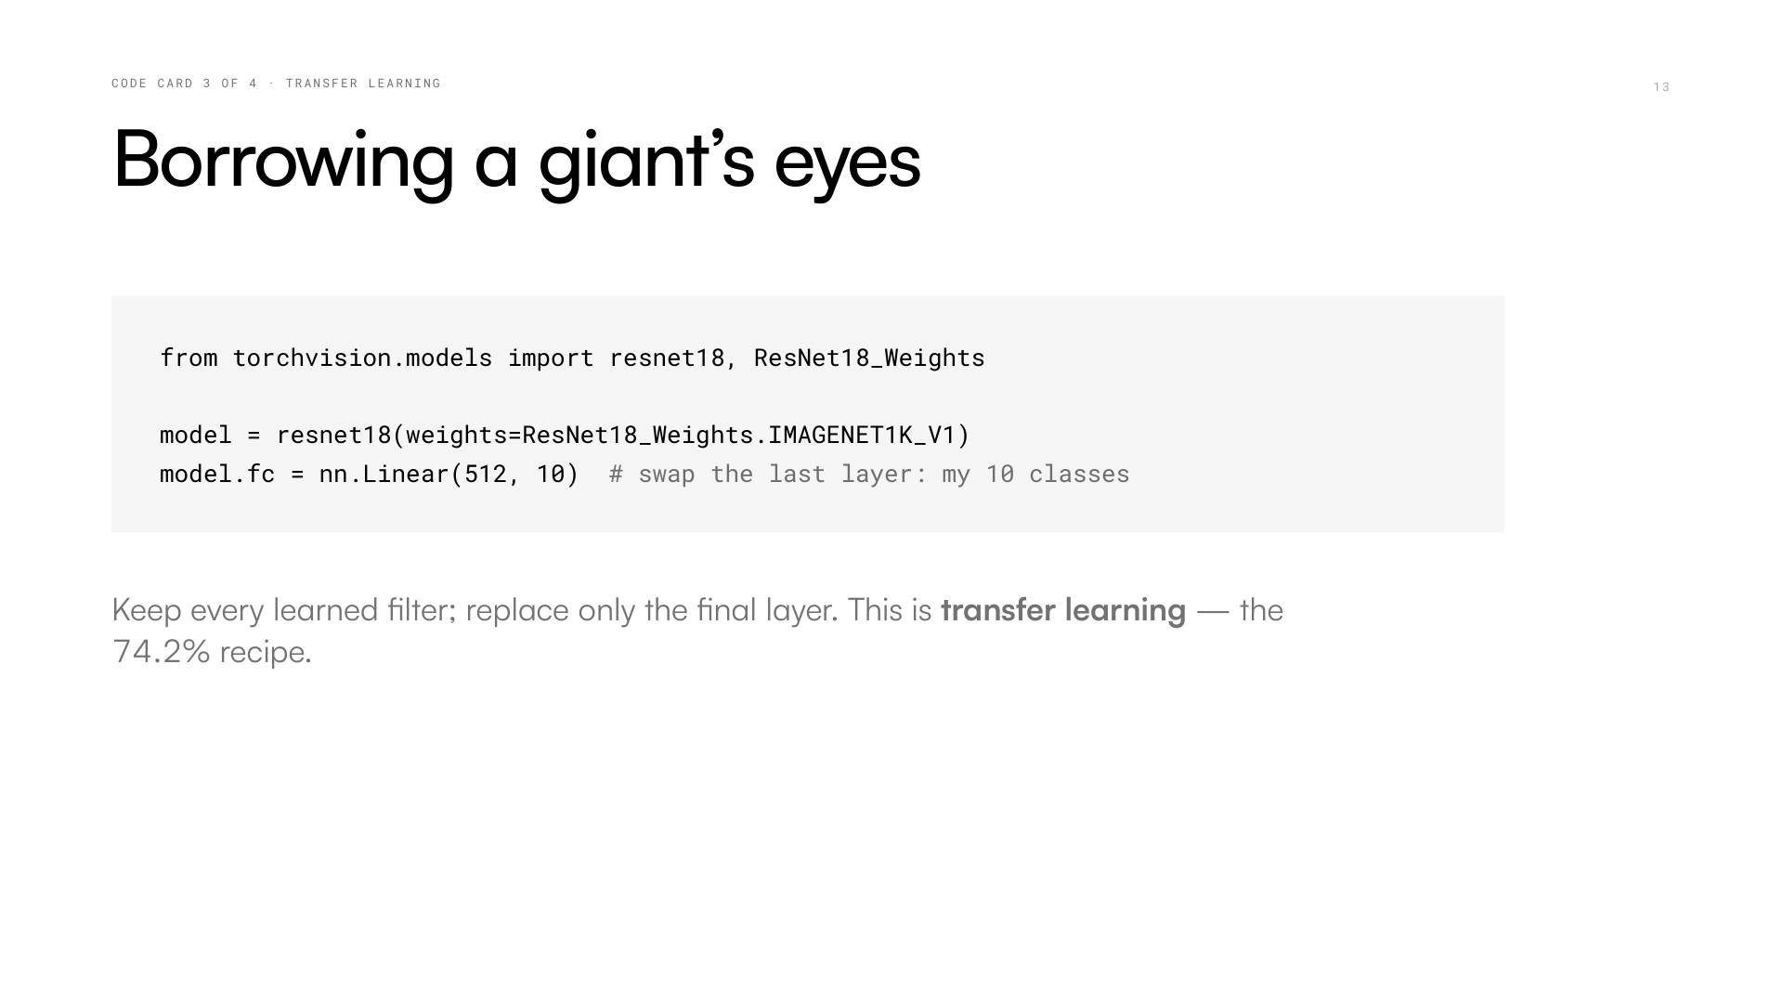
Notes:
And here is the entire giant-shoulders trick — four lines. Line one: download ResNet18 WITH the filters it learned from a million photos. Those filters already know edges, fur, wheels. Line two: its last layer answers the wrong question — it predicts a thousand ImageNet categories, but I have ten. So I rip off just that final layer and bolt on a fresh one for my classes. Then train briefly. That's "transfer learning," and it's how almost everyone uses vision AI in the real world — nobody starts from scratch if they can help it.

Slide 14
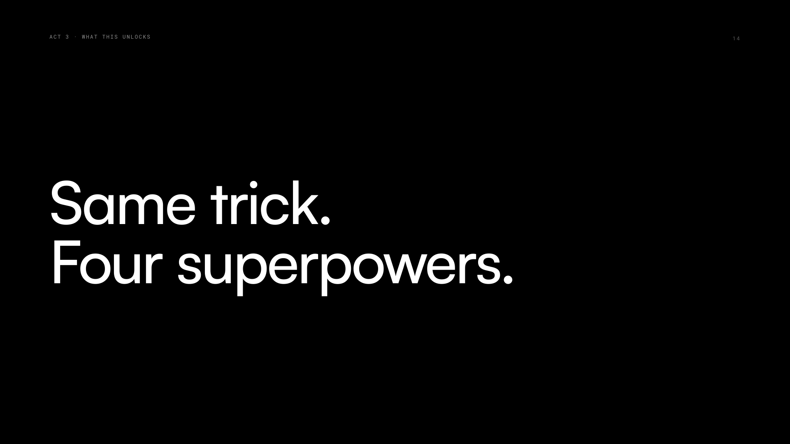
Notes:
You now own the core: images are numbers, filters find patterns, stacks find objects, and it all learns by guess-and-nudge. Act three is the fun part — four quick trailers of what that one trick unlocks. I'm not going deep on any of these; I just want you to see that none of them is magic anymore. Each one is the same CNN idea wearing a different costume. And yes — every output you're about to see, I generated myself while building these slides.

Slide 15
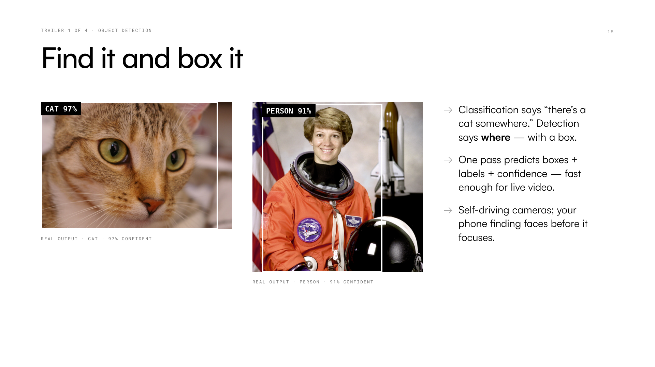
Notes:
Trailer one: detection. Our CNN said "this photo is a cat." Detection answers the harder question — WHERE is the cat? — by drawing a box. I downloaded a small pretrained detector and ran it on our two photos while making these slides: it boxed the cat with 97% confidence and the astronaut as a person at 91%. No training by me, ran in seconds on a normal CPU. This is the tech inside self-driving car cameras and the thing that finds faces before your phone focuses on them.

Slide 16
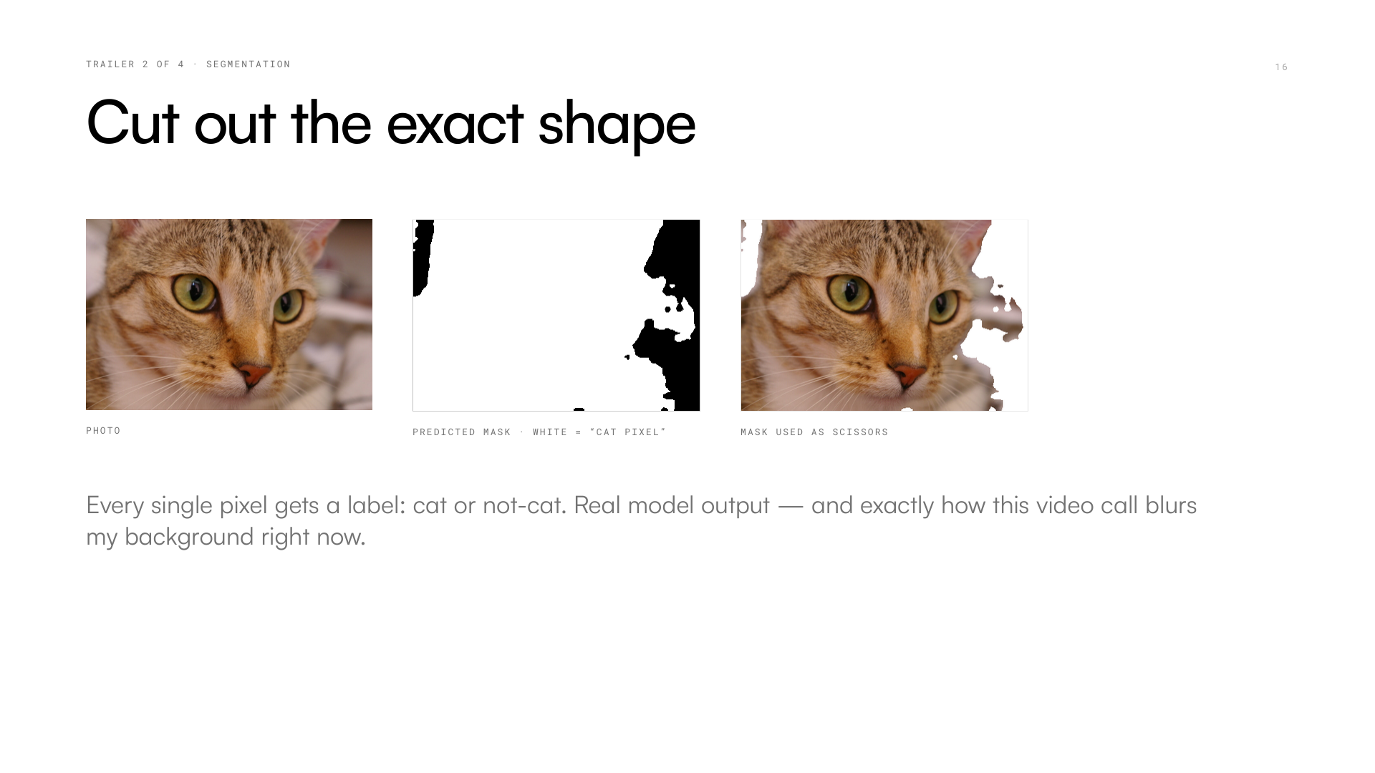
Notes:
Trailer two: sometimes a box isn't enough — you want the exact outline. Segmentation asks the network to decide for EVERY single pixel: cat, or not cat? Middle image: the real mask a pretrained model produced for me — white means "cat pixel." Right: use the mask as scissors and the cat lifts cleanly off the background. Sound familiar? It's exactly how this very video call can blur or replace my background in real time, and how doctors' software outlines organs in scans. Every pixel, classified.

Slide 17
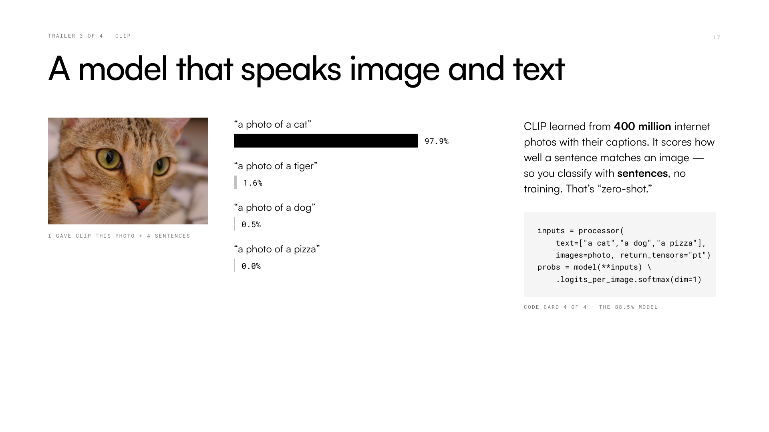
Notes:
Trailer three is my favorite. CLIP read 400 million internet images WITH their captions, and learned to score how well a sentence matches a picture. So instead of training anything, you just… ask. I gave it our cat photo and four sentences. Real output: "a photo of a cat" — 97.9%. Tiger gets 1.6% — fair, she's stripy! Pizza: zero. Three lines of code, no training, and remember the bar chart: this is the model that beat my hand-trained CNN with zero training photos. Words plus images in one brain.

Slide 18
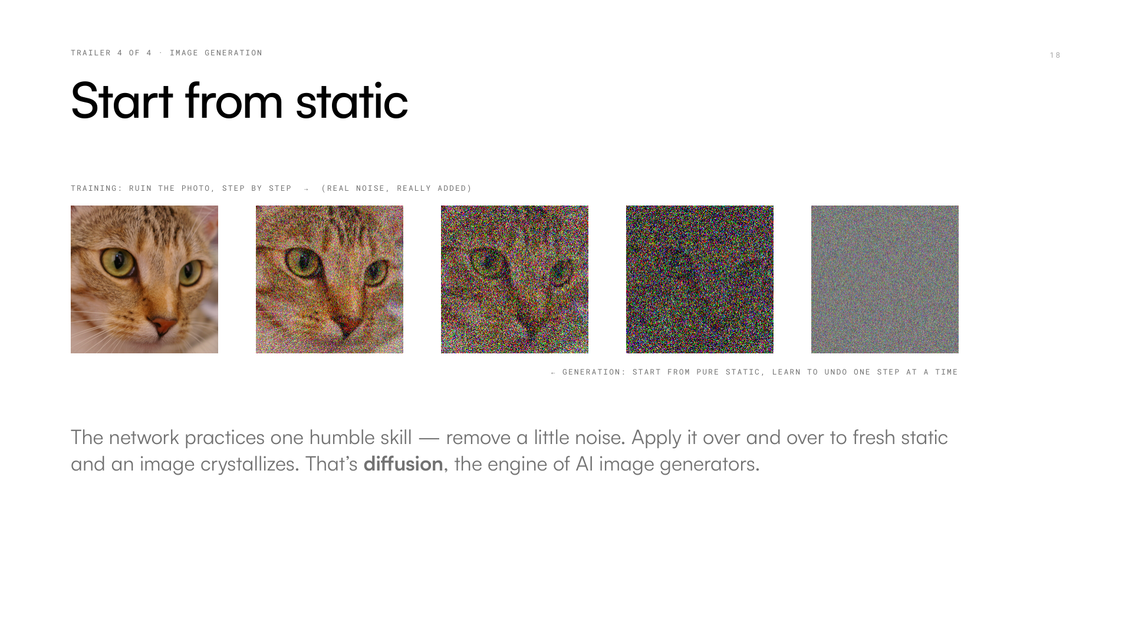
Notes:
Last trailer: how do AI image generators work? Weirdly, you train them by DESTROYING photos. Take the cat, add a pinch of noise, again, again — until it's pure TV static. I did the forward part for real, that's these frames. The network practices one humble skill: look at a slightly noisy image and clean it up a little. Now the magic: hand it PURE STATIC and apply that cleanup over and over. An image crystallizes out of noise. That's diffusion — the engine behind the famous image generators. Same convolutions underneath, by the way.

Slide 19
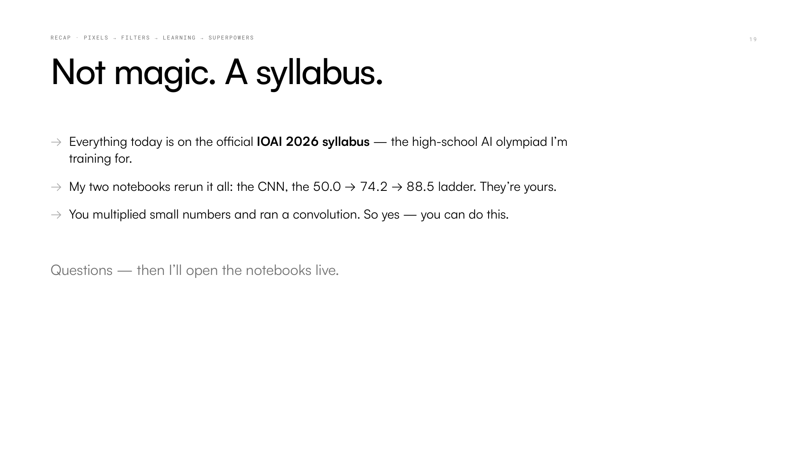
Notes:
Quick recap of the one story: a photo is a grid of numbers; a filter is a stencil we slid by hand; stacked filters see edges, then fur, then cat; and it all learns by guess-and-nudge. Here's the thing — none of today was magic, and none of it was university material. It's all literally on the official syllabus of the International Olympiad in AI, which high schoolers like us compete in. The two notebooks with everything I showed — the 50%, the 74.2%, the 88.5% — are yours; rerun them tonight on a normal laptop. Now: questions! And then I'll show you the notebooks live. ---

