Slide 1
Validation of Approximate DAG Processing in Federated Fog Systems
NSF IRES Project SUBR Cohort,
Advisor: Dr. Mathieu Korouma
Prepared by: Tapajit Chandra Paul and Mohsen Amini
High Performance Cloud Computing Lab (HPCC)
Computer Science and Engineering
University of North Texas
Apr 21, 2026

Slide 2
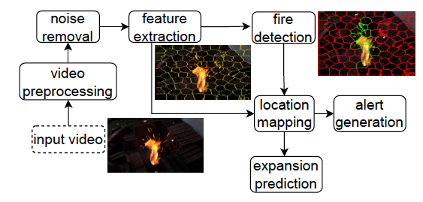
Motivation
Many real applications run as workflow pipelines (DAGs):
oil spill detection
fire detection
video analytics
IoT data processing
These workflows must:
meet deadlines
execute across distributed (fog/cloud) nodes
trade accuracy for faster execution
Our previous papers propose approximate DAG scheduling using:
MILP optimization
Greedy scheduling

Slide 3
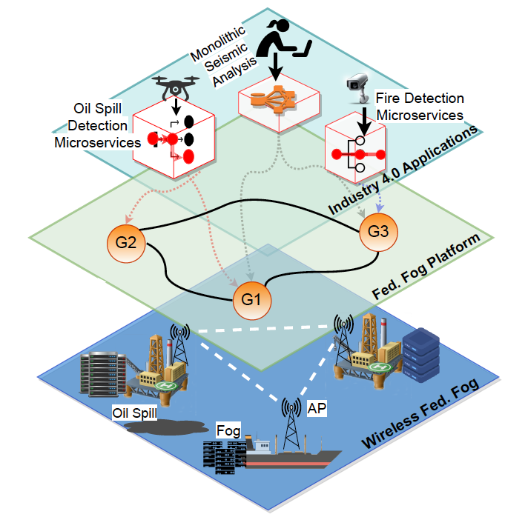
Scheduling Challenge in Fog Systems
Scheduling workflows across distributed nodes is difficult because:
heterogeneous compute resources
communication delays
workflow dependencies (DAG structure)
deadline constraints
Key decision:
Where should each task run and at what accuracy level?
Goal:
Balance accuracy, latency, and resource efficiency.

Slide 4
Project Objectives
Build benchmark dataset of realistic DAG workflows
Profile task runtime on different servers
Measure communication delay between nodes
Deploy workflows across federated fog testbed
Validate Greedy and MILP scheduling
Fine-tune approximation strategies

Slide 5
DAG Workflow Model
Workflow represented as Directed Acyclic Graph (DAG):
Node = task
Edge = dependency
Execution must follow dependency constraints.
Scheduler decides:
task placement
execution order
approximation level

Slide 6
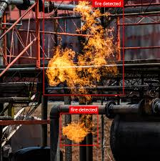
Build Benchmark Dataset
Example Workflows:
Human Activity Recognition
sensor input → windowing → feature extraction →
activity classification → alert/logging
Machine fault / anomaly detection
sensor read → filtering → FFT / feature extraction → fault classification → maintenance alert
Fire / smoke detection from regular camera images
image/frame input → resize/preprocess → smoke/fire detection → confidence check → alarm generation
Notes:
can drop the image resolution for faster execution

Slide 7
Profiling
Measure:
Task runtime on each server
Communication delay between nodes
Build performance dataset
Notes:
Data Collectiojn
Data cleaning
Output files usabvle by others
JSON/ formatting
Reusable

Slide 8
Profiling
Questions to answer:
How long does each task take on each machine?
Which tasks are the bottleneck tasks?
How much communication delay exists between nodes?
How does runtime change with different approximation levels?
Can we build a profiling dataset that the scheduler can directly use?
Notes:
Data Collectiojn
Data cleaning
Output files usabvle by others
JSON/ formatting
Reusable

Slide 9
Validation
Compare:
Greedy scheduler vs MILP
Full accuracy vs approximate execution
Prior work 1
Prior work 2
Metrics:
deadline satisfaction
accuracy
latency
resource usage
Notes:
Data Collection

Slide 10
Validation
Questions to answer:
Under what conditions do Greedy and MILP make different scheduling decisions?
How much latency improvement do we gain from approximate execution, and how much accuracy do we lose?
Which workflow types benefit the most from approximation-aware scheduling?
Is the extra overhead/complexity of MILP justified by better results compared with Greedy?
Notes:
Data Collection

Slide 11
Background / Tools to Prepare
Participants should prepare background in:
Python programming
scripting, file handling, package management
Tools: Python, virtual environments, Git
Linux / command line
terminal usage, bash basics, SSH
Tools: Linux shell, bash, SSH
Workflow / DAG basics
task dependencies, topological order, ready tasks

Slide 12
Background / Tools to Prepare (contd.)
Participants should prepare background in:
Data preprocessing
image loading, resizing, normalization
Tools: NumPy, Pandas
Off-the-shelf ML inference
running pretrained models, understanding input/outputs
Tools: Ultralytics YOLO, Hugging Face, basic (scikit-learn, tensorflow, keras, PyTorch) familiarity is helpful
Profiling / evaluation
runtime measurement, logging, result analysis
Tools: Python time, Pandas, matplotlib

Slide 13
Team Roles
John Hart (1) & Precious Sanyaolu (2)
create DAG benchmark dataset
run profiling experiments
Charlemon London (3)
Implementing the greedy/MILP methods
finding ready workflow (testbed)
scheduler validation
fine-tune approximate scheduling
Notes:
simple workflow
2-3 tasks
simple test workflow
for testing the method

Slide 14
Project Timeline
Pre-visit and Phase 1 (Weeks 1–2): gain background, literature review, workflow design
learn tool if you are unfamiliar (slide 11, 12)
understand papers
define workflows
setup dataset format
Phase 2 (Weeks 3–6): profiling and dataset generation
s1, s2: collect profiling data
s1, s2: setup testbed
s3: start with implementation
Phase 3 (Weeks 6–8): scheduler validation experiments
s1, s2: workflow - 3
s3: run scheduler experiments
s3: analyze results
s1, s2, s3: prepare final report/presentation/survey
Post visit / Phase 4:
improve scheduling approach
write paper
Notes:
8 weeks
parallel
Survey -> Jacob
before and after

Slide 15
Expected Outcomes
Benchmark DAG dataset
Profiling dataset
Validation results
Tuned scheduler / insights
Report or paper draft

Slide 16
Candidate Workflow: IoT Cloud Data Pipeline
Ready-made Docker Compose-based IoT workflow
Focus: local IoT data pipeline execution
Uses multiple containerized services
No AWS/Azure setup required
Suitable for profiling runtime and communication delay
Link: https://github.com/daleonpz/iot_cloud_infrastructure

Slide 17
Workflow Components
MQTT Broker: receives IoT sensor data
MQTT Agent: subscribes and stores data
MinIO: raw data lake
Airflow: workflow orchestration
ELT: transforms raw data
Cassandra: stores cleaned data
FastAPI: exposes data through REST API

Slide 18
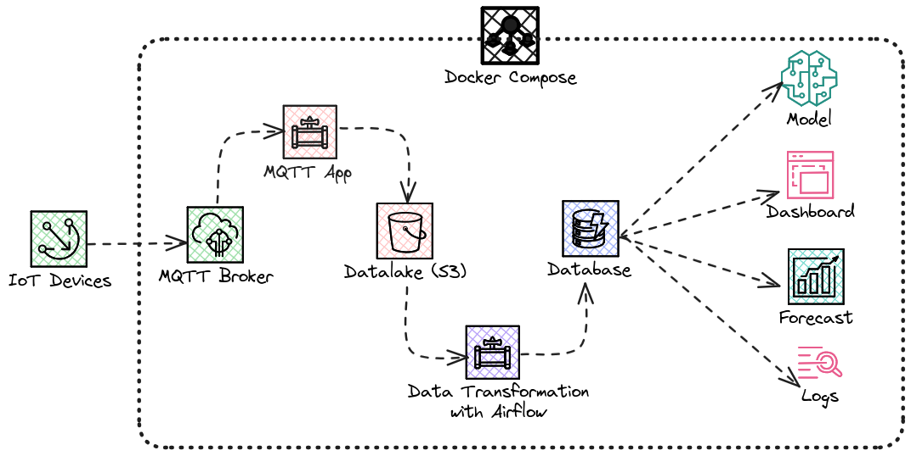
DAG Representation and Workflow Components
MQTT Broker: receives IoT sensor data
MQTT Agent: subscribes and stores data
MinIO: raw data lake
Airflow: workflow orchestration
ELT: transforms raw data
Cassandra: stores cleaned data

Slide 19
DAG Representation and Workflow Components
A device sends a small telemetry message. Example: { "temperature": 72F, "battery_level": 4200 (raw value) }
MQTT Broker receives the sensor data

Slide 20
DAG Representation and Workflow Components
MQTT Agent subscribes to the data topic receives the data
Raw data is stored in the Data Lake/MinIO
Transformation component processes the raw data. Transformer cleans/converts the data. Example:
72 Fahrenheit -> 22.22222 Celsius
4200 battery units -> 84%

Slide 21
DAG Representation and Workflow Components
Cleaned data is stored in the Database
Final data can be used for analytics or ML applications

Slide 22
Why Useful
Each component can be treated as a DAG task
Each data transfer becomes a dependency edge
Can measure task runtime per container
Can measure communication delay between services
Good starting workflow before larger DAGs

Slide 23


