Slide 1
Python Basics Bootcamp
Taposh Dutta Roy

Slide 2
Lecture Plan – Part I
Why Python and installation of Python? ( 15 mins)
Running your first python program (Jupyter Notebook, Pycharm) (15 mins)
Variables and Data Types ( 15 mins)
Operators (15 mins)
Control Structures : Conditional Statements and loops (15 mins)
Functions (10 mins)
Class Files (10 mins)
Exercise Problem (20 mins)

Slide 3
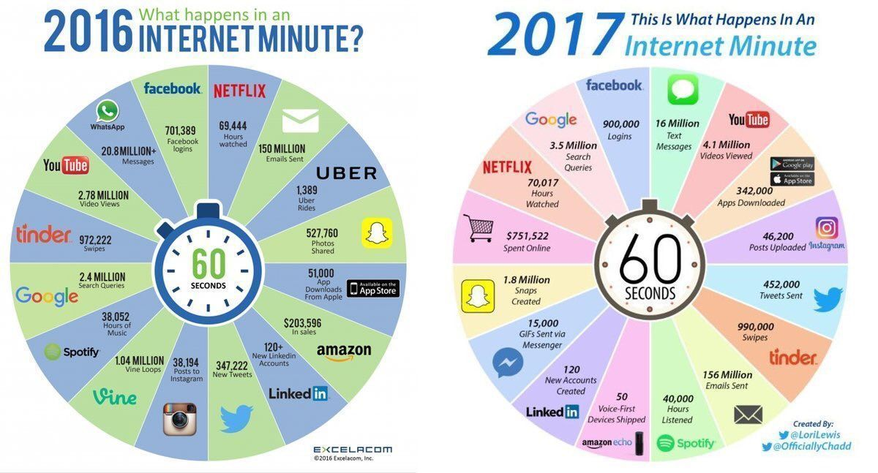
One Internet Minute …

Slide 4
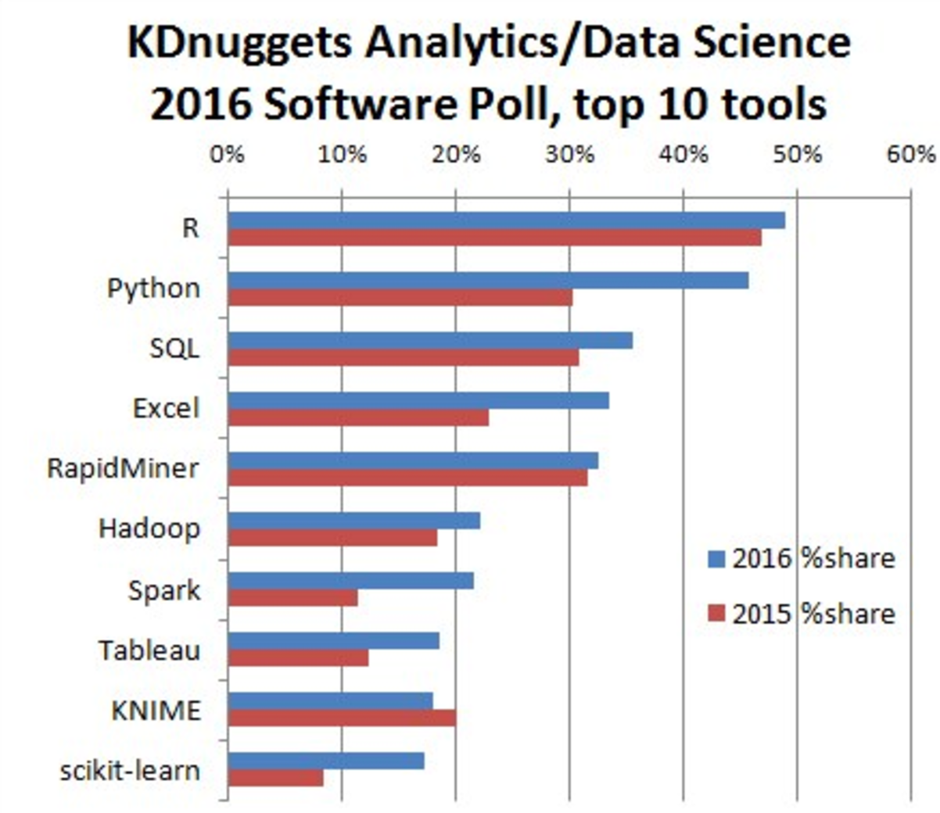
Why Python?
R and Python are the most used analytical tools.
Source: KD Nuggets
http://www.kdnuggets.com/2016/06/r-python-top-analytics-data-mining-data-science-software.html

Slide 5
5 Reasons why Python is Powerful
Python is Easy
Python is Fast
2
5
4
Python is not Python
Why
Python?
1
3
Python is Efficient
Python is Broad
https://www.codefellows.org/blog/5-reasons-why-python-is-powerful-enough-for-google/
Notes:
5 Reasons why Python is Powerful Enough for Google

Slide 6
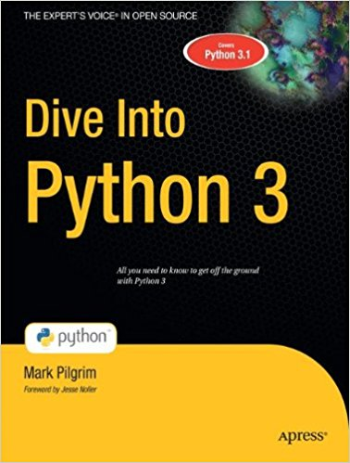

Installing Python
Two ways to Install Python :
You can install python directly from the web from python.org. A very good set of instructions are provided here : http://www.diveintopython3.net/installing-python.html
A more common way to install python is through the website of continuum https://www.continuum.io/downloads

Slide 7
Additional Documents
Python 3 documentation :
https://docs.python.org/3/
Dive into Python 3:
http://www.diveintopython3.net/Rapid GUI/
SciPy andNumPy documentation : http://docs.scipy.org/doc/numpy/index.html
Why Python 3?
https://pythonclock.org/
https://docs.python.org/3/howto/pyporting.html

Slide 8
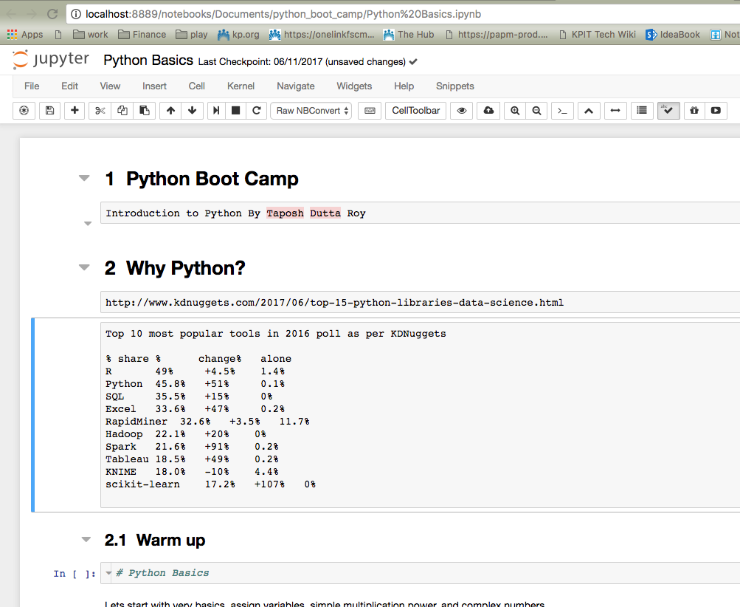
Ipython Notebook

Slide 9
Interpreted vs Compiled languages
Python is an Interepreted language

Slide 10
Data Types
Numbers : Integers, floating point numbers and Complex Numbers
String : String is immutable i.e. their characters cannot be changed.
Boolean : True or False
None : This is an important type of variable.
Sequence
lists : These are mutable i.e. value can be changed.
tuples : These are immutable.
range: These are immutable sequence of numbers

Slide 11
Lecture Plan – Part II
Plotting techniques in Python ( 10 mins)
Bar Chart (10 mins)
Histogram, Scatter Plot ( 10 mins)
Advanced Charting with data (10 mins)
Data Analysis – Titanic (30 mins)
Exercise (10 mins)
Data Analysis – Localization (UCI data-set)(30 mins)

